Slide 1
Alternative
Web Services
TOSSUG
Wei-Lun Chao <bluebat@member.fsf.org>
18 Oct. 2016

Slide 2


DuckDuckGo
URL: https://duckduckgo.com/
Service: Search Engine

Slide 3
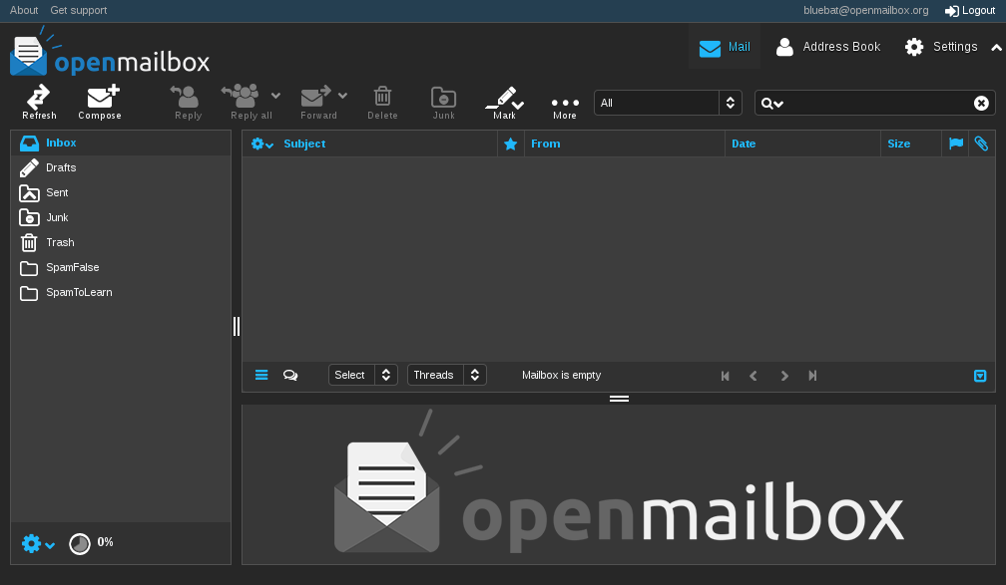
OpenMailBox
URL: https://www.openmailbox.org/webmail/
Service: E-Mail

Slide 4
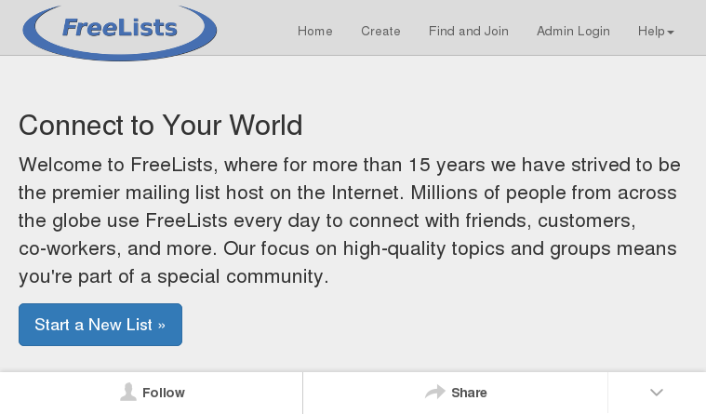
FreeLists
URL: https://www.freelists.org/
Service: Mailing List

Slide 5
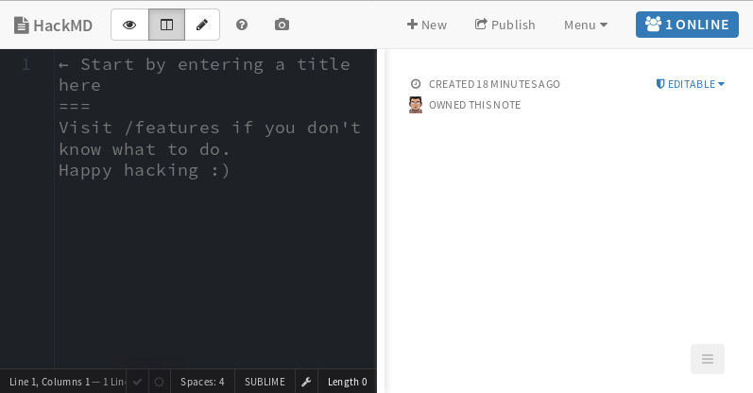
HackMD
URL: https://hackmd.io/
Service: Wiki Text

Slide 6
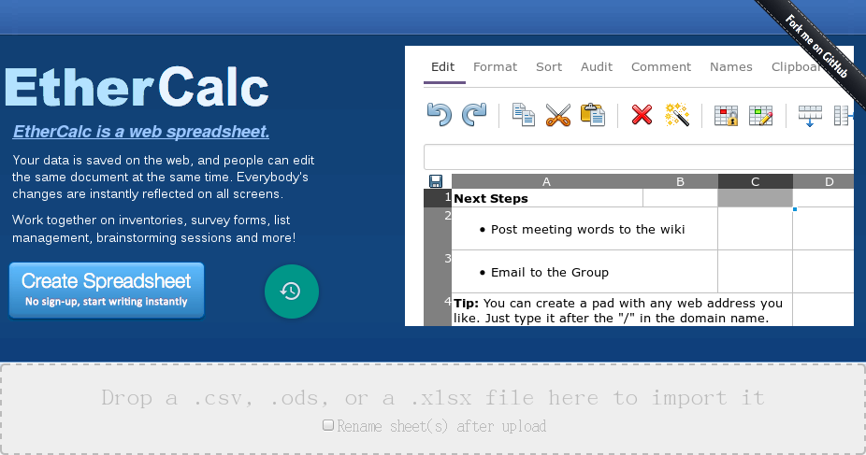
EtherCalc
URL: https://ethercalc.org/
Service: Wiki Spreadsheet

Slide 7
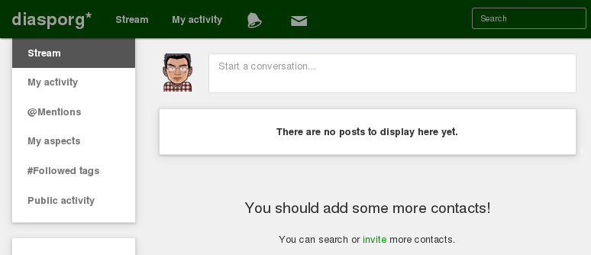
diasporg*
URL: https://diasp.org/
Service: Social Networking

Slide 8

jitsiMeet
URL: https://meet.jit.si/
Service: Group Meeting

Slide 9
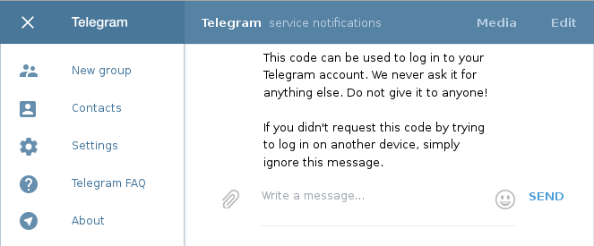
Telegram
URL: https://web.telegram.org/
Service: Instant Messaging

Slide 10
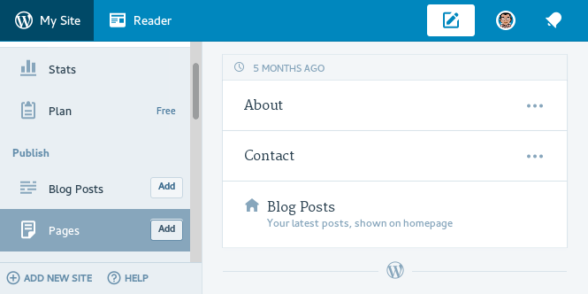
Wordpress
URL: https://wordpress.com/
Service: Blog

Slide 11
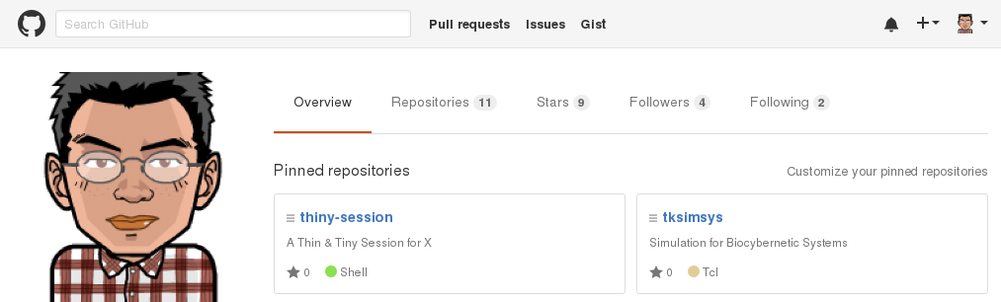
Github
URL: https://github.com/
Service: Version Control

Slide 12
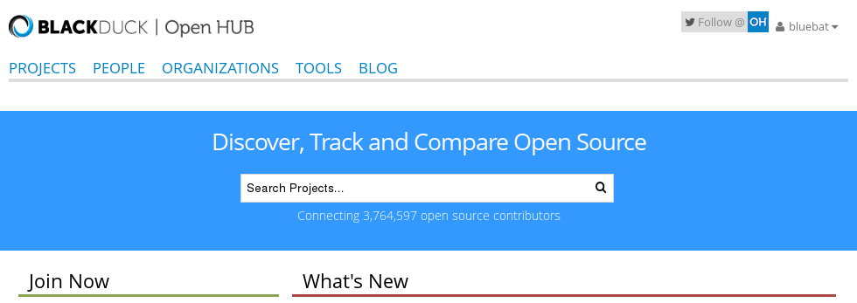
OpenHUB
URL: https://www.openhub.net/
Service: Software Forge

Slide 13
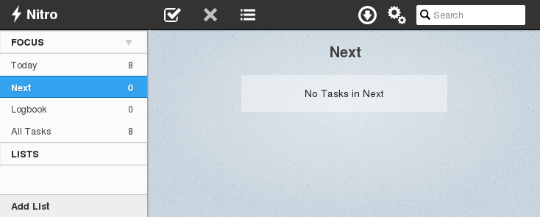
NitroTasks
URL: http://app.nitrotasks.com/
Service: To Do List

Slide 14
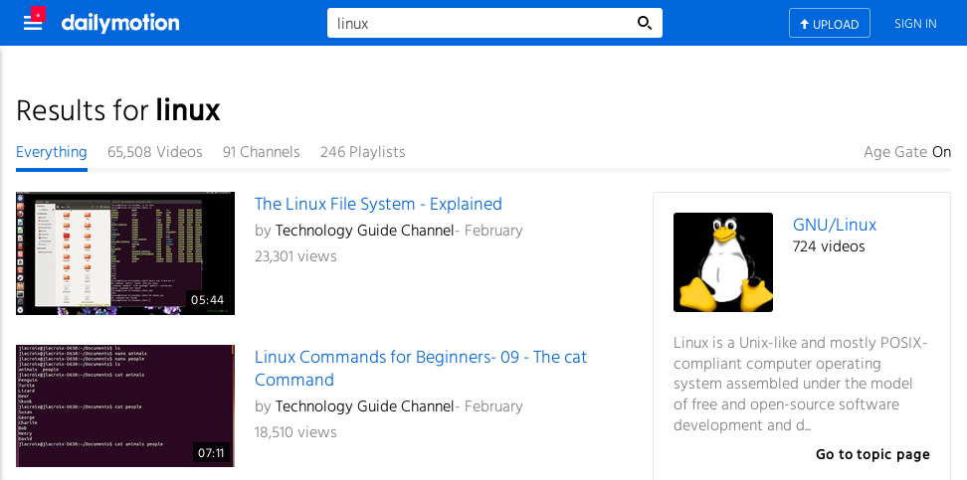
DailyMotion
URL: http://www.dailymotion.com/
Service: Video Sharing

Slide 15
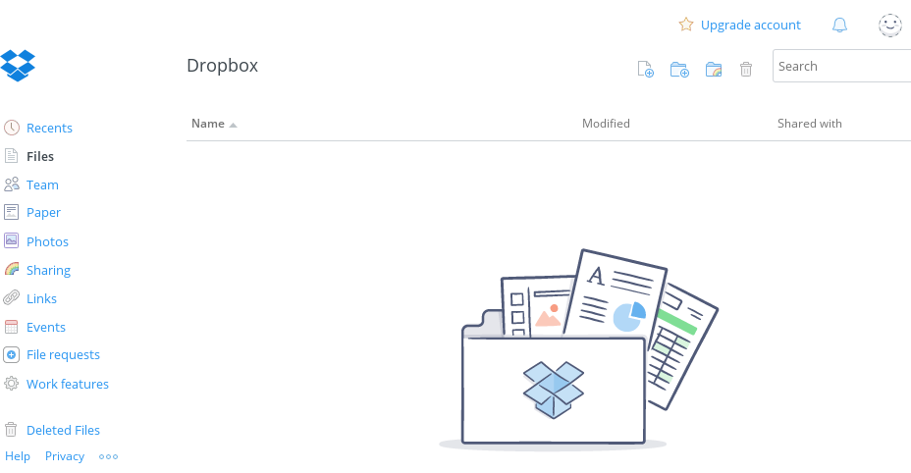
Dropbox
URL: http://www.dropbox.com/
Service: File Hosting

Slide 16

SpeakerDeck
URL: https://speakerdeck.com/
Service: Presentations Sharing

Slide 17
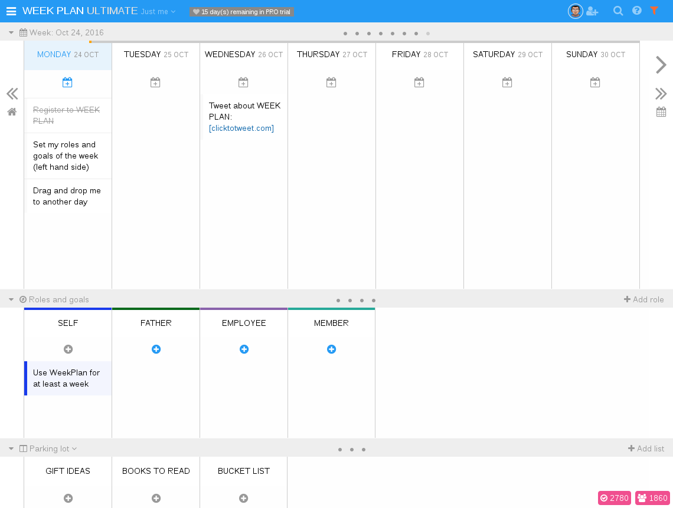
WeekPlan
URL: https://app.weekplan.net/
Service: Calendar

Slide 18
Thank you!
Slides Template：資訊未來大自由 by Eric Sun

