Slide 1
輕薄短小的Ｘ視窗作業階段
Fedora 23發行聚會
趙惟倫 <bluebat@member.fsf.org>
2015年12月12日
Notes:
大家好，我是趙惟倫，網路上慣用的代號是bluebat，其他關於我的資料，應該都可以利用網路搜尋得到，建議先從github和slideshare開始找起。
今天很高興有這個機會來跟各位分享我參與自由軟體訊息翻譯的經驗和心得。
本來題目是訂為「漢語語區本地化」，但是考慮到活動的重點並不在於技術探討，於是就將題目改為比較合適的「漢語語區本地化之路」。因此，關於如何進行本地化的技術部分，以及之前必須先打好基礎的國際化工作，也許等到下次有機會時再分享。

Slide 2
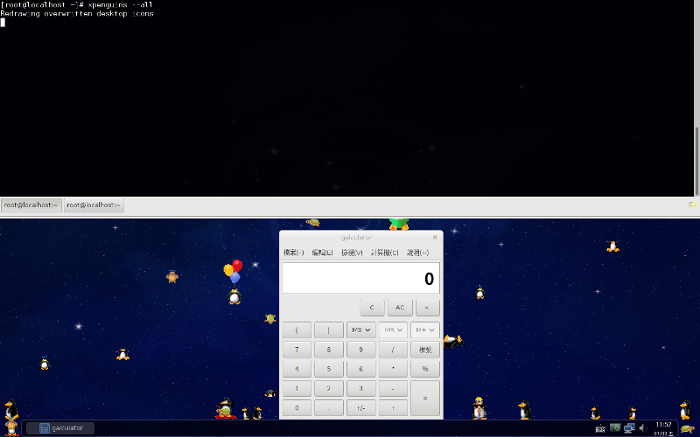
軟體專案
https://github.com/bluebat/thiny-session
Notes:
So, why I need a command-line calculator?
Because I don't want to open a calculator window
and click on a calculator emulator with mouse,
even if I just want to solve a simple arithmetic question.

Slide 3

組成
作業階段是介於視窗管理器與桌面環境之間的層級。 thiny-session是基於獨立精簡的GTK軟體集合。
主要依存套件
metacity, greybird-metacity-theme, notification-daemon,
xsettingsd, imsettings-gsettings, network-manager-applet, guake, volumeicon, pavucontrol, scrot, desktop-backgrounds-compat, nitrogen, sxhkd, viewnior, gshutdown, tint2
次要依存套件
system-config-printer, spacefm, midori, galculator, leafpad,
gst123, joe, arandr, mupdf, camorama, xinput_calibrator, wget, gftp, upower, ntpsec
Notes:
Sure, they do work, though a little ugly.
But, could it be written in the pure BASH script language? That is, only with keywords and built-in commands.
Oh, BASH is well-known with its lack of floating-point calculating, there are only limited operations for integer numbers. How do I use numbers in decimal representation?
What? Also need supports for complex numbers?

Slide 4
安裝
以Fedora netinstall光碟開機
軟體群組選擇Basic Desktop
登入後按滑鼠右鍵執行終端機模擬程式
以root身分安裝套件
> dnf install https://github.com/bluebat/\
thiny-session/releases/download/v0.8.0/\
thiny-session-0.8.0-1.noarch.rpm
/usr/share/xsession/thiny.desktop
/usr/bin/thiny-session
/usr/share/thiny-session/*
Notes:
Sure, they do work, though a little ugly.
But, could it be written in the pure BASH script language? That is, only with keywords and built-in commands.
Oh, BASH is well-known with its lack of floating-point calculating, there are only limited operations for integer numbers. How do I use numbers in decimal representation?
What? Also need supports for complex numbers?

Slide 5
設定
系統登入: /etc/lightdm/lightdm.conf
個人化: $HOME/.xprofile
user-session=thiny
autologin-user=YOURLOGIN
#!/bin/bash
# xrandr -o left
# xbacklight -set 100
# x11vnc -forever -repeat -passwd ******** &
# xdesktopwaves -q 9 -c 5 &
# $HOME/.dropbox-dist/dropboxd &
# parcellite &
> chmod +x $HOME/.xprofile
Notes:
OK, here you are. You may get this shell script of about 300 lines from my Github repository.

Slide 6
快捷鍵
guake
<F12>:下拉/升起終端機視窗
<F11>:全螢幕/半螢幕終端機視窗
tint2
<Ctrl><Alt><ArrowKey>:切換工作區
metacity
<Alt><Tab>:切換視窗
sxhkd
<PrtSc>:螢幕截圖(等待兩秒)
<Alt><PrtSc>:視窗截圖(等待點擊)
Notes:
Sure, they do work, though a little ugly.
But, could it be written in the pure BASH script language? That is, only with keywords and built-in commands.
Oh, BASH is well-known with its lack of floating-point calculating, there are only limited operations for integer numbers. How do I use numbers in decimal representation?
What? Also need supports for complex numbers?

Slide 7
縮減系統(選用)
視窗管理器
應用軟體
系統軟體
> dnf remove awesome i3 qtile
> dnf remove openbox ratpoison xmonad-basic
> dnf remove xterm rxvt-unicode abrt*
> dnf remove anaconda-core dnfdragora
> dnf remove selinux-policy* libselinux-utils
Notes:
Here are few examples. Elementary arithmetic with parenthesis for complex numbers are displayed here.
A buggy bonus is for exponential function.
The base can be a complex number, but the power should be an integer or an integer divided by 2.
You should use it in caution.

Slide 8
謝謝各位
敬請指教
簡報模板：資訊未來大自由(孫賜萍)
Notes:
以上是我今天的心得分享，謝謝各位。
如果有任何的建議或問題，歡迎提出來共同討論。

