Slide 1
A Command-line Calculator in pure BASH
Hong Kong Open Source Conference
Wei-Lun Chao <bluebat@member.fsf.org>
29 Mar. 2014
Notes:
Hello, everyone.
Today I would like to introduce you a little script I have made with regard to
"A command-line calculator in pure bash"

Slide 2
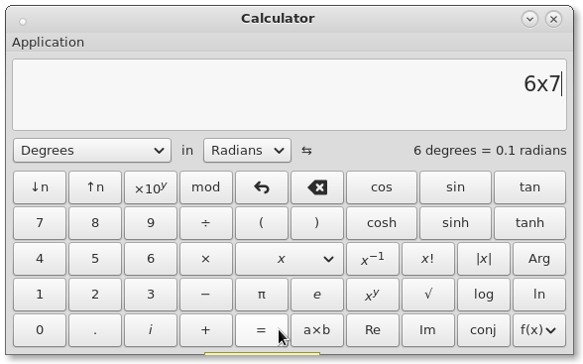
Not efficient!
Notes:
So, why I need a command-line calculator?
Because I don't want to open a calculator window
and click on a calculator emulator with mouse,
even if I just want to solve a simple arithmetic question.

Slide 3
Not intuitive!
> expr \( 9 - 3 \) \* 7
42
> expr '(' 9 - 3 ')' '*' 7
42
or
> echo $(((3**2-3)*7)
42
> printf '%d\n' $(((3**2-3)*7)
42
or
> dc <<< '6 k 2 2 ^ 3.5 + 1.5 - 7 / p'
.857142
> bc <<< 'scale=6;(2^2+3.5-1.5)/7'
.857142
Notes:
And you may ask, why not using the simple external command "expr" or the builtin "dollar sign with double parenthesis" or the advanced external command "bc"?
Are they not good enough?

Slide 4

Requirements
Only with keywords and built-in commands
In decimal representation
Variable scale value
Supporting complex numbers
Including +, -, *, /, ^ operators
Notes:
Sure, they do work, though a little ugly.
But, could it be written in the pure BASH script language? That is, only with keywords and built-in commands.
Oh, BASH is well-known with its lack of floating-point calculating, there are only limited operations for integer numbers. How do I use numbers in decimal representation?
What? Also need supports for complex numbers?

Slide 5
https://github.com/bluebat/.bash/raw/master/bashbc.sh
#!/usr/bin/bash
# A command-line calculator in pure BASH
# (c) 2016 Wei-Lun Chao <bluebat@member.fsf.org>, GPL.
# v1.0, 2014-3-25, for C+-*/C and C^(Z/2)
# v1.1, 2016-10-20, tweak n++ and shiftScale
shopt -s extglob
if [ "$scale" -ge 0 -a "$scale" -le 5 ] 2>/dev/null ; then
declare -i shiftScale="$scale"
else
declare -i shiftScale=3
fi
: : :
: : :
if [ $# -eq 0 ] ; then
echo "A command-line calculator in pure BASH"
echo "(c) 2016 Wei-Lun Chao <bluebat@member.fsf.org>, GPL."
echo "Usage: [scale=0..(3)..5] bashbc ARITH_EXPR"
exit 1
else
declare -l exprStr=`printf '%s' "$*"`
declare -l exprVal=`exprEval ${exprStr//[[:space:]]/}`
complexOut $exprVal
fi
Notes:
OK, here you are. You may get this shell script of about 300 lines from my Github repository.

Slide 6
Examples
ℂ +-*/ ℂ
ℂ ^ (ℤ/2)
> bashbc '(4.5+2.5)*(3-1)'
14
> bashbc '-(4i+3/(2*(-i)))'
-5.5i
> scale=5 bashbc '-4/1.2^(-3)'
-6.91204
> bashbc '(4-3i)^(1/2)'
2.121-0.707i
Notes:
Here are few examples. Elementary arithmetic with parenthesis for complex numbers are displayed here.
A buggy bonus is for exponential function.
The base can be a complex number, but the power should be an integer or an integer divided by 2.
You should use it in caution.

Slide 7
Further improvements
More precision (scale>5)
Complete operation (ℂ^ℝ even ℂ^ℂ)
Better error handling (divide by 0)
Notes:
Sure, they do work, though a little ugly.
But, could it be written in the pure BASH script language? That is, only with keywords and built-in commands.
Oh, BASH is well-known with its lack of floating-point calculating, there are only limited operations for integer numbers. How do I use numbers in decimal representation?
What? Also need supports for complex numbers?

Slide 8
Thank you!
Slides Template：資訊未來大自由 by Eric Sun
Notes:
Ok, that's all. Thanks for your listening.

