Slide 1
Virtual Desktop Infrastructure
Overview
TOSSUG
Wei-Lun Chao <bluebat@member.fsf.org>
18 Jan. 2022

Slide 2
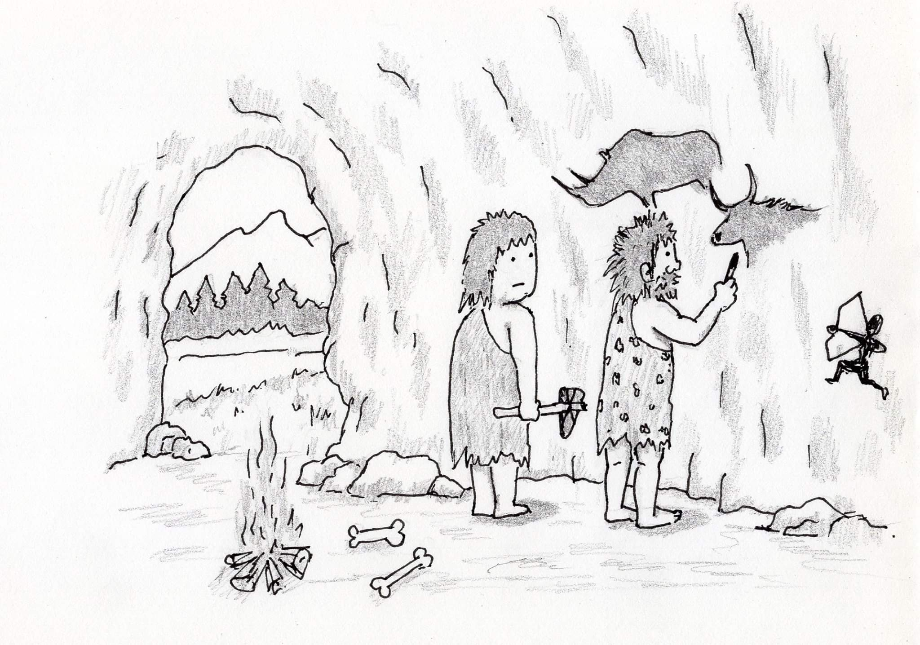
Ancient
https://m.facebook.com/CAVE-ART-1068969879968361/

Slide 3

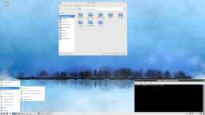
Legend
: Machine
: Desktop
: Software
: Protocol
: Example/Description

Slide 4
Standalone
X86 /
ARM /
RISC-V /
PowerPC
Linux /
BSD /
macOS /
Windows

Slide 5
Remote Access Service
Middle Machine
pcAnywhere /
TeamViewer /
AnyDesk /
Splashtop /
Paralles /
LogMeln /
RemotePC /
VNC Dispatcher
Remote Machine
Local Machine

Slide 6
Multi-Machine
Virtual Machine
Remote Desktop
RFB /
RDP /
Blast /
ICA /
PCoIP /
Mjpeg
TS /
xrdp /
vncserver
vncviewer /
mstsc /
icaclient /
freerdp
QEmu /
VirtualPC /
VirtualBox /
VMware Workstation
Host / Guest
Server / Client

Slide 7
Multi-Seat / Virtual OS Infrastructure
Multi-User/VM
Distributed Computing
PXE
NFS
(SR-IOV)
(IDV / TCI)

Slide 8
Remote Virtual Desktop
IGEL OS /
10ZiG OS /
ThinPro /
eLux /
OpenThinClient
PXE
(viewer)
ESXi /
XenServer /
Hyper-V /
Proxmox
(hypervisor)
Server
Fat / Thin / Zero Client

Slide 9
Virtual Desktop Infrastructure
Horizon
Client /
Receiver /
Remote Desktop /
virt-viewer
vSphere /
XenDesktop /
WVD /
Spice
On-premise
Client

Slide 10
Remote Desktop Gateway
Browser /
Other Clients
Netscaler /
StoreFront /
RDG /
Guacamole
Internet Data Center
Client

Slide 11
Desktop as a Service
WorkSpace One /
OpenStack
(cluster)
(Hyper-Converged Infrastructure)
Private Cloud
Endpoint

Slide 12
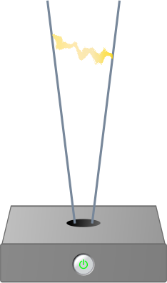



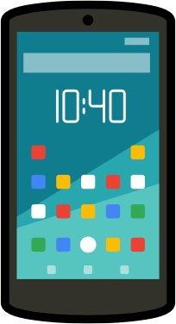

Internet of Things
Desktop as a Service
Software as
a Service
Data as
a Service
Content as
a Service
(container)
AWS /
Azure /
GCP
Public Cloud
Endpoint

Slide 13
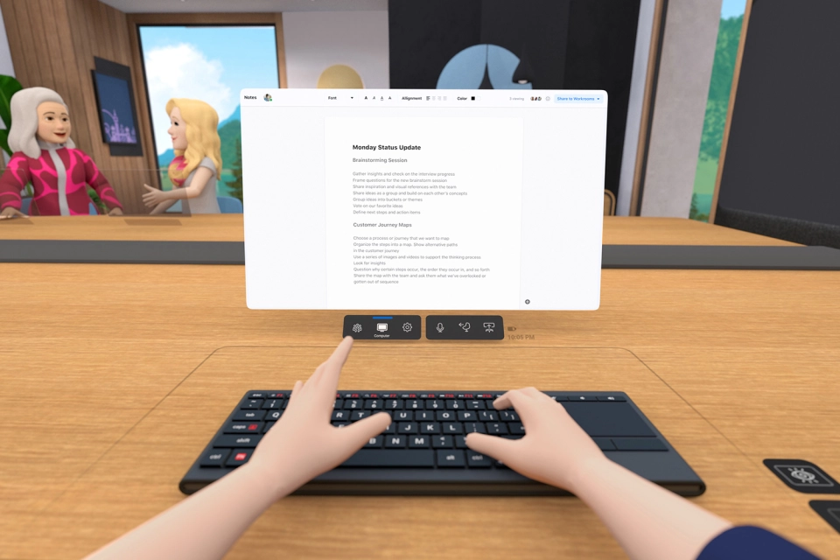
Future
https://www.facebook.com/watch/?v=282623437072819

Slide 14
Thank you!
Image Clips from https://openclipart.org/
Slides Template：資訊未來大自由 by Eric Sun

