Slide 1

Open Classes Project Interim Report

Slide 2
Contents
Problem
Description
User context
Team Organization
Process Model
Project Plan
Completed work
Remaining work
Interface Design and System Design

Slide 3
Problem - Description
Current system slow, and painstakingly tedious
Requires the user to drill down through excess data
System resets all search parameters for each class search
Customer wants a system that will be:
Easy to use
Graphical in nature
Customer envisions a system that accomplishes the same task using:
Radio buttons
Pull-down menus
Other GUI characteristics.

Slide 4
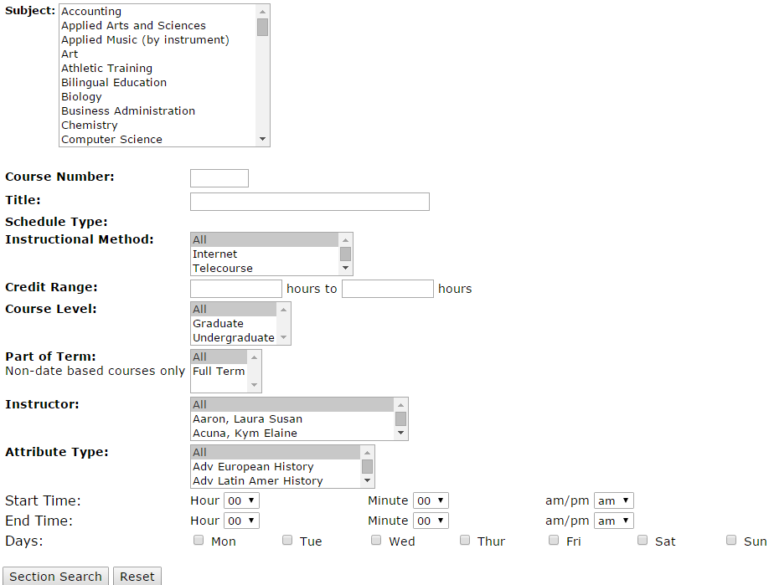
Problem – User Context
Current System
User selects Subject
Note: Subject does not encompass entire categories that are in degree plans
User enters other parameters
User clicks Section Search button

Slide 5
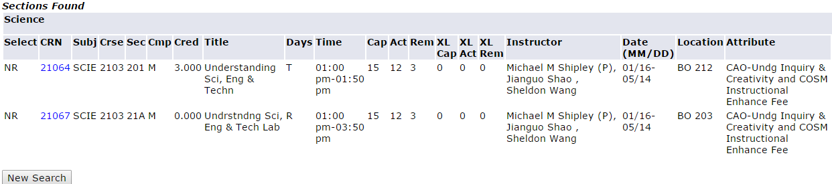
Problem – User Context (cont’d)
Current system displays only two Science classes, when dozens of Lab Science classes are offered
Thus, user clicks New Search button
Takes user to previous screen, with no selections saved

Slide 6
Team Organization
Democratic division
Every decision made by consensus
Work divided by task based on abilities
e.g. “If you create the database, I can code the interface.”
Reviews of individual work performed by team
Each member submits his or her work to the rest of the group for approval
Any member can request changes to another’s work

Slide 7
Process Model
Agile Scrum
Highest priority tasks completed first
e.g. “What do we need to do next?”
Chosen because of its cyclical and iterative nature
Easy to meet weekly after each sprint
Scrum model more adaptable to change than other process models

Slide 8
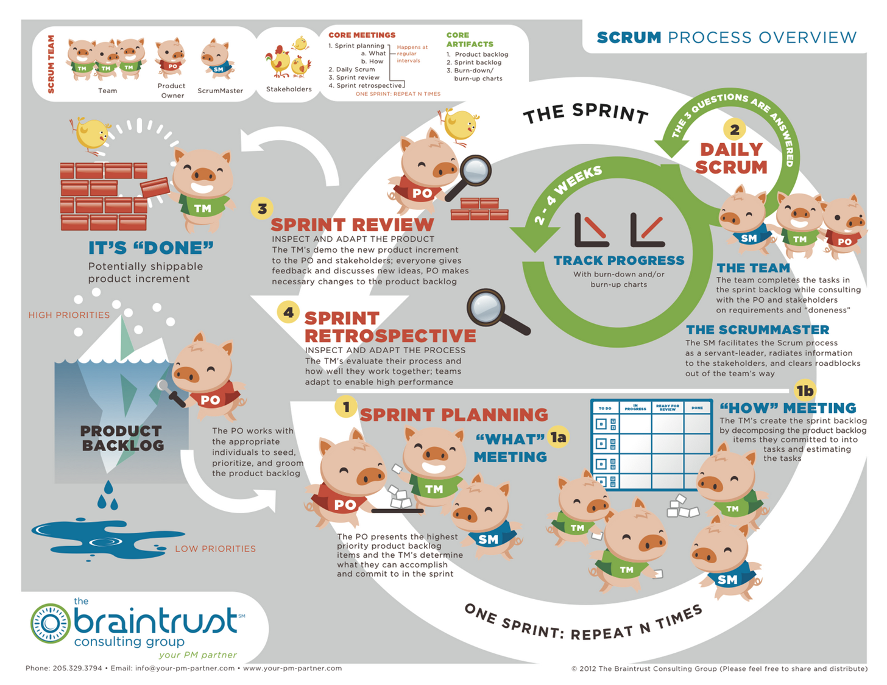

Slide 9
Project Plan – Completed Work

Slide 10
Project Plan – Work Left to Do

Slide 11
Design
Interface
How the user the user will interact with it
User interface picture
Java
System
The backend…i.e. the nitty gritty how it actually works kind of stuff
MySQL Workbench

