Slide 1

Open Classes Project
Final Report

Slide 2
Contents
Problem
  Description
  User context
Process Model
Team Organization
Interface Design and System Design
  Demo
What We learned
More Time Please?
Tardis trip anyone?

Slide 3
Problem - Description
Current system slow, and painstakingly tedious
  Requires the user to drill down through excess data
System resets all search parameters for each class search
Customer wants a system that will be:
  Easy to use
  Graphical in nature
Customer envisions a system that accomplishes the same task using:
  Radio buttons
  Pull-down menus
  Other GUI characteristics.

Slide 4
Problem – User Context
Current System
User selects Subject
  Note: Subject does not encompass entire categories that are in degree plans
User enters other parameters
User clicks Section Search button
Example:
  Current system displays only two Science classes, when dozens of Lab Science classes are offered
Thus, user clicks New Search button
  Takes user to previous screen, with no selections saved

Slide 5
Initial Requirements
Functional Requirements
  PDF to .txt converter
    PDF Tables converts to Word document
  Degree Plans
    same
  Queries
    Same
Non Functional Requirements
  Technical
    Added use of Oracle 11g, Apache Tomcat

Slide 6
Process Model
Agile Scrum
  Highest priority tasks completed first
    e.g. “What do we need to do next?”
  Chosen because of its cyclical and iterative nature
    Easy to meet weekly after each sprint
  Scrum model more adaptable to change than other process models

Slide 7
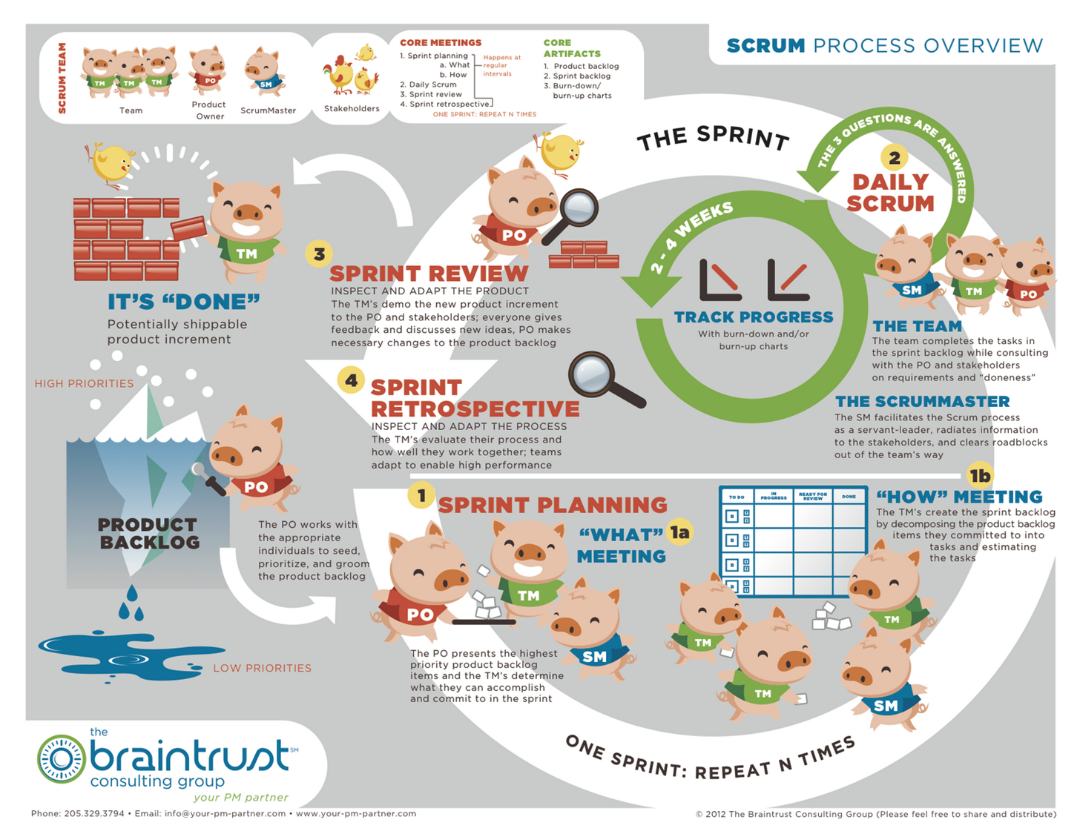

Slide 8
Team Organization
  Democratic division
    Every decision made by consensus
  Work divided by task based on abilities
    e.g. “If you create the database, I can code the interface.”
  Reviews of individual work performed by team
    Each member submits his or her work to the rest of the group for approval
    Any member can request changes to another’s work

Slide 9
Design
Interface
  User interacts with software using:
    Drop-down menus
    Selector buttons
    Radio buttons
  User must manually convert class schedule PDF
    Software available on CD

Slide 10
Design
System
  Programmed using:
    JavaScript and HTML on front end
    Oracle 11g database
    Apache Tomcat server
    MySQL Workbench
    Java
  Needed to have two types of databases
    Those created from degree plan lists of required classes
    Those created from each semester’s class schedule
  Program uses degree plan database to match open classes from the schedule

Slide 11
Project Demo
Known Issues
  During testing, program crashed when no selections made
    Has since been corrected with error message
  When selecting the Fall semester and selecting all subjects, only some subjects appear
    Issue still needs to be resolved

Slide 12
What have we learned this semester from making this application?
Document, document, document
  Creating documents throughout the process helped greatly when:
    Collaborating
    Going back and reviewing work
Coding itself is only a small portion of the SDLC
  Code design and paperwork were far more time-consuming
There are always more test cases than you realize
  Just when you think you’ve covered them all, you find more

Slide 13
What would we do with six more weeks to work on the project?
Work to improve documentation
Add another degree plan
  Would include Mathematics department degree plans as well
Do more extensive testing
Automate installation process for helper programs
  User would not need to manually create input documents
Find easier way to keep database updated
  Registrar changes input file constantly

Slide 14

What would you tell yourself if you time-traveled to the beginning of the semester?
Work little by little
  Any progress is better than no progress
Don’t get sick
  Seriously, get some rest
Make more time for face to face meetings
  Difficult to find times when we could all get together

