Slide 1

Open Classes Project Final Report

Slide 2
Contents
Problem
Description
User context
Process Model
Team Organization
Interface Design and System Design
Project Plan
Completed work
Remaining work

Slide 3
Problem - Description
Current system slow, and painstakingly tedious
Requires the user to drill down through excess data
System resets all search parameters for each class search
Customer wants a system that will be:
Easy to use
Graphical in nature
Customer envisions a system that accomplishes the same task using:
Radio buttons
Pull-down menus
Other GUI characteristics.

Slide 4
Problem – User Context
Current System
User selects Subject
Note: Subject does not encompass entire categories that are in degree plans
User enters other parameters
User clicks Section Search button
Example:
Current system displays only two Science classes, when dozens of Lab Science classes are offered
Thus, user clicks New Search button
Takes user to previous screen, with no selections saved

Slide 5
Initial Requirements
Functional Requirements
PDF to .txt converter
PDF Tables converts to Word document
Degree Plans
same
Queries
Same
Non Functional Requirements
Technical
Added use of Oracle 11g, Apache Tomcat

Slide 6
Process Model
Agile Scrum
Highest priority tasks completed first
e.g. “What do we need to do next?”
Chosen because of its cyclical and iterative nature
Easy to meet weekly after each sprint
Scrum model more adaptable to change than other process models

Slide 7
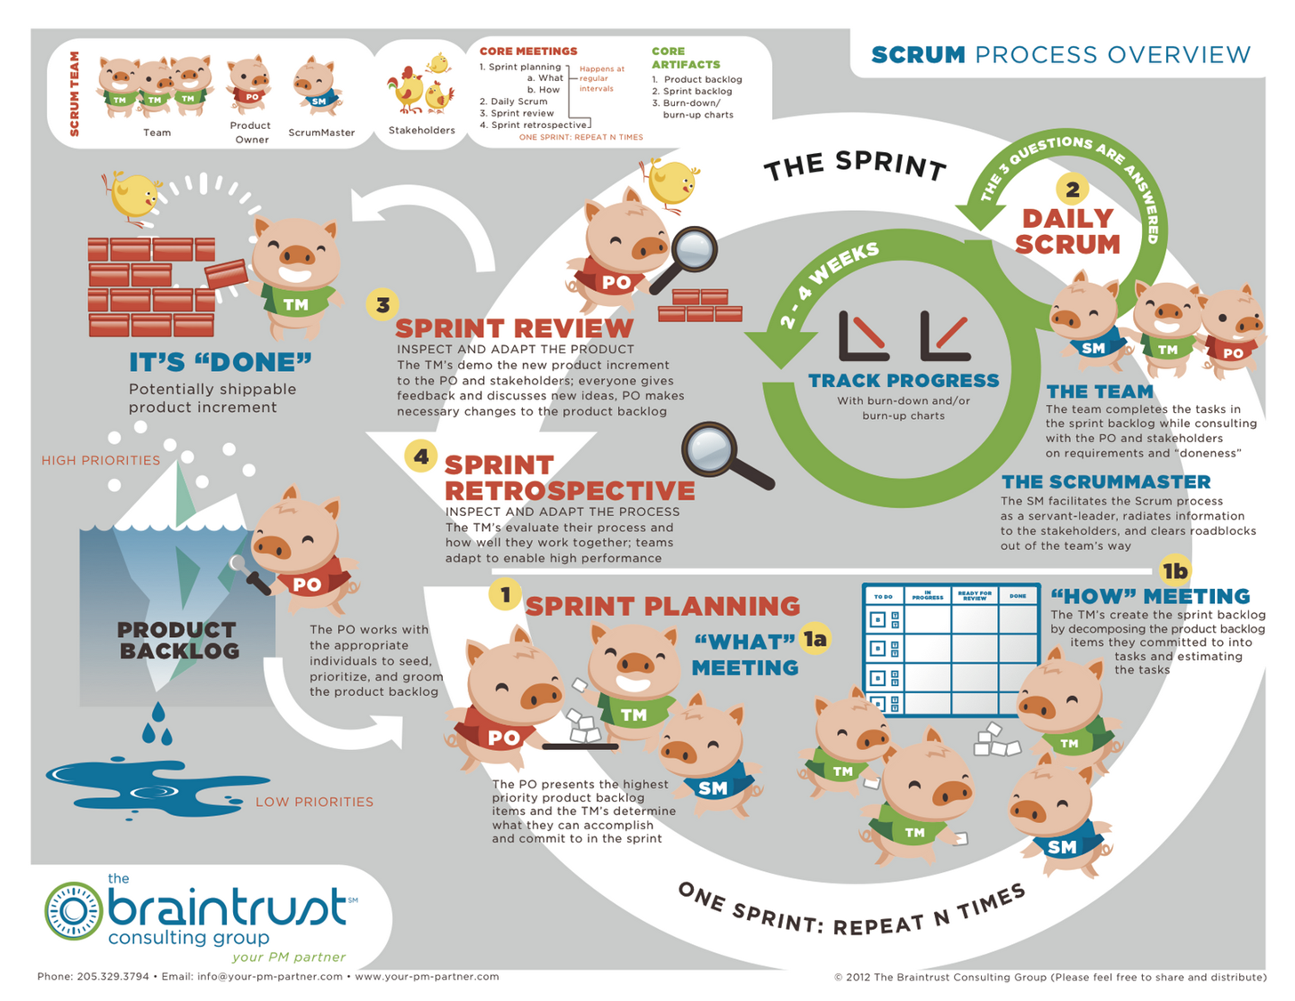

Slide 8
Team Organization
Democratic division
Every decision made by consensus
Work divided by task based on abilities
e.g. “If you create the database, I can code the interface.”
Reviews of individual work performed by team
Each member submits his or her work to the rest of the group for approval
Any member can request changes to another’s work

Slide 9
Design
Interface
User interacts with software using:
Drop-down menus
Selector buttons
Radio buttons
User must manually convert class schedule PDF
Software available on CD

Slide 10
Design
System
Programmed using:
JavaScript and HTML on front end
Oracle 11g database
Apache Tomcat server
MySQL Workbench
Java
Needed to have two types of databases
Those created from degree plan lists of required classes
Those created from each semester’s class schedule
Program uses degree plan database to match open classes from the schedule

Slide 11
Project Demo
Known Issues
During testing, program crashed when no selections made
Has since been corrected with error message

Slide 12
What have we learned this semester from making this application?
Document, document, document
Creating documents throughout the process helped greatly when:
Collaborating
Going back and reviewing work
Coding itself is only a small portion of the SDLC
Code design and paperwork were far more time-consuming
There are always more test cases than you realize
Just when you think you’ve covered them all, you find more

Slide 13
What would we do with six more weeks to work on the project?
Work to improve documentation
Add another degree plan
Would include Mathematics department degree plans as well
Do more extensive testing
Automate installation process for helper programs
User would not need to manually create input documents
Find easier way to keep database updated
Registrar changes input file constantly

Slide 14

What would you tell yourself if you time-traveled to the beginning of the semester?
Work little by little
Any progress is better than no progress
Don’t get sick
Seriously, get some rest
Make more time for face to face meetings
Difficult to find times when we could all get together

