Slide 1
Open Classes Project Interim Report
Tech Ninjas

Slide 2
Contents
Problem
Description
User context
Team Organization
Process Model
Project Plan
Completed work
Remaining work
Interface Design and System Design

Slide 3
Problem - Description
The current system is slow, and painstakingly tedious due to the drill down method of locating classes. Also, the system resets all search parameters for each class search. The customer wants a system which will be easy to use and graphical in nature. While the current system requires the user to drill down through a considerable amount of excess data, the customer envisions a system that accomplishes the same task using radio buttons, pull-down menus, and other GUI characteristics.

Slide 4
Problem – User Context
Add screen shots
College advising

Slide 5
Team Organization
Democratic division
Work divided by task based on abilities
Reviews of individual work performed by team

Slide 6
Process Model
Agile Scrum
Yeah stuff about that
Why we chose scrum model
Why this was the best model for our project compared to others

Slide 7
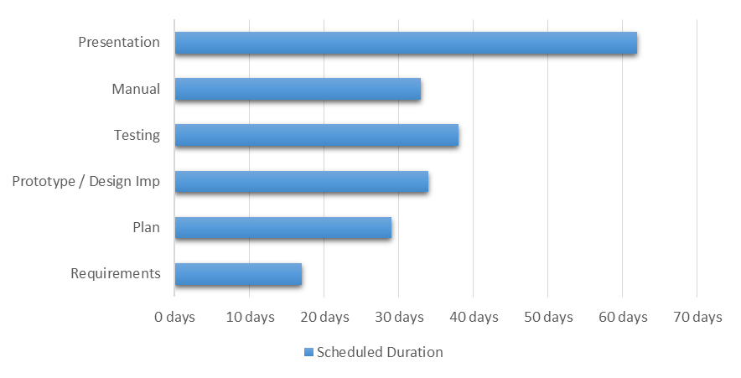
Project Plan – Completed Work

Slide 8
Project Plan – Work Left to Do

Slide 9
Design
Interface
How the user the user will interact with it
User interface picture
Java
System
The backend…i.e. the nitty gritty how it actually works kind of stuff
MySQL Workbench

