Slide 1

BUILDING SUPPLY CHAIN EFFICIENCY
TWO BINS AT A TIME

Slide 2

Who We Are
BlueBin Inc. specializes in strategic supply chain solutions for healthcare organizations. Implementing the tools and philosophy of the Toyota Production System (TPS), we install a robust kanban system (BlueBin Technology) to immediately improve the hospital’s supply chain operations and drive continuous improvement.
Our mission is simple; to assist healthcare providers in
ensuring their staff have the supplies they need
to do their jobs everyday.

Slide 3

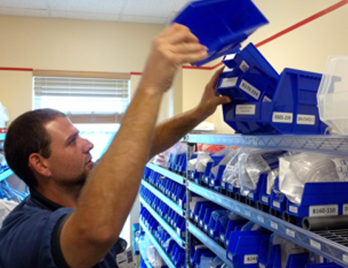

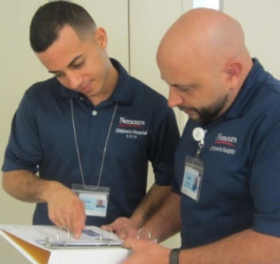



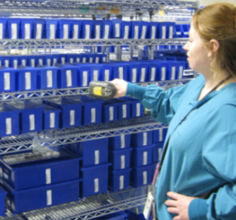

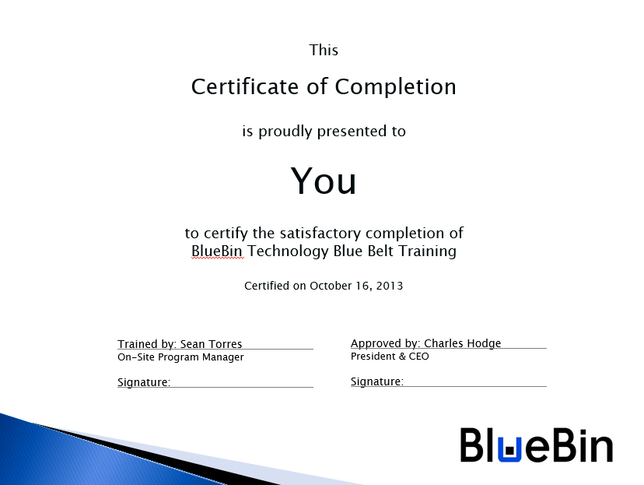
Daily Management System
Certification
Notes:
The daily management of the blue bin system is what sets us apart.
DMS is…
DMS Behavior:
Leaders as teachers
Expectation of improvement
Respect for people
Follow-up
Today’s focus is on Leadership Standard Work

Slide 4
Program Certification
Critical component of the BlueBin Daily Management System (DMS)
Primary Function:
Identifies the required aptitudes and knowledge in varying levels to sustain the BlueBin program
A Best Practice for developing, delivering, and evaluating the essential roles required to maintain and progress the BlueBin program
Management Purpose:
Ensures the competence of the BlueBin maintenance/build teams through tangible proficiencies of skills and knowledge
Provides objective measurements of hospital employees’ knowledge and skills in specific support functions
Establishes the expectation of excellence and quality through clearly defined, tiered-level competencies

Slide 5



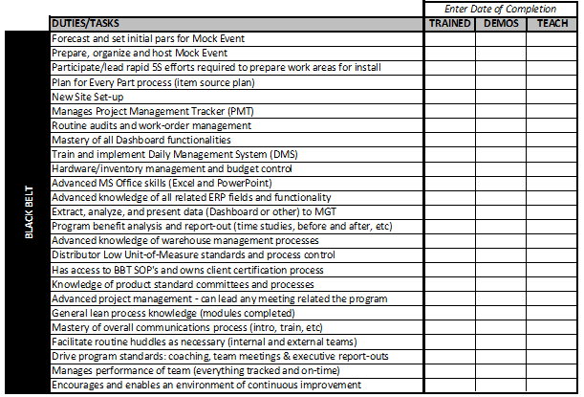
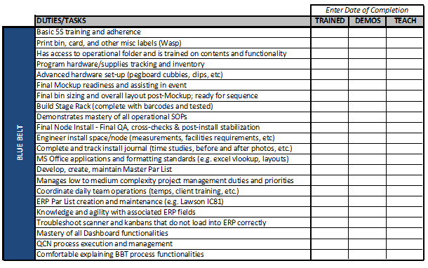
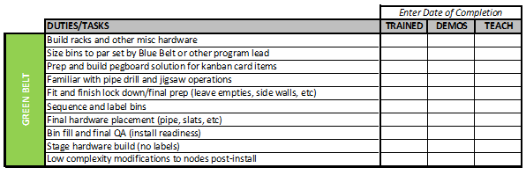
Certification Levels (Belts)
Tactical | Tactical/Strategic | Strategic/Objective
Associate/Tech | Specialist/Team Lead | Program Manager/Manager
Small scale projects | Mid-large scale projects | Big picture oversight
Task-oriented | Priority-oriented | Impact-oriented
Basic BlueBin build skills | Complex BlueBin build skills | Build mastery & management
Minimal technical skills | Makes data-driven decisions | Defines how/why of metrics
Follows instructions based on Blue Belt/Black Belt feedback | Build relationships with hospital staff and unit leaders to effectively communicate and train | Removes barriers and collaborates with Senior Leadership
Follows 6S protocol in all work/build areas | Updates DMS Master and all related documents | Updates Actions Tracker and all related project files

Slide 6
Who is/gets Certified?
BlueBin Build Team
Hospital Maintenance Team
New node installs
Belt training
SOP training
Dashboard training
DMS & LSW training
Clinical staff training
QCN management
Node maintenance
Gemba Audits
Stage maintenance
Huddle Board updates
Kanban adjustments
Visual standards compliance
Misc. post-install projects

Slide 7



When to Certify
Right away! Begin training for Maintenance Blue Belts upon project start. Program maintenance is an essential piece of the DMS immediately following the stabilization of new nodes.
Training ~6-8 weeks, full time, for Blue Belt completion (trained, demonstrates, can teach others).
Hospital Blue Belts are fully dedicated to the maintenance of the BlueBin program, and does not service nodes (strider role) or engage in significant competing roles that would impact program maintenance.

Slide 8
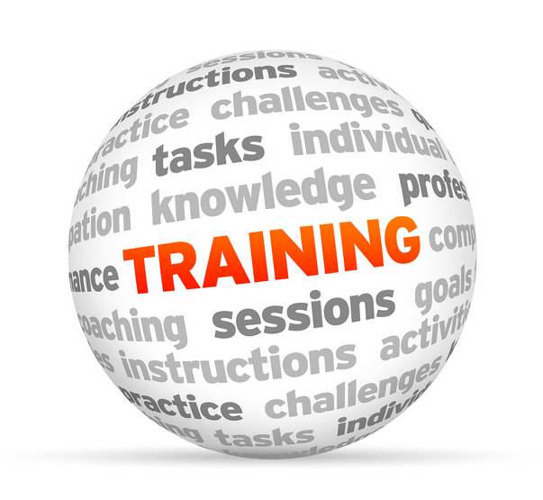

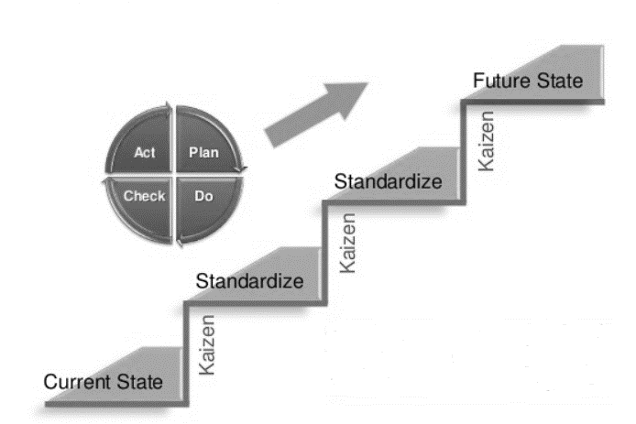

Summary – Belt Certification
Its position in the DMS
Trained
Demonstrates
Can Teach Others
To ensure the right people have had the right training to support the BlueBin program, the right way
To engage the current talent pool and support cross-functional training
To uphold standard work and continuous improvement gains
To sustain quality, reliability, and service excellence, in tandem with hospital mission and vision statement

Slide 9











Questions Please
www.bluebin.com

