Slide 1
Patrika
Team Agni

Slide 2
Introduction
Blogging is the act of creating and publishing content online in the form of written articles, often accompanied by images, videos, and links. It started as a form of online journaling but has evolved into a powerful medium for sharing knowledge, opinions, and expertise across various industries. Core value of blogging: a)Effective Communication b)Authenticity c)Creativity

Slide 3
Evolution of Blogging
Blogging has evolved significantly from its early days as a form of online journalism. Initially, bloggers shared their thoughts with a small audience, much like personal diary entries. Over period of time, blogging became a powerful tool for digital marketing, education, and brand development, allowing businesses and individuals to establish authority, engage with audiences, and build a loyal communities.

Slide 4
Challenges in the Blogging Industry
According to a 2013 study by Pingdom, the average age of visitors to top blogs was 41 years old, indicating that younger generations are less engaged with traditional blogging. Platforms like YouTube, TikTok, and Instagram dominate content consumption with short, engaging videos. Many businesses and influencers prioritize video content for higher reach and engagement, As a result, the blogging industry has struggled to attract and retain younger audiences, leading to a decline in its mainstream popularity.

Slide 5
How Our Blogging Platform is Different
Our blogging platform stands out from traditional platforms in several key ways:
One-Click Post Summarization – Users can quickly summarize any post with a single click, allowing them to skim through content efficiently and navigate to other posts seamlessly. Traditional platforms require users to read full articles to grasp the key points.
AI-Powered Chatbot for Assistance – Unlike conventional platforms where users rely on FAQs or customer support, our platform integrates a chatbot that provides instant assistance. Whether users need help with blogging tips, technical support, or platform navigation, the chatbot ensures a smoother experience.

Slide 6
Benefits of Our Platform
With the new features coming like AI and chatbot users need not to be a native speaker as they can frame grammatically correct sentence, make content readable for global audiences With AI power assistance reduces the time for creators in sentence framing. Bloggers can focus more on creativity and authenticity Chatbots provide instant support for content ideas, SEO strategies, and technical issues.

Slide 7
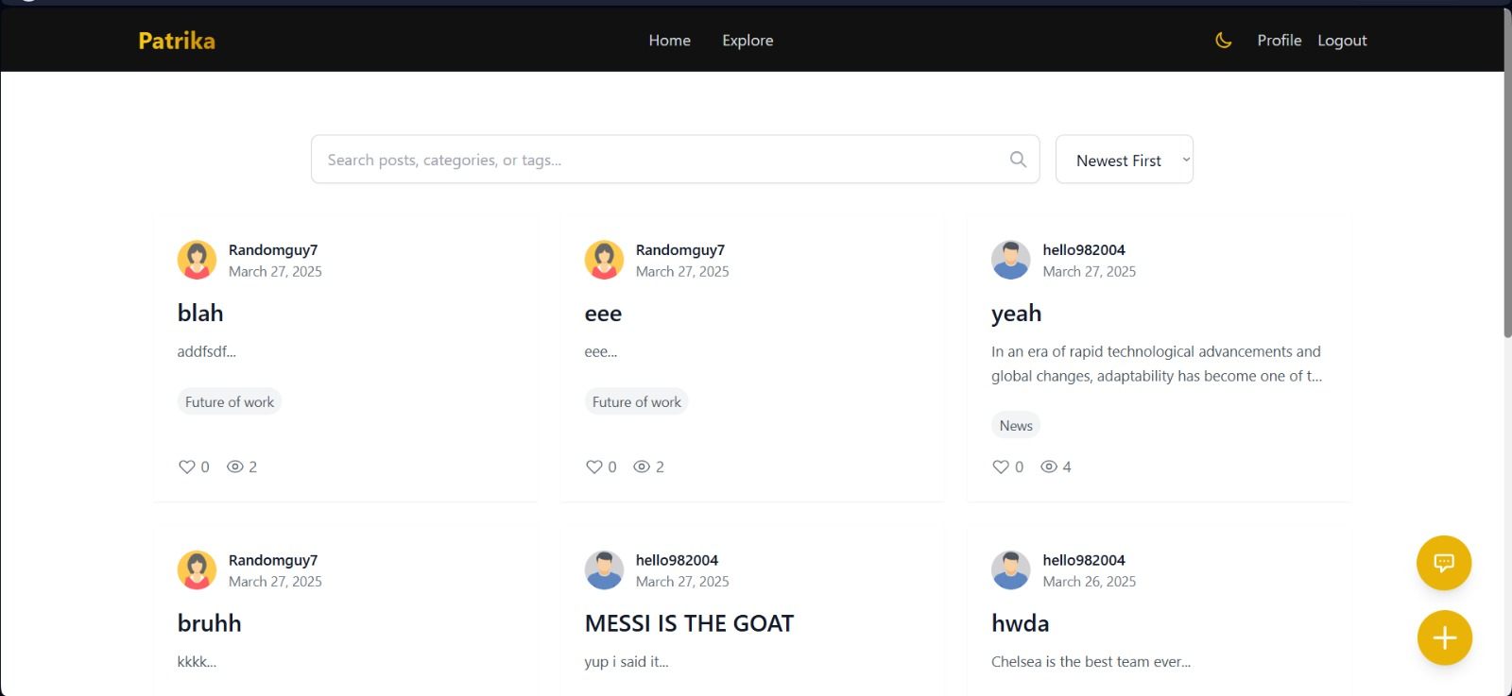
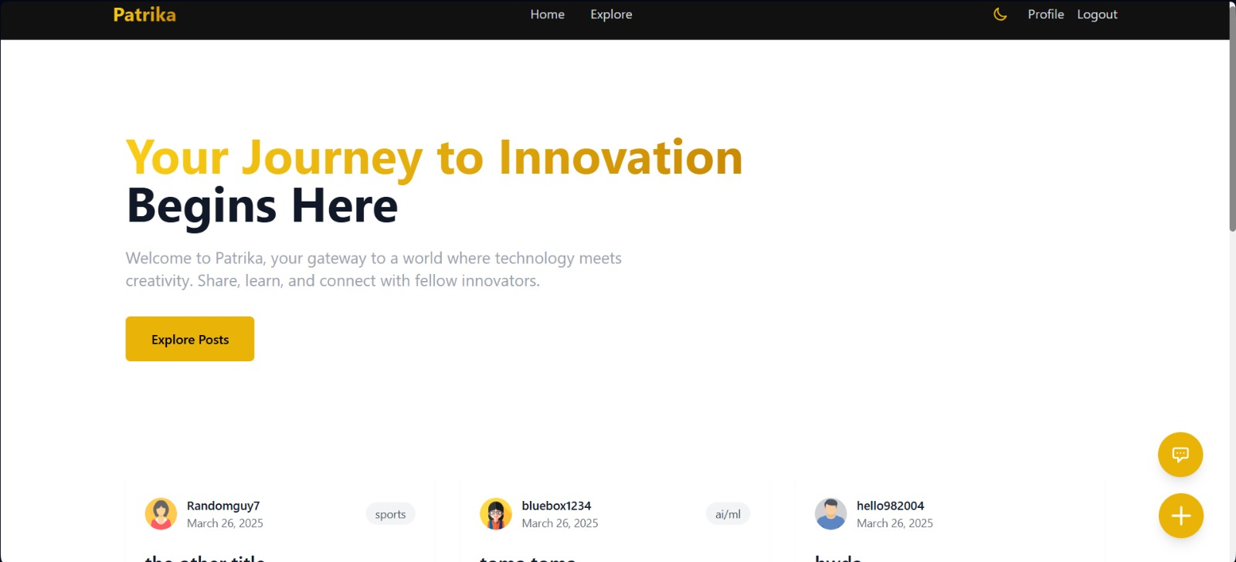

Slide 8
Thank you

