Slide 1


Team Name: PeriLoop
Team Size: 1 (solo entry)
Problem Statement: Statement 3: Closing the Screening-to-Care Loop
PeriLoop Console. Every perioperative task and every patient message gets a named owner and a written closure, around elective orthopaedic surgery.
Working prototype · synthetic data only · not clinically validated

Slide 2


Team members*
[Name, country, role, organization, age confirmation]
S.No | Name | Country | Role | Organization | Age confirmation
1 | Tan Shun Herng | Malaysia | Orthopaedic medical officer; clinical lead and builder | Independent entry (employed by the Ministry of Health Malaysia; entered in a personal capacity) | 34
2
3
4
5

Slide 3
Team Capability Summary*
Maximum 1,000 characters
Solo entrant: an orthopaedic medical officer in a Malaysian public hospital who works every day in the pathway this prototype addresses: pre-operative clinic, ward and post-operative follow-up.
Clinical work in this project: defined the problem from practice, set the line between "emergency" and "same day", labelled 368 test messages blind, and will sign off every clinical rule before any real use.
Technical work: designed and built with AI coding assistants. Every rule decision, measurement and failure is written in a public decision log. An independent AI review was commissioned mid-challenge and its criticisms were acted on.
Known gaps: no software engineer, no second clinician labeller, no native Arabic reviewer and no hospital IT partner yet. These are the first people a pilot would add.
803 characters

Slide 4
Architecture or workflow diagram*
Every patient message passes the same fixed steps. The AI can raise urgency but never lower it, and never writes clinical advice to a patient.
Triage pipeline (server)
Patient or carer
Private chat link, no app
English, Malay, Chinese, Arabic
Sees only fixed urgent texts, approved clinic answers, or a receipt
Staff Console
Alerts: who acknowledged, and when
Inbox and reply drafts the staff edit
Checklist: a task closes only with written evidence
Dose warning before a reply is sent
Calendar: over-booked days, with a suggested move
Learning: AI proposes a lesson, the chief doctor approves
1
Mask identifiers
Phone, IC and email removed before storing or sending
2
Fixed red-flag rules
Word lists plus the clinician's emergency line. No AI
3
Raise-only checks
Clinic phrases · confirmed patient profile · dose table
Staff input
Checklist per patient from pathway rules
Readings typed by staff, flagged by fixed thresholds
Operation dates and a cases-per-day limit
4
AI second check
Only if steps 2 and 3 found nothing. Can raise, with a severity grade
Underneath
Audit log of every decision and change
AI provider set by three settings; all calls queued, safety checks first
5
Decision and reply
Emergency or same-day: fixed text and a staff alert. Otherwise: approved answer or receipt

Slide 5
Target users and intended outcome*
Doctors and nurses
Orthopaedic units in public hospitals with no patient portal, where follow-up runs on phone calls and memory.
They get one screen of what needs a person now, with an owner on every item.
Patients and carers at home
Adults having elective joint, spine or sports surgery, writing in English, Malay, Chinese or Arabic.
They get a private chat link, a clear instruction when something is urgent, and honest wording about who reads messages and when.
Clinic coordinators
The people who book operations and chase missing results.
They see over-booked days, overdue pre-operative tasks, and a task to tell the patient when a date moves.
Intended outcome
Nothing found is left without an owner. An abnormal result, a missing consent or a worried message always has a named person and a closure with evidence.
An urgent message reaches a clinician the same day. Fixed rules first, an AI check that can only raise, and an alert that records who acknowledged it.
No patient receives clinical advice written by an AI. Urgent replies are fixed texts; clinical questions go to a person.
This is Statement 3 applied to surgery: pre-operative screening finds a risk, and the loop is closed only when someone has acted on it.

Slide 6
How will success be measured?*
Nothing has been measured with real patients yet. These are the measures a pilot would report, each taken from data the Console already records.
Measure | How it is measured | Why it matters
Pre-operative tasks closed with evidence before the operation date | Checklist records: closed-with-evidence tasks over all tasks due before surgery, per patient | The loop is closed before the patient reaches theatre
Time from an urgent message to a clinician acknowledging it | Alert log: time raised to time acknowledged, median and worst case, in and out of clinic hours | An alert nobody opens is not safety
Urgent messages that triage missed | A clinician reads a random sample of messages classed routine each week and marks any that should have alerted | The only honest way to find missed emergencies
Alerts a doctor marks "not urgent" | Doctor feedback button on each alert, per 100 messages | The cost of over-alerting: staff stop reading alerts
AI drafts sent unchanged, and lessons that work | Learning page counts: drafts sent as written against drafts rewritten, per approved lesson | Whether the assistant is saving staff time or adding work
Unplanned emergency visits and readmissions within 30 days | Hospital records, compared with the same unit before the pilot | The patient outcome; needs ethics approval and a larger sample
Before a live pilot: a silent period where the system runs beside usual care and its alerts are reviewed but not acted on.

Slide 7
Evidence supporting the approach*
Citations, studies, benchmarks, or prior testing.
Our own measurements (invented messages only)
Published evidence
Test | Result
368 English messages labelled blind by one orthopaedic medical officer; rules + AI check | All 155 he called emergencies raised an alert (rules alone: 150). None of his 114 routine messages did
Same labels, emergency text | 134 of 155 by rules alone after his emergency line was added; the rest are told "call the clinic today"
913 messages, 4 languages, real model (DeepSeek), AI labels | Rules alone alerted on 491 of 537 urgent (91%; Arabic 73%). Rules + AI: 537 of 537. False alerts 14, then 20, of 376
AI check by itself | When it answered, it flagged every urgent message. About 2.5% of single calls fail; a retry recovered them
A failed run, kept in the record | New features overloaded the provider and a third of AI checks were lost. Staff were alerted each time; no labelled emergency was missed. Fixed and re-run
Automated texts help after joint replacement. Randomised trial, 159 patients: an SMS bot improved engagement and early outcomes. It could not receive patient replies. Campbell et al., J Bone Joint Surg Am 2019. doi:10.2106/JBJS.17.01505
App-based care after knee replacement is feasible at scale. Randomised trial, 401 patients, smartphone platform with a watch against in-person physiotherapy (one-year follow-up summarised by OrthoEvidence, 2025).
AI replies to arthroplasty patients are being studied, with surgeons grading autonomous replies as mostly acceptable (AAHKS 2026 abstract), and retrieval-based triage of fracture questions (Kahan et al., J Am Acad Orthop Surg 2026).
What is missing in that work, and built here: inbound messages triaged by fixed rules first; an AI that may only raise urgency and never writes clinical advice; every item owned and closed with evidence; and misses published, not hidden.
Limits: invented messages, one clinician, one model, test sets the rules were tuned on. Not clinical validation.

Slide 8
Data sources and legal right to use them*
List source, type, owner, sensitivity, permissions, and whether personal data is used.
Source | Type | Owner | Sensitivity | Permission to use | Personal data?
30 fictional patients in the demo | Invented records and intake answers | The entrant | None | Created for this project | No
913 test messages in four languages | Invented patient messages, written by AI | The entrant | None | Created for this project | No
368 blind urgency labels | Clinical judgement on invented messages | The entrant (labeller) | None | Own work | No
Pathway items, thresholds, dose table, clinic answers | Rules drafted by AI from general clinical practice; awaiting clinician sign-off | The entrant | None | Own work; no guideline text copied | No
Text typed into the public demo by visitors | Free text | The visitor | Could be sensitive if a visitor ignores the banner | Banner: fictional data only; identifiers masked; demo resets after 30 minutes idle | Not intended
Published studies | Citations only | Their publishers | None | Cited, not reproduced | No
No real patient data has been used at any point. When the AI is on, message text is sent to the configured model provider (DeepSeek for these tests). For real patients the model must run in-country, and the measurements must be repeated on that model.

Slide 9
Risks and safeguards*
Privacy; security; bias; explainability; misuse; human oversight; failure modes.
Risk | Safeguard built | What remains
A missed emergency | Fixed rules run first and never depend on the AI. The AI check can only raise. Every reply lists the emergency number | Fixed word lists miss unusual wording: every fresh test found misses. Rules alone are not safe
AI gives unsafe advice | Urgent replies are fixed texts. Clinical questions are handed to a person. An output guard blocks advice, verdicts and medicine instructions in any AI wording | The guard is a filter, not a proof. It blocked about 13 model replies per test run
AI unavailable | All calls queued with safety checks first; one retry; then a staff alert. A daily ceiling switches to rules only, and the screen says so | About 2.5% of single calls fail at this provider
Human oversight | Staff confirm every patient fact the AI proposes; the chief doctor approves every lesson; lessons cannot change triage or carry a dose | Alerts are seen only when staff open the Console: no SMS, no on-call rota
Wrong dose | A dose above the usual maximum, reported by a patient or typed in a reply, is shown to the doctor before anything is sent | The dose table is AI-drafted and awaits clinician sign-off
Privacy and security | Identifiers masked; passwords hashed; login limits; audit log; AI key kept on the server | One data file, not encrypted; the chat link is the patient's only identity; no in-country model yet
Bias and language | Four languages tested separately and reported separately | Arabic is weakest (rules alone 73%). Malay, Chinese and Arabic texts are machine drafts with no native review

Slide 10
Hardware requirements
Required if wearable, sensor, connected device, or other hardware is there. Include sourcing and safety.
Not applicable.
PeriLoop is software only. Patients use the browser on their own phone; staff use any computer with a browser. There is no wearable, sensor or connected device.

Slide 11
If the application requires login authentication, please provide valid access credentials
or enable a "Continue as Guest" option with all necessary features and functionalities accessible to guest users.
Live demo
https://periloop-console-production.up.railway.app
Doctor (chief): doctor password: [DOCTOR PASSWORD]
Nurse: nurse password: [NURSE PASSWORD]
Fictional patients only. The demo puts itself back to its starting state after 30 minutes without activity.
Source code
https://github.com/bluebud123/periloop-console
Runs locally with one command and no dependencies: node app/server.js
Read docs/decision-log.md for every measurement, including the ones that went badly.
Five things to try (about four minutes)
1 Open Live view and send, as the patient: "I cant breathe and my chest hurts". Watch each step of the pipeline and the alert.
2 Send: "I have been taking 3 tramadol every 4 hours". The doctor is shown the dose against the usual maximum; the patient is not.
3 Open a patient, expand Doctor brief, press Suggest a reply, rewrite the draft and send it. Then open Learning.
4 Close a checklist task: it will not close without written evidence.
5 Open Rules: every clinic answer is marked as a draft until a doctor approves it.

Slide 12
Path to pilot and scale*
Stakeholders, integration, regulatory needs, timeline assumptions, and sustainability.
Stage | What happens
Now to 3 months | Clinician sign-off of rules, thresholds, dose table and texts. A second clinician labels the test set. Native review of Malay, Chinese and Arabic. A hazard log
3 to 6 months | Ethics approval at one orthopaedic unit. Silent period: the system runs beside usual care; alerts are reviewed, not acted on; misses are counted against real messages
6 to 12 months | Live pilot with knee replacement patients under a named clinical safety lead. Notifications and an on-call rota are added first
After a pilot | More procedures (five more pathways already exist as data). A second site in the UAE with an Arabic-first model
Integration
Blood results: typed by staff today; next, scan a lab report and a nurse confirms each value; then a direct feed from the lab system using HL7 or FHIR, and the health information exchange in Abu Dhabi.
Regulatory and data
Likely software as a medical device: classification to be confirmed with the regulator. The AI model must run in-country and be re-measured before use.
Stakeholders and sustainability
Orthopaedic department, nursing, hospital IT, ethics committee, patients. Running cost is small: about US$5 a month to host and a fraction of a cent per message for the model. Priced per operation episode.
Assumptions: no site, permission or funding is in place today. Timelines depend on ethics and hospital IT approval, which the entrant does not control.

Slide 13
Pre-existing IP and third-party materials*
Identify ownership, licenses, open-source components, and restrictions.
Item | Ownership and licence | Restriction or note
PeriLoop Console source code, rules, texts, tests and documents | Written during the challenge by the entrant, working with AI coding assistants. Owned by the entrant. Public repository; no open-source licence has been chosen yet | No pre-existing product. The repository also holds an earlier single-page prototype from the same challenge period
AI coding assistants | Commercial AI assistants were used to write most of the code, rules, translations and documents, under their standard terms | Stated openly throughout. All such content is treated as unverified until a clinician signs it off
Runtime | Node.js (open source, MIT licence). No other libraries or packages are used | None
AI model at run time | DeepSeek API, used under its commercial terms for the tests and the demo. The provider is a setting and can be replaced | No model weights are distributed. Results apply to the model tested
Test data and clinician labels | Invented by the project; labels are the entrant's own clinical judgement | None
Employer | The entrant is employed by the Ministry of Health Malaysia and enters in a personal capacity, in his own time, using no patient data or hospital systems | The entrant will confirm his employer's rules on outside work and intellectual property before any pilot or commercial use

Slide 14
Conflict of interest declaration*
Disclose relationships with organizers, partners, or judges.
None to declare.
The entrant is not employed by or contracted to the Department of Health Abu Dhabi, Future Health, Microsoft, Inception, MBZUAI or Hack2skill.
He has no family or close personal relationship with a judge, organiser or collaborator staff member.
He has no financial interest in an organisation running or judging the challenge.
He has had no access to non-public information about the challenge or its evaluation.
For transparency: he is a doctor employed by the Ministry of Health Malaysia, which has no role in this challenge.

Slide 15
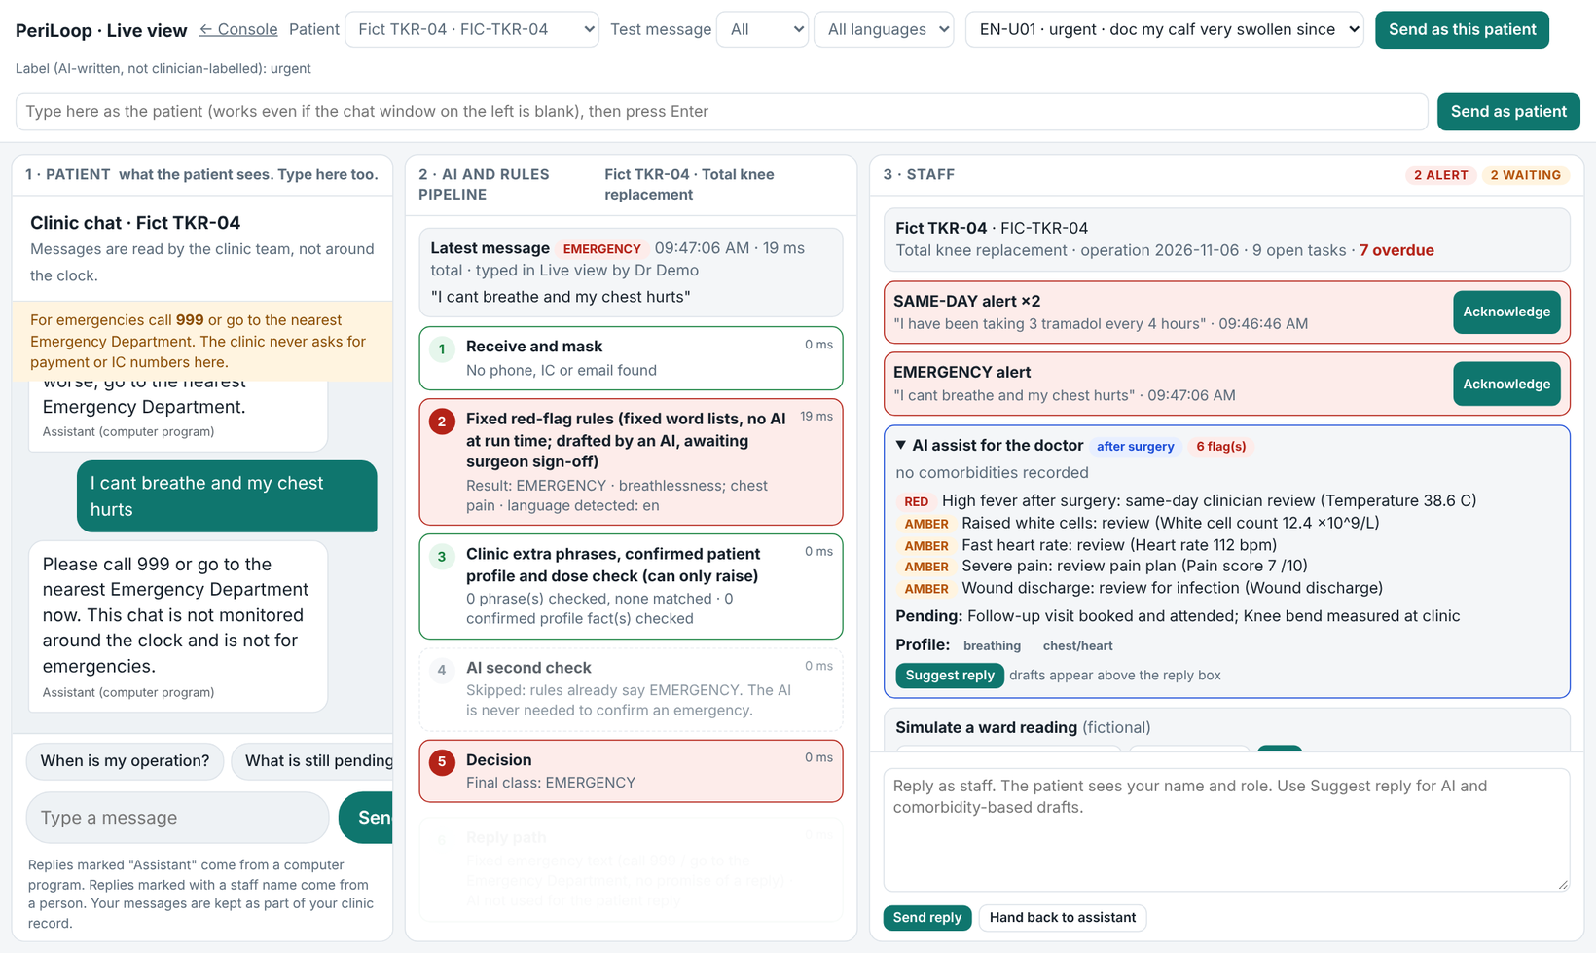
Additional Slide: the Live view, where every decision can be seen
Left
What the patient sees: a fixed emergency text.
Middle
Each step of the pipeline, with its result and time.
Right
What staff see: the alerts, and the flags on this patient.
In this picture
The rules caught the emergency in 19 ms, so the AI check was skipped: an emergency never waits for the AI.
The earlier message about tramadol raised a same-day alert from the dose check.
Fictional patient. Local run.

Slide 16


