Slide 1
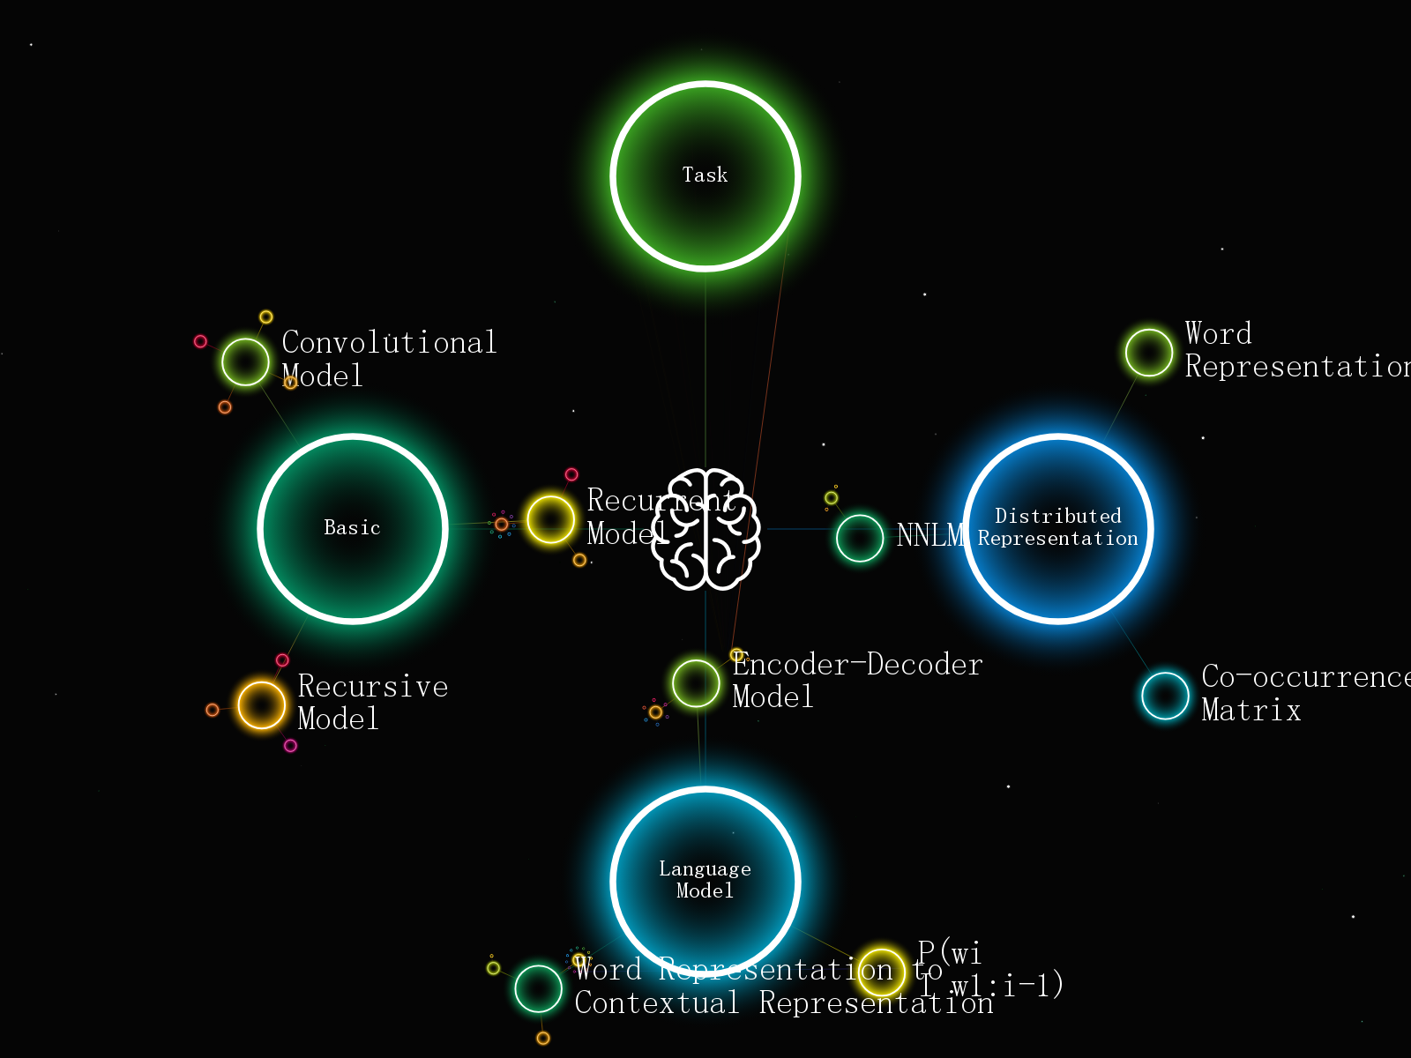
NAMED ENTITY RECOGNITION
Under the guidance of : Dr SUNIL
VIVEK KUMAR – 18BCS110
LALIT PALARIYA – 18BCS047
RITISHEK YADAV – 18BCS079
YOGENDRA SINGH – 18BCS113

Slide 2
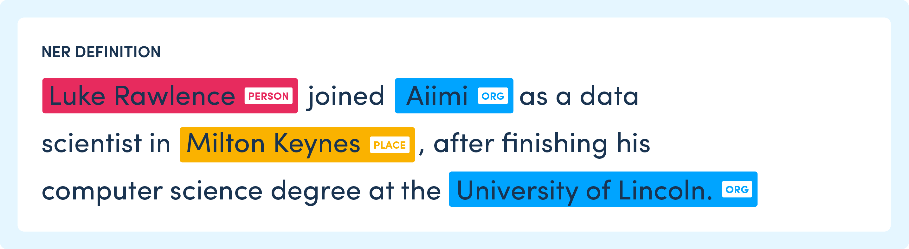
INTRODUCTION
Named entity recognition refers to identifying named entities from text. Named entities are real world objects, like people, products, locations, and dates.
Named Entity are typically noun phrases that refers to some specific object, person or places.
Ex:

Slide 3
WHY NER ?
To get context from text (or) Unstructured Data.
Key part of Information Extraction System
Pre processing for Different classification levels
Information filtering
Information Linking

Slide 4
NAMED ENTITY TYPES
The Name Entity is hierarchy is divided into three major classes Entity Name, Time and Numerical expression
NE TYPES
ENAMEX
NUMEX
TIMEX

Slide 5
TAGSET
ENAMEX
Person
Individual
Family name
Title
Group
Organization
Government
Public/private company
Religious
Non-government
Political Party
Paramilitary
Charitable
Association
GPE (Geo-political Social Entity)
Media
Location
Place
District
City
State
Nation
Continent
Address
Water-bodies
Landscapes
Celestial Bodies
Manmade
Religious Places
Roads/Highways
Museum
Theme parks/Parks/Gardens
Monuments
Facilities
Hospitals
Institutes
Library
Hotel/Restaurants/Lodges
Plant/Factories
Police Station/Fire Services
Public Comfort Stations
Airports
Ports
Bus-Stations
Locomotives
Artifacts
Implements
Ammunition
Paintings
Sculptures
Cloths
Gems & Stones
Entertainment
Dance
Music
Drama/Cinema
Sports
Events/Exhibitions/Conferences
Cuisine’s
Animals
Plants
NUMEX
Distance
Money
Quantity
Count
TIMEX
Time
Date
Day
Period

Slide 6
How Does NER Work?
When we read a text, we naturally recognize named entities like people, values, locations, and so on. For example, in the sentence “Mark Zuckerberg is founders of Facebook, a company from the United States” we can identify three types of entities:
“Person”: Mark Zuckerberg
“Company”: Facebook
“Location”: United States
For computers, however, we need to help them recognize entities first so that they can categorize them.
This is done through machine learning and Natural Language Processing (NLP).
NLP studies the structure and rules of language and creates intelligent systems capable of deriving meaning from text and speech, while machine learning helps machines learn and improve over time.
To learn what an entity is, an NER model needs to be able to detect a word, or string of words that form an entity (e.g. New York City), and know which entity category it belongs to.
So first, we need to create entity categories, like Name, Location, Event, Organization, etc., and feed an NER model relevant training data. Then, by tagging some word and phrase samples with their corresponding entities, you’ll eventually teach your NER model how to detect entities itself.

Slide 7
How to Do NER
Methodologies: -
Rule Based
Machine Learning
Hidden Markov Model (HMM)
Naïve Bayes Classifier
Maximum Entropy Markov Model (MEMM)
Conditional Random Fields (CRF)
Hybrid Approach
Open Source NER API: -
Natural Language Toolkit (NLTK)
SpaCy
Stanford Named Entity Recognizer (SNER)

Slide 8
Some problems in identifying NE
Variation of Named Entity
Dr Manmohan Singh
Manmohan Singh
Manmohan
Ambiguity of Named Entity types
Tata (Person vs Organization)
Washington (Location vs Person)
1947 (Date vs Time)

Slide 9
Ambiguity Problems
Person Vs Location
Sir C. P Ramaswamy was the Diwan of Travancore (Person)
Sir C.P Ramaswamy Road is in Chennai (Location)
Person Vs Organization
Anil Ambani opened Reliance Fresh (Person)
Reliance Fresh is under Anil Ambani Group Ltd (Organization)

Slide 10
APPLICATIONS
Classifying news for content
Automatically summarizing Resumes
Optimizing search engine algorithms
Powering recommendation systems
Simplifying customer support

Slide 11
References:
https://www.mygreatlearning.com/blog/named-entity-recognition/
https://www.analyticsvidhya.com/blog/2021/06/part-10-step-by-step-guide-to-master-nlp-named-entity-recognition/
https://www-nlpir.nist.gov/related_projects/muc/proceedings/ne_task.html
https://www.frontiersin.org/articles/10.3389/fcell.2020.00673/full
https://medium.com/analytics-vidhya/named-entity-recognition-ner-for-text-extraction-2d95a04eb67f

