Slide 1
P1
Program to Calculate the Probabilities
User inputs the numbers N and M
Print all the cases when the sum is M when throwing N of dice
2
6
(1, 5)
(2, 4)
(3, 3)
(4, 2)
(5, 1)

Slide 2
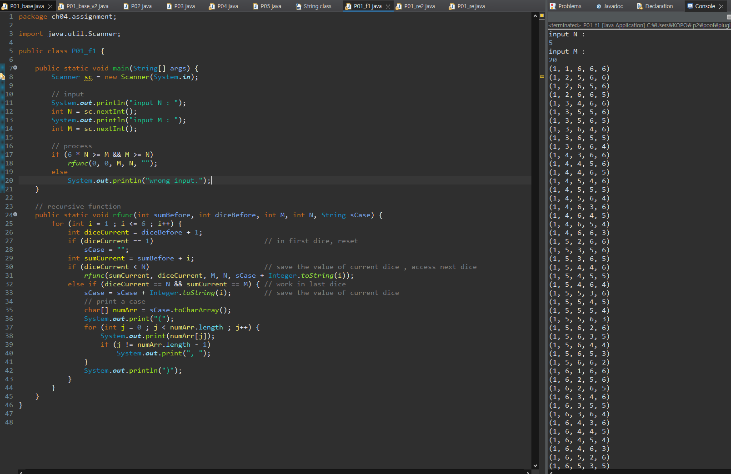

Slide 3
P2
Banking System
This program runs indefinitely until the user tries terminating it
#Menu
Deposit
Withdrawal
Balance : 0
-> 1
10000
#Menu
Deposit
Withdrawal
Balance : 10000
-> 2
2000
#Menu
Deposit
Withdrawal
Balance : 8000

Slide 4
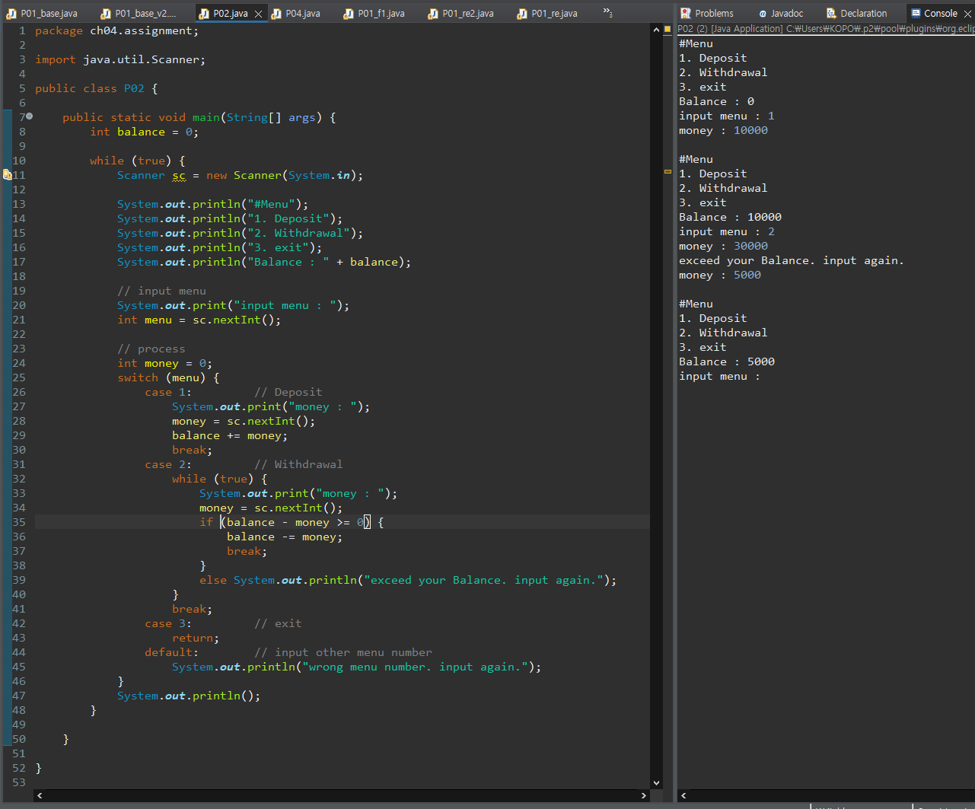

Slide 5
P3
Program to Calculate the Sum of Multiples of N
User inputs the two numbers for the M and N respectively
Calculate the sum of multiples of N from 1 to M
20
5
SUM : 50(5, 10, 15, 20)

Slide 6
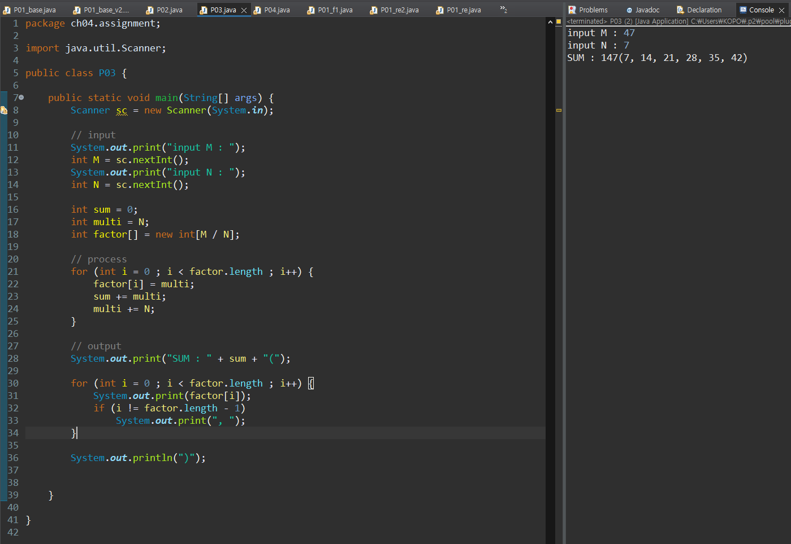

Slide 7
P4
Encryption and Decryption
Create your own encryption algorithm
e.g., a->b, b->c, c->d, d->e
#Menu
Encryption
Decryption
-> school
Result : tdippm
2. Encryption
3. Decryption
-> tdippm
Result : school

Slide 8
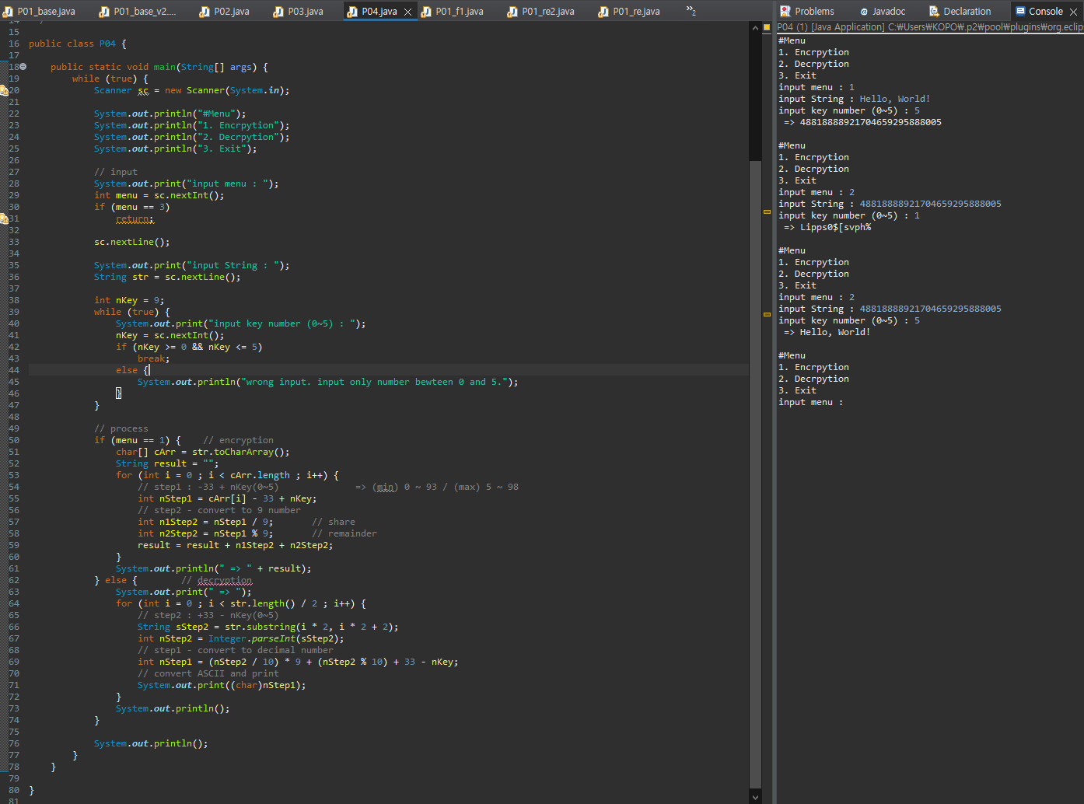

Slide 9
P5
Data Confirmation
Set up your conditions
The number of conditions should be at least 5
e.g.,
#1 : The string length should be over 10
#2 : The string should contains the character ‘k’
….
-> abdefewqqwer
FAIL
-> kdefkdie123
PASS

Slide 10
