Slide 1
P1
Program to Duplicate Numbers
User inputs two sets of numbers(The lengths of the arrays must be dynamically allocated)
Print the duplicate numbers
1.3 2 4.5 2.7 12.3 -6
2.0 4 33 -1.3 -6 -23 0 -1
2.0
1 3.4 4 -6.4 10 11.3
3.6 4.0 1.0 6.23 11.6
1.0 4.0
2 -3 -23 233
-3.0 0 2 23
-3.0 2.0

Slide 2
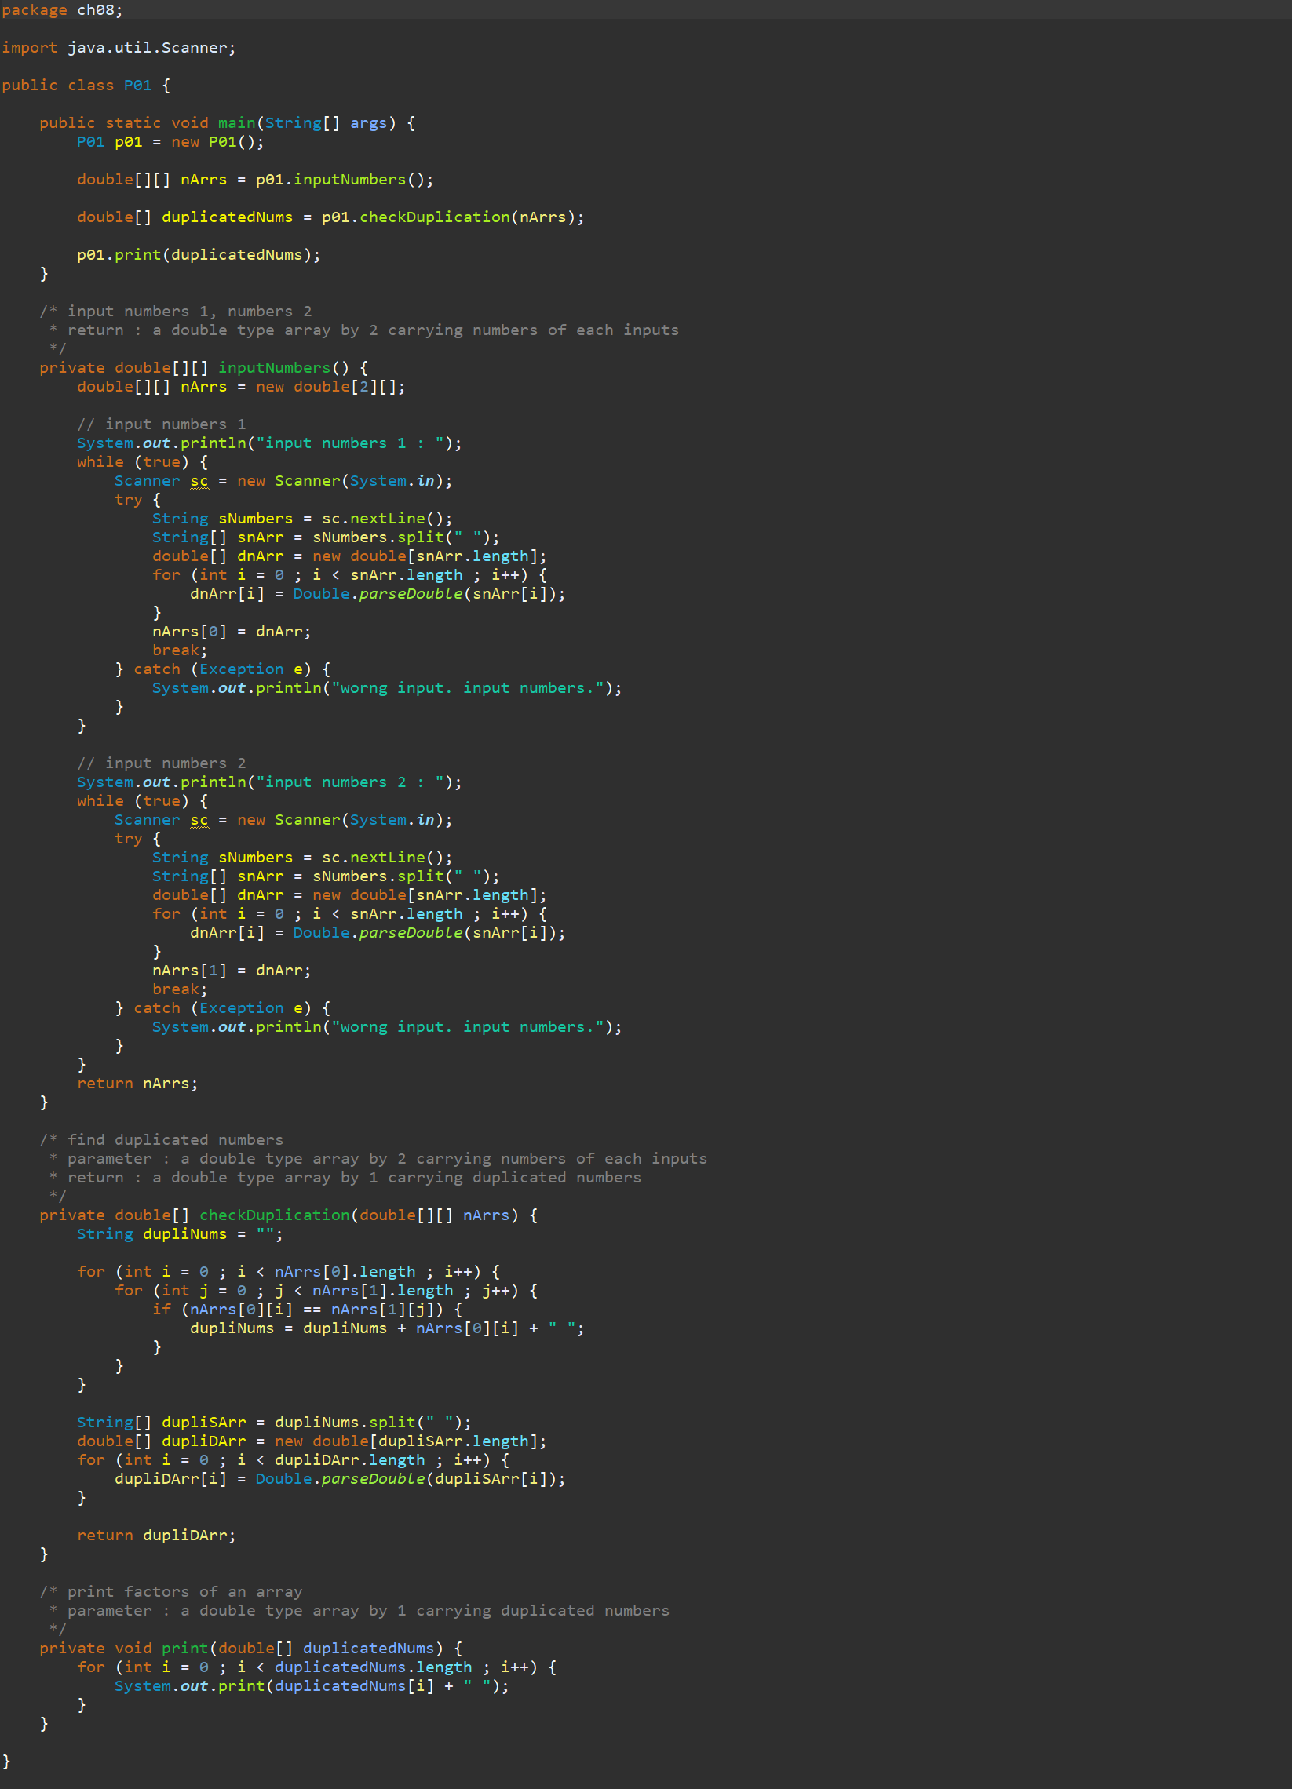
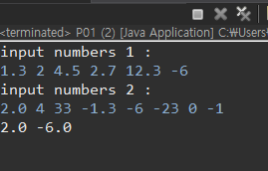
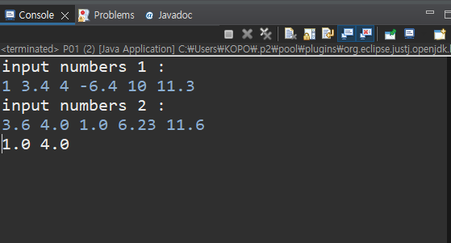
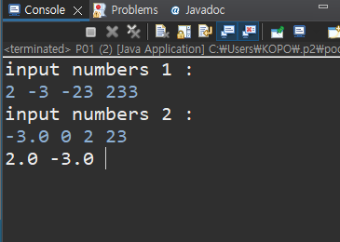

Slide 3
P2
Program to Print the Characters in the Middle
User inputs a string
Print the characters in the middle
International
a
school
ho
Person
rs
Bike
ik

Slide 4
