Slide 1
A1
Fibonacci Numbers
The formula for this is as below
F₀ = 0, F₁ = 1
F_{n} = F_{n-1} + F_{n-2}
0, 1, 1, 2, 3, 5, 8, 13, 21, 34, 55 …
Use a list
User inputs a number
Print the number of elements from the Fibonacci Numbers
7
0 1 1 2 3 5 8

Slide 2
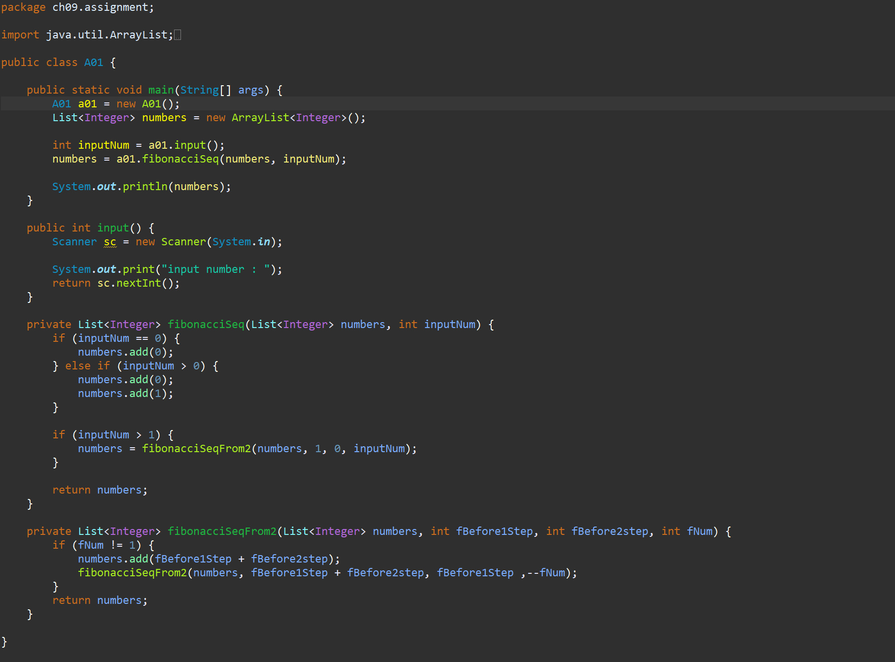
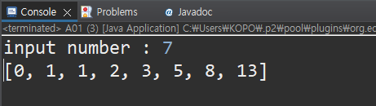

Slide 3
A2
Comparing Strings
User inputs the two words and assign them to lists
Print the following information
1. Size of the first word
2. Size of the second word
3. Number of the same characters
school
scholar
1 : 6
2 : 7
3 : 5

Slide 4
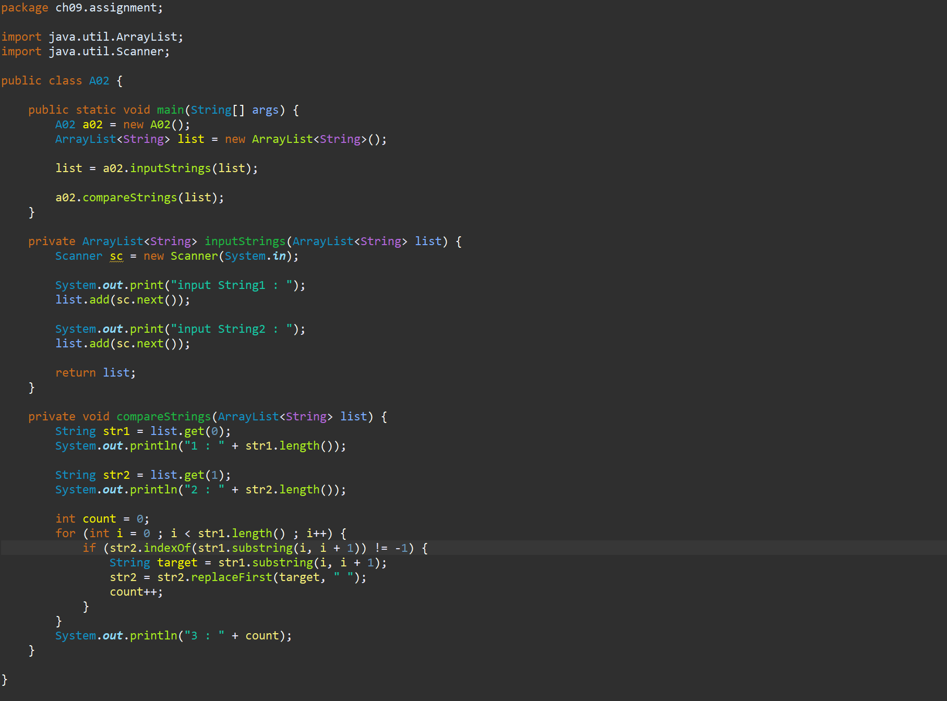
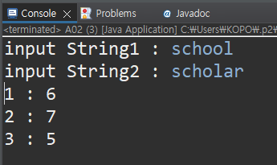

Slide 5
A3
Descriptive Statistics Calculation
User inputs a number, and assign it to a list
Prints the number of numbers, mean, maximum, minimum
This is performed indefinitely
5
Result : 1 - Mean 5, Max 5, Min 5
3
Result : 2 – Mean 4, Max 5, Min 3
1
Result : 3 – Mean 3, Max 5, Min 1

Slide 6
