Slide 1
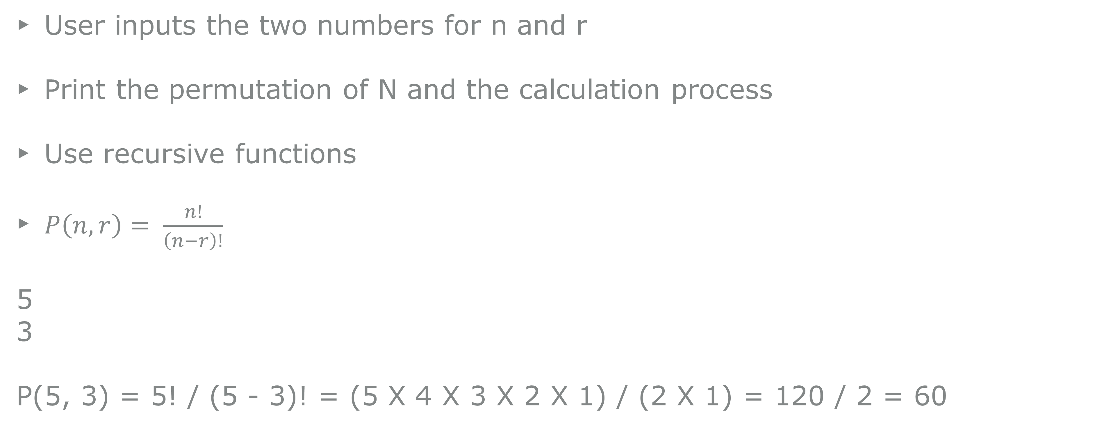
A1
Permutation
User inputs the two numbers for n and r
Print the permutation of N and the calculation process
Use recursive functions
$P\left(n, r\right)= \frac{n!}{\left(n−r\right)!}$
5
3
P(5, 3) = 5! / (5 - 3)! = (5 X 4 X 3 X 2 X 1) / (2 X 1) = 120 / 2 = 60

Slide 2
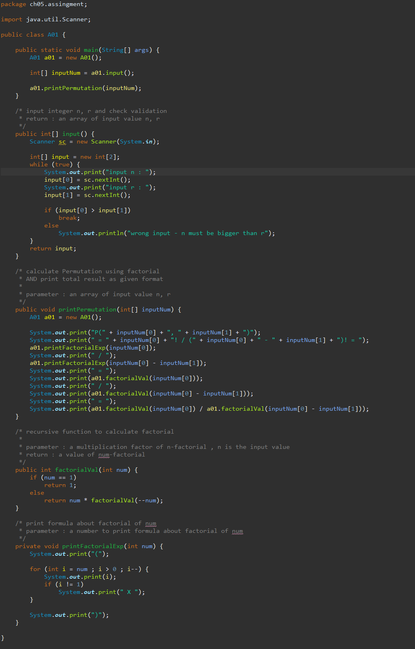
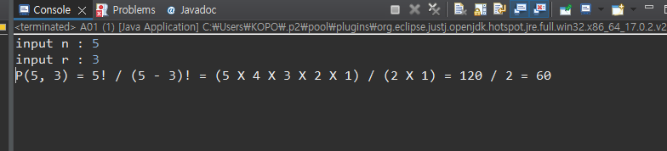

Slide 3
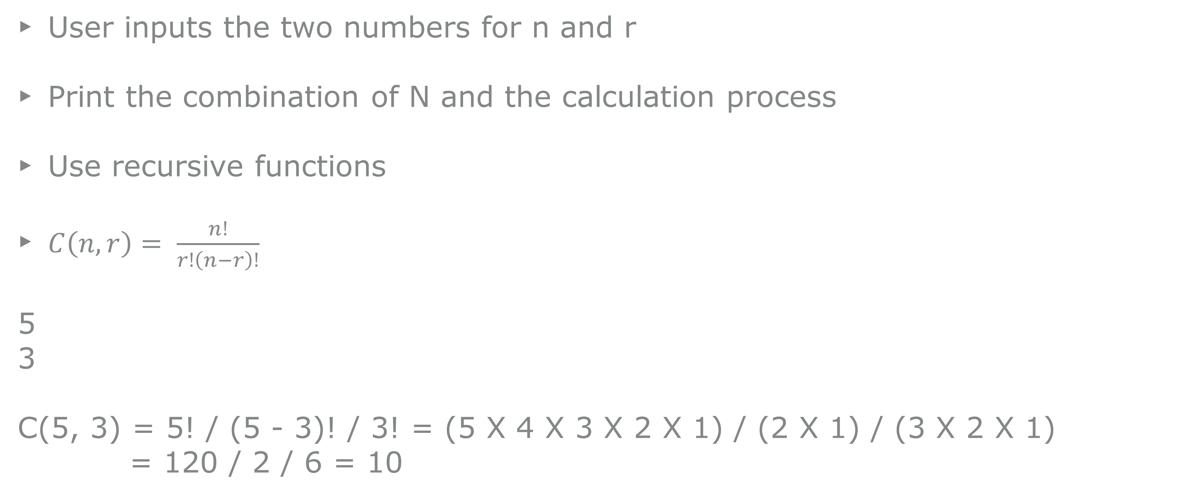
A2
Combination
User inputs the two numbers for n and r
Print the combination of N and the calculation process
Use recursive functions
$C\left(n, r\right)= \frac{n!}{r!\left(n−r\right)!}$
5
3
C(5, 3) = 5! / (5 - 3)! / 3! = (5 X 4 X 3 X 2 X 1) / (2 X 1) / (3 X 2 X 1)
= 120 / 2 / 6 = 10

Slide 4
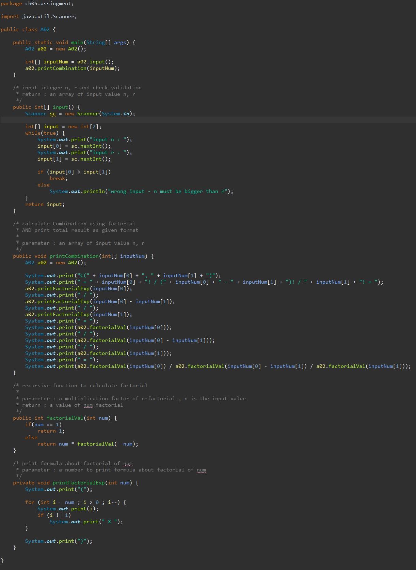
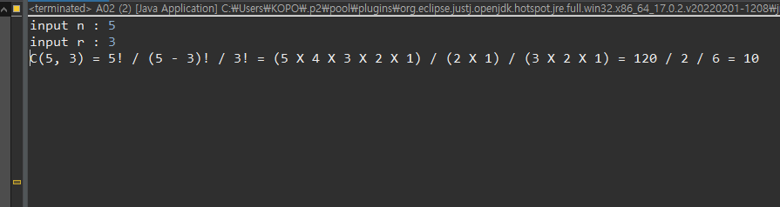

Slide 5
A3
Multiplication Table
User inputs a number, N
Print the N times of multiplication table
Use recursive functions
5
5 X 2 = 10
5 X 3 = 15
5 X 4 = 20
5 X 5 = 25
5 X 6 = 30
5 X 7 = 35
5 X 8 = 40
5 X 9 = 45

Slide 6
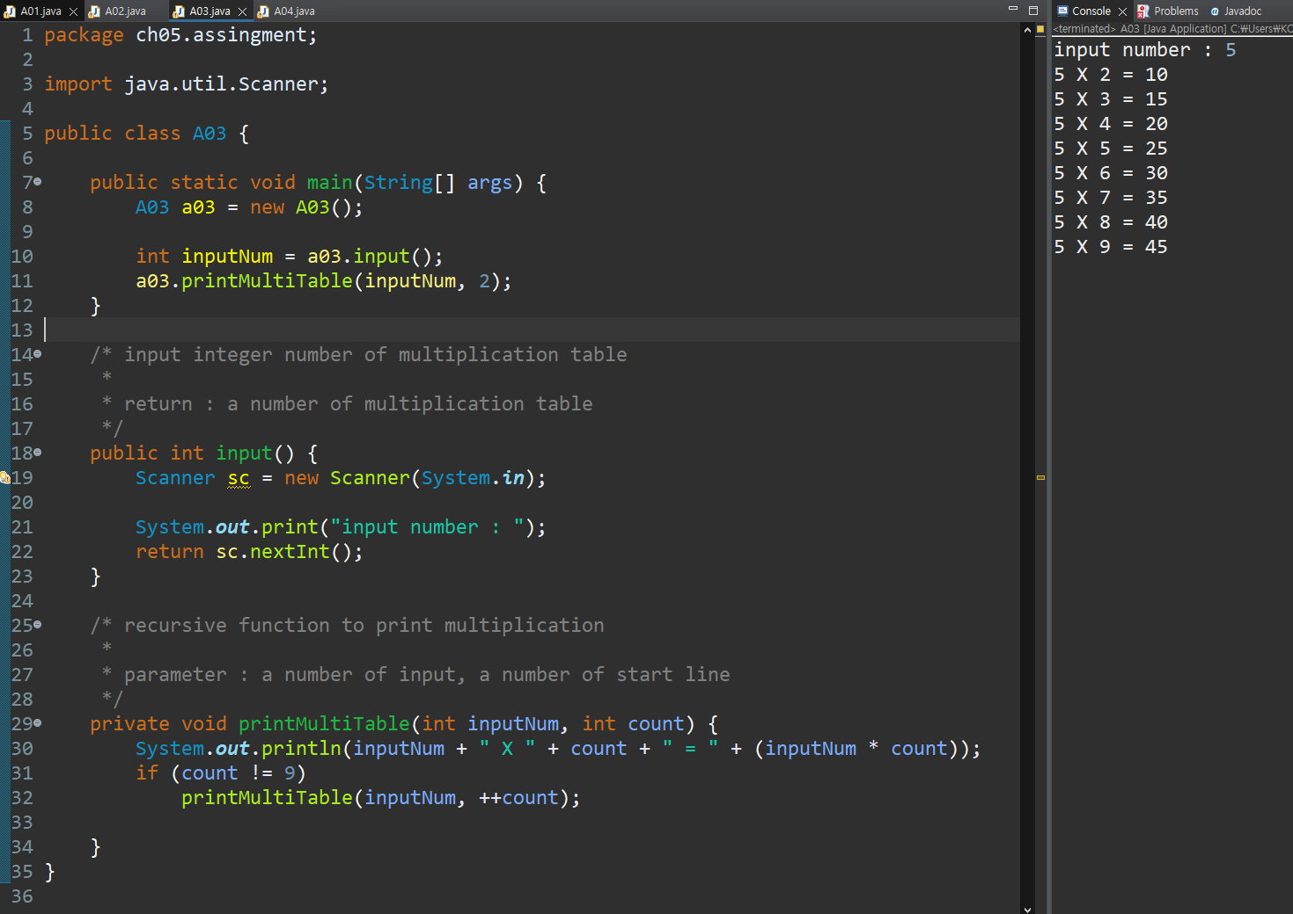

Slide 7
A4
Fibonacci Sequence
The formula for this is as below
F₀ = 0, F₁ = 1
F_{n} = F_{n-1} + F_{n-2}
0, 1, 1, 2, 3, 5, 8, 13, 21, 34, 55 …
User inputs a number
Print the number of elements from the Fibonacci sequence
Use recursive functions
7
0 1 1 2 3 5 8

Slide 8
