Slide 1
R1
Drawing a line vertically or horitontally
User inputs 0s or 1s
The whole size is 4 x 3
Show “Pass” if 0s are connected vertically or horitontally
[Example]
0001
1101
1101
Pass
1010
1000
0111
Fail

Slide 2
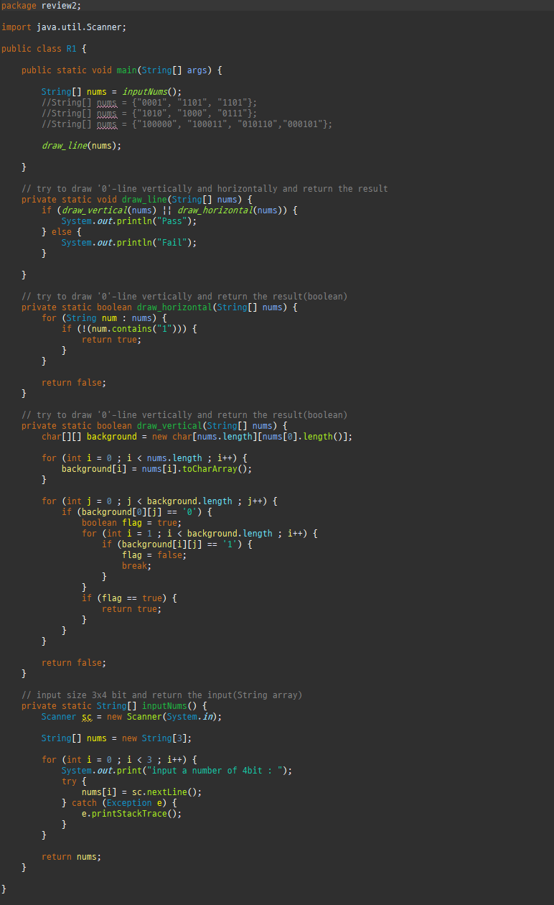
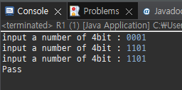
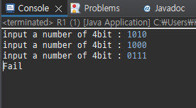
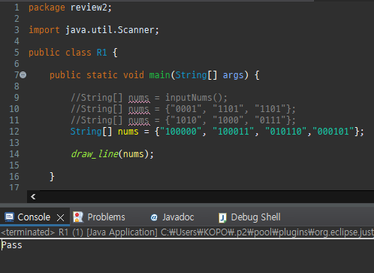

Slide 3
R2
Calculating ages in international age and in Korean age
User inputs the current date and birthday
Show the ages in international age and in Korean age
[Example]
Current Date :
20200902
Birthday :
20180904
3 years old in Korean age
2 years old in international age

Slide 4
