Slide 1
A1(Cont’d)
Course Registration Program
Menu
1. Course List
2. My Course
-> 1
Course List
1. Korean
2. Math
3. English
4. Social Studies
5. Science
0. Back to Main
-> 4
“Social Studies” is registered.

Slide 2
A1(Cont’d)
Course Registration Program
-> 4
“Social Studies” is registered.
Course List
1. Korean
2. Math
3. English
4. Social Studies
5. Science
0. Back to Main
-> 0
Menu
1. Course List
2. My Course
-> 2

Slide 3
A1
Course Registration Program
2. My Course
-> 2
My Course
1. Social Studies
- End –
-> 0
Menu
1. Course List
2. My Course
-> 1

Slide 4
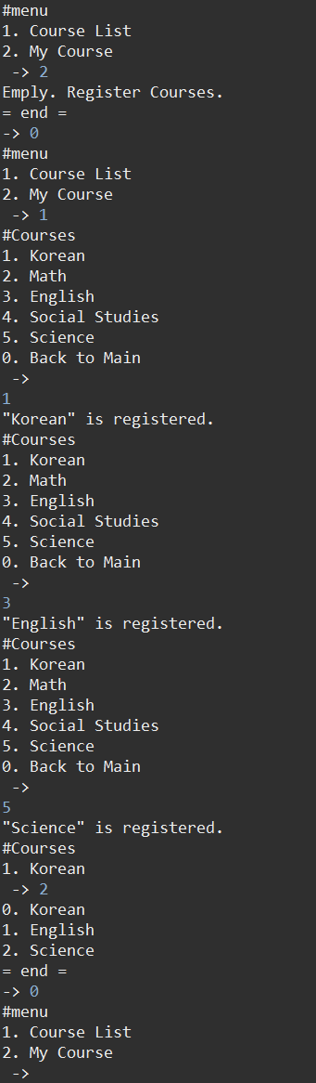
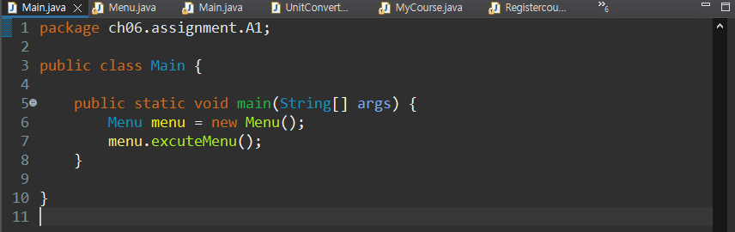

Slide 5
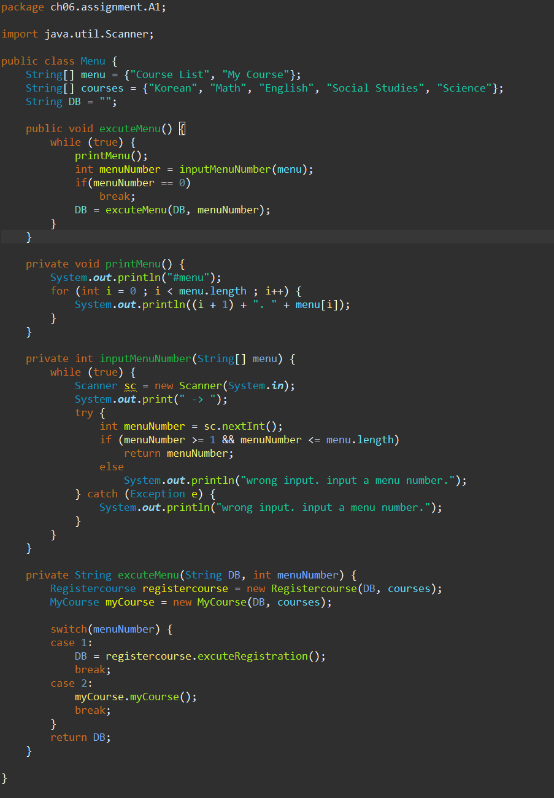

Slide 6
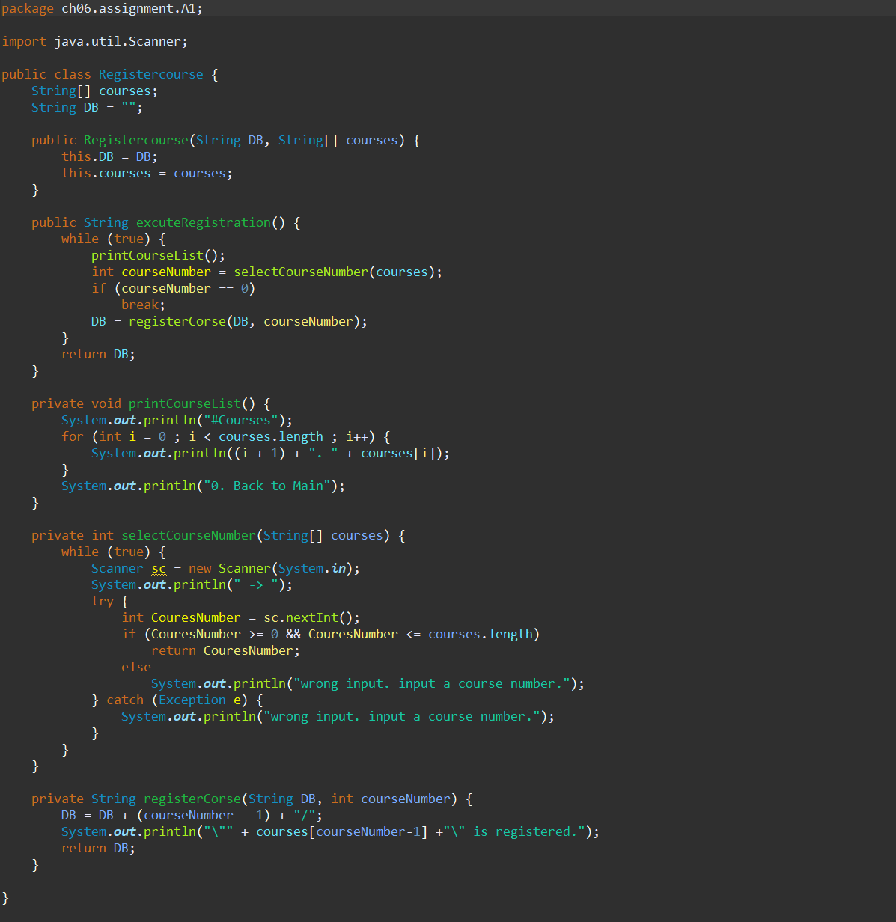

Slide 7
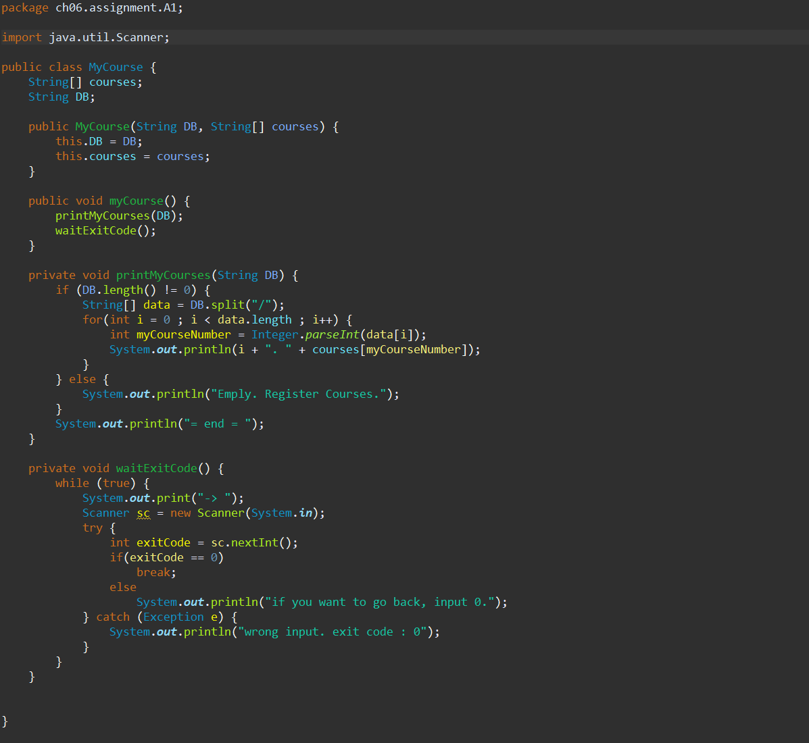

Slide 8
A2
Reverse a Number
User inputs a number
Print the reversed number
Use a method and parameter
245823
328542

Slide 9
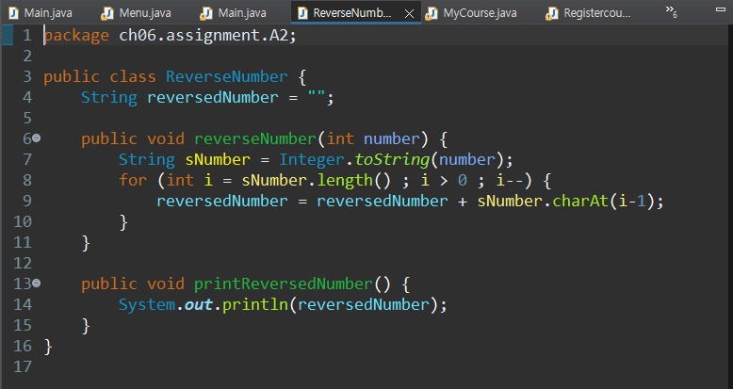
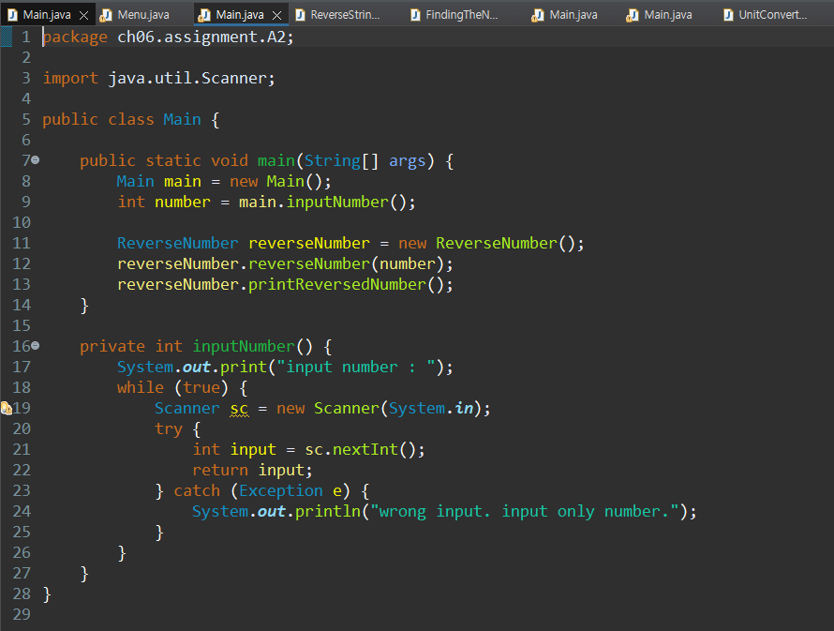
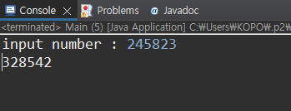

Slide 10
A3
Reverse a String
User inputs a string
Print the reversed string
Use a method and parameter
Hint, “charAt()”
Hello
olleH

Slide 11
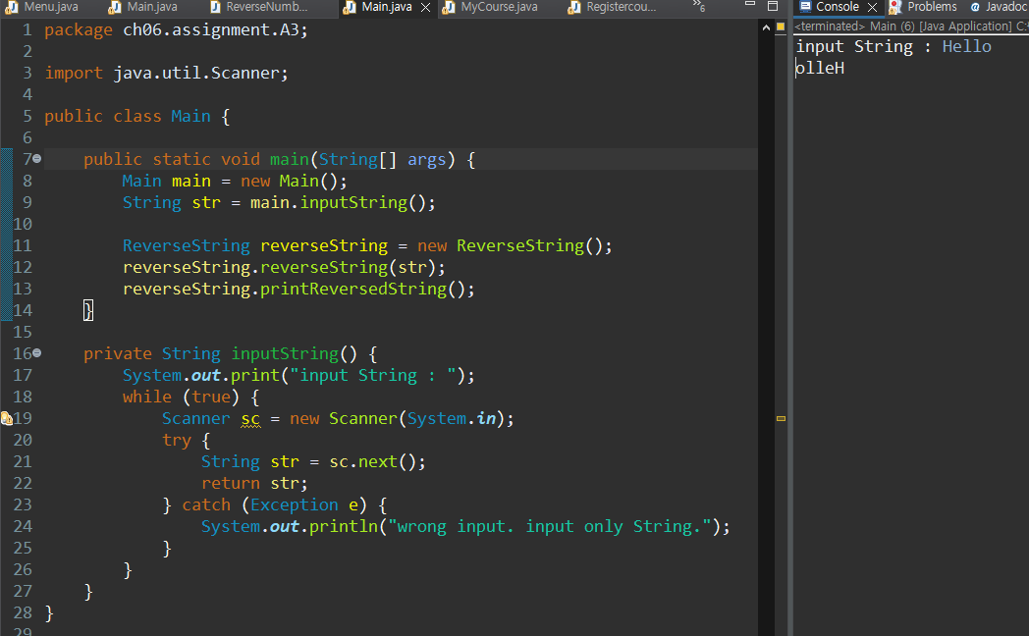
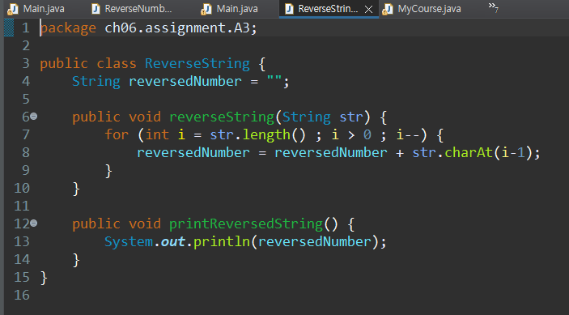

Slide 12
A4
Finding the Nearest Number
User inputs a series of numbers
(ex, 1.1 2.2 -5.7 10.3 20.2, -31.2)
User inputs a number among the numbers above
(ex, -5.7)
Print the number which is the nearest one to the input number
1.1 2.2 -5.7 10.3 20.2 -31.2
-5.7
2.2

Slide 13
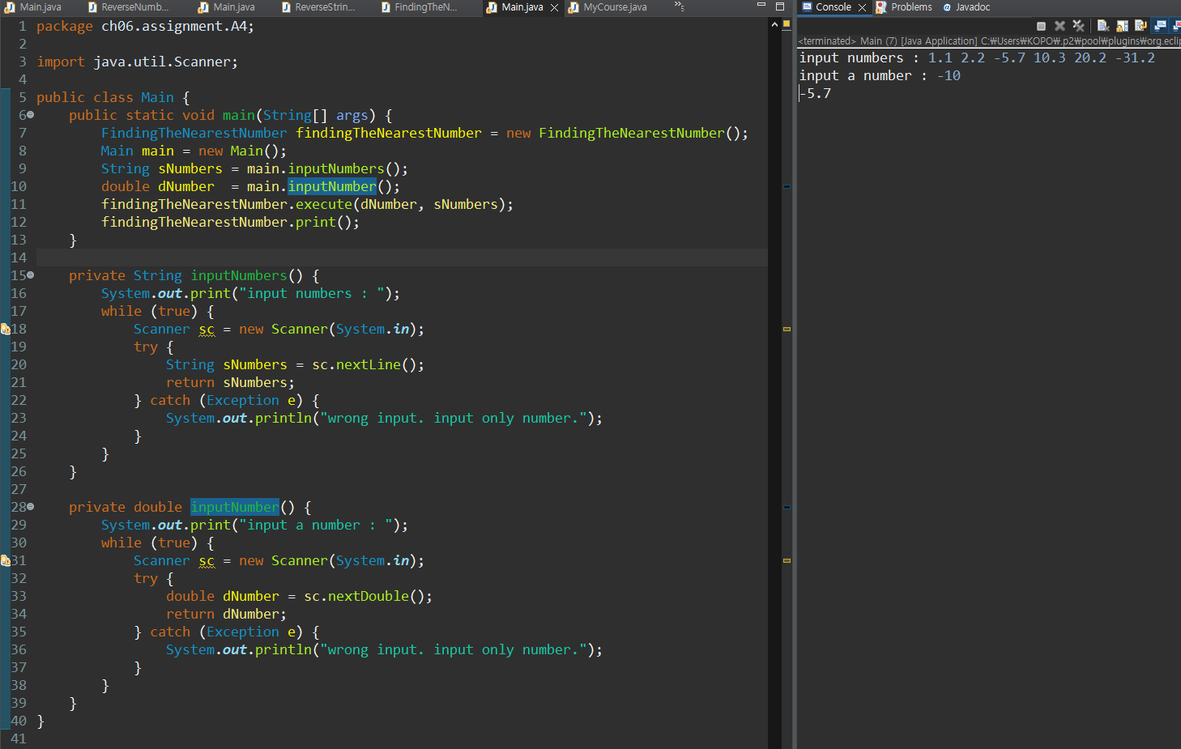

Slide 14
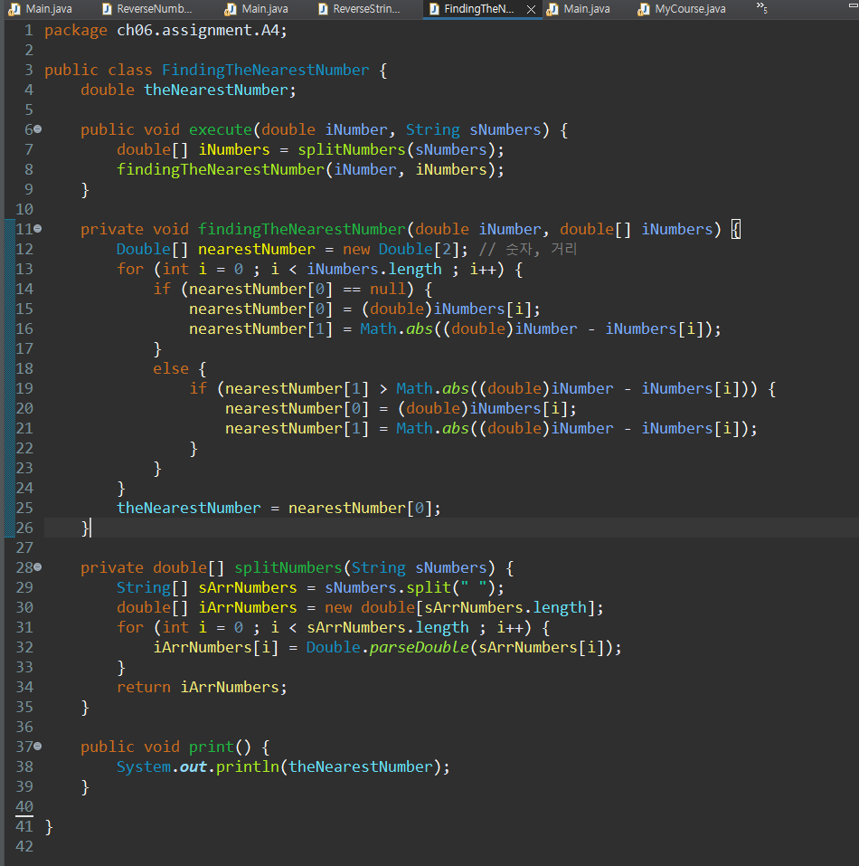

Slide 15
A5
Unit Converter
Print the menu
# Unit
1. cm
2. m
3. mm
4. km
5. mile
User selects the two units and inputs a number
Print the result
Use at least one class and one method
3 1
33
3.3

Slide 16
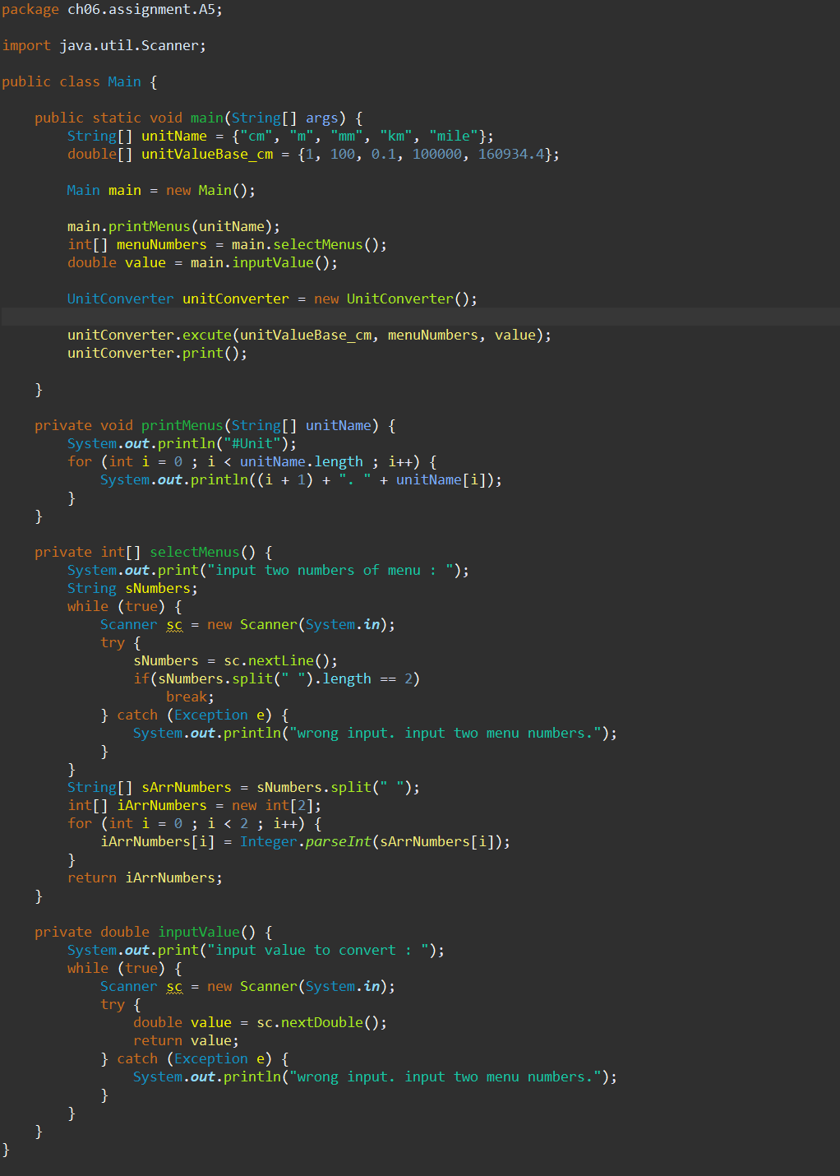

Slide 17
