Slide 1
A1
Timer II
Print the current time on the screen
User inputs a time in second
The program prints out “time is over” after the input time
Add an exceptional statement that waits for the user input again when the time is already over
12:34:45
30
time is already over(It’s 12:36:10)
100
time is over(12:37:50)

Slide 2
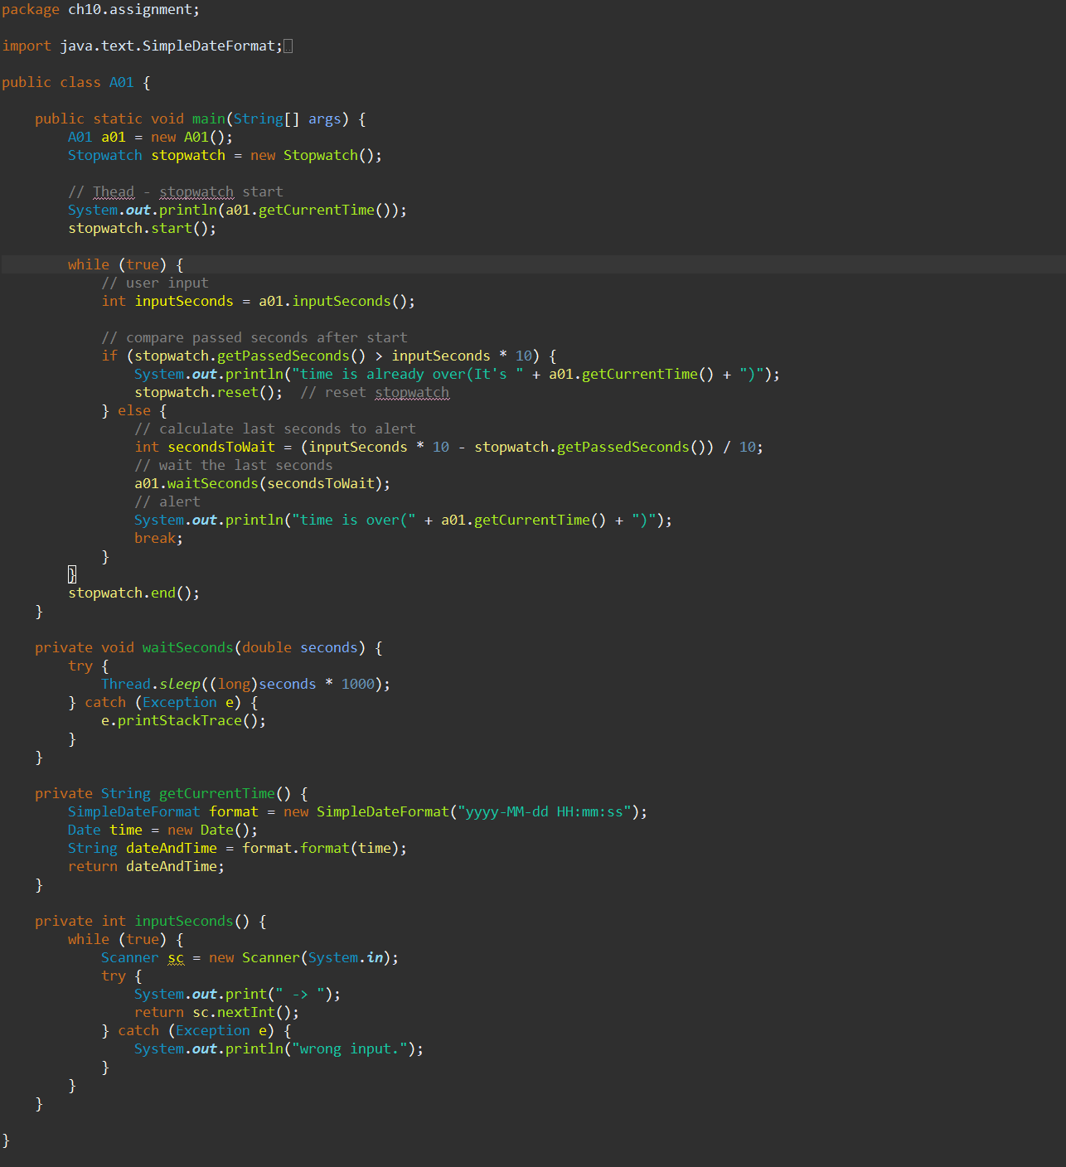
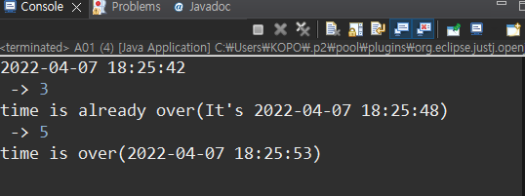
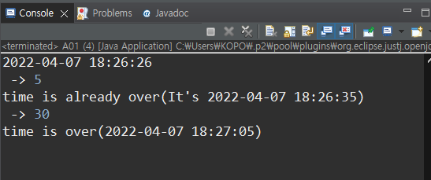
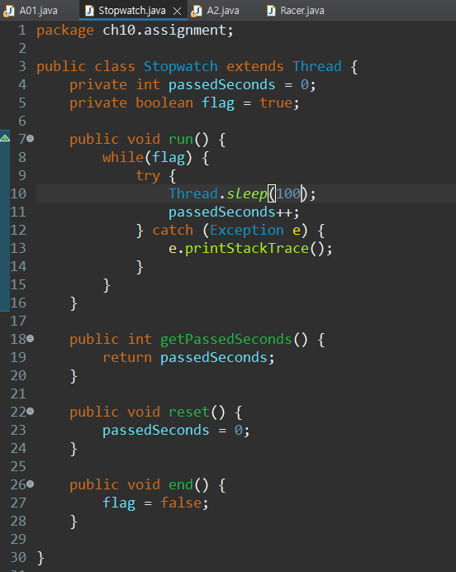

Slide 3
A2
Running Race Game
User inputs a number N(number of runners)
N of threads are created
Print the running progresses of runners every second
Use the function, Math.random() to update the progresses
(Maximum is less than 10m and running distance is 50m)
3
(1s) | (2s) | (3s) | (4s) | (5s) | (6s) | (7s) | (8s) | (9s)
6.5m | 12.3m | 17.2m | 26.4m | 34.5m | 42.1m | (Finished) |  |  | 1
3.2m | 8.9m | 16.8m | 24.6m | 31.2m | 40.0m | 45.1m | 49.1m | (Finished) | 3
3.1m | 10.2m | 17.1m | 23.8m | 32.4m | 39.7m | 46.2m | (Finished) |  | 2

Slide 4
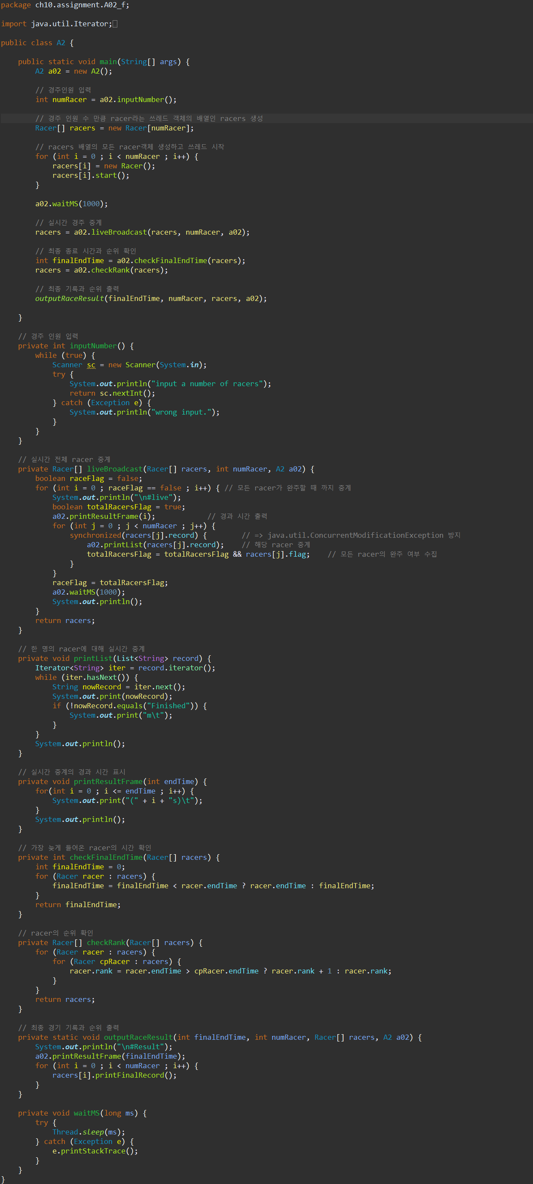
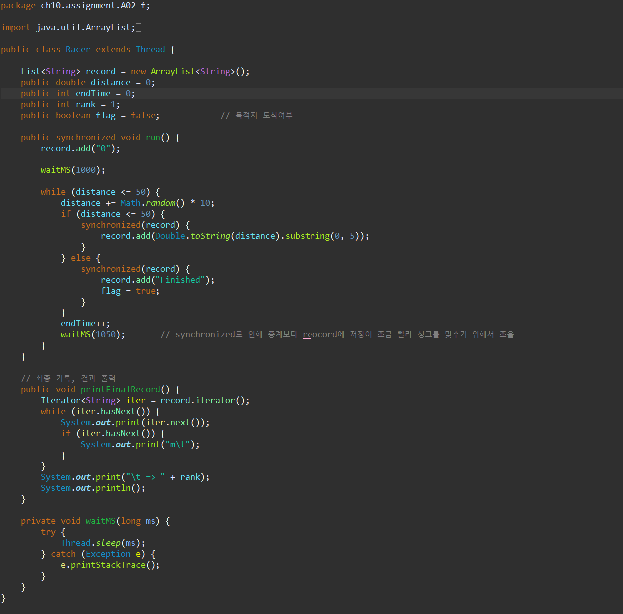

Slide 5
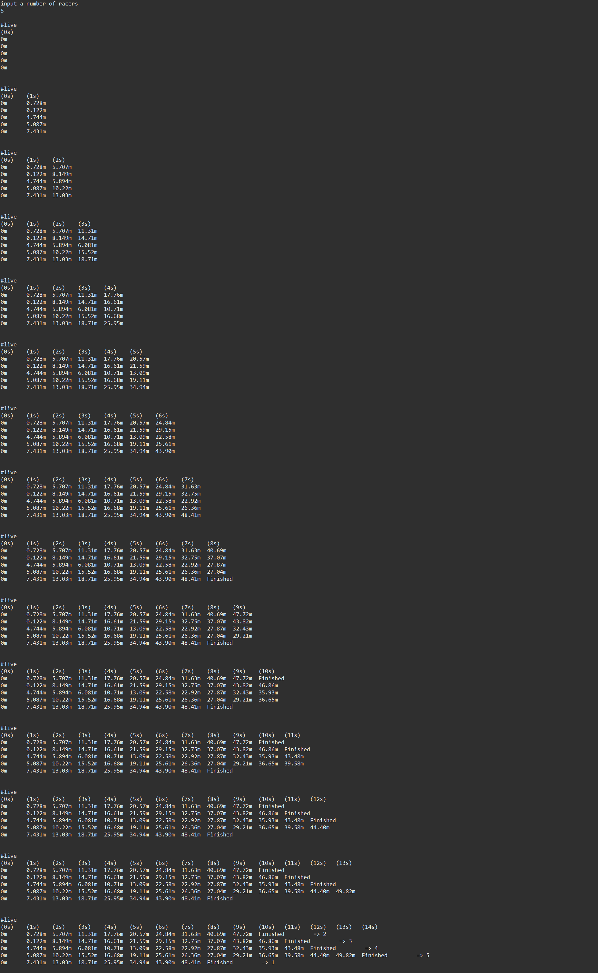

Slide 6
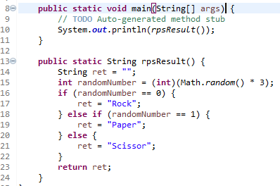
A3
Rock-Paper-Scissors Game
User inputs a number(0 : Rock, 1 : Paper, 2 : Scissor)
User plays the Rock-Paper-Scissors game with the computer
Print the result
Hint, Math.random() returns 0.0 <= number < 1.0

Slide 7
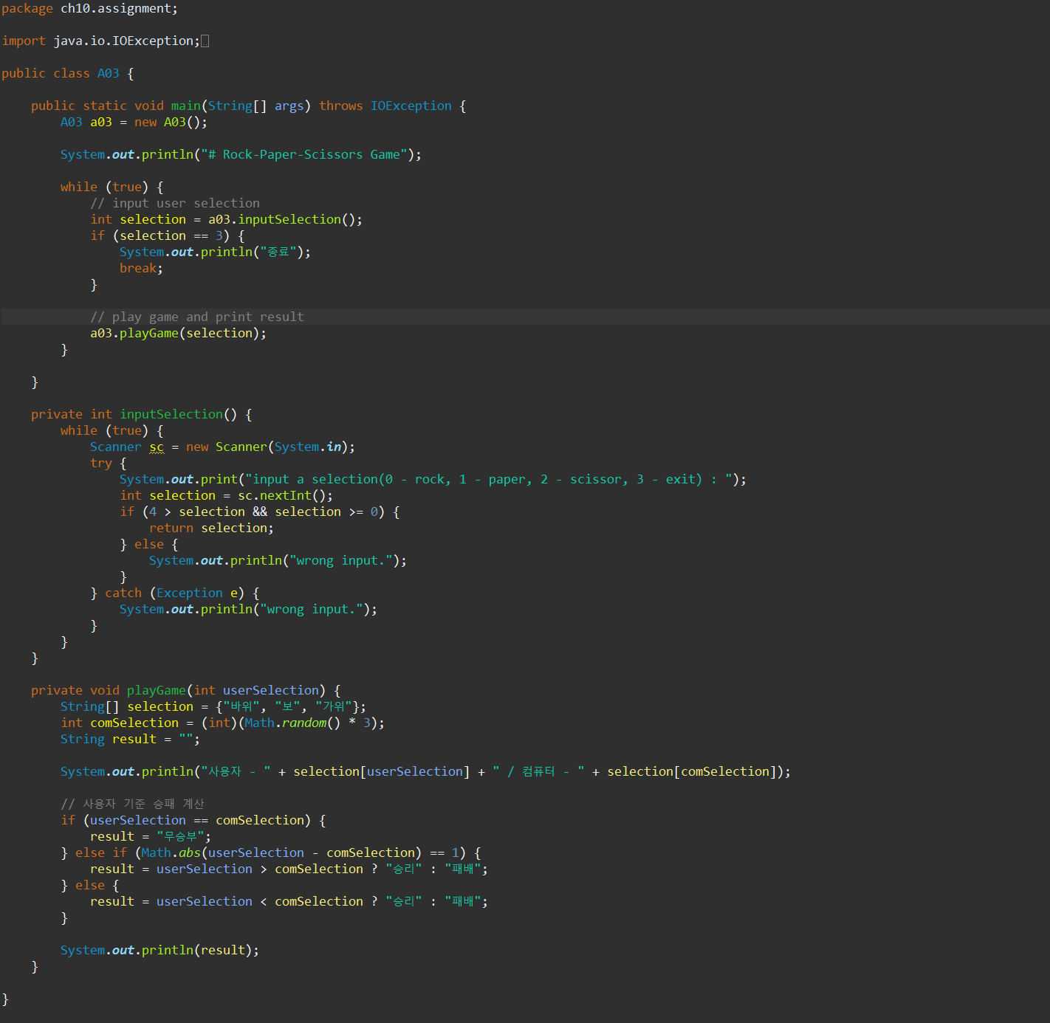
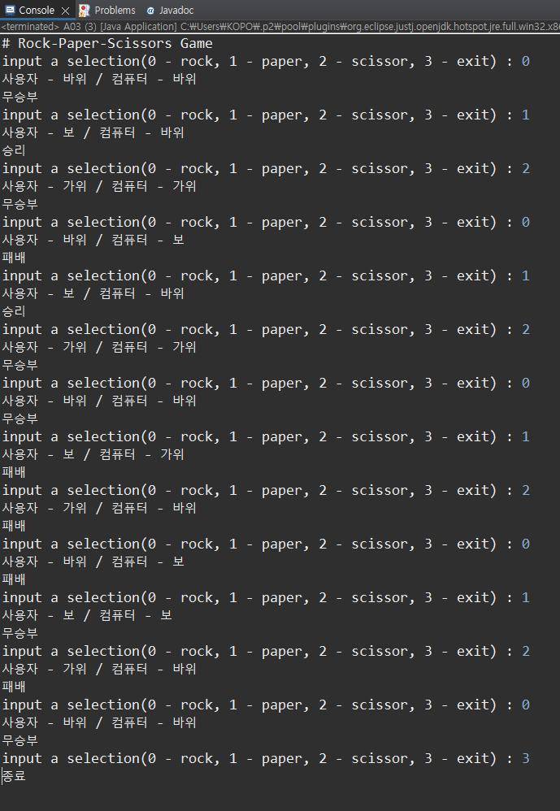

Slide 8
A4
Descriptive Statistics
Open the shared csv file
Calculate and write the mean by point/day/hour to a file

Slide 9
