Slide 1
R1
Comparing the two strings
User inputs the two strings
Show the result if those two strings are the same after relocation
[Example]
abcdefg
fgdceba
Yes
Abbbccd
Bbbccda
No
Abc
cbA
Yes

Slide 2
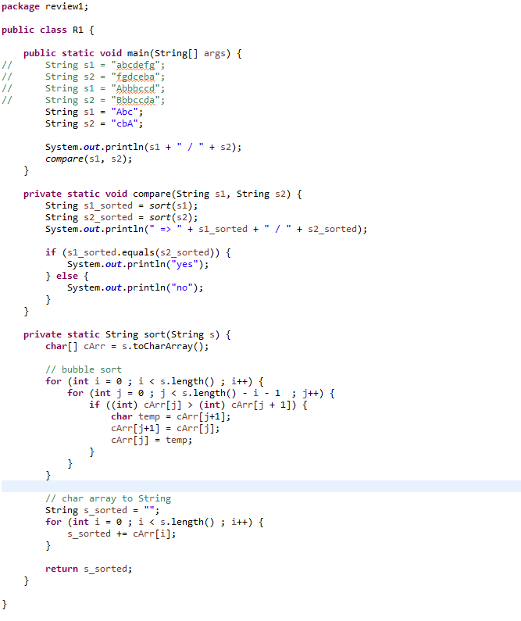




Slide 3
R2
Comparing the velocities in different units
User inputs the three values
Each is m/s, km/h, m/ms in order
Comparing the values and print the quickest one
[Example]
190
780
0.19
780km/h

Slide 4
