Slide 1
A1
Finding a Character
User inputs a string and a character
Find the character from the string and show the order of the first found(case sensitive)
[Example]
South Korea has a earned a reputation as a leading global ICT center
s
15
South Korea has a earned a reputation as a leading global ICT center
S
1

Slide 2
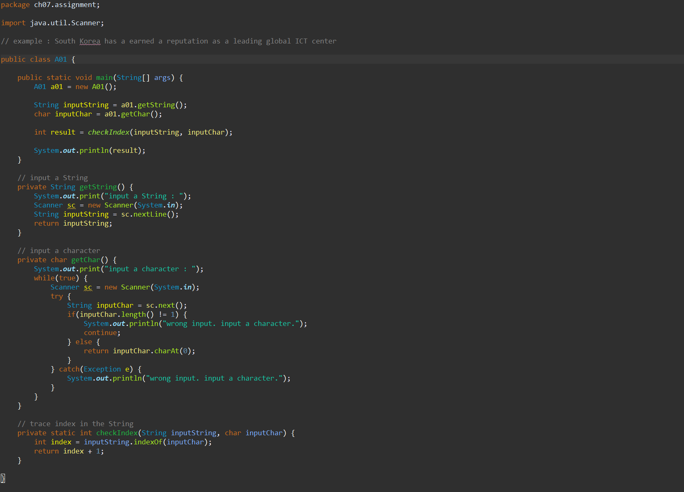
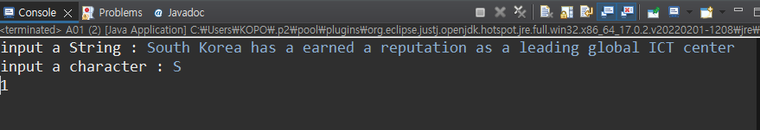
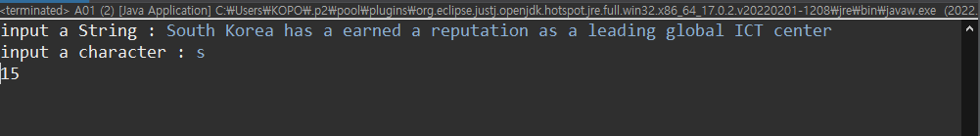

Slide 3
A2
Printing Numbers Matching the Condition
Initialize an integer array
Print the numbers with N in each digit
[Code]
int[] numbers = {123, 32, 356, 53, 2, 67, 31, 78, 41, 9, 29};
[Example]
5
356 53
2
123 32 2 29

Slide 4
