Slide 1

Lightning Talk
Tree transformation with Python

Slide 2
Nodes and trees
Node
  Base object for building trees
  Provides a dictionary like API and implements zope.interface.mapping.IFullMapping
  Knows about it's position. It implements zope.location.interfaces.ILocation
  Can be accessed flat. Nodes are accessible from each other via UID references
Every data structure can be represented as tree, i.e. XML, UML, File System, SQL, LDAP

Slide 3
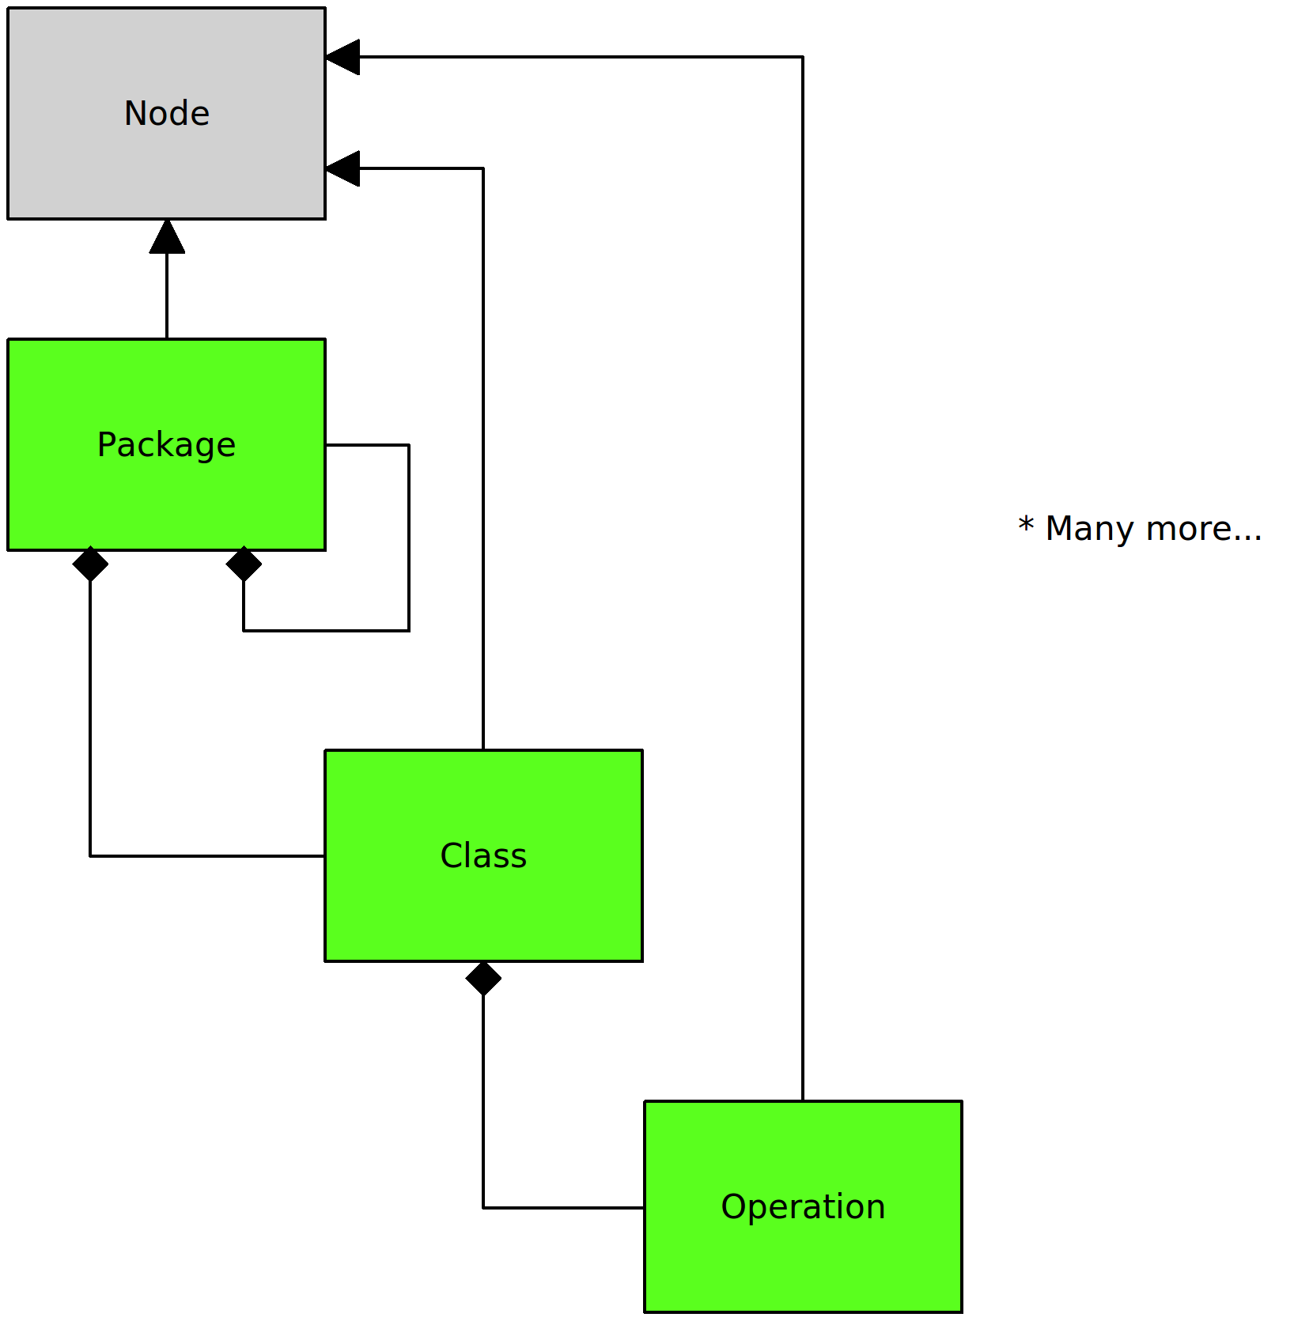
UML as node compliant tree

Slide 4
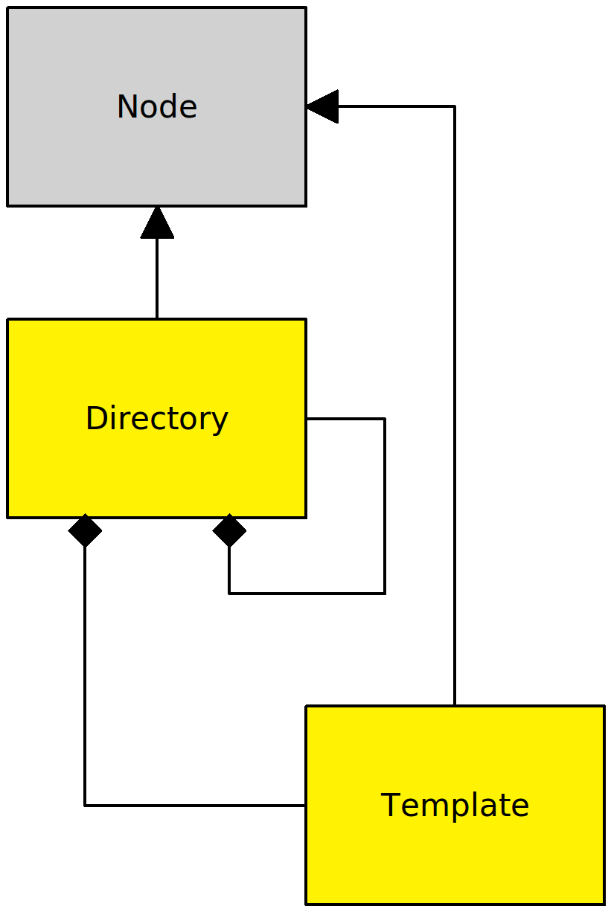
FS as node compliant tree

Slide 5
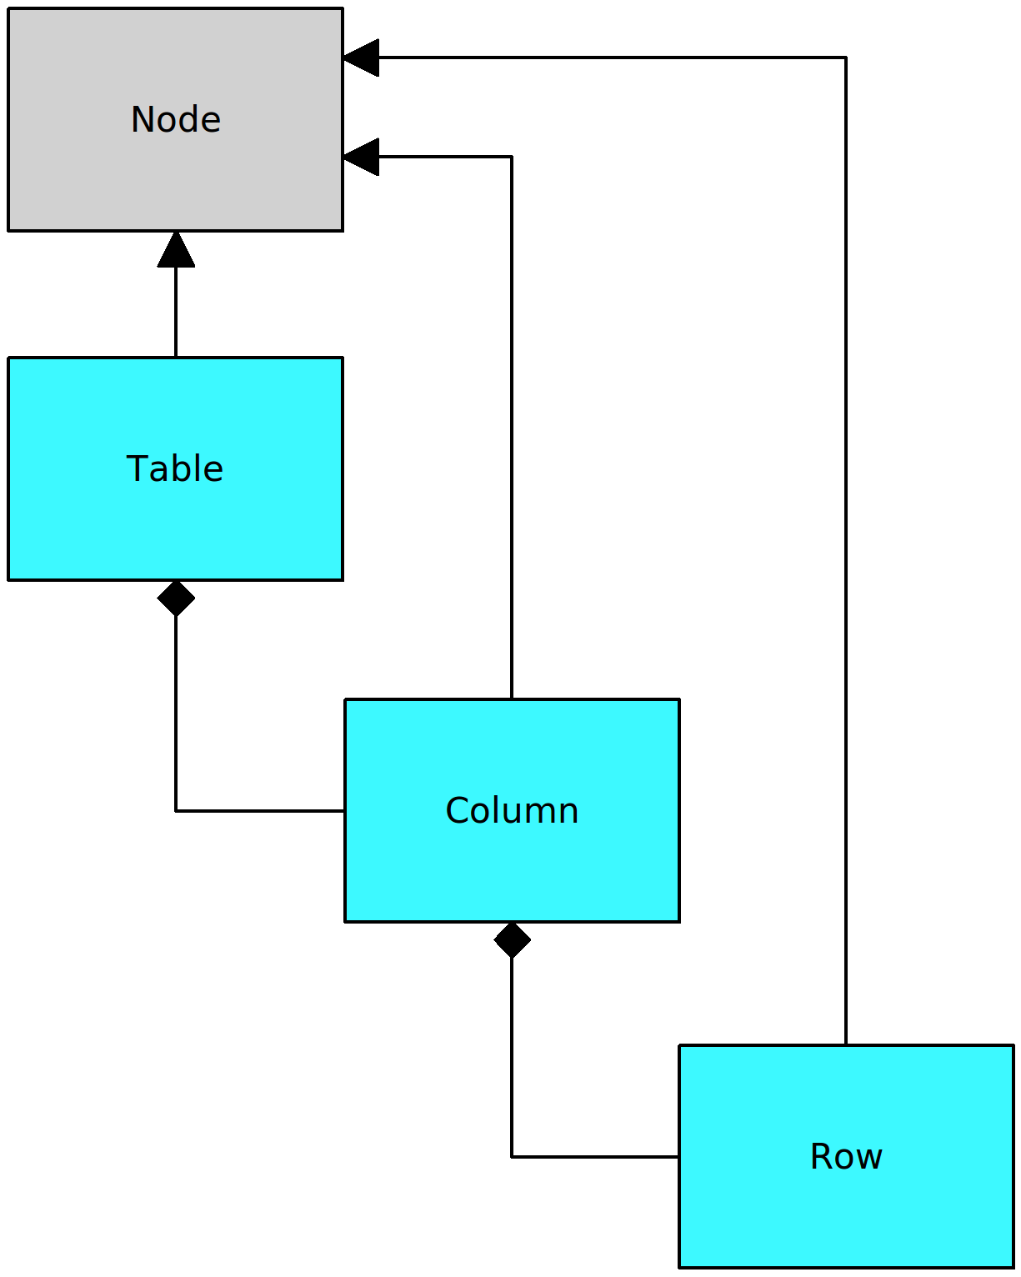
SQL as node compliant tree

Slide 6
IO System
AGX IO System
  Based on Nodes
  Follows the interfaces provided by Node
  Introduces ISource and ITarget, both derive from INode
  ITarget promises to persist or dump the tree on __call__() in any way.

Slide 7
Tree transformation chain
Iterate over all nodes of source tree and look up handlers, which are responsible for creating target nodes inside the target tree based on the information from the source node.
Transformation chain components located in agx.core
Finally target tree is called.

Slide 8
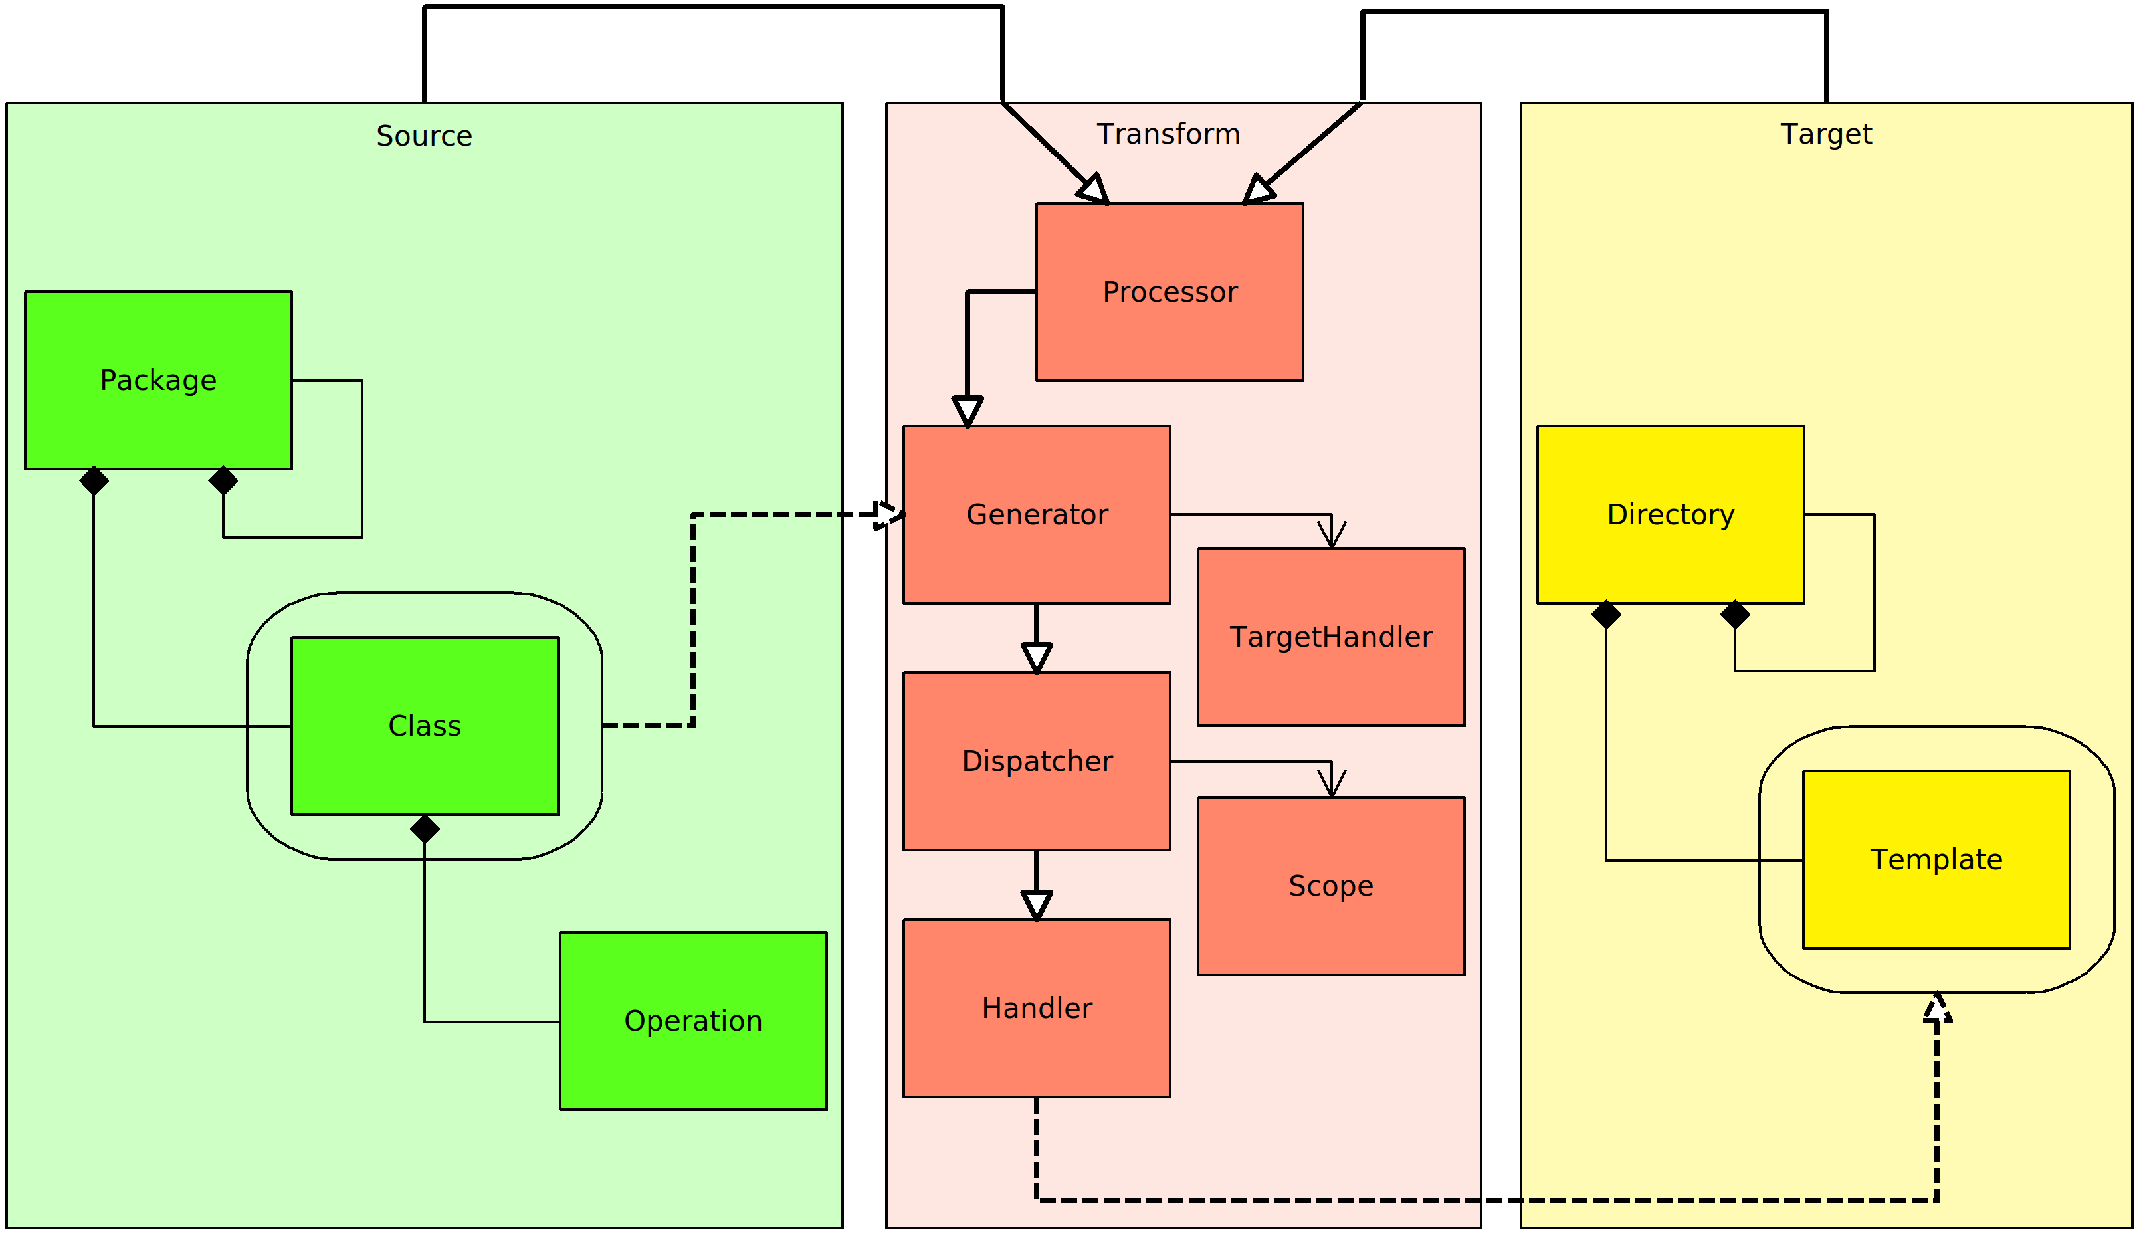
Tree transformation chain

Slide 9
Thank you!

