Slide 1
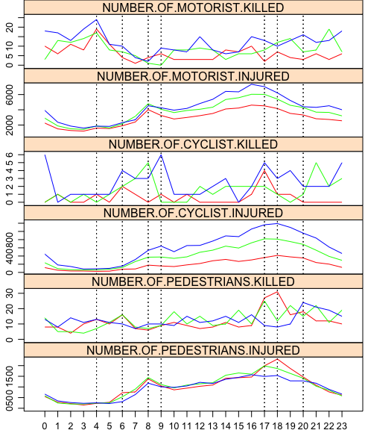
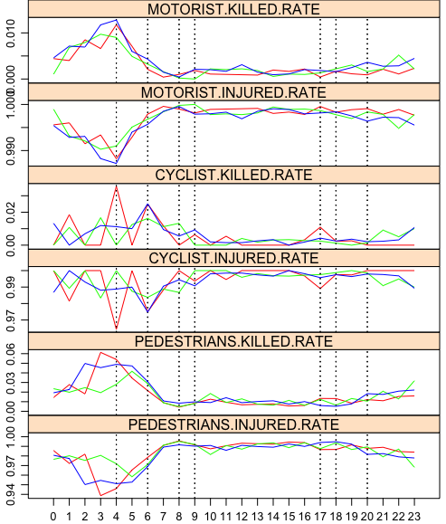
Case Study on NYPD Vehicle Collisions
rush hour
rush hour
dark hours

Slide 2
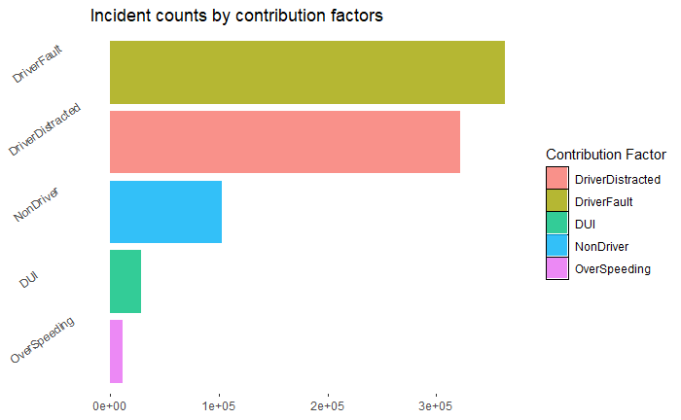
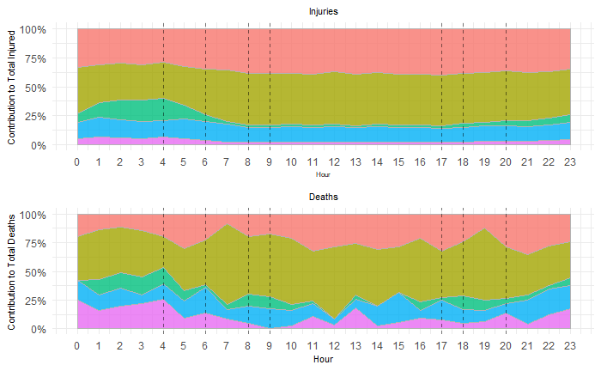
Contribution of factors to incidents and fatalities
Driver’s own Fault and Distracted due to external factors leads to most incidents and fatalities
Driver not obeying traffic rules properly contribute most in the morning and evening rush hours
DUI incidents happen in night time, being the 3rd most contributing factor to injuries
In the dark hours, over-speeding death cases are high and proper speed check posts should be installed to prevent this

