Slide 1

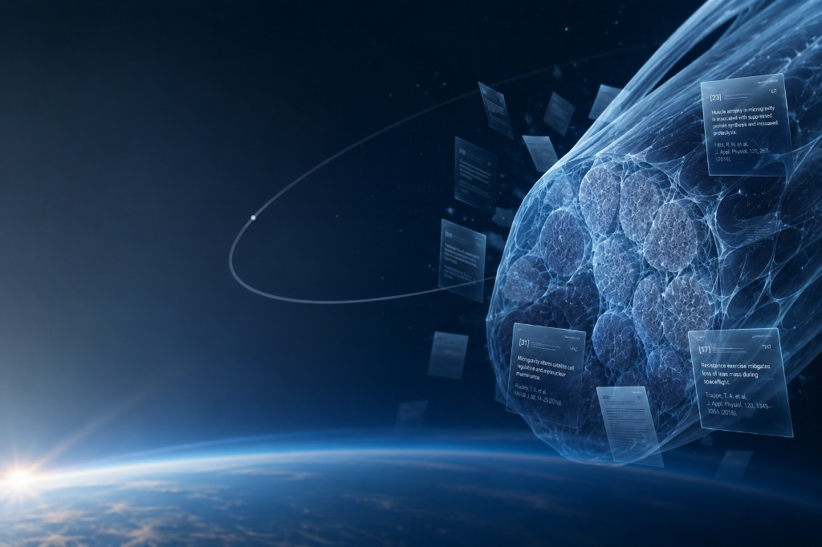
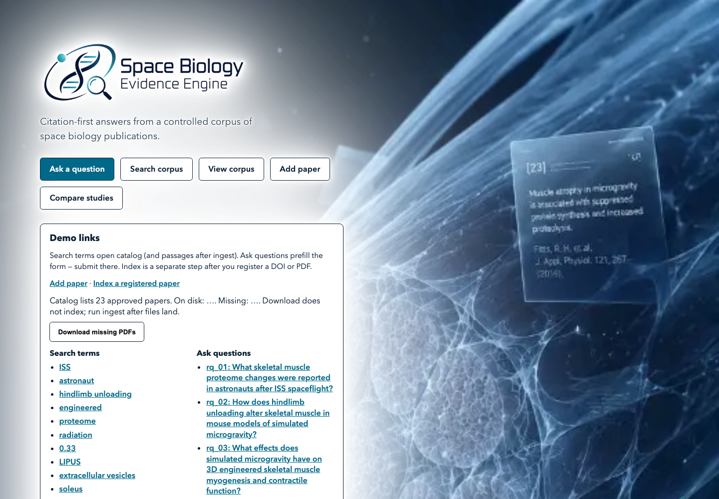
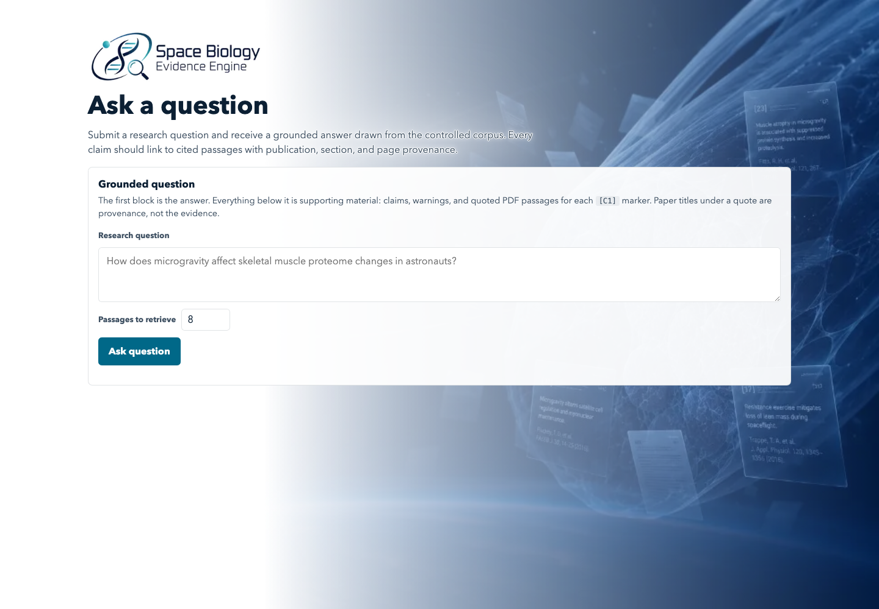
Citation-first evidence for space-biology research
Local-first RAG for 23 approved microgravity and skeletal-muscle publications.
Who it serves
Researchers, students, educators, and corpus maintainers who need inspectable evidence—not unsupported model recall.
Core capabilities
Semantic + keyword search; grounded Q&A; passage citations; provenance; evidence sufficiency; study comparison.
Current status
MVP complete and demo-ready locally. Code, CI, docs, ingestion, retrieval, Ask, citation UI, and evaluations are complete.
Demo + participation
Docker + indexed PDFs + Ollama/OpenAI support the live app; screenshots provide backup. Not participating live; required artifacts are submitted.
John Hernandez | jherna65@fau.edu | Sponsor: FAU AI HootCamp | Repository: github.com/bluefate/spacebio-evidence-engine

