Slide 1

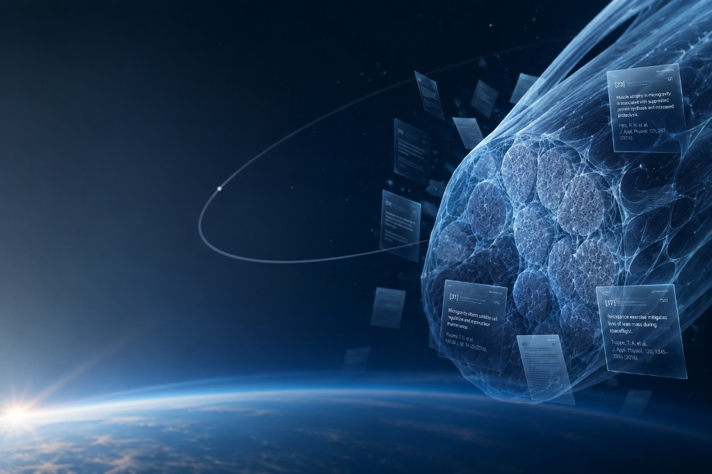
Space Biology Evidence Engine
Citation-first research synthesis from a controlled corpus
John Hernandez | jherna65@fau.edu FAU AI HootCamp | Final Project 2026
Notes:
Good [afternoon].
I’m presenting the Space Biology Evidence Engine, a citation-first research synthesis system for space biology.
The project was originally based on NASA’s
‘Space Biology Knowledge Engine’ challenge.
However,
since the competition had already closed,
it was decided to continue with a similar
concept as an independent project,
with a stronger focus
on information retrieval,
citations,
traceability,
and answering scientific questions
directly from source material.
The name ‘Space Biology Evidence Engine’
was chosen
because the word ‘Evidence’
better represents this emphasis
than the broader term ‘Knowledge.’

Slide 2
The problem
Space biology evidence is fragmented and difficult to synthesize safely
Scattered evidence
Relevant studies span publishers, organisms, experimental models, and terminology.
High trust bar
Scientific users need passage-level provenance, not unsupported model recall.
Slow comparison
Researchers repeatedly search, read, and reconcile study context by hand.
• Primary users: space-biology researchers, students, educators, and corpus maintainers
Space Biology Evidence Engine | John Hernandez | 2
Notes:
The core problem we’re solving is not access to a language model.
Researchers already have that.
The real problem is evidence discovery with scientific provenance and explicit limits.
We need to know where an answer comes from,
what study it is based on,
and when the evidence is simply not strong
enough to support a claim

Slide 3
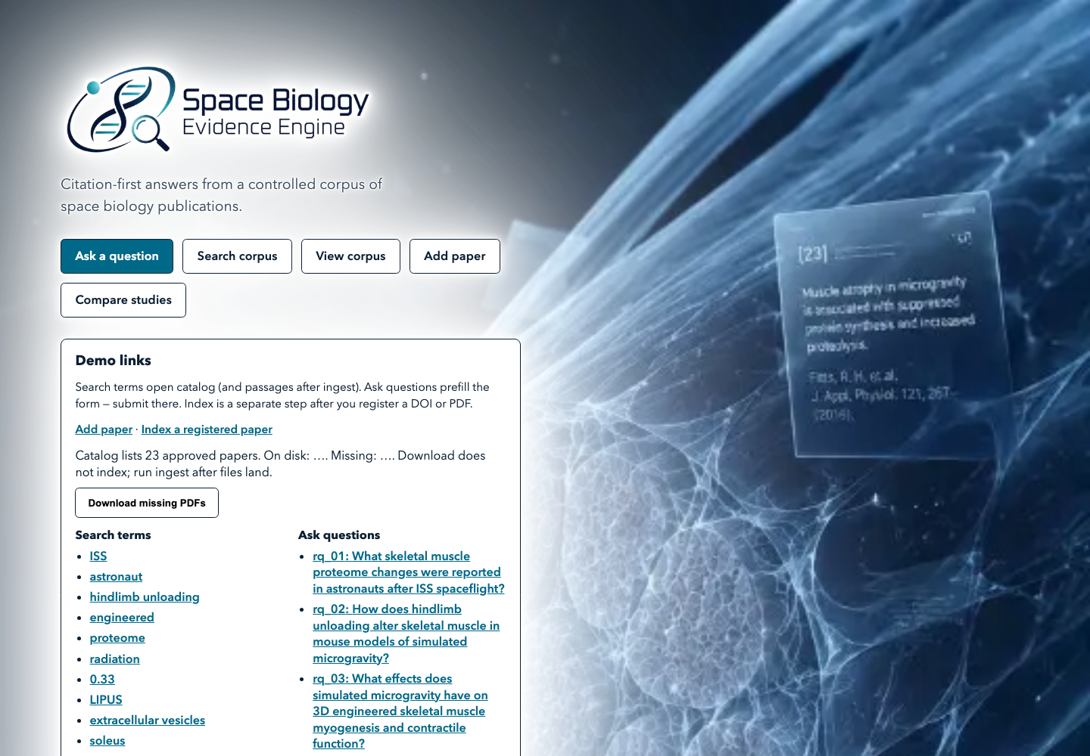
The solution
A controlled, provenance-preserving evidence engine
• 23 owner-approved open-access publications
• Semantic + keyword retrieval over indexed passages
• Grounded answers with passage-level citations
• Explicit insufficient-evidence responses
• Local-first operation with optional OpenAI or Ollama generation
Space Biology Evidence Engine | John Hernandez | 3
Notes:
Our solution is a controlled corpus and a fail-closed design.
The system only answers from an approved set of open-access publications.
If it cannot retrieve supporting passages,
it does not silently fall back to general model knowledge.
It tells the user the evidence is insufficient

Slide 4
Architecture
Retrieval and generation remain independently testable
Approved PDFs
License + quality checks
Ingest
Extract → chunk → embed
Postgres + pgvector
Metadata + vectors
Hybrid retrieval
Semantic + full-text
Grounded answer
Citation validation
• Next.js frontend
• FastAPI API
• SQLAlchemy + Alembic
• Local embeddings
• Provider-neutral LLM interface
Space Biology Evidence Engine | John Hernandez | 4
Notes:
Here is the architecture.
Data flows from approved PDFs through extraction, chunking, and embedding into PostgreSQL with p g vector.
Retrieval then selects passages,
the answer generator grounds every claim in those passages,
and the UI displays citations back to the original publication, section, and page.
The same provenance fields survive the entire pipeline

Slide 5
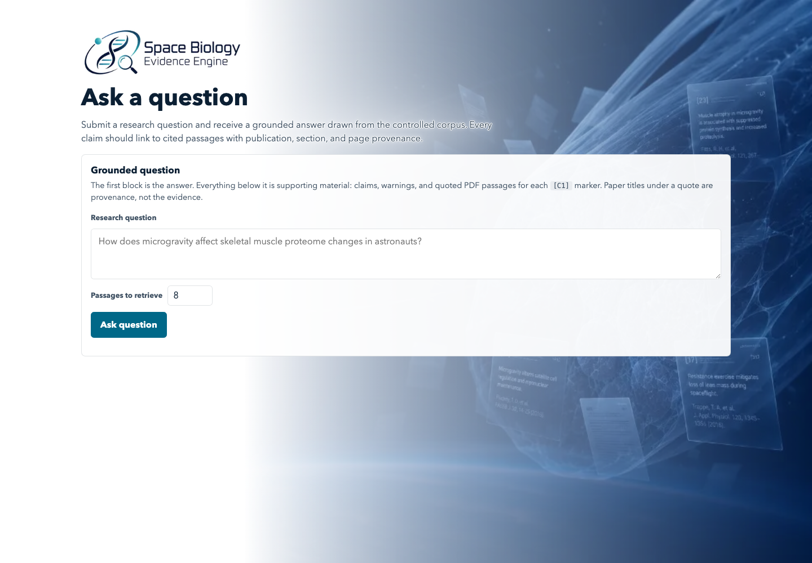
Grounded question answering
Answers are constrained to retrieved corpus passages
Evidence sufficiency
Weak or empty retrieval returns a fixed insufficient-evidence response without invoking the LLM.
Citation validation
Unknown, missing, or invented citation markers fail closed instead of becoming successful answers.
Space Biology Evidence Engine | John Hernandez | 5
Notes:
Here you can see the Ask interface.
The user asks a scientific question.
The system retrieves relevant passages and generates an answer in which every claim maps to a retrieved citation.
If no passages support a claim, that claim is rejected rather than invented

Slide 6
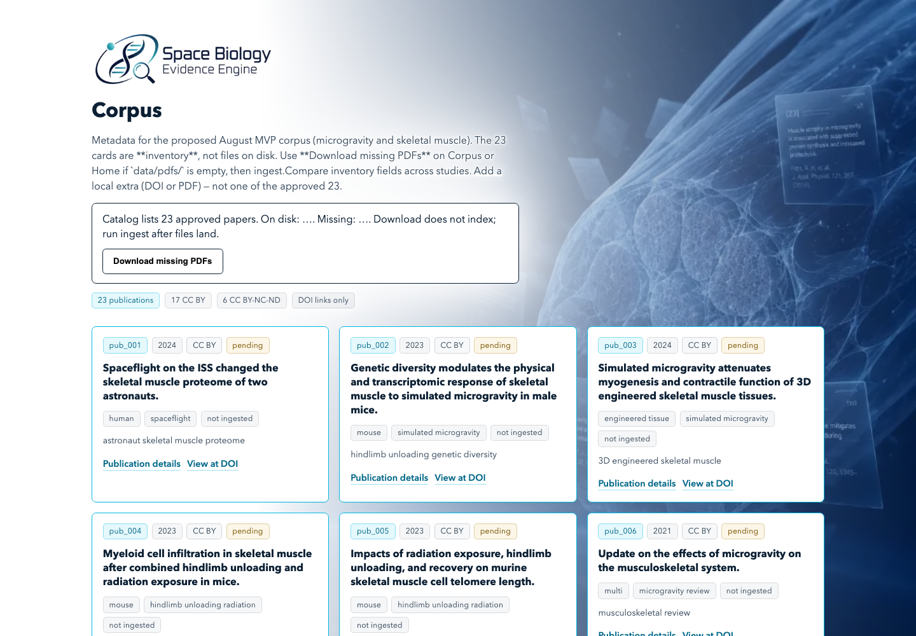
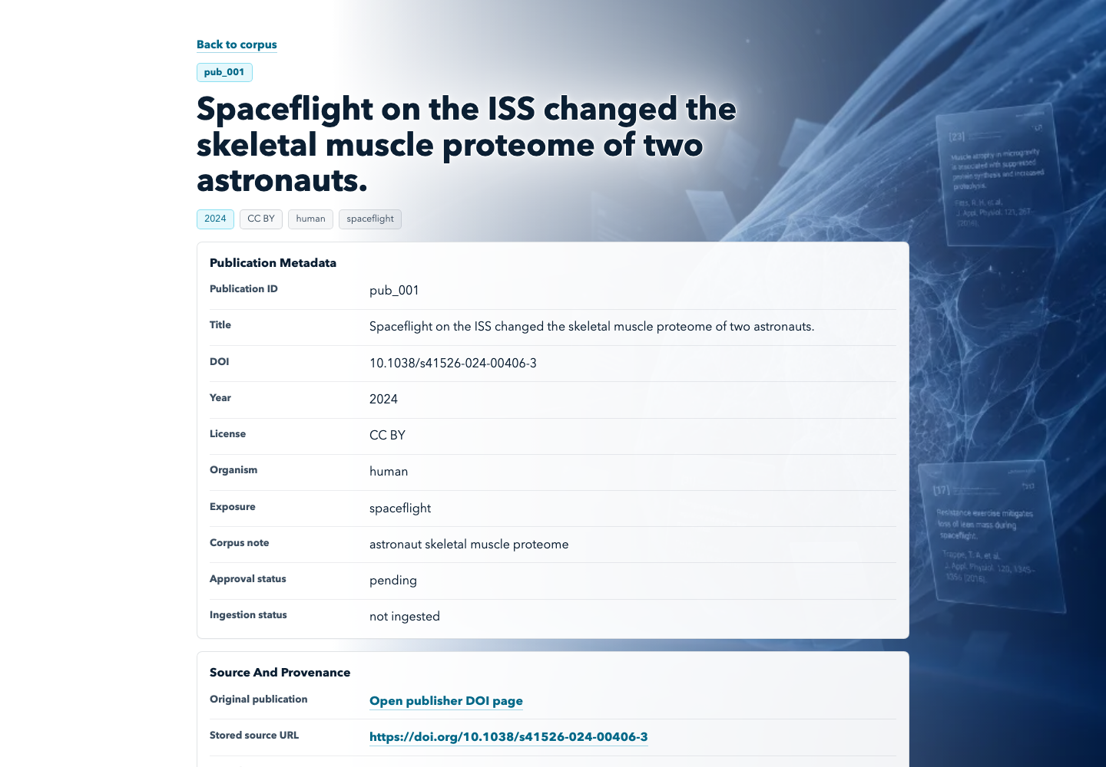
Controlled corpus and provenance
Inventory visibility makes the evidence boundary explicit
Space Biology Evidence Engine | John Hernandez | 6
Notes:
Users can inspect the approved corpus
and open individual publication metadata: title, DOI, license, organism, exposure, and ingest status.
Every answer ultimately points back to one of these sources, so provenance is always visible

Slide 7
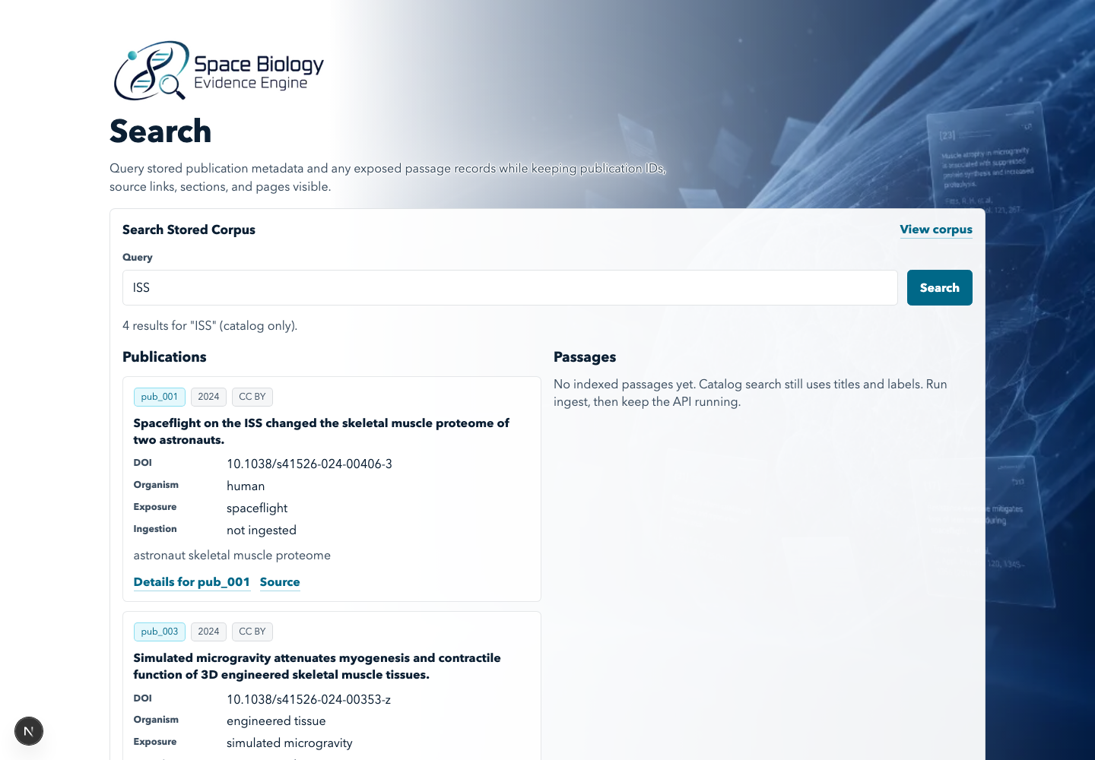
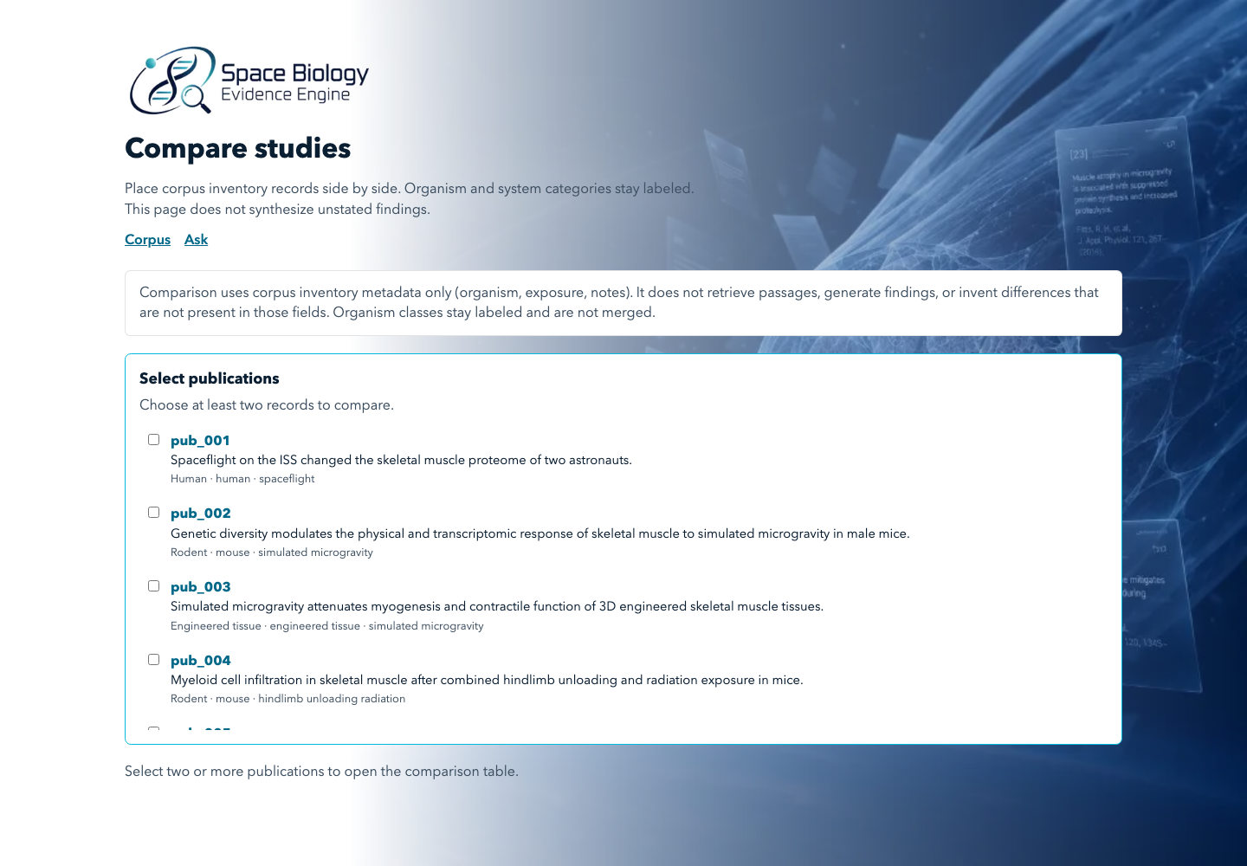
Search and study comparison
Discovery without collapsing distinct evidence types
• Search preserves IDs, source links, sections, and pages
• Compare keeps organism and experimental-system labels visible
Space Biology Evidence Engine | John Hernandez | 7
Notes:
The system supports semantic
and keyword search over indexed passages.
The compare workspace lets researchers place studies side by side.
Comparison is metadata-based and deliberately does not invent cross-study findings

Slide 8
AI capabilities and safeguards
Useful automation with explicit scientific boundaries
Local embeddings
Sentence Transformers for private, low-cost semantic retrieval.
Provider-neutral generation
OpenAI and local Ollama paths behind a shared interface.
Hybrid retrieval
Vector similarity and PostgreSQL full-text retrieval with optional reranking.
Evidence gates
Minimum passage and publication support before generation.
Citation-first output
Passage IDs and publication provenance remain inspectable.
Hallucination checks
Offline fixtures flag unsupported claims and citation mismatches.
Space Biology Evidence Engine | John Hernandez | 8
Notes:
The AI stack uses local embeddings by default, with an optional OpenAI model for generation.
The key safeguard is the distinction between retrieval and generation:
retrieval identifies evidence, and generation summarizes only what retrieval supports.
Nothing more

Slide 9
Results and engineering quality
A tested MVP with transparent limitations
23 publications
Approved controlled corpus inventory
292+ Python tests
Unit, API, retrieval, ingestion, citation, and accessibility coverage
CI quality gates
Ruff, Pyright, Python tests, Node typecheck and UI tests
• Citation correctness, hallucination, and retrieval evaluation harnesses
• No secrets committed; `.env` loading and fail-closed provider configuration
• Accessible interface patterns and keyboard-tested UI components
Space Biology Evidence Engine | John Hernandez | 9
Notes:
Engineering validation includes linting,
type checking,
unit tests,
web tests,
and a production Next.js build.
The app reports measurable engineering results
while avoiding claims of scientific accuracy
beyond the available evaluation fixtures
and human review process

Slide 10
Demo readiness and operations
Local-first setup with a documented backup path
Primary demo
Run Postgres/pgvector, ingest approved PDFs, start FastAPI + Next.js, and use Ollama or OpenAI for grounded Ask.
Backup demo
Use repository screenshots and this deck if network, model, Docker, or showcase equipment is unavailable.
• Documented clean-machine setup and troubleshooting
• PDF fetch/ingest commands and provenance-preserving index
• Static corpus browsing remains available without the model provider
Space Biology Evidence Engine | John Hernandez | 10
Notes:
This slide explains the live-demo sequence and backup plan:
the application can be started locally with Docker Compose,
plus it contains static corpus to provide fallback if any service is unavailable during review

Slide 11
Known limitations and future work
The MVP is intentionally bounded
• Local deployment only; no public production URL
• Grounded Ask requires an indexed corpus plus configured OpenAI or Ollama provider
• Scientific outputs still require human review
• Corpus focuses on microgravity and skeletal muscle
• Future: stronger retrieval benchmarks, broader curated corpus, reviewer workflow, and production deployment
• Graph extraction remains experimental; no graph database in the MVP
Space Biology Evidence Engine | John Hernandez | 11
Notes:
There are some limitations.
Local-first deployment
and a tightly controlled topics
were conscious scope decisions, not hidden gaps.
Future work includes
broader corpus expansion,
deeper evaluation,
and optional graph-native persistence
once the retrieval pipeline is fully validated

Slide 12
Trustworthy evidence, one passage at a time
A practical foundation for citation-first space-biology research
• Controlled corpus
• Grounded retrieval
• Validated citations
• Transparent limitations
John Hernandez jherna65@fau.edu GitHub: bluefate/spacebio-evidence-engine
Space Biology Evidence Engine | John Hernandez | 12
Notes:
The goal again is trustworthy evidence, one passage at a time.
Thank you for your time.

