Slide 1

Scala Programming
By, Nilesh Magar

Slide 2
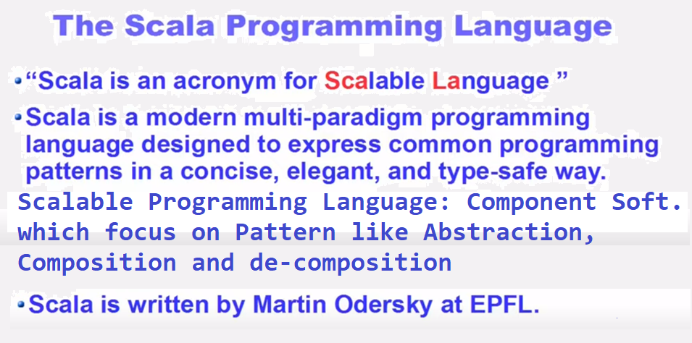
Intro:

Slide 3
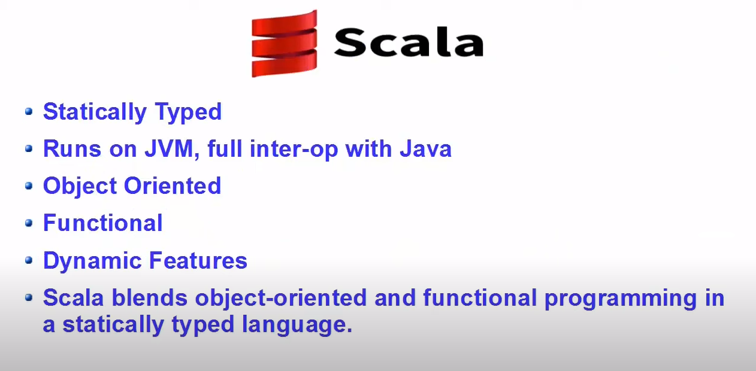

Slide 4
General-purpose programming language.
Supports Object oriented, functional and imperative programming approaches
Strong static type language.
Does not have concept of primitive data
Scala is influenced by Java, Haskell, Lisp, Pizza
File extension of scala source file: .scala or .sc.

Slide 5
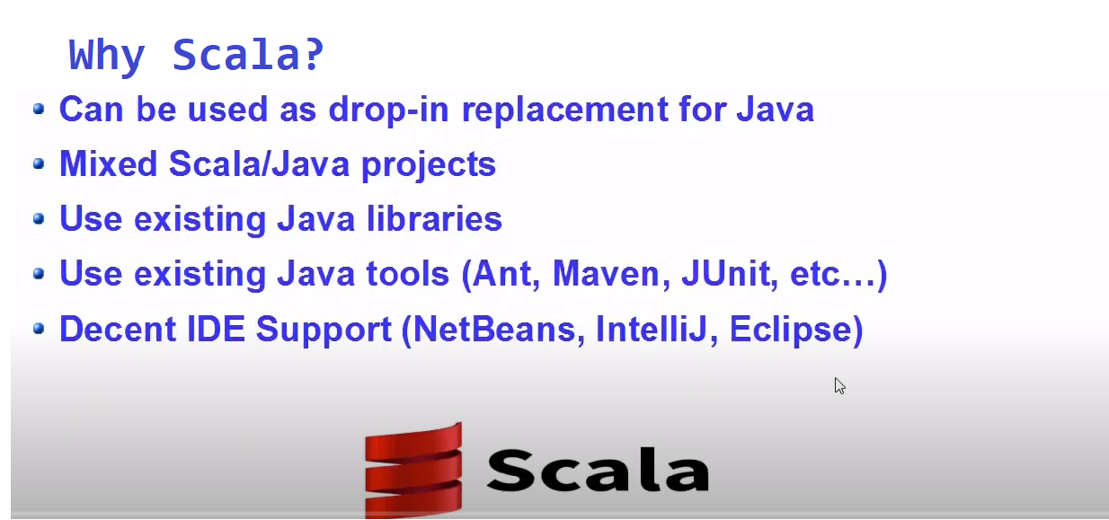

Slide 6
Scala Over other languages:
Java is platform independent but problem of boiler plate code: ex: setter, getter, JDBC etc.
Ruby: Simplicity & Productivity but static typing and compile by code is better in Scala.
Functional goodness and concurrency support like Haskel but with benefits of OOP

Slide 7
Where to use Scala
Web applications
Utilities and libraries
Parallel batch processing
Concurrency and distributed application
Data analysis with Spark
AWS lambda expression
Ad hoc scripting in REPL etc.

Slide 8
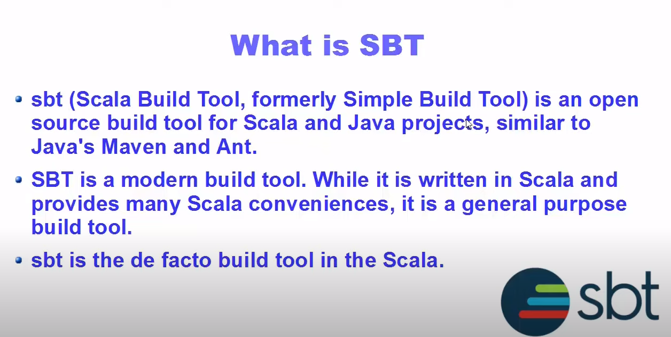

Slide 9
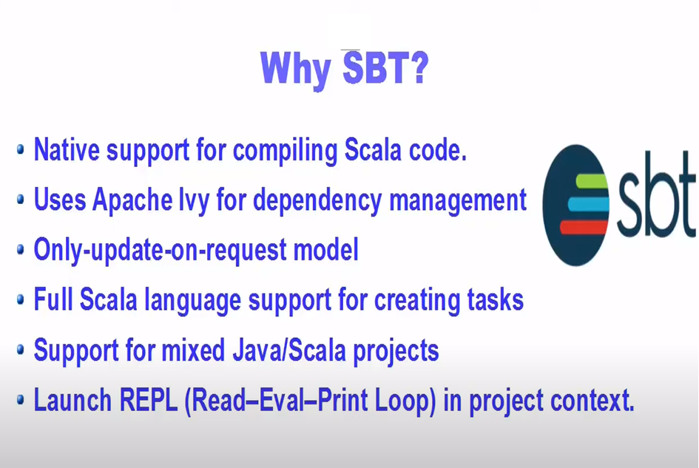

Slide 10
SBT installation
Installation of Java : set path and JAVA_HOME
Installation of Compiler:
Getting Started | Scala Documentation (scala-lang.org)
https://www.scala-sbt.org/download.html

Slide 11
Variables and data types:
Mutable Variable
var data = 100
data = 101
Or
var data:Int = 100
Immutable Variable:
val data = 100
data = 101 // Error

Slide 12
Data Types in Scala
Much similar to java in terms of their
storage,
length
Except: no concept of primitive data types :object and starts with capital letter

Slide 13
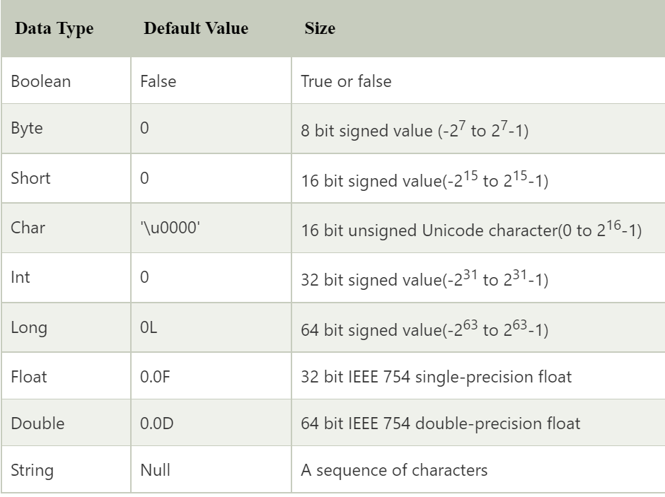
Data types in scala: Any

Slide 14
Simple Program of Scala
object ScalaExample{
def main(args:Array[String]){
println ("Hello Scala");
}
}

Slide 15
Addition of 2 no’s
object ScalaExample{
def main(args:Array[String]){
var a:Int=30;
var b:Int=20
var c=a+b;
println("Addition of a and b is ",c); }}

Slide 16
Scala Conditional Expressions
If statement
If-else statement
Nested if-else statement
If-else-if ladder statement

Slide 17
Scala if statement
if(condition){
// Statements to be executed
}
Example:
var age:Int = 20;
if(age > 18){
println ("Age is greate than 18")
}

Slide 18
Scala If-Else Statement
if(condition){
// If block statements to be executed
} else {
// Else bock statements to be executed
}
var number:Int = 21
if(number%2==0){
println("Even number")
}else{
println("Odd number")
}

Slide 19
Scala If-Else-If Ladder Statement
if (condition1){
//Code to be executed if condition1 is true
} else if (condition2){
//Code to be executed if condition2 is true
} else if (condition3){
//Code to be executed if condition3 is true
}
...
else {
//Code to be executed if all the conditions are false
}

Slide 20
Example on if else ladder
Print the grade of the student based on his marks

Slide 21
Scala – Read data from Console
To read a Data from console input, we need to import:
import scala.io.StdIn.readLine
import scala.io.StdIn.readInt(),
Import scala.io.StdIn.readFloat()

Slide 22
Example: Read Int:
import scala.io.StdIn
object ReadInt{
def main(args: Array[String]) {
print("Enter a number: ")
var hours = readInt()
hours = hours + 1
println("Your entry + 1 : "+hours)
} }

Slide 23
Scala Pattern Matching
feature of scala same as switch case in other programming languages
object MainObject {
def main(args: Array[String]) {
var a = 1
a match{
case 1 => println("One")
case 2 => println("Two")
case _ => println("No")
}
}
}

Slide 24
while loop
Used to iterate code till the specified condition
Tests boolean expression and iterates again and again
If you don't know number of iterations prior
while(boolean expression){
// Statements to be executed
}

Slide 25
Example using while
object MainObjectWhile {
def main(args: Array[String]) {
var a = 10;
while( a<=20 ){
println(a);
a = a+2
}
}
}

Slide 26
Scala do-while loop
object MainObjectdoWhile {
def main(args: Array[String]) {
var a = 10;
do {
println( a );
a = a + 2;
}
while( a <= 20 )
}
}

Slide 27
Scala for loop
for( i <- range){
// statements to be executed
}
range is a value which has start and end point
You can pass range by using to or until keyword
object MainObject {
def main(args: Array[String]) {
for( a <- 1 to 10 ){
println(a);
}
}
}

Slide 28
For loop using until keyword
object MainObject {
def main(args: Array[String]) {
for( a <- 1 until 10 ){
println(a);
}
}
}

Slide 29
Scala for-loop filtering
object MainObject {
def main(args: Array[String]) {
for( a <- 1 to 10 if a%2==0 ){
println(a);
}
}
}

Slide 30
For loop using yield keyword
we can use yield keyword which returns a result after completing of loop iterations:
object MainObject {
def main(args: Array[String]) {
var result = for( a <- 1 to 10) yield a
for(i<-result){
println(i)
}
}
}

Slide 31
for-loop on Collection
object MainObject {
def main(args: Array[String]) {
var list = List(1,2,3,4,5,6,7,8,9)
for( i <- list){
println(i)
}
}
}

Slide 32
for-each loop for Iterating on Collection
object MainObject {
def main(args: Array[String]) {
var list = List(1,2,3,4,5,6,7,8,9)
list.foreach{
println
}
list.foreach(print)
println
list.foreach((element:Int)=>print(element+" ")) }
}

Slide 33
Scala for-loop using by keyword
by keyword is used to skip the iteration
object MainObjectusingBy {
def main(args: Array[String]) {
for(i<-1 to 10 by 2){
println(i)
}
}
}

Slide 34
Break Statement in scala
used to break a loop or program execution
It skips the current execution
Inside inner loop it breaks the execution of inner loop
import scala.util.control.Breaks._
object BreakExample {
def main(args: Array[String]) {
breakable{
for(i<-1 to 10 by 2){
if(i==7)
break
else
println(i)
} } } }

Slide 35
Different ways to use import statements
Importing all public members of package
import college._
Imports only selected members of a package
import ollege.{faculty, houseKeeping}
Imports and rename the members.import
college.{student => stu}

Slide 36
Scala Comments
In scala, there are three types of comments
Single line comment: //
Multiline comment: /* statements*/
Documentation comment:
/**
*Author name:
*Date of development
*/

Slide 37
Functions in scala
It provides rich set of built-in functions
We can create function by using def keyword
Data type of parameters is must while function return is optional
If you don't specify return type of a function, default return type is Unit
def functionName(parameters : typeofparameters) : returntypeoffunction = {
// statements to be executed
}
We can create function with or without = (equal) operator

Slide 38
Function without using = Operator
object MainObject {
def main(args: Array[String]) {
functionExample()
}
def functionExample() {
println("This is a simple function")
}
}

Slide 39
Function with = operator
object MainObject {
def main(args: Array[String]) {
var result = functionExample()
println(result)
}
def functionExample() = {
var a = 10
a
}}
Scala functions don’t use return statement
Return type infers by compiler from the last expression or statement present in the function

Slide 40
Scala Parameterized Function
object MainObject {
def main(args: Array[String]) = {
functionExample(10,20)
}
def functionExample(a:Int, b:Int) = {
var c = a+b
println(c)
}
}

Slide 41
Recursion Function
Multiplying two numbers by using recursive function
object MainObject {
def main(args: Array[String]) = {
var result = functionExample(15,2)
println(result)
}
def functionExample(a:Int, b:Int):Int = {
if(b == 0)
0
else
a+functionExample(a,b-1)
}
}

Slide 42
Function Parameter example with default value
object MainObject {
def main(args: Array[String]) = {
var result1 = functionExample(15,2)
var result2 = functionExample(15)
var result3 = functionExample()
println(result1+"\n"+result2+"\n"+result3)
}
def functionExample(a:Int = 0, b:Int = 0):Int = {
a+b
}
}

Slide 43
Function Named Parameter
object MainObject {
def main(args: Array[String]) = {
var result1 = functionExample(a = 15, b = 2)
var result2 = functionExample(b = 15, a = 2)
var result3 = functionExample(15,2)
println(result1+"\n"+result2+"\n"+result3)
}
def functionExample(a:Int, b:Int):Int = {
a+b
}
}

Slide 44
Scala Array
Array is a collection of mutable values
It is an index based data structure which starts from 0 index to n-1
Scala arrays can be generic, means, you can have an Array[T], where T is a type parameter or abstract type
Scala Types of array
Single dimensional array
Multidimensional array

Slide 45
Scala Single Dimensional Array
Store elements in linear order
elements are stored in contiguous memory space
Index based operations
Syntax
var arrayName : Array[arrayType] = new Array[arrayType](arraySize); or
var arrayName = new Array[arrayType](arraySize) or
var arrayName : Array[arrayType] = new Array(arraySize); or
var arrayName = Array(element1, element2 ... elementN)

Slide 46
Singel domensional array example:
object SingleDiemnsionalArray1{
def main(args:Array[String]){
var arr = Array(1,2,3,4,5)
for(a<-arr)
println(a)
println("Third Element = "+ arr(2))
}
}

Slide 47
Singel domensional array example:
object SingleDiemnsionalArray1{
def main(args:Array[String]){
var arr = new Array[Int](5)
arr(0)=10
println("Third Element = "+ arr(0))
}
}

Slide 48
Scala Passing Array into Function
object ArrayToFunction{
def show(arr:Array[Int]){
for(a<-arr)
println(a)
println("Third Element = "+ arr(2))
}
def main(args:Array[String]){
var arr = Array(1,2,3,4,5,6)
var a = new ArrayExample()
a.show(arr)
}
}

Slide 49
Iterating By using Foreach Loop

Slide 50
object MainObject{
def main(args:Array[String]){
var arr = Array(1,2,3,4,5)
arr.foreach((element:Int)=>println(element))
}
}

Slide 51
Concatenation of the array
import Array._
object Concat{
def main(args: Array[String])
{
var arr1 = Array(1, 2, 3, 4)
var arr2 = Array(5, 6, 7, 8)
var arr3 = concat( arr1, arr2)
for ( x <- arr3 )
{
println( x )
}
}}

Slide 52
Create Array with Range
import Array._
object RangeArray{
def main(args: Array[String]) {
var myList1 = range(10, 20, 2)
var myList2 = range(10,20)
for ( x <- myList1 ) {
print( " " + x )
}
println()
for ( x <- myList2 ) {
print( " " + x )
}
}
}

Slide 53
Scala Multidimensional Array
It is an array which store data in matrix form
var arrayName = Array.ofDim[ArrayType](NoOfRows,NoOfColumns) or
var arrayName = Array(Array(element...), Array(element...), ...)

Slide 54
Scala Multidimensional Array Example by using ofDim
object MulArrayDim{
def main(args:Array[String]){
var arr = Array.ofDim[Int](2,2)
arr(0)(0) = 15
for(i<-0 to 1){
for(j<-0 to 1){
print(" "+arr(i)(j))
} }
}
}

Slide 55
Scala Multidimensional Array by using Array of Array
object ArrayOfArray{
def main(args:Array[String]){
var arr = Array(Array(1,2,3,4,5), Array(6,7,8,9,10))
arr(0)(0) = 15
for(i<-0 to 1){
for(j<-0 to 1){
print(" "+arr(i)(j))
}
println
}
}
}

Slide 56
Concatenation of Multi dimensional array

Slide 57
String in scala
sequence of characters
It is index based data structure and use linear approach to store data into memory
String is immutable in scala
var greeting = "Hello world!";
or
var greeting:String = "Hello world!";

Slide 58
String Length
object StringLength{
def main(args: Array[String]) {
var palindrome = "Dot saw I was Tod";
var len = palindrome.length();
println( "String Length is : " + len );
}
}

Slide 59
Concatenating Strings
string1.concat(string2);
"My name is ".concat("Zara");
"Hello," + " world" + "!"

Slide 60
String functions
char charAt(int index)
int compareTo(Object o) (Contents are checked)
int compareToIgnoreCase(String str)//
String concat(String str)
boolean equals(Object anObject)(Contents are checked)
==

Slide 61
Palindrome String
object Palindrome {
def palindrome(x: String): String=
{
var rev: String=""
if(x.toString.length> 1)
{
rev=x.toString.reverse }
else if(x.length > 1)
{
rev=x.reverse }
if (rev==x) return ("Value is a palindrome")
else return ("Value is not a palindrome")
}
def main(args: Array[String]): Unit = {
println(palindrome("MADAM1".toString))
}}

Slide 62
Scala - Classes & Objects
A class is a blueprint for objects
Once you define a class, you can create objects from the class blueprint with the keyword new.
Through the object you can use all functionalities of the defined class.

Slide 63
Classes and object in scala
class Student{
var id:Int = 101;
var name:String = "Nilesh";
}
object ScalaClass{
def main(args:Array[String]){
var s = new Student()
println(s.id+" "+s.name);
} }

Slide 64
Class and Method:
class Student1{
var id:Int = 101;
var name:String = "Nilesh";
def show(){
println(id+" "+name);
}
}
object ScalaClass1{
def main(args:Array[String]){
var s = new Student1()
s.show(); }}

Slide 65
Scala Constructor
In scala, constructor is not special method
Scala provides primary and any number of auxiliary constructors
Scala Primary Constructor:
concept of primary constructor with the definition of class.
You don't need to define explicitly constructor if your code has only one constructor.
It helps to optimize code.
You can create primary constructor with zero or more parameters.

Slide 66
Primary constructor
class Studentc(id1:Int,age1:Int) {
var id:Int=id1
var age:Int=age1
def showStudentData() {
println ("Id of the Employee is: " + id);
println ("Age of the Employee is : " + age);
}}
object StudentDemoPrimaryConstr {
def main(args: Array[String]) {
val e1 = new Studentc(104,24);
val e2 = new Studentc(105,25);
e1.showStudentData();
e2.showStudentData();
}}

Slide 67
Scala Secondary (auxiliary) Constructor
You can create any number of auxiliary constructors in a class
You must call primary constructor from inside the auxiliary constructor
“this” keyword is used to call constructor from other constructor
When calling other constructor make it first line in your constructor

Slide 68
Scala Secondary (auxiliary) Constructor
class Studentax(id:Int, name:String){
var age:Int = 0
def showDetails(){
println(id+" "+name+" "+age)
}
def this(id:Int, name:String,age:Int){
this(id,name)
this.age = age
} }
object AuxilaryConstr{
def main(args:Array[String]){
var s = new Studentax(101,"Nilesh",20);
s.showDetails()
}}

Slide 69
Constructor Overloading
class Studentov(id:Int){
def this(id:Int, name:String)={
this(id)
println(id+" "+name)
}
println(id)
}
object ContructorOverloading{
def main(args:Array[String]){
new Studentov(101)
new Studentov(100,"India")
}
}

