Slide 1
LAB Ⅱ LECTURE 03
Developing with Git
Seoul National University
Graphics & Media Lab
Donghoon Han

Slide 2
Lab Objectives
Introduction
Setting up Git / Git Basics
Basic Branching / Merging

Slide 3
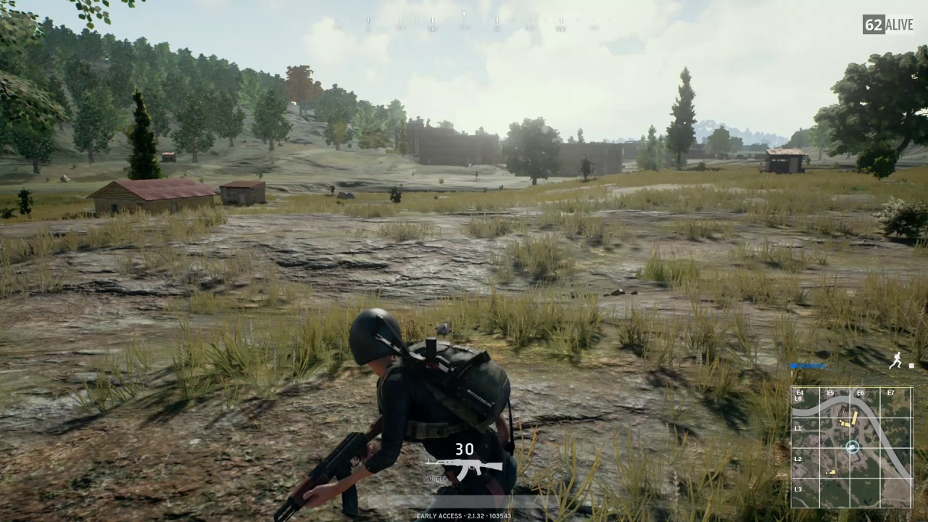
Consider a Game Development Company
Graphics
Map Management
Resource Control
User Interaction
Simulation

Slide 4
Process of Development
While (1) everyone does {
Create;
Edit;
Save;
}
Final Goal
Obtain well-cleaned source files without any conflicts to other source files.
Draw Model
Shader Effect
Shadow
Texturing
Bug Fix

Slide 5
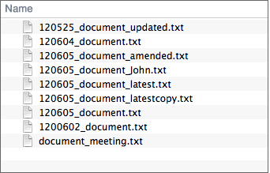
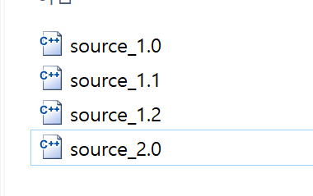
Why Version Control?
May need to return to a previous version
You may decide to “restart”.
The simplest way : making copies
Can result in too many copies : 100 revisions means 100+ copies??
Hard to distinguish between versions
It may be much worse in a team development
Image courtesy of https://backlog.com/git-tutorial

Slide 6
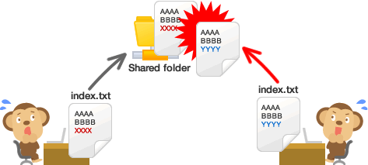
Conflicts can occur when working in teams
Image courtesy of https://backlog.com/git-tutorial

Slide 7
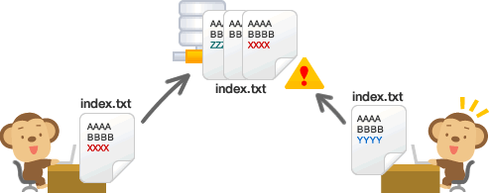
VCS Supports Team Working
Image courtesy of https://backlog.com/git-tutorial

Slide 8
What is Version Control System?
A system that records changes to the files over time
Developer can restore specific versions at any time
VCS
Version 5
Version 4
Version 3
Version 2
Version 1
Image courtesy of https://backlog.com/git-tutorial

Slide 9

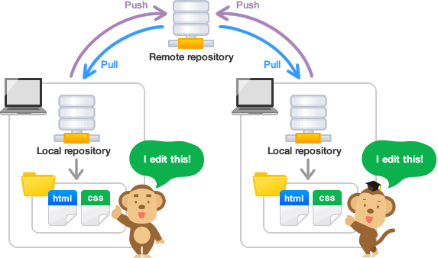
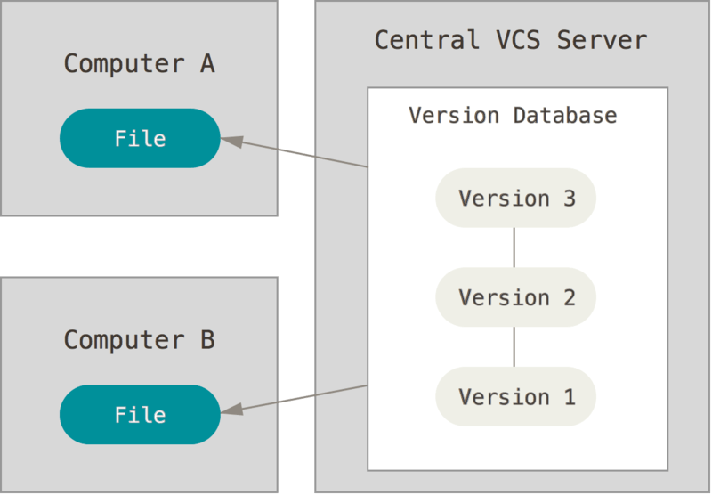
What is Git?
A distributed version control system (DVCS)
In traditional VCS (CVS, SVN, …), a single server contains all the versioned files, and a number of clients that check out files from the server.
In Git, clients fully mirror the repository, including its full history in the “local repository”
Image courtesy of https://git-scm.com/book and https://backlog.com/git-tutorial

Slide 10
Why Git?
Git’s distributed structure has many advantages
Developments could be continued even if the server (remote repository) went down
Each developer can create their own specific revisions and could be merged later
In addition, developer can work with more than 2 repositories (useful in collaborating with different groups of people in different ways simultaneously within the same project – very common in open-source projects)
Many open-source projects use Git, can be easily found in GitHub (https://www.github.com).

Slide 11
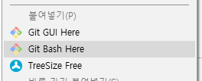
Setting up Git
Windows, macOS : download from https://git-scm.com/downloads
Linux : install from the package manager
sudo apt-get install git (Debian, Ubuntu, etc)
sudo dnf install git (Fedora, RHEL, etc)
Invoking Git commands
Linux, macOS : via console
Windows : open a colsole for Git
Right click on the folder -> Click ‘Git Bash Here’
Basic setup (user name and e-mail)
git config --global user.name “Your Name“
git config --global user.email yourmail@example.com

Slide 12

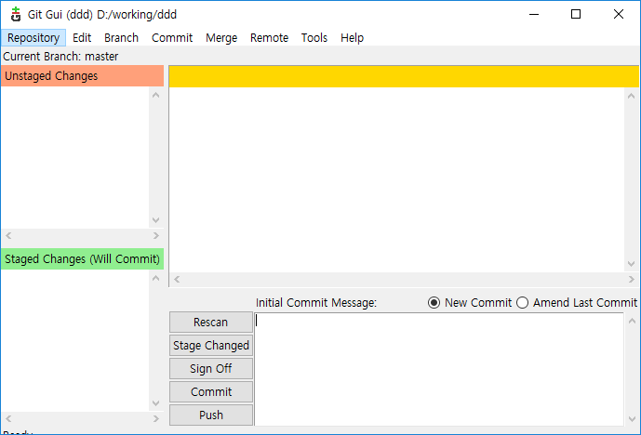
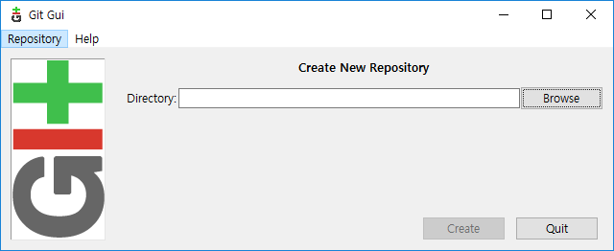
Git Basics : Creating a Git Repository
To make current working directory as a Git repository
Using Git CLI
Open a console and locate the directory using cd command
Type git init
Using Git GUI
Locate the directory and right-click -> “Git GUI here”
Select “Create New Repository”

Slide 13
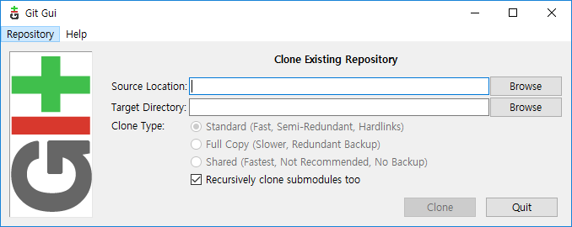
Git Basics : Cloning a Git Repository
Or you can clone existing Git repository into your workspace
Using Git GUI
Select “Clone Existing Repository”
Using Git CLI
Type git clone <URL to a Git repository>
Or type git clone <URL to a Git repository> <target directory> to clone into another directory

Slide 14
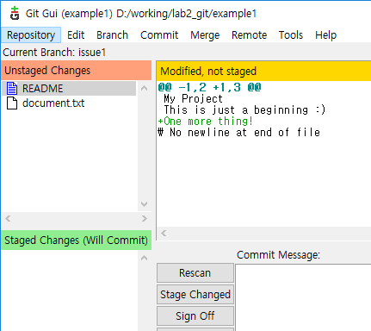
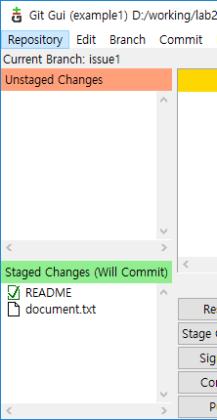
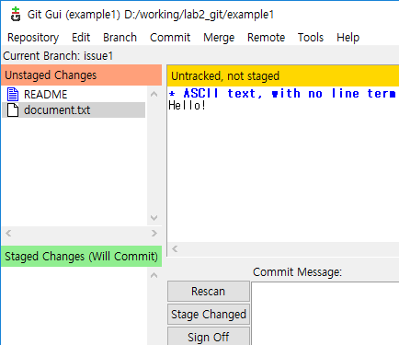
Git Basics : Making changes in Git repository
New or modified files are noticed in GUI, as ‘Unstaged Changes’
If changes are not shown, click ‘Rescan’
Those changes can be added to Git by clicking ‘Stage Changed’

Slide 15
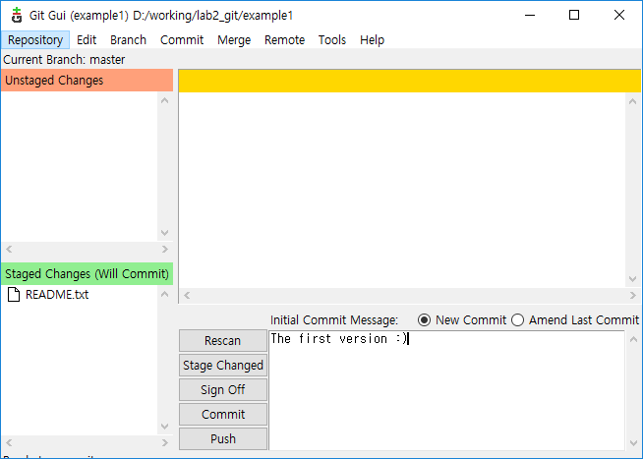
Git Basics : Making changes in Git repository
To make a version from staged changes, type a message and click ‘Commit’

Slide 16
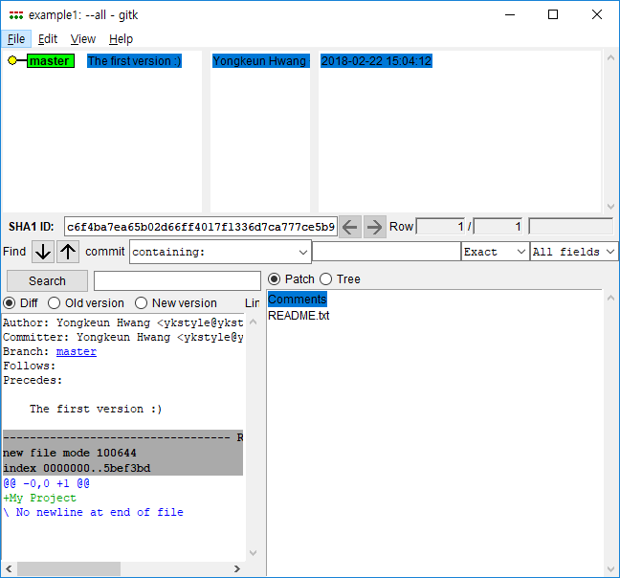
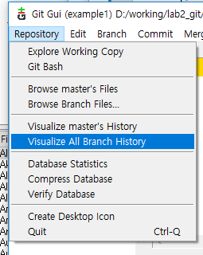
Git Basics : Making changes in Git repository
Version history can be viewed in ‘Visualize All Branch History’

Slide 17
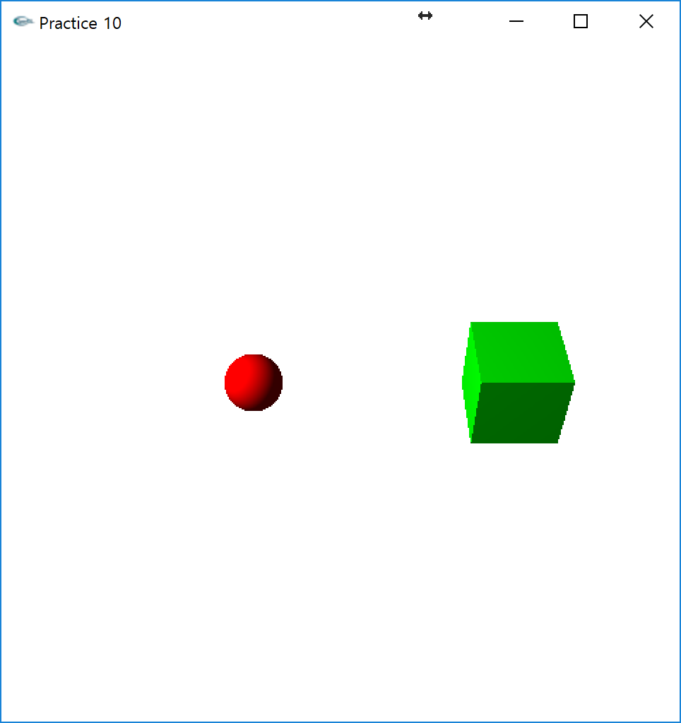
Mission #1
Create a project using given source file and initialize as a Git repository
Add all files to Git, and commit with message ‘init’

Slide 18
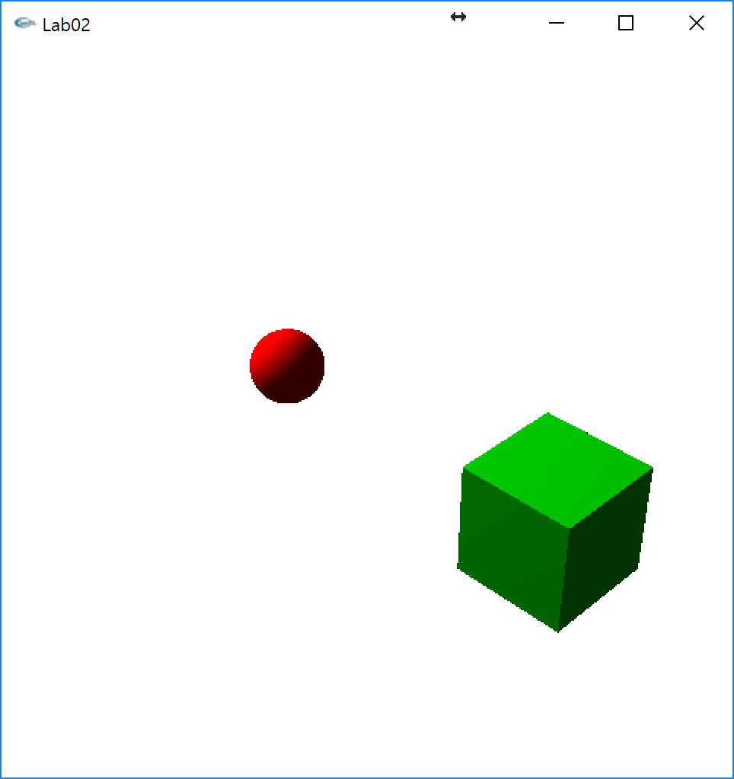
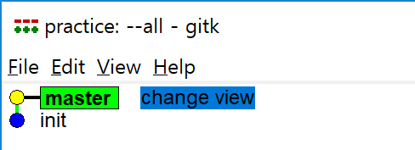
Mission #1 (cont.)
Modify the main.cpp file, stage the file and commit the change again with message ‘view change’
gluPerspective(30.0f, 1.0f, 0.1f, 100.0f);
gluLookAt(10.0f, 10.0f, 10.0f, 0.0f, 0.0f, 0.0f, 0.0f, 1.0f, 0.0f);

Slide 19
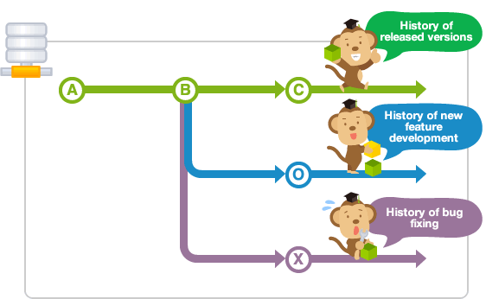
Basic Branching and Merging
What is branching?
In a collaborative environment, it is common for several developers to share and work on the same source code
Some developers will be fixing bugs while others would be implementing new features
Therefore, there has got to be a manageable way to maintain different versions of the same code base
Image courtesy of https://backlog.com/git-tutorial
Notes:
Can be done in various branches

Slide 20
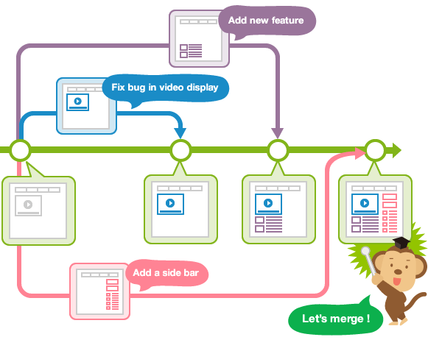
Basic Branching and Merging
What is branching?
Branch is essentially an independent line of development.
It helps to isolate your work from that of other team members
Different branches can be merged into any one branch provided that they belong to the same repository
Image courtesy of https://backlog.com/git-tutorial
Notes:
Branching – making branches freely

Slide 21
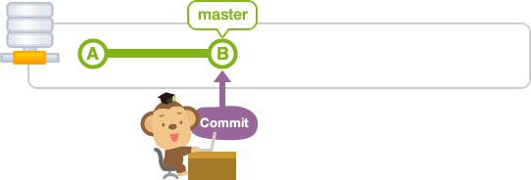
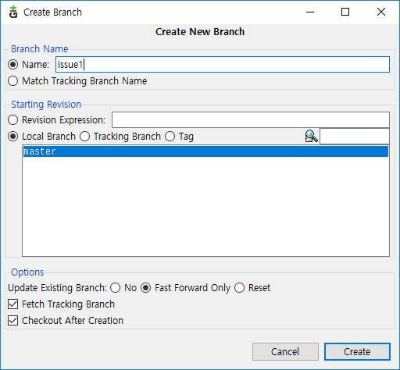
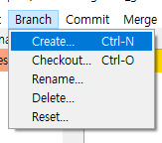
Basic Branching and Merging
Branching in Git
Every Git repository has the
‘master’ branch by default
Additional branches can be created
anytime using ‘Branch->Create’ menu
Image courtesy of https://backlog.com/git-tutorial

Slide 22
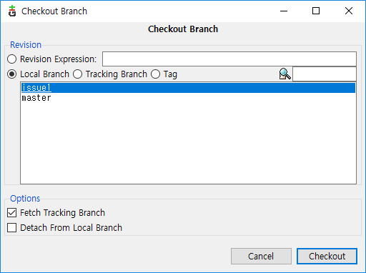
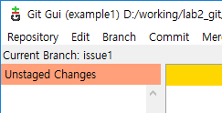
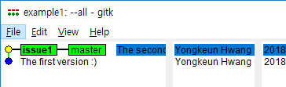
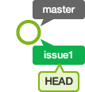
Basic Branching and Merging
Working with branches
Use ‘Branch->Checkout’ menu to switch to another branch
HEAD represents the current snapshot/position of a branch
Image courtesy of https://backlog.com/git-tutorial
Notes:
Branch 선택 가능

Slide 23
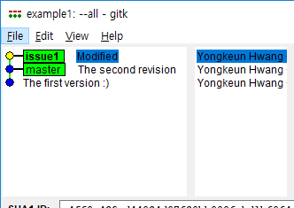
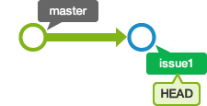

Basic Branching and Merging
If we make a change then commit
the tree of history would look like:
We then combine the revisions of issue1 to master, by merge menu
Checkout to master branch first
Go to ‘Local Merge’ menu and select a branch to merge
Image courtesy of https://backlog.com/git-tutorial
Notes:
현재 있는 branch 노란색
지금 딱히 가지를 치고 있진 않다..
다시 master에서 stage change, commi을 하면 그때서야 가지를 칠 것
합치고자하는 브래치를 기본으로 두고
그 다음 merge

Slide 24
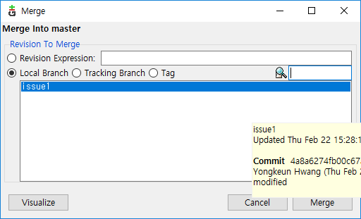
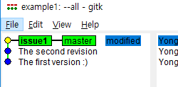
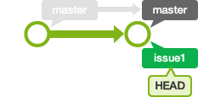
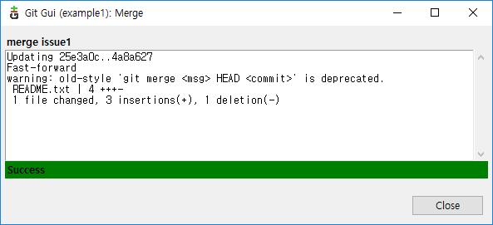
Basic Branching and Merging
We then combine the revisions of issue1 to master, by merge menu
Go to ‘Local Merge’ menu and select a branch to merge
Switched to ‘issue1’ branch after merge
Image courtesy of https://backlog.com/git-tutorial

Slide 25
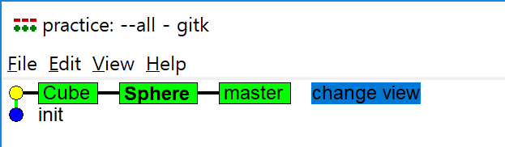
Mission #2
Start from the Mission #1
Create a branch <Cube>, <Sphere> and checkout

Slide 26
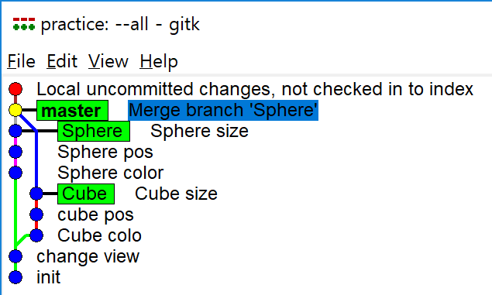
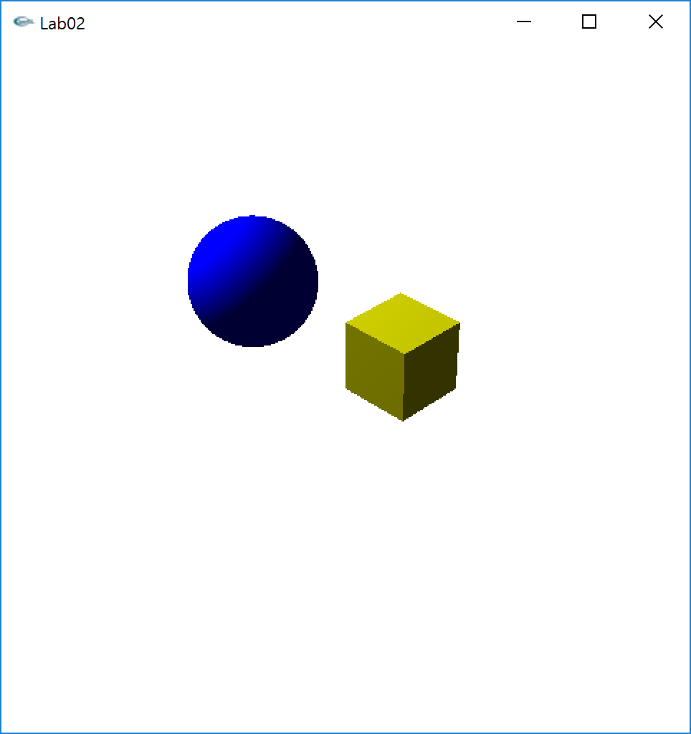
Mission #2 (cont.)
In Cube branch, 3 commits in following order
Modify Cube.h file, color : {1,1,0}
Modify Cube.h file, pos : {1,1,0}
Modify Cube.h file, size : 1
In Sphere branch, 3 commits in following order
Modify Sphere.h file, color : {0,0,1}
Modify Sphere.h file, pos : {-3,0,-1}
Modify Sphere.h file, size : 1
Checkout to master branch and merge
with Sphere, Cube branches

Slide 27
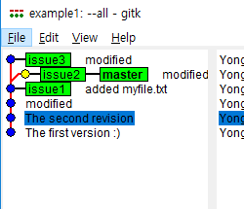
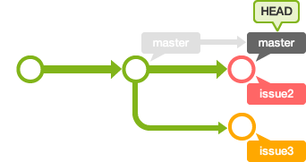
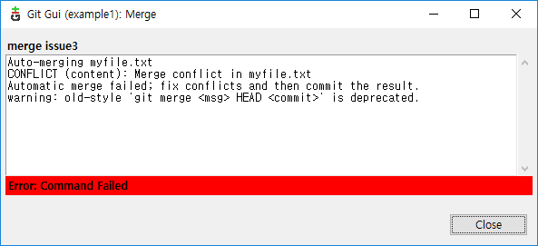
Resolving conflicts
Automatic merge cannot be performed when there are any ‘conflicts’ between branches
E.g. a file is modified in both branches, so that contents are not same
Image courtesy of https://backlog.com/git-tutorial

Slide 28
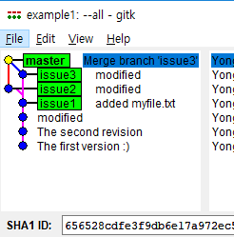
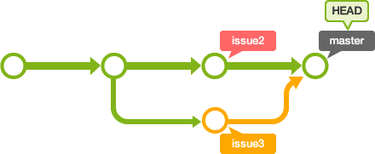
Resolving conflicts
To resolve conflict, modify files which caused conflict
In above case, ‘myfile.txt’
version in HEAD (currently master)
Git commands even a monkey can understand
add: Register a change in an index
<<<<<<< HEAD
commit: Save the status of an index
=======
pull: Obtain the content of a remote repository
>>>>>>> issue3
version in issue3
modify
Git commands even a monkey can understand
add: Register a change in an index
commit: Save the status of an index
pull: Obtain the content of a remote repository
stage and
commit
Image courtesy of https://backlog.com/git-tutorial
Notes:
HEAD가 master

Slide 29
Exercise #3
Start from the exercise #2
Create a Branch <Test> and modify main.cpp
glClearColor(0.0f,0.0f,0.0f,1.0f);
Checkout to master branch and modify main.cpp
gluPerspective(60.0f, 1.0f, 0.1f, 100.0f);
Merge <Test> branch
Resolve any conflicts if occur
glClearColor from <Test>
gluPerspective from master
Notes:
위에 라인과 아래 라인이 독립적이기 때문에 충돌이 일어나지 않음

Slide 30
Appendix : Git CLI commands
add command (git add FILENAME)
Tracking status of new or modified files to the ‘staged file’
rm command (git rm FILENAME)
Want to remove some files
mv command (git mv FROM_FILE TO_FILE)
Want to move some files
Remove files to be untracked (using --cached switch)

Slide 31
Appendix : Git CLI commands
Status command (git status)
Check the staged (tracked), unstaged (new or modified, but not tracked) files
commit command (git commit –m “descriptions”)
Committing last changes and make a version
Log command (git log)
Viewing history of commit
Difference between files can also be checked using –p switch
.gitignore file
contains a list of files which should not be tracked
log files, any temporary files, etc

Slide 32
Appendix : Git CLI commands
Undoing Changes
Commit with amend switch (git commit --amend)
Make additional changes to the latest commit
Useful to avoid excessive commits
Unstaging files (git reset HEAD FILENAME)
Useful when files are changed, but want to be committed later
Unmodifying files (git checkout -- FILENAME)
Reverting files to the latest commit

Slide 33
Appendix : Git CLI commands
Branch related
Create a branch (branch command)
git branch NAME_OF_BRANCH
Merge with another branch (merge command)
git merge BRANCH_TO_MERGE_WITH
Image courtesy of https://backlog.com/git-tutorial

