Slide 1
LAB Ⅱ LECTURE 02
Debugging
Seoul National University
Graphics & Media Lab
Donghoon Han

Slide 2

Mission
Modify the code in which the problem occurs.

Slide 3
Contents
Debugging
Sample code
Process
Set breakpoints
Start debugging
Inspect the code & value
Other Debugging Techniques
Practice

Slide 4
Debugging
What is ‘Debugging’?
The process of finding and resolving defects or problems within the program that prevent correct operation of computer software or a system.
What is ‘Debugger’(= Debugging tool)?
A computer program that is used to test and debug other programs (the “target” program).
A tool for you to monitor your code’s variable value at runtime. (Identifying which code is incorrect?)
Visual Studio has built-in debugger.
https://msdn.microsoft.com/en-us/library/k0k771bt.aspx

Slide 5
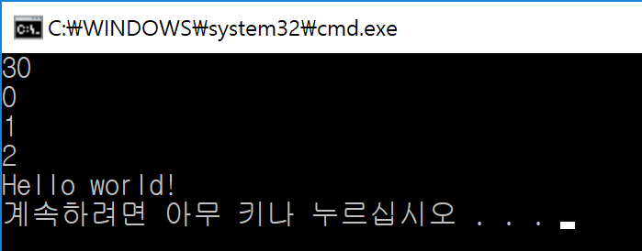
Sample code
#include <iostream>
#include <string>
using namespace std;
int add(int x, int y){
return x+y;
}
int addTest() {
return add(10,20);
}
void main() {
int a = 0;
float b[3];
int c = 0;
string d;
for (int i = 0; i < 3; i++){
a++;
b[i] = i;
}
c = add(b[1], b[2]);
d = "Hello world!";
a = addTest();
cout << a << endl;
for(int i=0; i<3; i++)
cout << b[i] << endl;
cout << d << endl;
}

Slide 6
Process
Start
Set breakpoints
Start debugging
Inspect the code & value
No
Want to stop?
Yes
End

Slide 7


Set breakpoints
Breakpoint is an intentional stopping or pausing place in a program, put in place for debugging purposes.
Breakpoint pauses the execution of the code and allows developers to examine controls and variables before the program continues to execute.
Toggle(set/remove) breakpoint
By clicking in the left margin of a source code file.
By clicking your cursor on a line of code and pressing F9.
Looks like:
During execution:

Slide 8
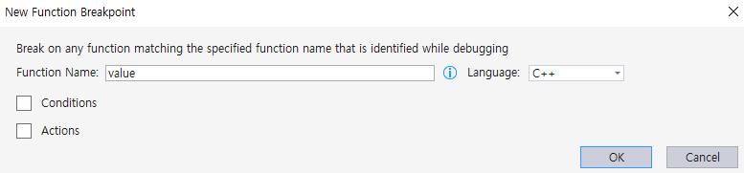

Set breakpoints
Function breakpoint
You can set a breakpoint by entering Function Name (with Conditions and Actions)
Debug > New Breakpoint > Function Breakpoint (or press CTRL+B)
Enable/Disable breakpoint
Enables or disables the breakpoint on the current line of code.
By putting your cursor on the breakpoint, and clicking Enable breakpoint (or press CTRL+F9).
Notes:
Function breakpoint 는 빨간색으로 안찍힘
Ctrl+F9 하면 잠깐 breakpoint를 멈춤

Slide 9
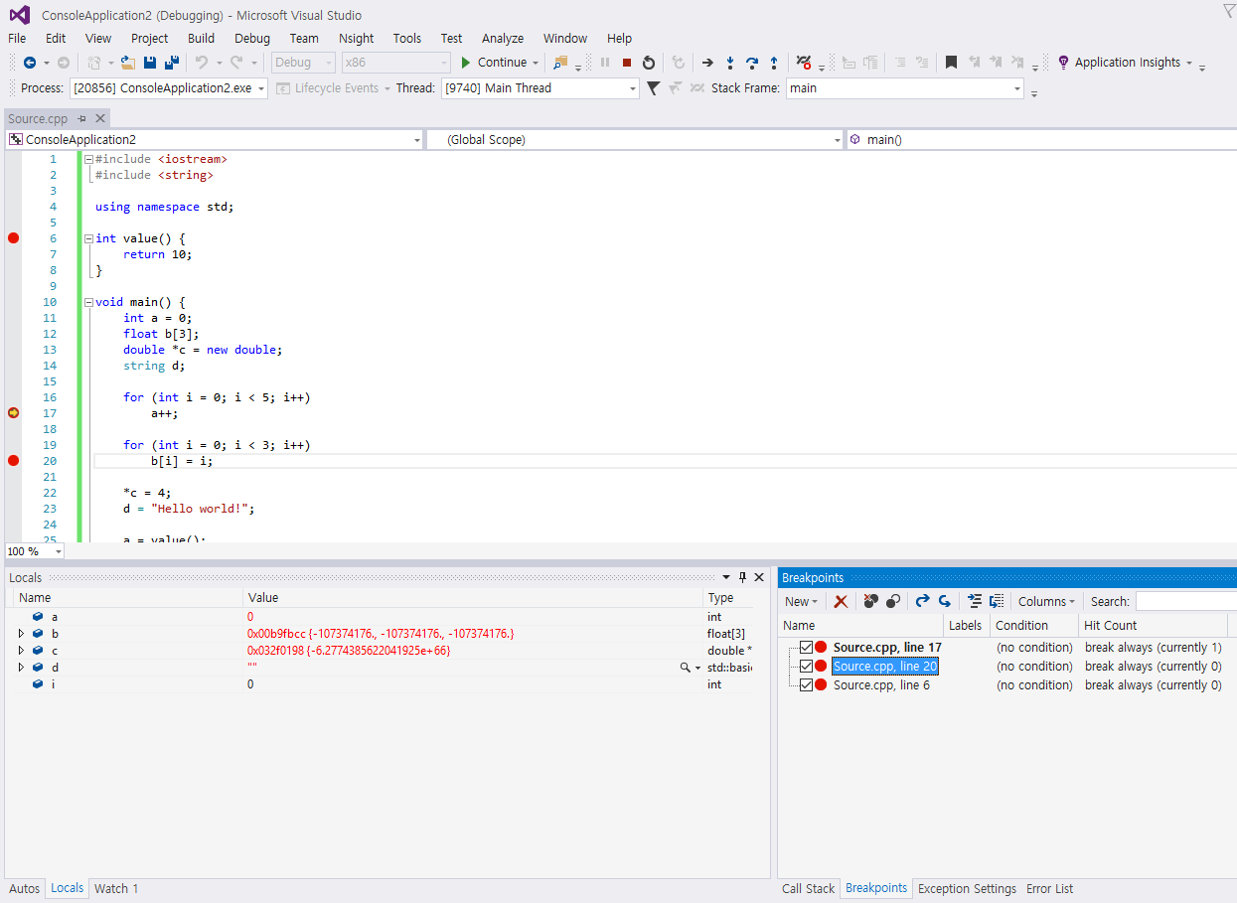
Set breakpoints
Managing breakpoints
You can use the Breakpoints window to see all the breakpoints you have set in your solution.
Debug > Windows > Breakpoints (or press CTRL+ALT+B)

Slide 10
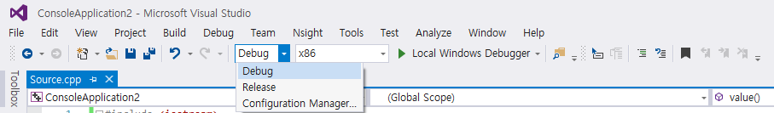
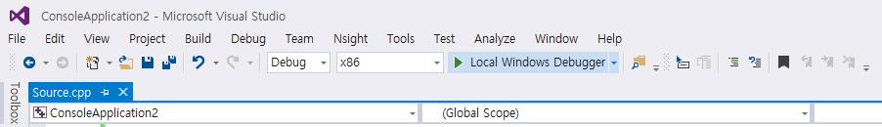
Start debugging
Select Debug in the solution configuration.
Click green arrow to start debugging
Notes:
Release ->

Slide 11
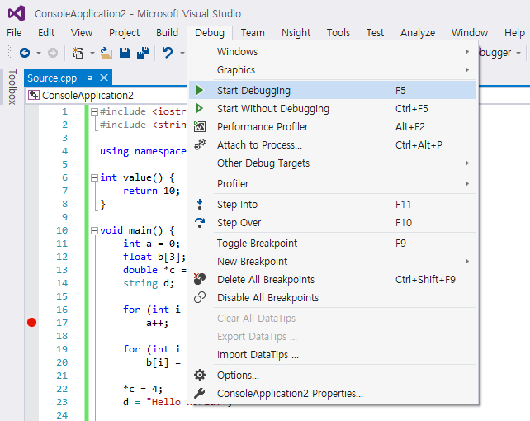
Start debugging
Debug > Start Debugging (or press F5) (another way to start)

Slide 12
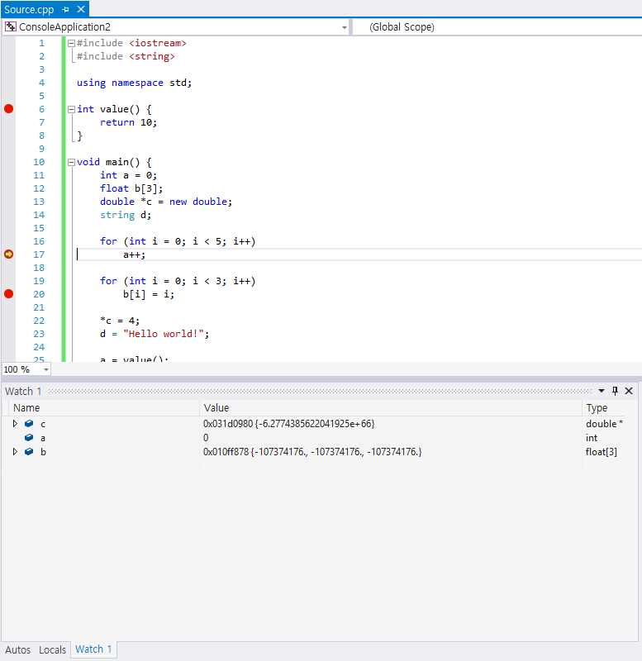
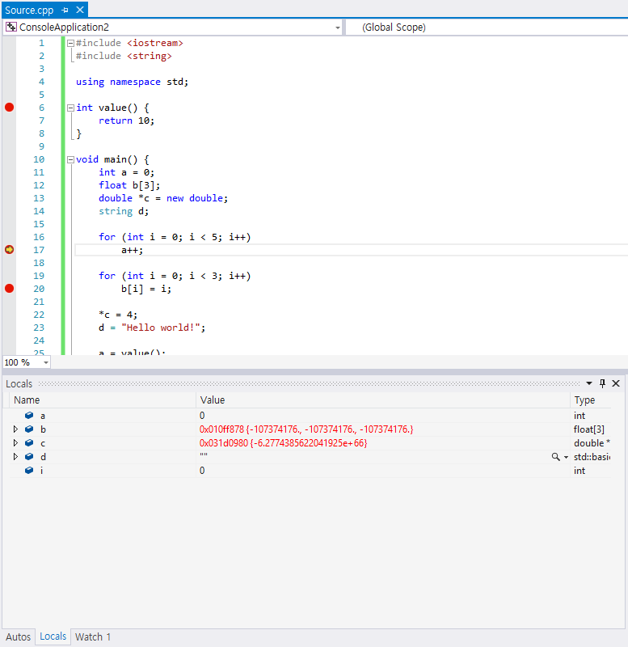
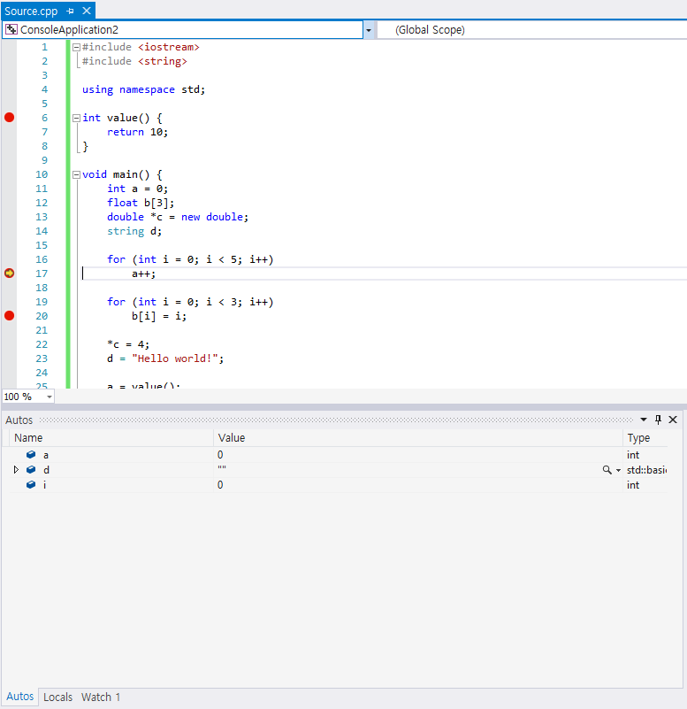
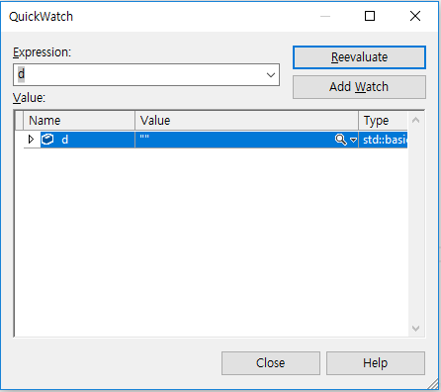
Inspect the code & value
Debugger windows
QuickWatch
Autos
Locals
Watch

Slide 13
Inspect the code & value
Debugger windows
Autos window
Displays variables used around the current line (the place where the debugger is stopped).
Debug > Windows > Autos (or press CTRL+ALT+V, A)
Locals window
Displays variables that are defined in the local scope.
Debug > Windows > Locals (or press CTRL+ALT+V, L)
Watch window
Displays variables and expressions during a debugging session.
Accommodates several variables
Debug > Windows > Watch > Watch (1, 2, 3, 4)
QuickWatch window
Same as Watch window, except for showing a single variable at a time.
Debug > QuickWatch (or press SHIFT+F9)

Slide 14
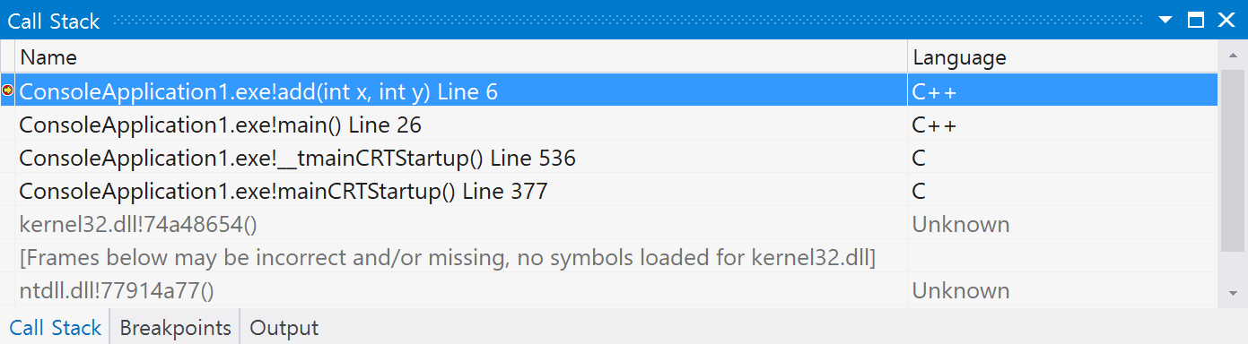
Inspect the code & value
Debugger windows
Call Stack window
Displays the name of each function and the programming language that it is written in.
The function or procedure name may be accompanied by optional information, such as module name, line number, and parameter names, types, and values.

Slide 15
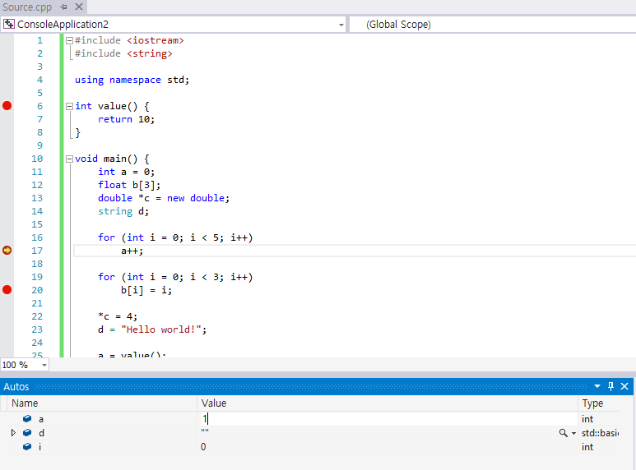
Inspect the code & value
A powerful feature of these windows is that they allow the variables to be modified.
Notes:
A++ 실행하기 이전에 a 가 1로 바뀐 후에 그다음 실행된다

Slide 16
Inspect the code & value
Yellow arrow shows you the code that will execute next.
Advanced feature: this arrow can be dragged up(down) to repeat(jump to) the code you want to execute. (you may not need to use this feature in this class.)

Slide 17
Inspect the code & value
Break mode control
Continue
Resumes the running process of a program until next breakpoint.
Debug > Continue (or press F5)
Step Into
Executes the next line of code. If there is a function invocation at the current line, it will jump into the function execution.
Debug > Step Into (or press F11)
Step Out
Proceeds to the next line of code but does not step into any function calls.
Debug > Step Out (or press F10)
Step Over
Executes the remaining lines of a function in which the current execution point lies.
Debug > Step Over (or press SHIFT+F11)
Restart
Restart the program execution. It is usually used when the code is changed during debugging.

Slide 18
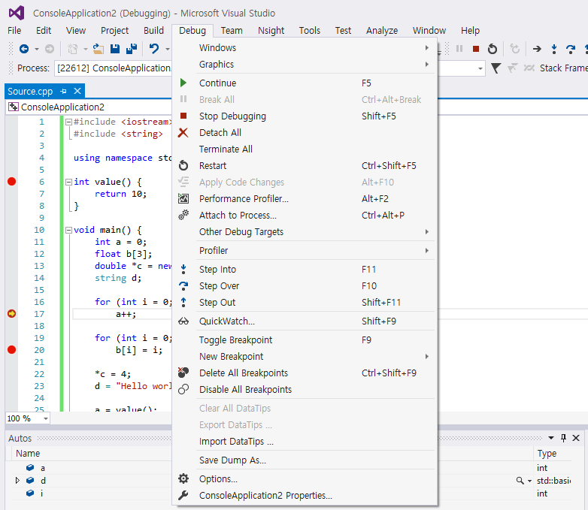
Inspect the code & value
Break mode control

Slide 19
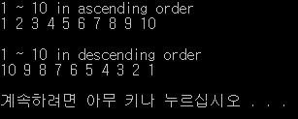
Practice
#include <iostream>
#define num 10
using namespace std;
void main() {
int *a, b[num];
cout << "1 ~ 10" << " in ascending order" << endl;
for (int i = 0; i < num; i++) {
b[i] = i + 1;
cout << b[i] << " ";
}
cout << endl << endl;
a = b;
cout << "1 ~ 10" << " in descending order" << endl;
for (int i = 0; i < num; i++) {
a[i] = b[num - i];
cout << a[i] << " ";
}
cout << endl << endl;
}

Slide 20
Other Debugging Techniques
Interactive debugging
Studied in this class
Print debugging (sometimes called printf debugging)
By using printf function in C
Remote debugging
Post-mortem debugging
“Wolf-fence” algorithm
Delta debugging
Saff Squeeze

Slide 21
Mission
Modify the code in which the problem occurs.

