Slide 1
CryptoParty
Email and Encryption

Slide 2
About CryptoParty
CryptoParty is a decentralized global initiative to introduce basic cryptography tools – such as Tor anonymity network, public key encryption (PGP/GPG), and OTR (Off The Record messaging) – to the general public.
CryptoParty was originally conceived during a Twitter conversation between AsherWolf and Computer Security people in the Summer of 2012 with a special interest in teaching basic cryptography tools to Journalists and Activists. There are CryptoParties currently being held worldwide on every continent (except Antarctica)
The ability to converse privately and anonymously is a basic human right and should be available to anyone.

Slide 3
Harassment Policy
We want everybody regardless of race, creed, religion, or gender to feel welcome.
Harassment of any kind will not be tolerated.
You will be asked to leave if your behavior warrants it.

Slide 4
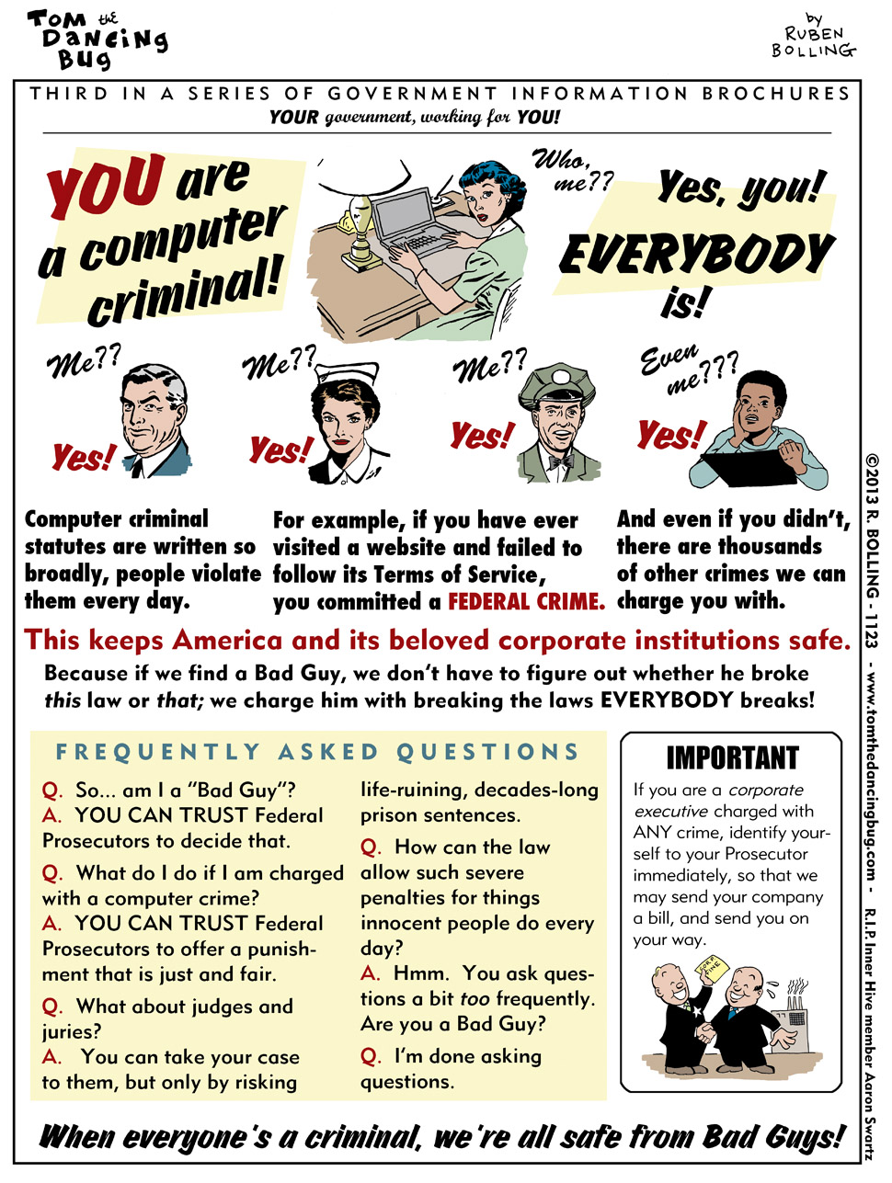

Slide 5
Who’s out to get me?
(hint EVERYONE!)
Criminals
Advertisers
LEO and State Sponsored Surveillance
Targeted Attacks vs. Random Attacks

Slide 6

The Criminals

Slide 7
The Criminals
After the Low Hanging Fruit
Main focus is on business
Individuals are crimes of opportunity
Organized Crime is growing
Typically after information for identity theft, credit card/bank info
Can be an victim due to attack against a company you do business with.

Slide 8

The Advertisers
They want everything. Everything you do online, every website you visit, hobbies, shopping preferences, everything.

Slide 9
The Advertisers
Google can now predict more accurately when and where a flu outbreak will occur.
http://www.google.org/flutrends/us/

Slide 10
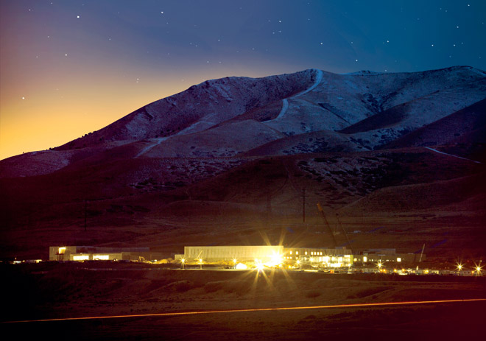
LEO and State Sponsored Surveillance
Most world governments do some kind of surveillance on their citizens.
Here in the USA the NSA is actively collecting EVERYTHING they can on EVERYBODY.
http://www.wired.com/threatlevel/2012/03/ff_nsadatacenter/

Slide 11
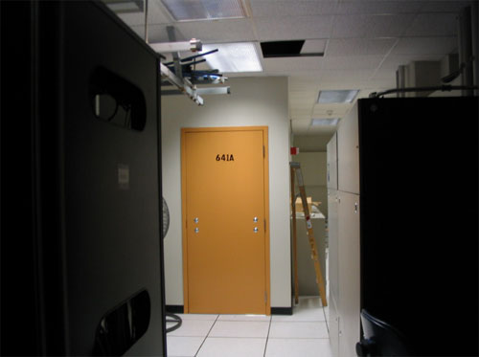
LEO and State Sponsored Surveillance
http://www.wired.com/science/discoveries/news/2006/05/70944

Slide 12
LEO and State Sponsored Surveillance
Tap into internet and landline phone traffic.
Can use fake 3G cell sites (which are mobile) to intercept cell phone traffic.
Can acquire data about you from Social Media or email providers without a warrant provided they show the holder of the data that it is relevant to a criminal investigation. Warrants are easy to get.
William Binney a former NSA Director turned whistleblower has come forward Edward Snowden has released documents that expose the extent of the NSA surveillance without warrants.

Slide 13
Privacy vs. Anonymity
Its important to understand the difference.
Privacy protects the contents of a communication or file, but is not designed to hide identity. In some cases it confirms identity.
Anonymity hides identity but may not or in some cases can not protect the contents of a communication or file.

Slide 14
Passwords
The best password is one you don’t know.
Length is arguably the most important element in determining the strength of a password.
Never recycle passwords.
Change as often as is practical and possible.
Never use dictionary words.
Noun Method
  GeorgeWashington’sWoodenTeeth@MountVernon
    41 Characters - Easy to Remember
  Randomly Generated 20 character password
    dDHC0pQg9cGmxmFsjEVF – Hard To Remember

Slide 15

Passwords

Slide 16
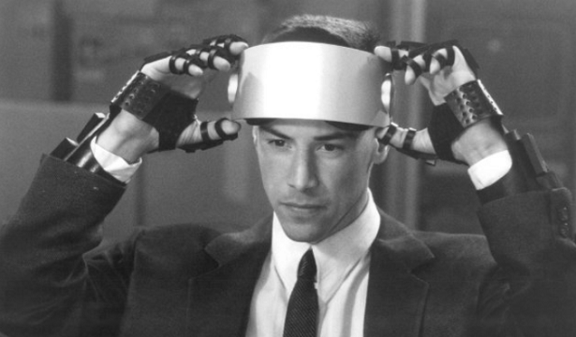
Practical Security
High Tech isn’t always best.

Slide 17
Practical Security
Leave the cell phone at home and meet in person.
Keep notes on a current operation/action/business idea on paper. Lock the paper up. Keep it near the fireplace/shredder if its really sensitive.
Backup passwords and keys to a CD and lock it up in a safe, safe deposit box, grandparents house, trusted friends house.
Evaluate what data you are storing and where you are storing it.

Slide 18
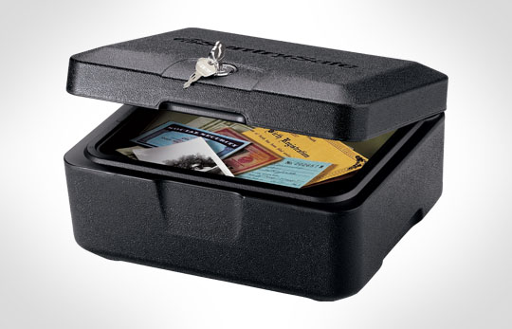
Practical Security

Slide 19

Practical Security
Only you can decide how paranoid you want to or need to be.

Slide 20
Email
Sending an email is like sending a postcard. Anybody along the delivery route can read it.
You cannot know if all connections are encrypted.
Free emails providers often mine the contents of an email to feed their targeted advertising engine.

Slide 21
PGP/GPG
PGP – Pretty good privacy. Developed by Phil Zimmerman in 1991
PGP is a program that you can use to encrypt the contents of a file.
PGP is NOT an anonymizing tool! In fact one of PGPs main purposes is to ensure the identity of the person that sent the message.

Slide 22
PGP/GPG
GPG (Gnu Privacy Guard) is an open source implementation of PGP.
They are compatible with each other.
PGP can be used to sign or encrypt.
To use PGP you need to generate a set of keys. A public key and a private key.
You keep the private… private and give the Public key to the… wait for it … Public.

Slide 23


PGP/GPG
Private
Public

Slide 24
PGP/GPG
If your keys are compromised ALL of your past communications can be compromised as well.
If you lose your password you can never recover your keys
When encrypting a message you can add as many recipients as you want provided you have keys for all of them.
Software developers use PGP to sign their software downloads so you can ensure that you are receiving the correct file.

Slide 25
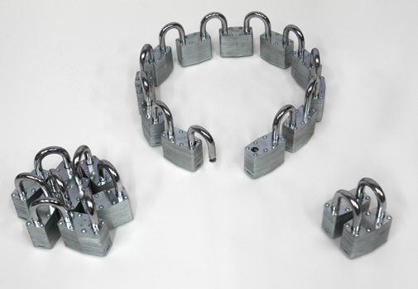
PGP/GPG

Slide 26
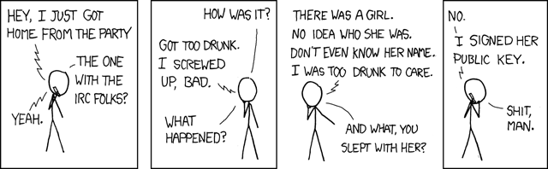
Signing Keys
Signing a key indicates that you trust that key and that you believe that the key belongs to the right person.
Be extremely careful about signing keys.

Slide 27
Revoking a key
When initially generating your keys you can optionally generate a Revocation Certificate.
If your keys ever become compromised you can email a copy of the Revocation Certificate to everyone so they can render your public key invalid.
Make sure to store your revocation certificate in a secure location.

Slide 28
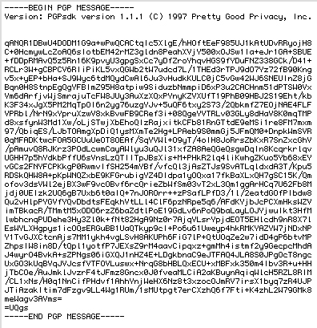
The Email

Slide 29
The Software (Linux)
ThunderBird
Enigmail extension for thunderbird
PGP is installed by default on many (most/all) Linux distros.
Enable and use LUKS

Slide 30
The Software (Windows)
Required
Mozilla Thunderbird
Enigmail Extension for Thunderbird.
GPG4Win
Recommended
KeePass – For Passwords
Truecrypt -

Slide 31
The Software (Mac)
Not an expert here
GPGTools for Mac
Thunderbird
Enigmail extension for Thunderbird

Slide 32
Others
Android - APG and K-9 Mail
IOS ipgmail
Windows Mobile – Your Screwed
Nokia – Just leave (only kidding)

Slide 33
Contact Me
josh@wtftacos.com
@scottjosh
PGP Fingerprint 5FB259B9
www.wtftacos.com for slides or other tutorials

Slide 34
Next Presentation
OTR
TOR
Encryption, Stenography, and Password Protection
  Luks, Truecrypt, Bitlocker, File Vault, KeePass
Mobile Device Security
Secure Calls with Encrypted VOIP
I2P
Also Mailing list?

