Slide 1
CryptoParty
Introduction to Tor

Slide 2
About CryptoParty
CryptoParty is a decentralized global initiative to introduce basic cryptography tools – such as Tor anonymity network, public key encryption (PGP/GPG), and OTR (Off The Record messaging) – to the general public.
CryptoParty was originally conceived during a Twitter conversation between AsherWolf and Computer Security people in the Summer of 2012 with a special interest in teaching basic cryptography tools to Journalists and Activists. There are CryptoParties currently being held worldwide on every continent (except Antarctica)
The ability to converse privately and anonymously is a basic human right and should be available to anyone.

Slide 3


The Problem
Notes:
Tor can be used to prevent online profiling.
Corporations track us everywhere on the Internet and they build surprisingly detailed profiles on us.
They sell this data to other corporations which may then be used against you.
Employees at corporations may abuse their your trust and access your data.
Governments often spy on the users of the Internet in countries they control.

Slide 4




Examples
Notes:
Tor can be used to prevent online profiling.
It was discovered in August of 2012 that Orbitz customers that were identified as Mac users were given quotes on average 20% higher than those coming from Windows Computers.
In September of 2010 it was revealed that Aviva was using data gathered on individuals by companies that specialize in consumer data gathering to determine life insurance policy rates and in some cases deny applicants insurance altogether

Slide 5
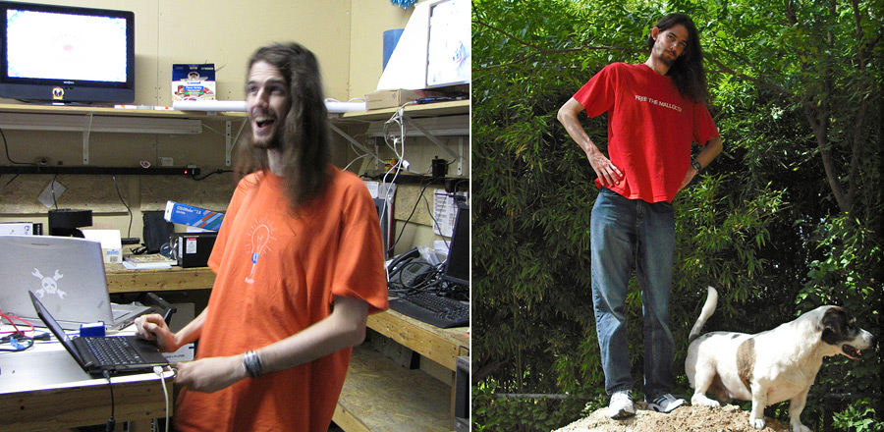
Examples
Notes:
Tor can be used to prevent online profiling.
A Google engineer used his access to stalk and spy upon several underage children reading their chat logs, voice mail messages and emails.
David Barksdale from the Kirkland, WA Google Office, started violating the privacy of children as young as 15 years old many of whom he first met at a Technology Group in Seattle.

Slide 6

Examples
Notes:
Tor can be used to prevent online profiling.
While today you may have nothing to hide. In the future that may not be the case.

Slide 7

The Solution
Notes:
Tor is an advanced proxy network that allows you to connect to web based services anonymously.
Tor is a separate Internet, or Deep Net, that allows websites to operate while hiding their physical location.

Slide 8
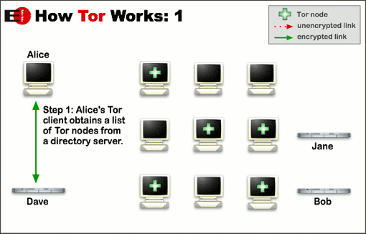
How Tor Works
Notes:
Tor can be used to prevent online profiling.

Slide 9
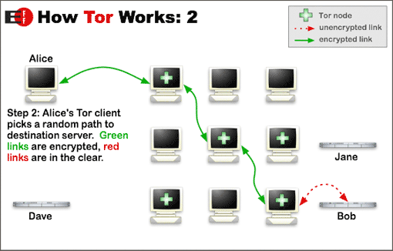
How Tor Works
Notes:
Tor can be used to prevent online profiling.

Slide 10
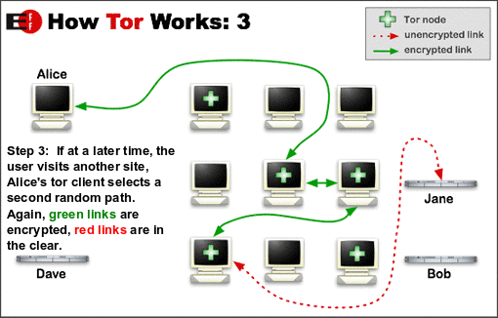
How Tor Works
Notes:
Tor can be used to prevent online profiling.

Slide 11
Uses for Tor
People use Tor to fight tracking and surveillance.
Businesses use Tor to research competitors secretly.
Law Enforcement uses Tor to research criminal activity.
Governments use Tor to keep information secure.
Journalists and Activists use Tor for their personal safety.

Slide 12
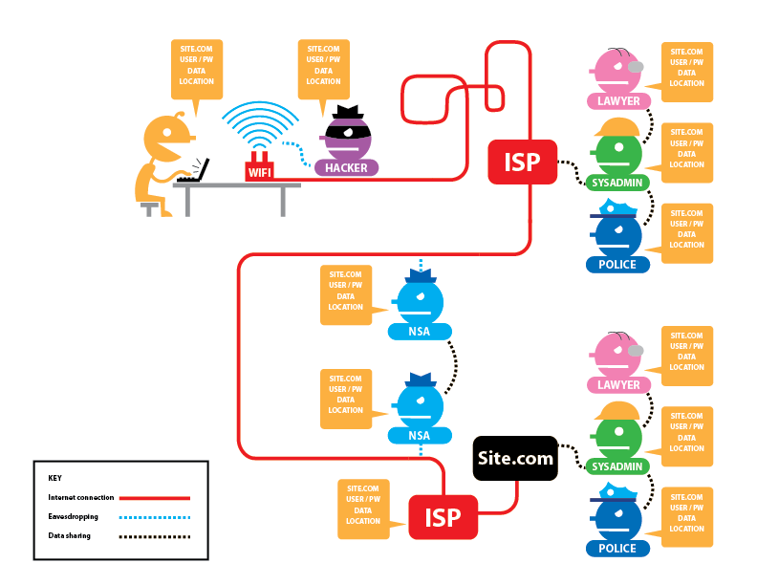
What Tor Protects
Notes:
Normal Internet Browsing without Tor or SSL

Slide 13
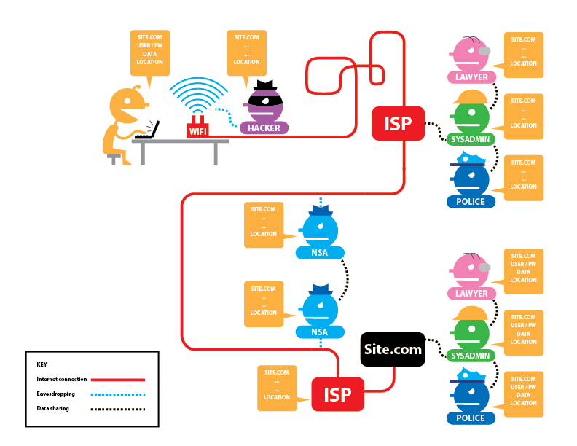
What Tor Protects
Notes:
With SSL

Slide 14
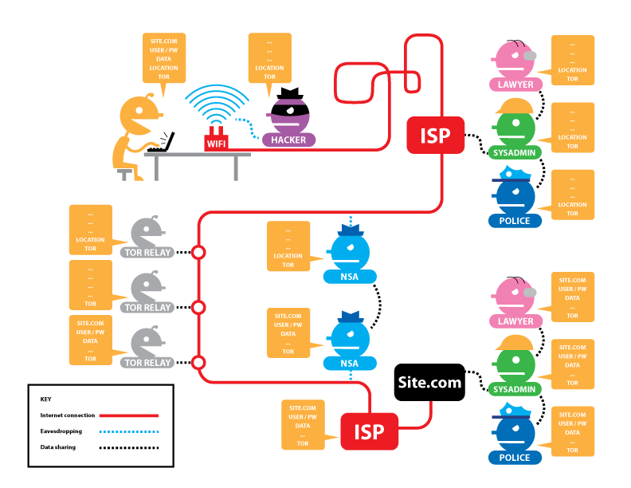
What Tor Protects
Notes:
With Tor

Slide 15
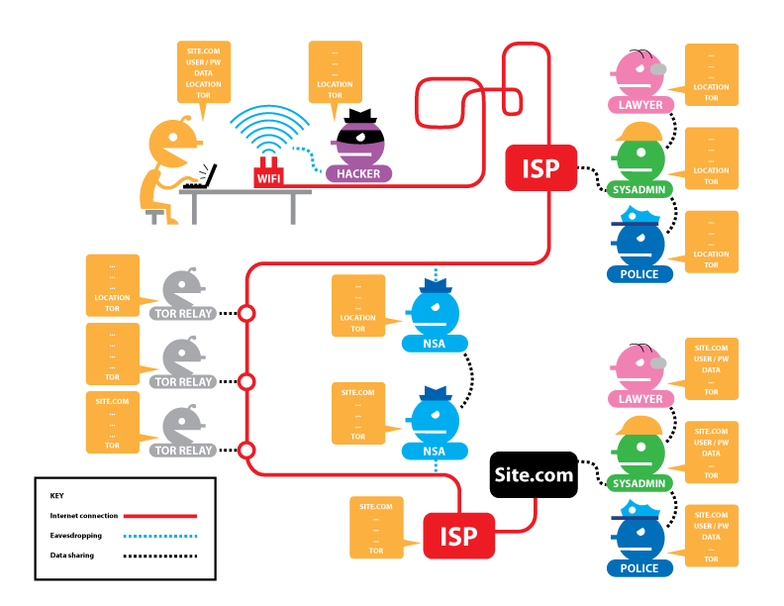
What Tor Protects
Notes:
With Tor and SSL

Slide 16

Tor Hidden Services
Notes:
There are websites and services that exist that are accessible only from the Tor Network. This allows servers to run without being able to pinpoint their location.
There are some legitamate uses for this. And some illegal uses as well.

Slide 17
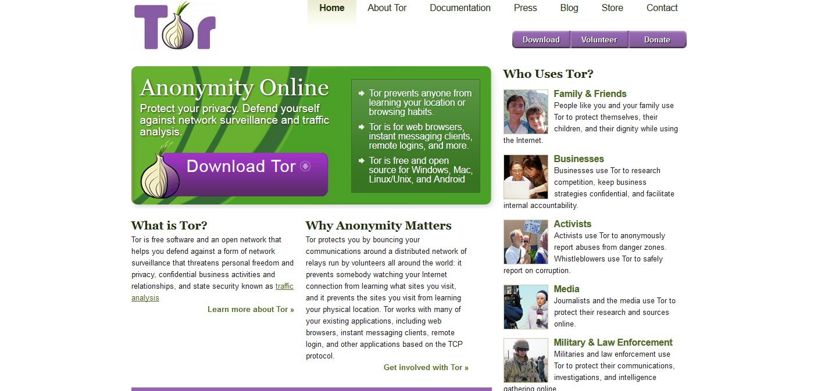
Obtaining Tor
Notes:
All you need to do is go to torproject.org and download the latest bundle for your operating system

Slide 18
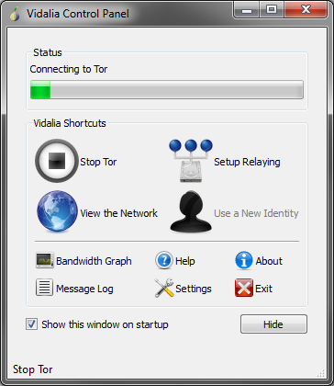
Using Tor

Slide 19
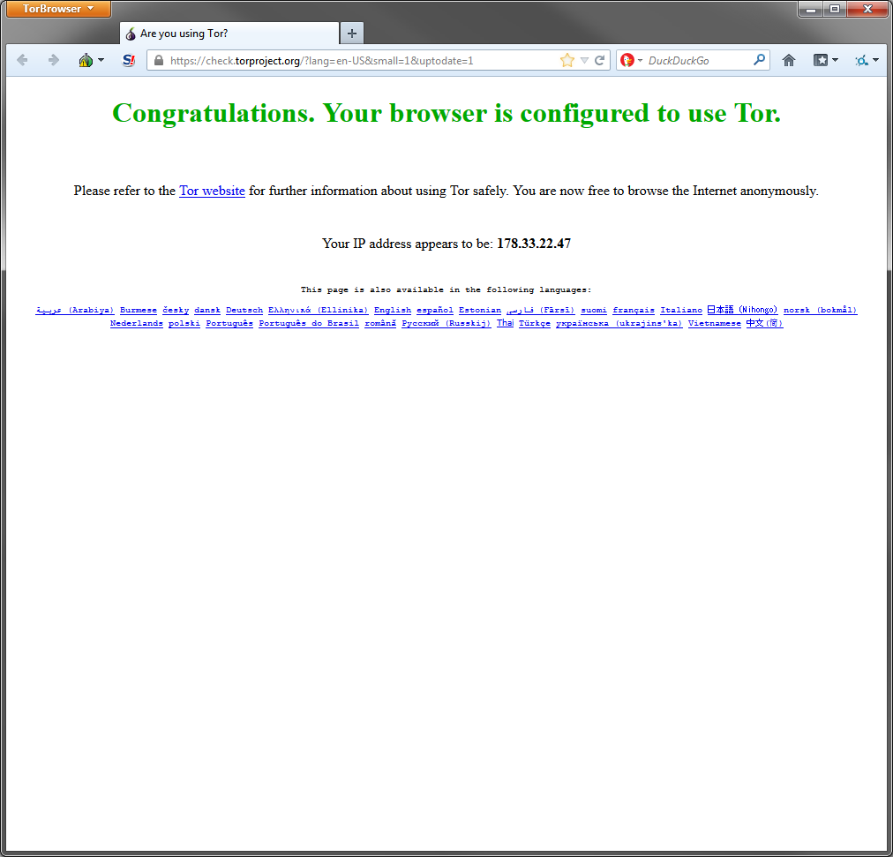
Using Tor
Notes:
The Tor Browser should start automatically.

Slide 20

A Particular Set of Skills
Notes:
Tor cannot protect you from yourself.
Tor can only route TCP traffic.
Flash and Java are disabled by default. They can create connections that bypass Tor and leak IP or other information.
Tor is not fast. A standard 20 minute BitTorrent download could takes days through Tor.

Slide 21
Tails
Tails is a live Operating System designed to be run on a DVD or CD that routes all traffic through Tor by default.
Download from https://tails.boum.org

Slide 22
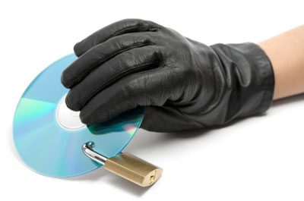
Tails
Notes:
Remove the hard drive, Boot from a DVD, use an encrypted flash drive/sd card that can be physically destroyed.
It erases itself and all data off the computer on shutdown. Unless you write data to the harddrive or to a thumbdrive.

Slide 23

Final Thought
Notes:
Consider Running a Tor Relay, Bridge, Exit node
Tor has a great writeup available on how to run a bridge for $3/month
https://cloud.torproject.org/

Slide 24
Contact Info
Twitterings @scottjosh
Email josh@wtftacos.com
Site www.wtftacos.com

