Slide 1
CryptoParty DFW
File Encryption with TrueCrypt

Slide 2
About CryptoParty
CryptoParty is a decentralized global initiative to introduce basic cryptography tools – such as the TOR anonimity network, public key encryption (PGP/GPG) and OTR (Off The Record messaging) – to the general public.
The ability to converse privately and anonymously is a basic human right and should be available to anyone.

Slide 3
Harrasment Policy
We want everybody to feel welcome.
Harrasment of any kind will not be tolerated
You will be asked to leave if your behavior warrants it.

Slide 4

TrueCrypt
Notes:
TrueCrypt is a program that allows you to create encrypted file storage containers and use them to perform on-the-fly encryption.
On-the-fly means it is encrypted right before its saved, and decrypted right before its loaded.
There are 2 ways to achieve this
Whole Disk Encryption
On Windows you can encrypt the system disk
Encrypted Containers
Additionally TrueCrypt allows you to create a hidden container

Slide 5
Whole Disk Encryption
Protects everything on the disk.
Requires a password to unlock the contents.
Legal protections inside the US against disclosing your password.

Slide 6
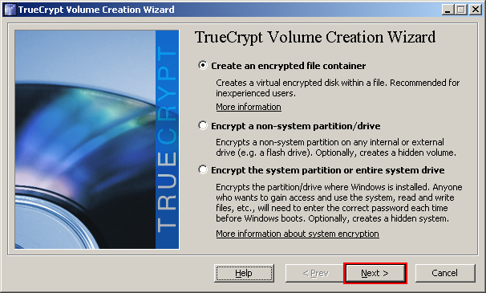
Encrypting a Disk
Notes:
This can be a very time consuming process.
Only one option for hash and encryption algorithm.
(AES SHA-512)
Mandatory reboot, then encryption process begins.
Let it run overnight.
Can be paused.

Slide 7
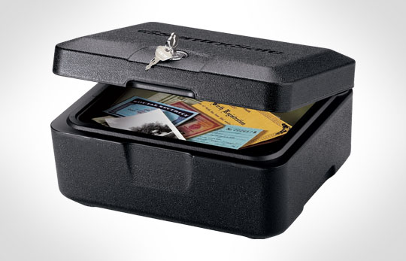
Rescue CD
Notes:
During the encryption process you will need to create a rescue cd. Store this CD someplace safe.

Slide 8
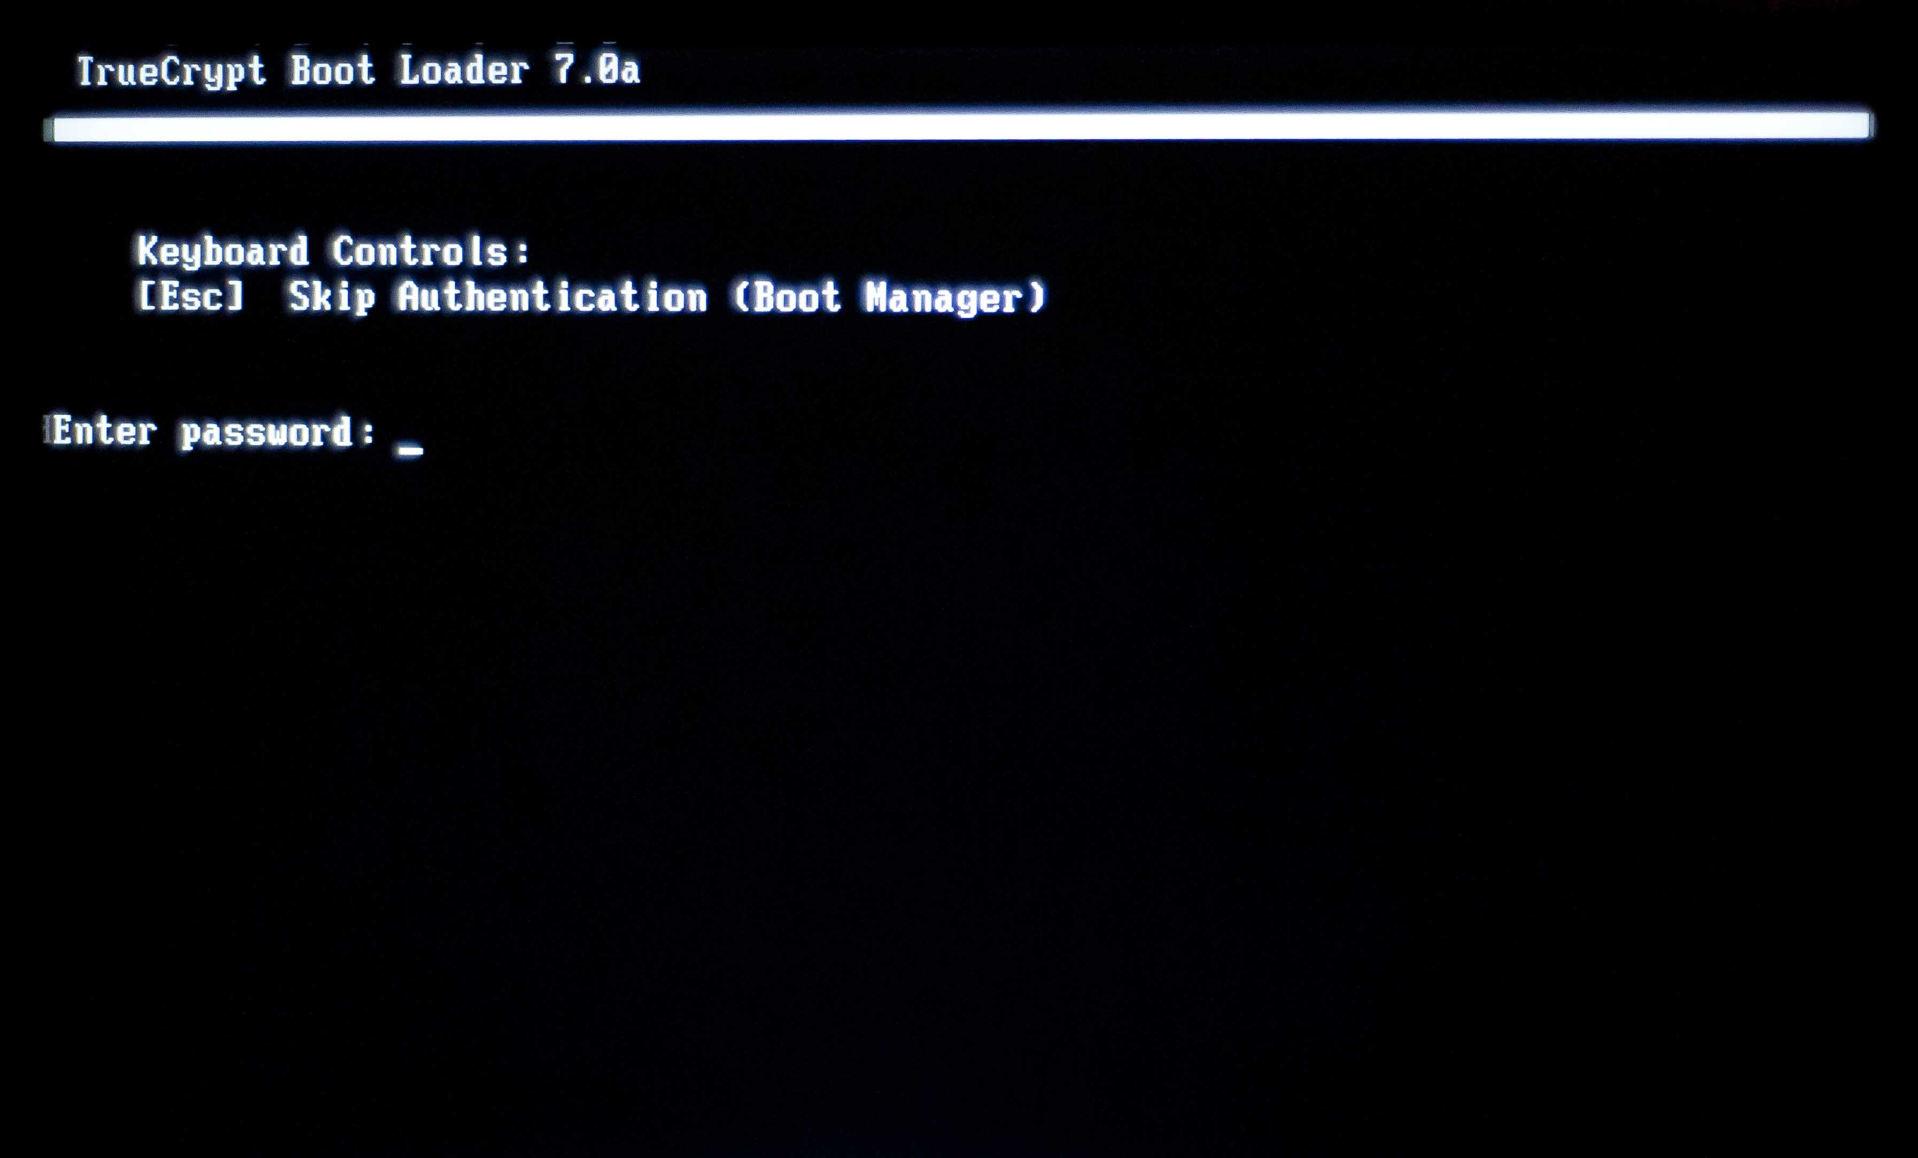
Whole Disk Encryption

Slide 9
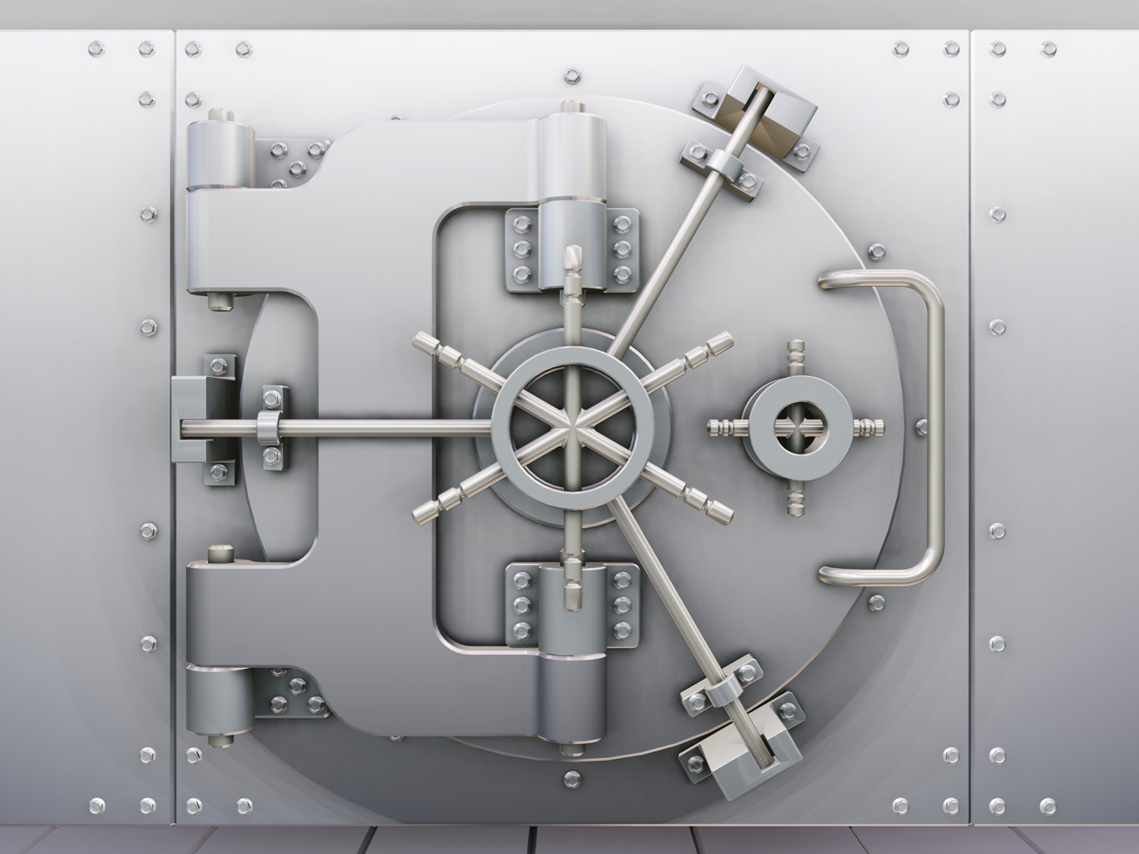
Encrypted Containers
Notes:
Encrypted Containers are just files.
They can be stored anywhere.
They can be used cross platform

Slide 10

Plausible Deniability
Notes:
Create Volumes within volumes.
Virtually impossible to prove that hidden volume exists.
Although close inspection can imply (greatly) that a hidden volume exists.
One password for decoy volume
Another password for real volume

Slide 11
Contact
josh@wtftacos.com
@scottjosh
@kylemaxwell
@cryptopartydfw
PGP Fingerprint ID 0x5FB259B9
wtftacos.com

