Slide 1


Flutter
Provider and SQFLITE
By: Tika Yesi Kristiani

Slide 2
What is flutter?
Flutter is a free and open source mobile UI-Framework using dart language (2011) released in May 2017 by Google.

Slide 3
Flutter Advantages
Simple to learn
Quick compilation
Reduce code development time
Similar to native app performance
Community support
Good Documentation
ETC..

Slide 4
MVVM
MVVM is a Model-View-View Model architecture that removes the tight coupling between each component.
Model, represents the data of the business logic
View, consists the UI. User action from view will be send to view model
View Model, bridge between View and Model / business logic.

Slide 5
MVVM Architecture
Model
Local Data Source
Send Request
View
(UI)
UI Event
View Model
(Live Data)
Request
Use Case
Repository
Response
Response
Response
Response
Send Request
Remote Data Source

Slide 6
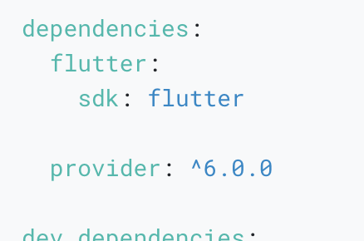
Provider
Provider Is one of the state management in Flutter. The provider package is easy to understand and it doesn’t use much codeways using state management in flutter.
Provider dependencies:

Slide 7
Three main concept in provider
Change Notifier
ChangeNotifierProvider
Consumer

Slide 8
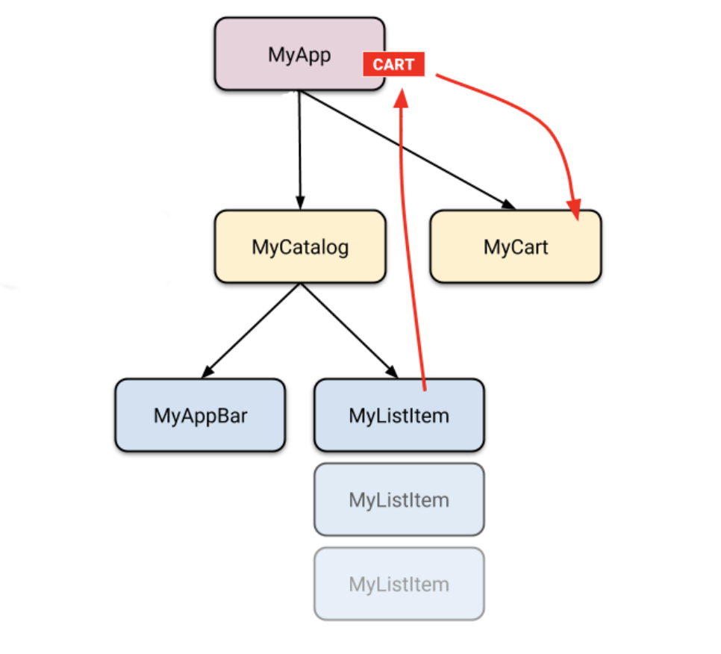
Provider example concept
Source: https://docs.flutter.dev/

Slide 9

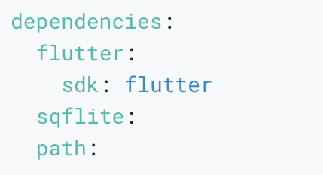
SQFLite
The sqflite package provides classes and functions to interact with a SQLite database.
The path package provides functions to define the location for storing the database on disk.

Slide 10
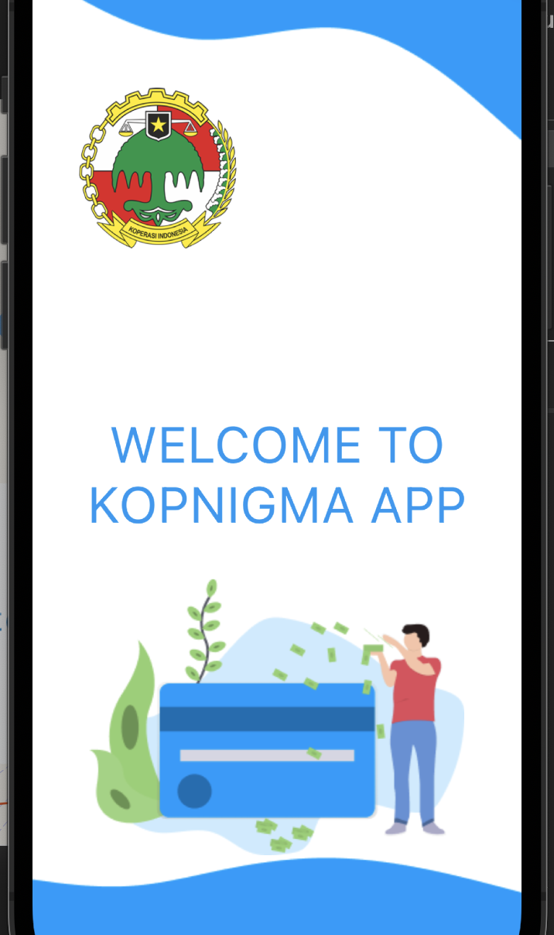
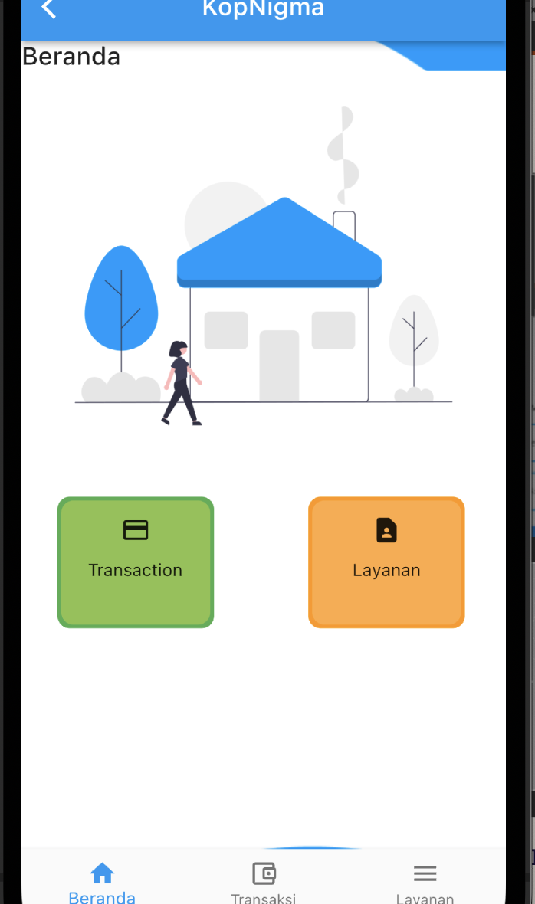
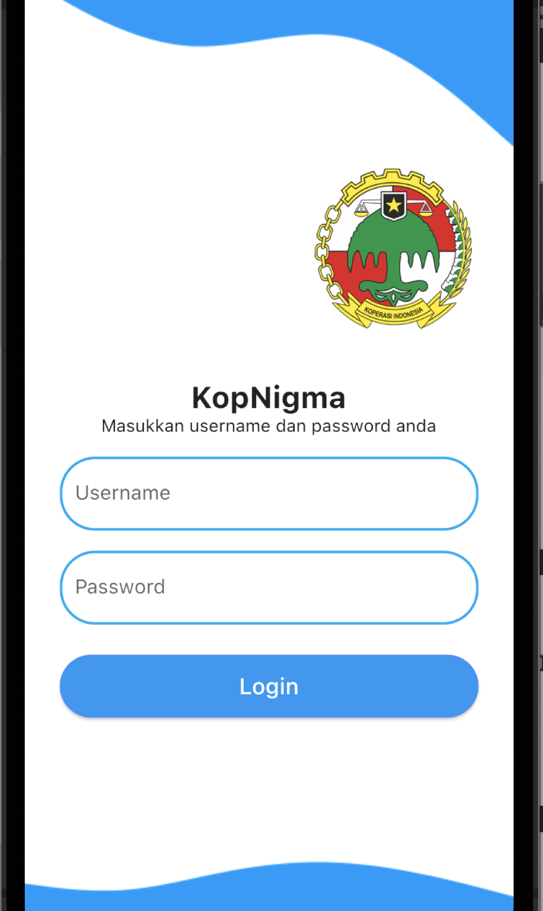
Kopnigma APP handson

Slide 11

Happy Coding

