Slide 1
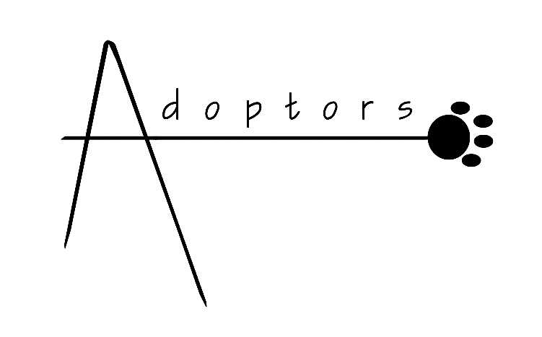

Slide 2
OBJECTIVE
This website connects all adopters with pets (cats and dogs) and help them from being alone to being adopted.

Slide 3
MISSION
To help homeless pet out of the street and able to get them a new shelter.

Slide 4
VISION
Adoptor is a site that composed of cooperative individuals and different organizations that aims to help stray animals live better lives.

