Slide 1


Slide 2
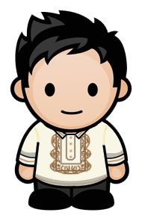
THE FILIPINO TODAY

Slide 3
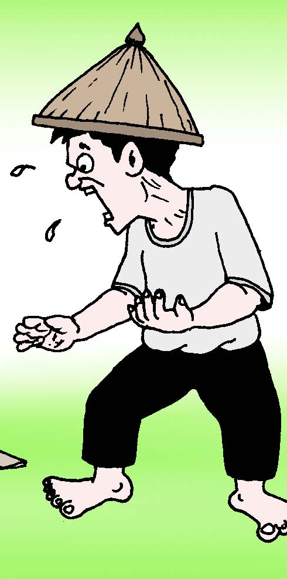
THE FILIPINO TODAY

Slide 4
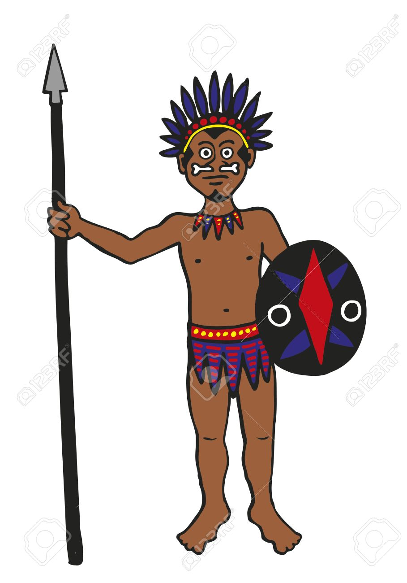
THE FILIPINO TODAY

Slide 5
THE FILIPINO TODAY

Slide 6
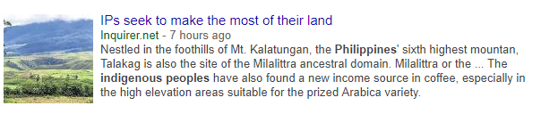

Slide 7
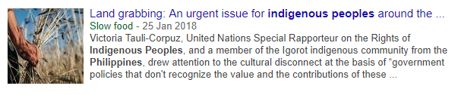

Slide 8
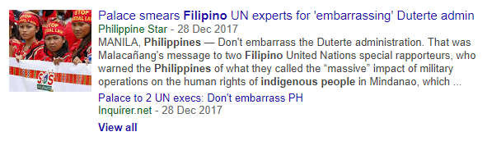

Slide 9
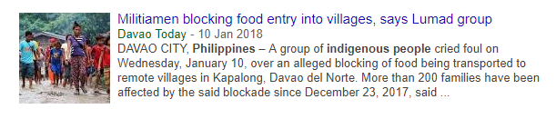

Slide 10


Slide 11
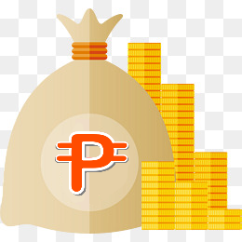
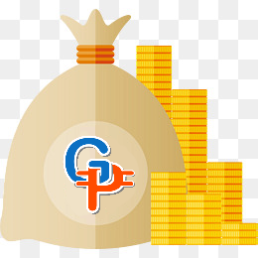
What is GoPondo?
Fundraising project that targets Filipino/s in need of help financially.

Slide 12
But not everyone has money!

Slide 13
INTRODUCING GoPondo Credits

Slide 14


What are GoPondo Credits?
GoPondo Credits is a form of currency obtained by finishing several microtasks offered in the website.

Slide 15
DEMO

