Slide 1
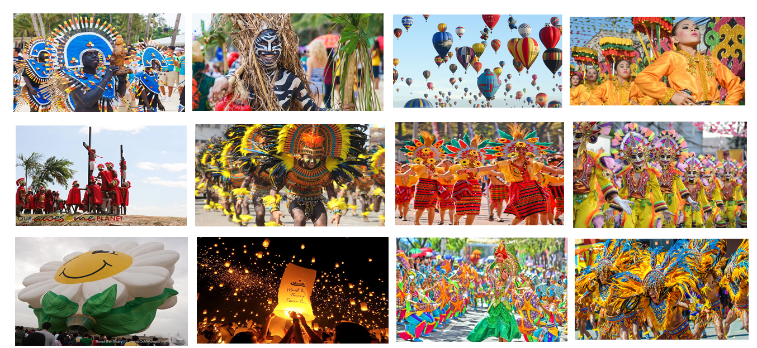
#CULTURANGPILIPINAS
Domasig, Prince
Fortuna, Zaphaneth
Palce, Louise
Soliveres, Eunel

Slide 2

INTRODUCTION
These days less and less of our Filipino brothers and sisters care about upholding our own different cultures
They find it tiresome to keep following our cultural roots and find other cultures to be more interesting which makes up diversity

Slide 3
INTRODUCTION
Being diverse is a good way to spread our culture and mix with others in peace while respecting their culture and earning respect in the same way
But nowadays we are too diverse that our own “already diverse culture” is spread too thin that it may just be forgotten

Slide 4
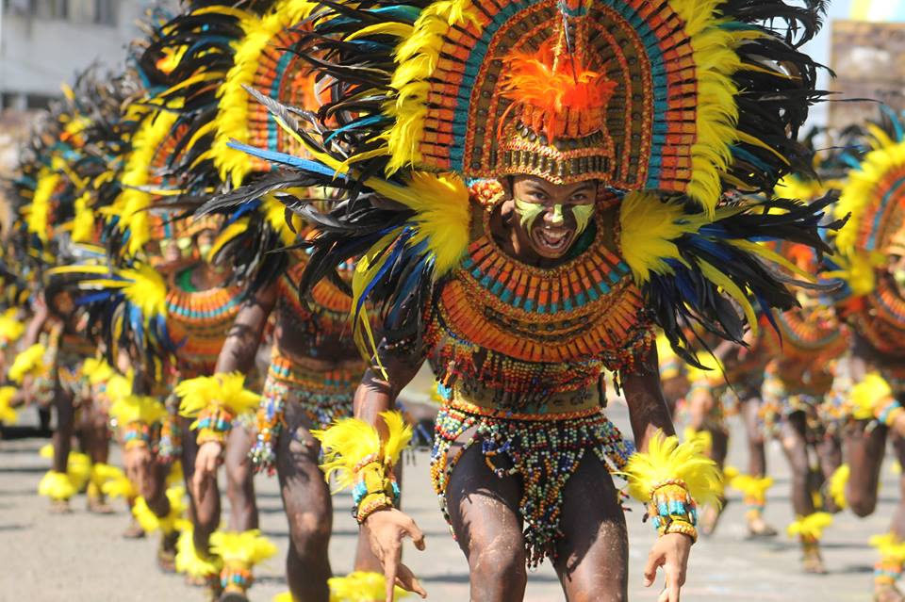

Slide 5
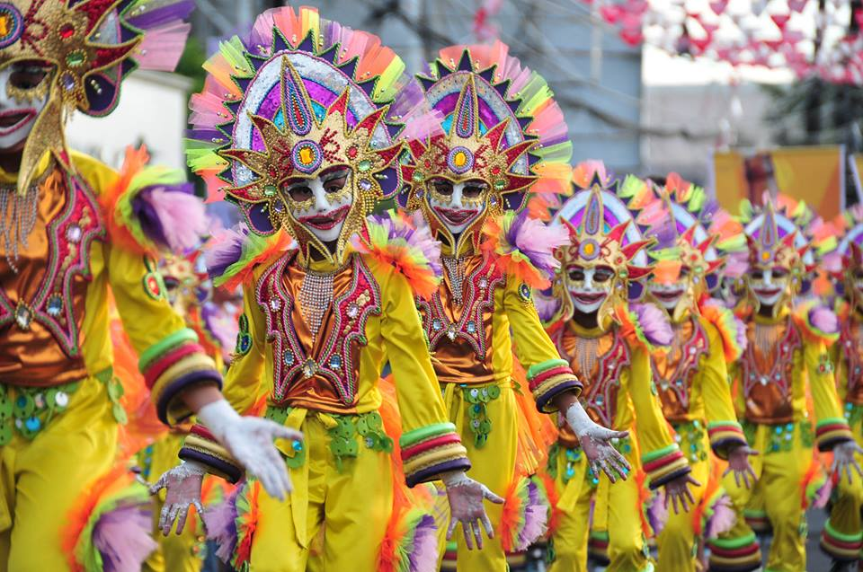

Slide 6
PROBLEMS TO ANSWER :
How do we make Filipinos remember their own cultural roots before mingling with others, while at the same time also spreading ours to others?

Slide 7
ANSWERS
We made a site, that will be a reminder for us Filipinos to look and live our own culture while still loving others.

Slide 8
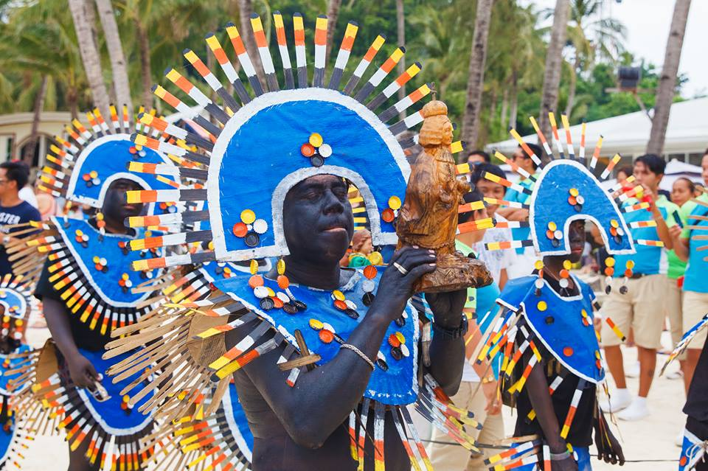

Slide 9
#CULTURANGPILIPINAS
Our site shows the exact date of Filipino Fiestas (Festival)
It is soon possible to make mobile applications to notify our fellow Filipinos when its time to celebrate our cultures
Other than notifications it will be possible to make threads and events to gather Filipinos to celebrate

Slide 10
#CULTURANGPILIPINAS
This site would be very useful in promoting nation building as it keeps our own people and family close to our “already diverse” Filipino culture

Slide 11
