Slide 1
EyeTour
Developed By Team GenSec

Slide 2
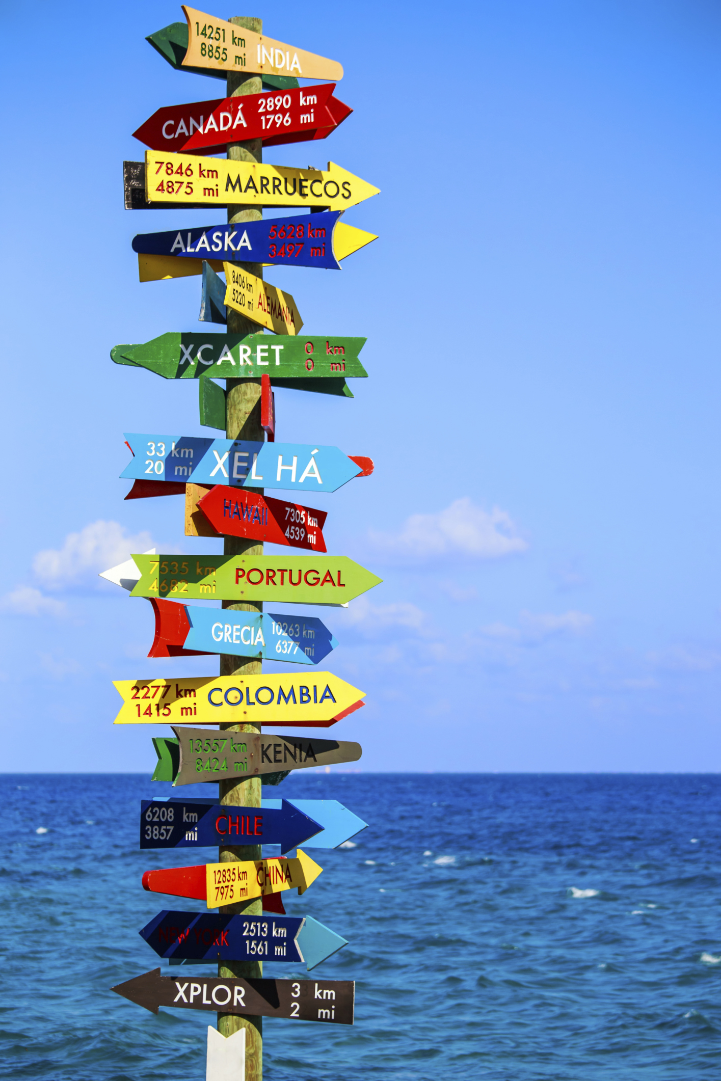

Why??

Slide 3
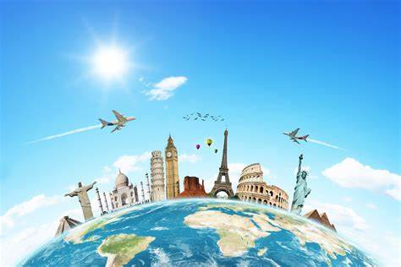

Information? Facts? Help?
??

Slide 4
Solution

