Slide 1
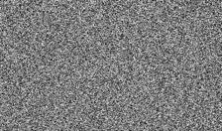
Generator G_{θ}
Generator G_{θ}
Noise
Noise
Real Data
Fake Batch
Real Data
Fake Batch
Static Repr. φ
Adverse Repr. ψ
Static Repr. φ
Adverse Repr. ψ
D_{static}(p, q_{θ})
D_{adv}(p, q_{θ})
D_{static}(p, q_{θ})
D_{adv}(p, q_{θ})
min_{θ} D_{static}(p, q_{θ}) + λ_{adv} ∗ D_{adv}(p, q_{θ})
max_{ψ} D_{adv}(p, q_{θ})
Fake Samples
Fake Samples
Real Samples
Update G_{θ}
Real Samples
Update ψ
Pull Closer
Push Apart
(a) G-step Training
(b) D-step Training
Notes:
Editable reconstruction of AdvFD (Gao et al., 2026), arXiv:2608.11205v1, Figure 3. Original module/edge geometry retained from the authors’ vector PDF. Text/formulas, icons, contours and scatter points are native editable objects. The two noise tiles are replaceable raster pictures. Scatter positions were redrawn and are illustrative. Use Comic Neue (supplied fonts) and DejaVu Serif. Ungroup or double-click a group to edit its contents. This page reproduces AdvFD, not the local classifier-guidance method. The original D-step static branch is retained for visual fidelity; its objective only optimizes the adverse branch.

Slide 2
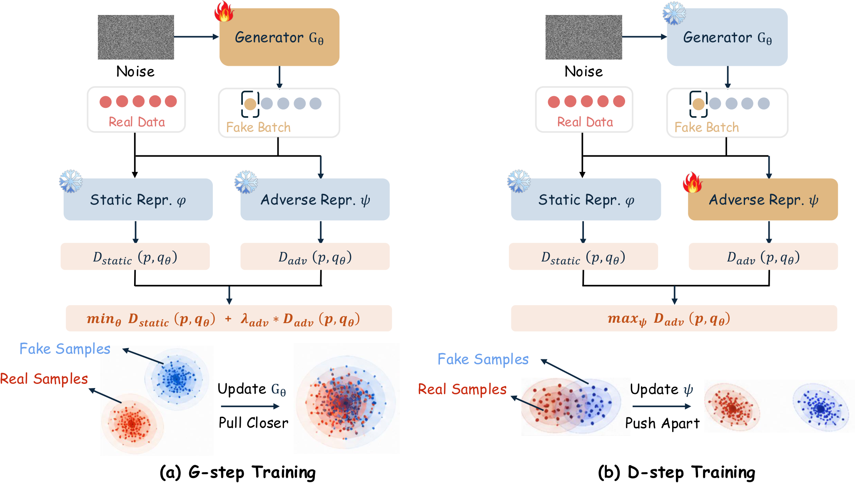
Notes:
Original Figure 3 from https://arxiv.org/abs/2608.11205v1, for visual comparison. Edit slide 1.

