Slide 1
Strain Limiting and Position Based Dynamics

Slide 2
The Stiffness Issue
Real-world fabrics resist strongly to stretching, once they stretch beyond certain limits.
But, increasing the stiffness can cause problems.
Explicit integrators will be unstable
Solution: smaller time steps and more computational time.
The linear systems involved in Implicit integrators will be ill-conditioned.
Solution: more iterations and computational time.
Can we achieve high stiffness, with a low computational cost?

Slide 3

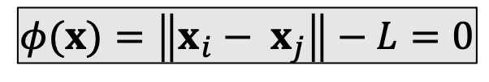
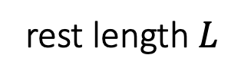









A Single Spring
If a spring is infinitely stiff, we can treat the length as a constraint and define a projection function.
$$x_{j}$$
rest length $L$
$$x_{i}^{new}$$
$$x_{j}^{new}$$
$$x_{i}$$
$$x_{i}$$
$$x_{j}$$
$$x_{j}$$
$$x_{j}^{new}$$
$$φ(x)=\left\|x_{i}− x_{j}\right\|−L=0$$
$$x_{i}^{new}$$
Constraint
$$x_{i}$$
Stretched case
Compressed Case

Slide 4

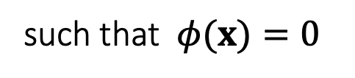


A Single Spring
If a spring is infinitely stiff, we can treat the length as a constraint and define a projection function.
$$\left\{x_{i}^{new},x_{j}^{new}\right\}=argmin\frac{1}{2}\left\{{m_{i}\left\|x_{i}^{new}−x_{i}\right\|}^{2}+{m_{j}\left\|x_{j}^{new}−x_{j}\right\|}^{2}\right\}$$
such that $φ(x)=0$
rest length $L$
$$x_{i}$$
$$x_{j}$$
$${x=\{x}_{i},x_{j}\}$$
$$φ(x)=\left\|x_{i}− x_{j}\right\|−L=0$$
Boundary $∂Ω$
Constraint
$$Ω=\{x∈R^{6}:φ(x)=0\}$$

Slide 5
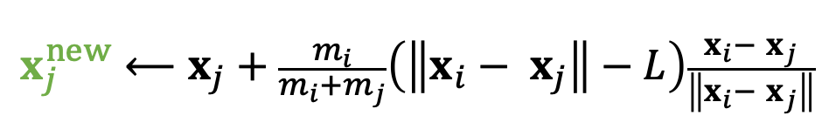
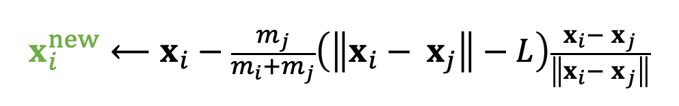

A Single Spring
If a spring is infinitely stiff, we can treat the length as a constraint and define a projection function.
$$\left\{x_{i}^{new},x_{j}^{new}\right\}=argmin\frac{1}{2}\left\{{m_{i}\left\|x_{i}^{new}−x_{i}\right\|}^{2}+{m_{j}\left\|x_{j}^{new}−x_{j}\right\|}^{2}\right\}$$
such that $φ(x)=0$
rest length $L$
$$x_{i}$$
$$x_{j}$$
$$x^{new}⟵Projection(x)$$
$$φ(x)=\left\|x_{i}− x_{j}\right\|−L=0$$
$$x_{i}^{new}⟵x_{i}−\frac{m_{j}}{m_{i}+m_{j}}\left(\left\|x_{i}− x_{j}\right\|−L\right)\frac{x_{i}− x_{j}}{\left\|x_{i}− x_{j}\right\|}$$
Constraint
$$x_{j}^{new}⟵x_{j}+\frac{m_{i}}{m_{i}+m_{j}}\left(\left\|x_{i}− x_{j}\right\|−L\right)\frac{x_{i}− x_{j}}{\left\|x_{i}− x_{j}\right\|}$$
$$φ\left(x^{new}\right)=\left\|x_{i}^{new}− x_{j}^{new}\right\|−L=\left\|x_{i}−x_{j}−x_{i}+x_{j}+L\right\|−L=0$$
By default, $m_{i}=m_{j}$, but we can also set $m_{i}=∞$ for stationary nodes.

Slide 6












Multiple Springs – A Gauss-Seidel Approach
What about multiple springs? The Gauss-Seidel approach projects each spring sequentially in a certain order. Imagine two springs with unit rest lengths…
$$x_{0}$$
$$x_{0}$$
$$x_{0}$$
2
1
$$x_{0}$$
$$x_{0}$$
$$x_{1}$$
1.75
1
1.1875
$$x_{1}$$
$$x_{1}$$
$$x_{1}$$
$$x_{1}$$
1.375
1
2.5
1
2
$$x_{2}$$
$$x_{2}$$
$$x_{2}$$
$$x_{2}$$
$$x_{2}$$

Slide 7




Multiple Springs – A Gauss-Seidel Approach
Projection (by Gauss-Seidel)
For $k=0…K$
For every edge $e=\{i,j\}$
$$x_{i}⟵x_{i}−\frac{1}{2}\left(\left\|x_{i}− x_{j}\right\|−L_{e}\right)\frac{x_{i}− x_{j}}{\left\|x_{i}− x_{j}\right\|}$$
$$x_{j}⟵x_{j}+\frac{1}{2}\left(\left\|x_{i}− x_{j}\right\|−L_{e}\right)\frac{x_{i}− x_{j}}{\left\|x_{i}− x_{j}\right\|}$$
We cannot ensure the satisfaction of every constraint. But the more iterations we use, the better those constraints are satisfied.
Although the name is related to Gauss-Seidel, it differs from Gauss-Seidel. It is more relevant to stochastic gradient descent (in machine learning).
The order matters. The order can cause bias and affect convergence behavior.

Slide 8

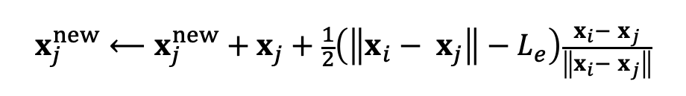


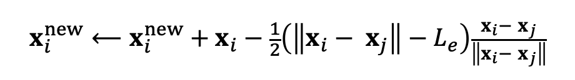






Multiple Springs – A Jacobi Approach
Projection (by Jacobi)
To avoid bias, the Jacobi approach projects all of the edges simultaneously and then linearly blend the results.
The problem is an even lower convergence rate.
Again, the more iterations it uses, the better the constraints are enforced.
For $k=0…K$
For every vertex $i$
$$x_{i}^{new}⟵0$$
$$n_{i}⟵0$$
For every edge $e=\{i,j\}$
$$x_{i}^{new}⟵x_{i}^{new}+x_{i}−\frac{1}{2}\left(\left\|x_{i}− x_{j}\right\|−L_{e}\right)\frac{x_{i}− x_{j}}{\left\|x_{i}− x_{j}\right\|}$$
$$x_{j}^{new}⟵x_{j}^{new}+x_{j}+\frac{1}{2}\left(\left\|x_{i}− x_{j}\right\|−L_{e}\right)\frac{x_{i}− x_{j}}{\left\|x_{i}− x_{j}\right\|}$$
$$n_{i}⟵n_{i}+1$$
$$n_{j}⟵n_{j}+1$$
For every vertex $i$
$$x_{i}⟵(x_{i}^{new}+{αx}_{i})/(n_{i}+α)$$

Slide 9






Position Based Dynamics (PBD)
Position based dynamics (PBD) is based on the projection function.
The stiffness behavior, i.e., how tightly constraints are enforced, is subject to non-physical factors.
The number of iterations
The mesh resolution
The velocity update following projection is important to dynamic effects.
This method is applicable to other constraints as well, including triangle constraints, volume constraints, and collision constraints.
To implement these constraints, simply define their projection functions.
A PBD Simulator
//Do Simulation, update $x$ and $v$
$$v ⟵…$$
$$x ⟵…$$
//Now PBD starts.
$$x^{new} ⟵Projection(x)$$
$$v ⟵v+(x^{new}−x)/∆t$$
$$x⟵x^{new}$$

Slide 10
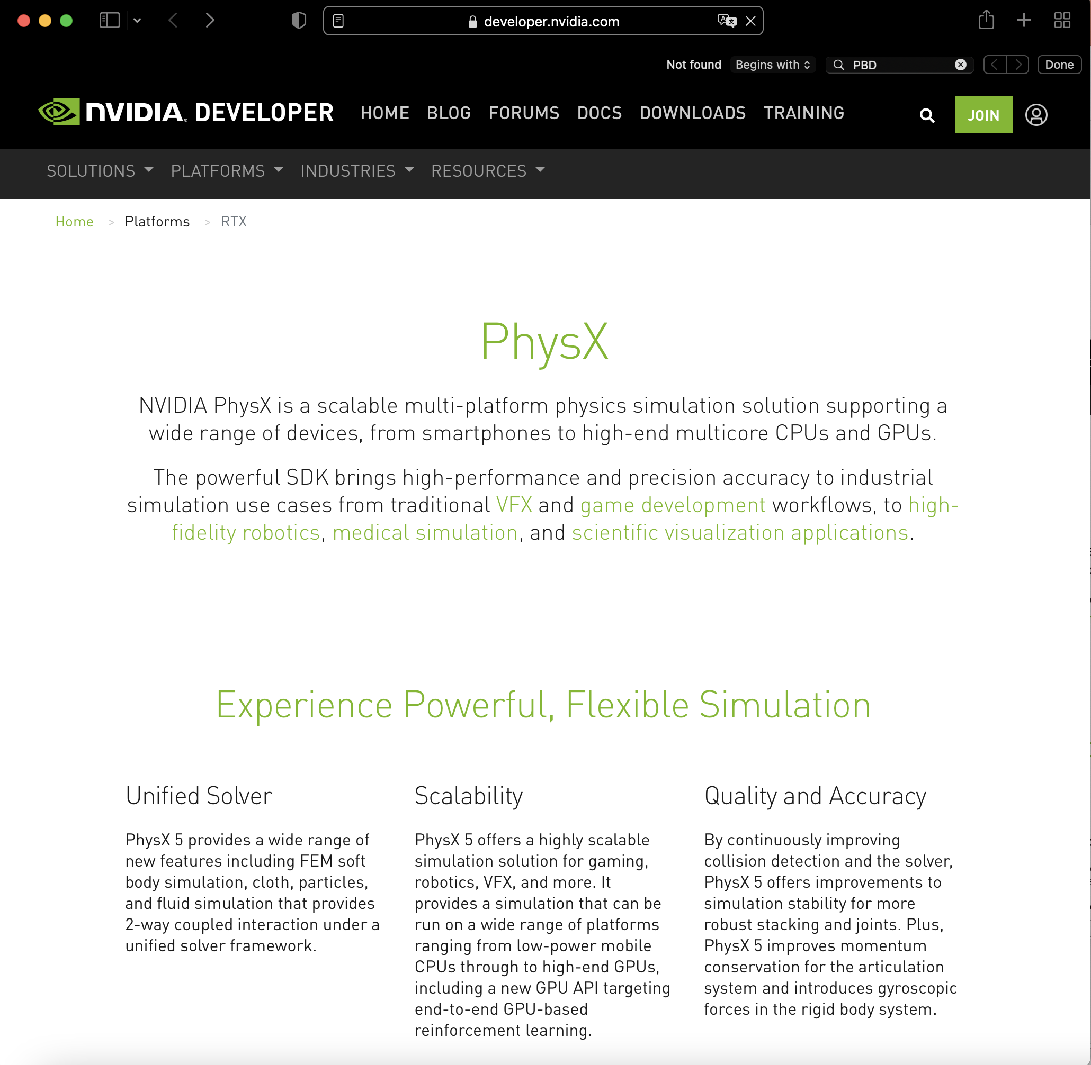
Pros and Cons of PBD
Pros
Parallelable on GPUs (PhysX)
Easy to implement
Fast in low resolutions
Generic, can handle other coupling and constraints, including fluids
Cons
Not physically correct
Low performance in high resolutions
Hierarchical approaches (can cause oscillation and other issues…)
Acceleration approaches, like Chebyshev

Slide 11
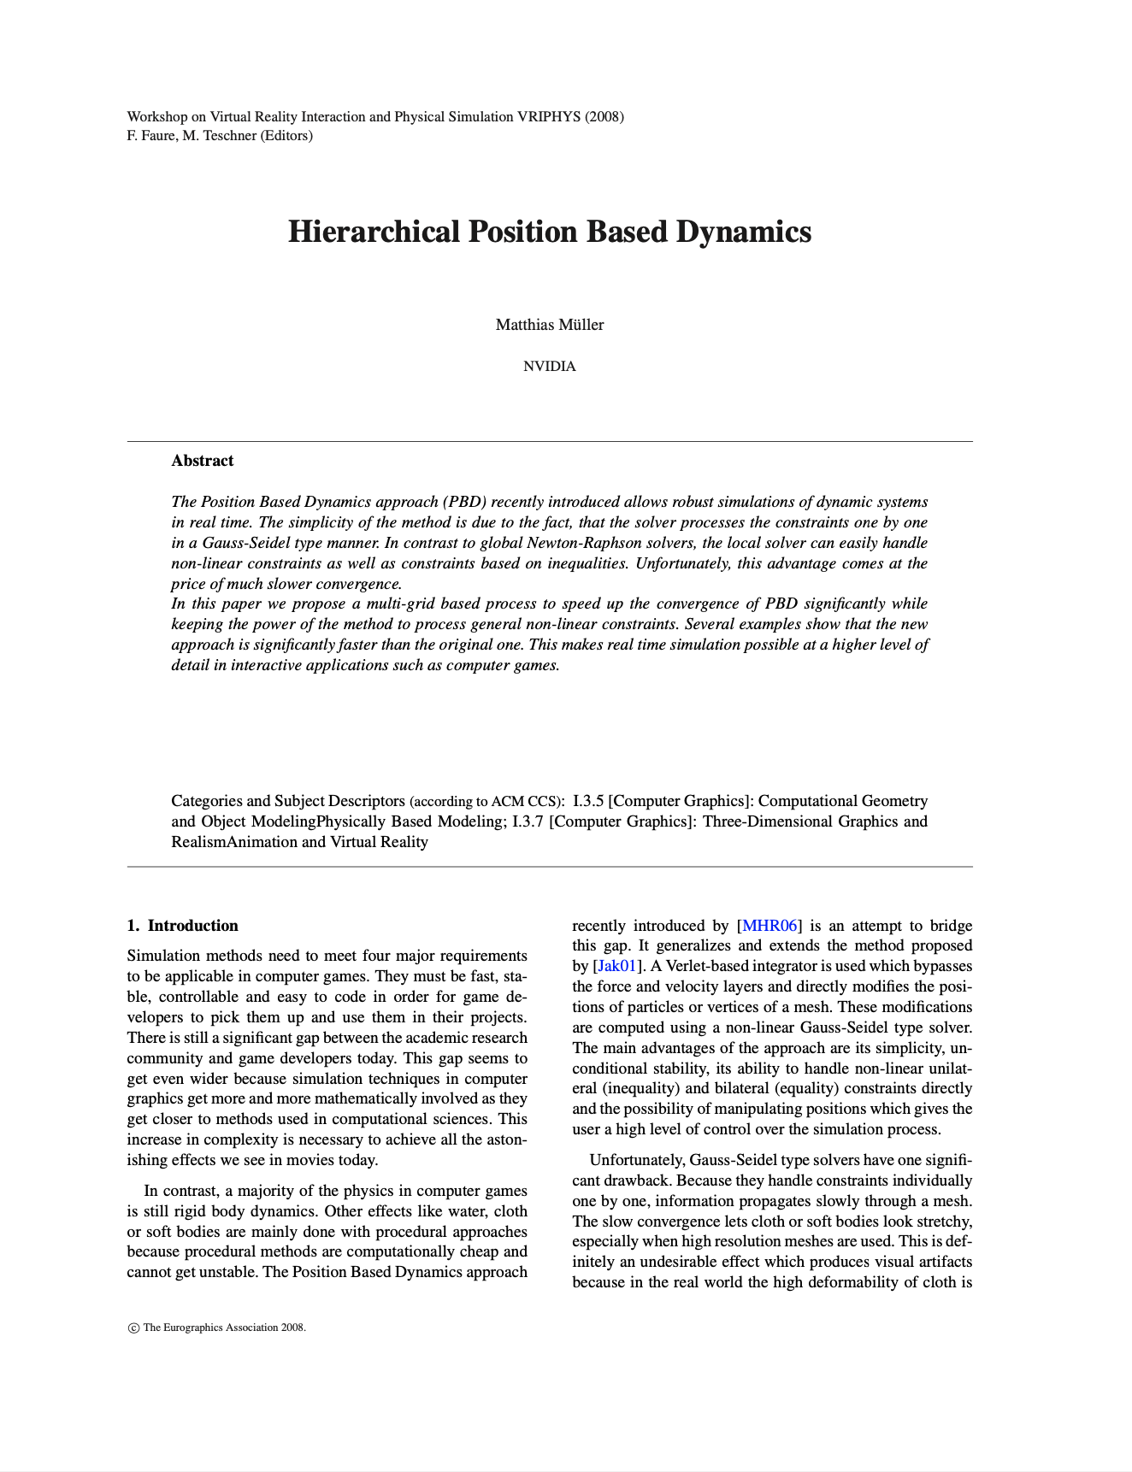
After-Class Reading
Muller. 2008. Hierarchical Position Based Dynamics. VRIPHYS.

