Slide 1

Automated TTP Extraction and Analysis Tool using MITRE ATT&CK Framework
In the ever-evolving landscape of cybersecurity, staying ahead of threat actors requires efficient analysis of their tactics, techniques, and procedures (TTPs). Our innovative Automated TTP Extraction and Analysis Tool leverages the power of the MITRE ATT&CK framework to revolutionize threat intelligence processing. This cutting-edge solution addresses the time-consuming and error-prone nature of manual TTP extraction, providing senior analysts and cybersecurity managers with a powerful asset for rapid threat assessment and defense prioritization.
By combining advanced natural language processing techniques with the comprehensive MITRE ATT&CK knowledge base, our tool streamlines the process of identifying and categorizing cyber threats. This presentation will guide you through the tool's architecture, functionality, and potential impact on your organization's cybersecurity posture.
by SIDDHARTH

Slide 2
Problem Statement and Objectives
The Challenge
Our Solution
Target Users
Manual extraction of TTPs from threat intelligence reports is a labor-intensive process prone to human error. Analysts spend countless hours sifting through dense reports, potentially missing critical insights or misclassifying threats. This inefficiency can lead to delayed responses to emerging threats and suboptimal allocation of defensive resources.
Our objective is to develop an automated tool for TTP extraction and analysis using the MITRE ATT&CK framework. This tool aims to significantly reduce the time and effort required for threat analysis while improving accuracy and consistency in TTP identification. By leveraging advanced AI techniques, we can provide cybersecurity professionals with a powerful asset for rapid threat assessment and proactive defense planning.
The primary audience for this tool includes senior analysts and cybersecurity managers who need to quickly process large volumes of threat intelligence and make informed decisions about security priorities. The tool's intuitive interface and comprehensive output make it valuable for both tactical and strategic cybersecurity planning.

Slide 3
Data Collection and Preprocessing
1
Web Scraping
Our data collection process begins with web scraping from the MITRE ATT&CK website (https://attack.mitre.org) using Selenium. This ensures we have the most up-to-date information on tactics, techniques, and procedures. The MITREExtractor class is responsible for navigating the website and extracting relevant data.
2
Data Structuring
Once raw text is collected, we convert it into a structured JSON format. This step involves parsing the HTML content, extracting key information such as technique IDs, names, descriptions, and associated tactics. The structured format allows for easier processing and integration with our machine learning models.
3
Data Cleaning
The final preprocessing step involves cleaning the data to remove any inconsistencies, HTML artifacts, or irrelevant information. This ensures that our models are trained on high-quality, relevant data, improving their overall performance in TTP extraction and analysis tasks.

Slide 4



Model Architecture
BERT NER Model
BERT QA Model
Integrated Pipeline
Our model architecture begins with a BERT-based Named Entity Recognition (NER) model. This component is crucial for identifying and extracting relevant entities from the input text, such as malware names, attack vectors, and targeted systems. The NER model has been fine-tuned on cybersecurity-specific datasets to enhance its performance in recognizing domain-specific entities.
Following the NER model, we employ a BERT-based Question Answering (QA) model. This component is designed to extract relevant passages and answers from the text based on predefined questions related to TTPs. The QA model helps in identifying specific details about the techniques and procedures used by threat actors.
The NER and QA models work in tandem within an integrated pipeline. The entities extracted by the NER model are used to refine the questions posed to the QA model, improving the relevance and accuracy of the extracted information. This synergy between the two models enables a more comprehensive and precise TTP extraction process.

Slide 5
TTP Extraction Process
1
2
3
4
Raw Text Input
Entity Extraction
Passage Retrieval
MITRE ATT&CK Mapping
The process begins with ingesting raw text from threat intelligence reports. This unstructured data serves as the foundation for our analysis.
The BERT NER model identifies relevant entities within the text, such as malware names, attack techniques, and targeted systems. These extracted entities provide context for further analysis.
Using the extracted entities, the BERT QA model retrieves relevant passages from the text that describe specific TTPs. This step narrows down the focus to the most pertinent information.
The extracted TTPs are then mapped to corresponding MITRE ATT&CK tactics and techniques. This mapping provides a standardized framework for understanding and categorizing the threat actor's behavior.

Slide 6
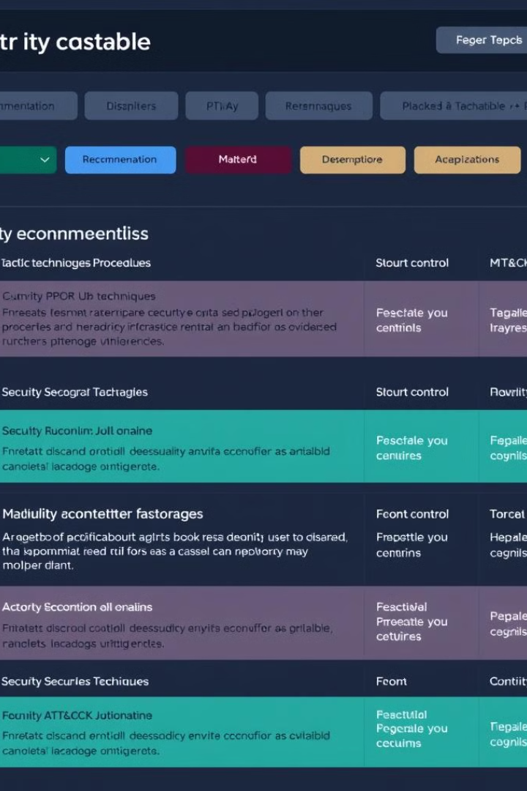
Security Control Recommendations
TTP Analysis
Once TTPs are identified and mapped to the MITRE ATT&CK framework, our tool analyzes the specific techniques and their potential impact on the organization's security posture.
Mitigation Mapping
The tool then links the identified TTPs to relevant MITRE ATT&CK mitigations. This process involves matching the techniques to recommended countermeasures and security controls.
Prioritization
Security control recommendations are prioritized based on factors such as the prevalence of the technique, its potential impact, and the organization's current security capabilities.
Actionable Insights
The final output provides actionable insights, including specific security controls to implement, configuration changes, and best practices to mitigate the identified threats.

Slide 7
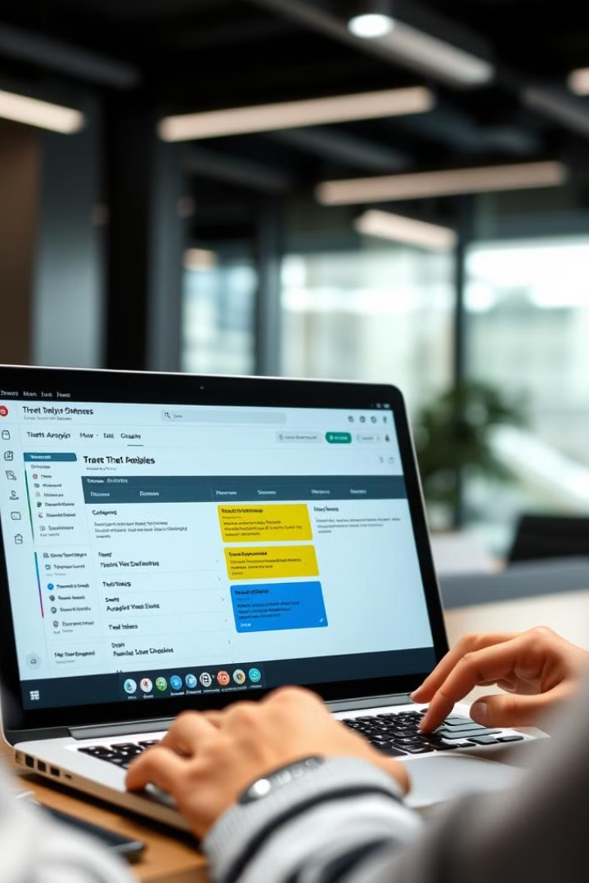




Tool Usage for Monthly Threat Analysis
Report Upload
Users begin by uploading monthly threat intelligence reports to the tool's interface. The system supports various file formats, including PDF, DOC, and TXT.
Automated Analysis
The tool processes the uploaded reports, extracting TTPs and mapping them to the MITRE ATT&CK framework. This step significantly reduces the time required for manual analysis.
Results Review
Analysts review the extracted TTPs, associated MITRE ATT&CK techniques, and recommended security controls through an intuitive dashboard interface.
Defense Prioritization
Based on the tool's output, cybersecurity managers can quickly prioritize defense strategies, allocate resources, and update security policies to address the most pressing threats.

Slide 8
Conclusion and Future Improvements
1
Transformative Impact
2
AI Integration
Our Automated TTP Extraction and Analysis Tool revolutionizes the way organizations process threat intelligence. By significantly reducing analysis time and improving accuracy, it enables cybersecurity teams to stay ahead of emerging threats and prioritize their defenses effectively.
Future improvements will focus on integrating Large Language Models to enhance the tool's natural language understanding capabilities. This will allow for more nuanced interpretation of threat reports and improved context-aware analysis.
3
Expanded Functionality
4
Continuous Improvement
We plan to expand support for additional input formats and integrate with popular threat intelligence platforms. This will create a more seamless workflow for analysts and further streamline the threat analysis process.
As the threat landscape evolves, so too will our tool. We are committed to ongoing refinement of our models and regular updates to ensure alignment with the latest MITRE ATT&CK framework revisions.

