Slide 1
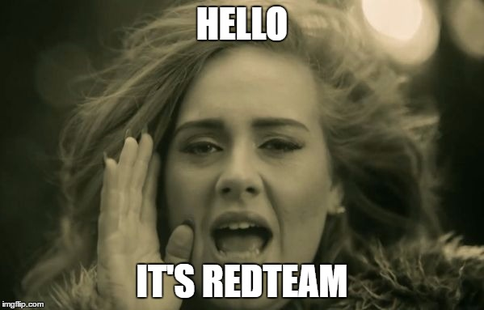

Slide 2
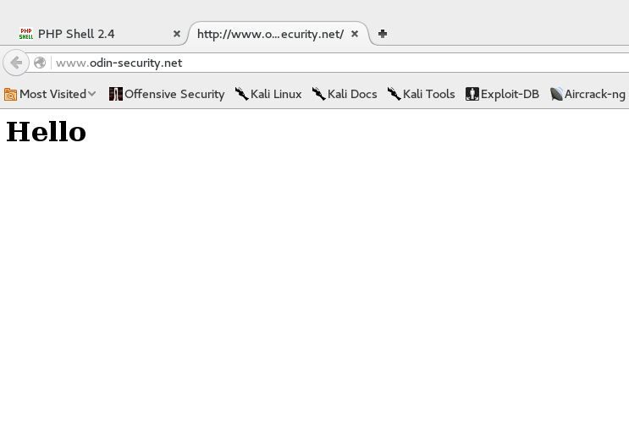
What did you learn this weekend

Slide 3
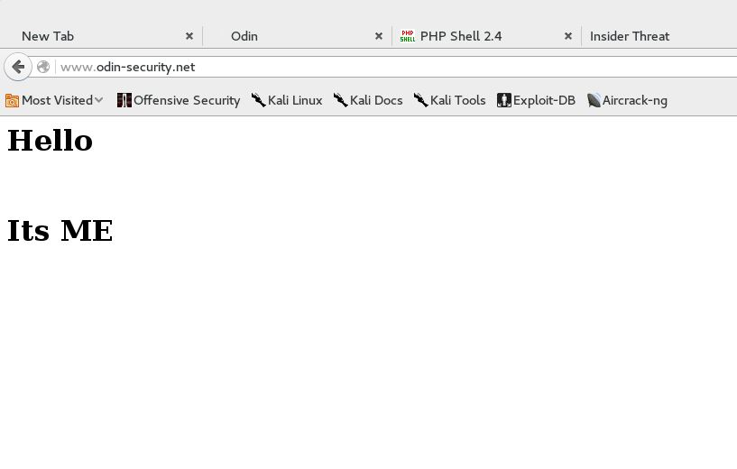
Did you learn to

Slide 4
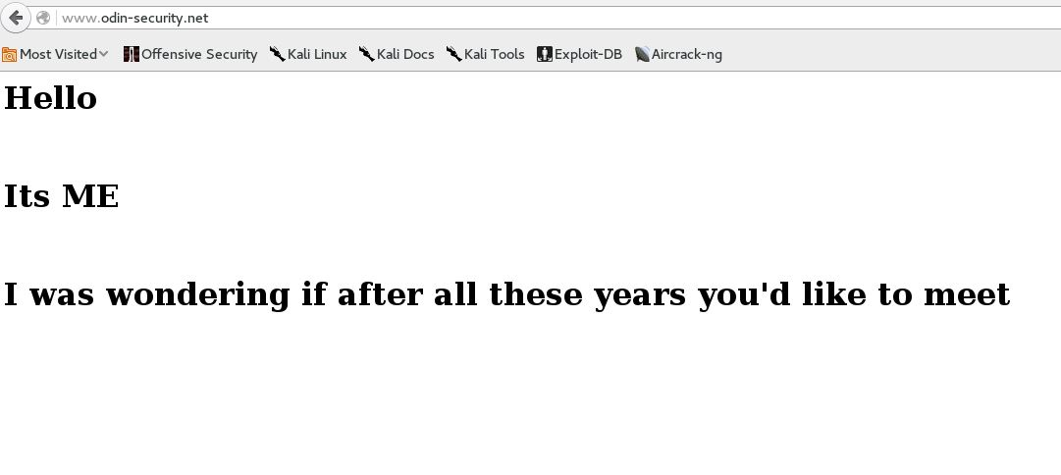
Pay attention to An attacker

Slide 5
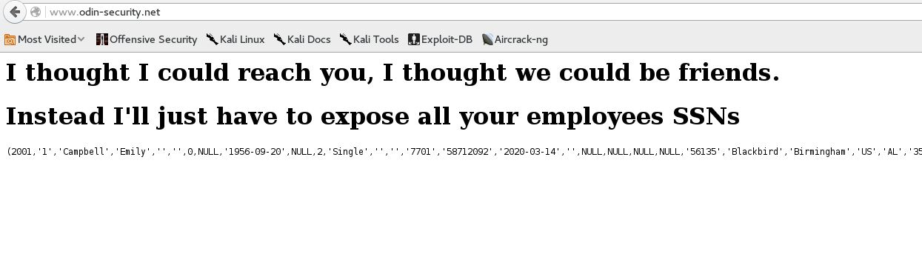
Trying to talk to you

Slide 6
For those first timers to nationals
Red Team at Nationals
We don’t get any information about your network prior to the event
We don’t get any passwords ahead of time
We don’t get access to your team rooms
We start when you start
There is a set of red teamers assigned just to your team

Slide 7
The first 10 minutes
You get a blue team packet, prior to hour 0 you know
Your servers
Your Services
Your scored services
Your networks

Slide 8
Use your advantage
Change Passwords on Scored Services and Infrastructure first
Patch after changing passwords if you have to choose between the two
Configure your firewalls third to prevent egress
Configure your firewalls to only allow scored services in
Read up on remote administration of your services

Slide 9
The redteam advantage
We only have to find one way in
You have to find all the ways we can get in

Slide 10

National redteam day 1
Anyone can get in once
A national redteamer stays in
Persistence
Agents
De-Security
Authentication bypass
Keylogging
Webshells
New accounts
Stealing all valuable data

Slide 11
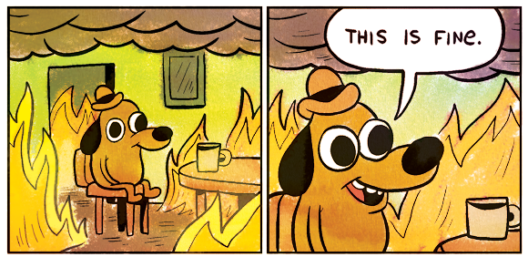
National redteam day 2
Exposing PII
Defacing websites
Scored service take down
MBR wiping
System reposession

Slide 12
Two days, two lessons
Day 1
Learn to Hunt
Assume Compromise
Day 2
Respond don’t react
Root cause analysis

Slide 13
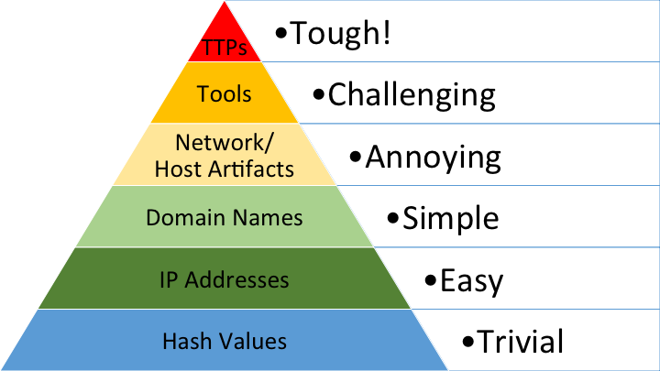
Going hunting
Know Normal
Network Connections
Event Logs/Syslog
Weblogs
Antivirus/Antimalware
Hash checks
Use Splunk!

Slide 14

Consider real IR
Memory Forensics
Free and Open Source
Rekall – Works on live memory
Volatility – Works on memory dumps
We can’t hide from memory forensics
Execution artifacts
Deleted file recovery

Slide 15
Think about why things are happening
If a website keeps getting defaced
If a database keeps getting deleted
If a windows domain controller becomes a linux system
YOU HAVEN’T FIXED THE PROBLEM

Slide 16
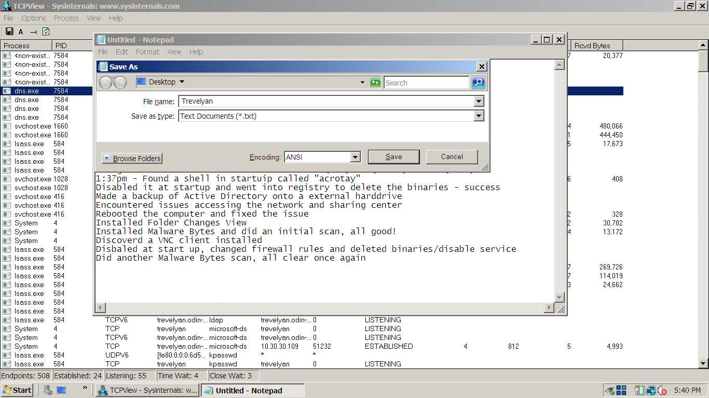
All clear, once again

Slide 17
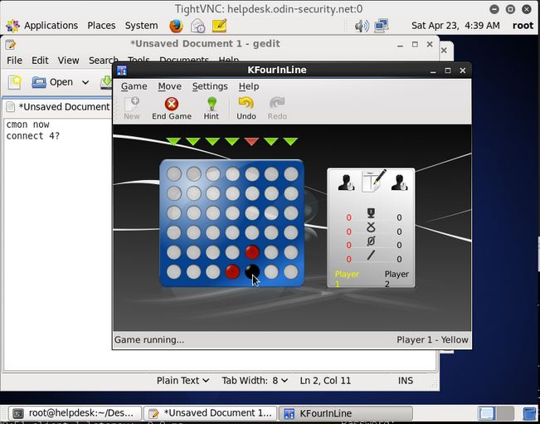
Playing games to distract you

Slide 18
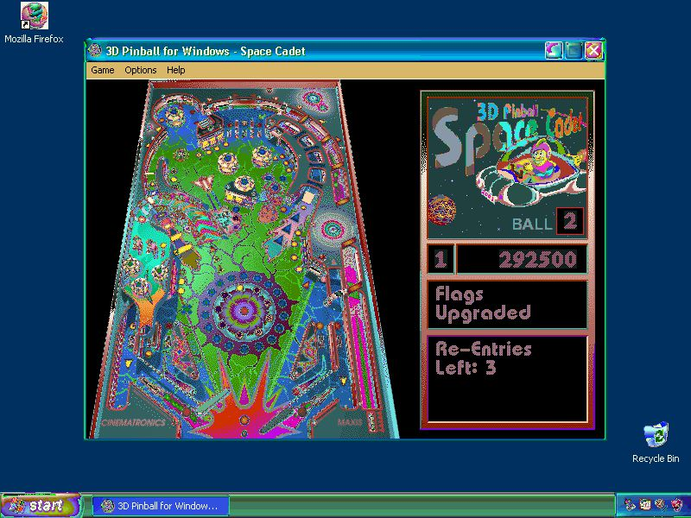
Other times just passing time on your systems

Slide 19
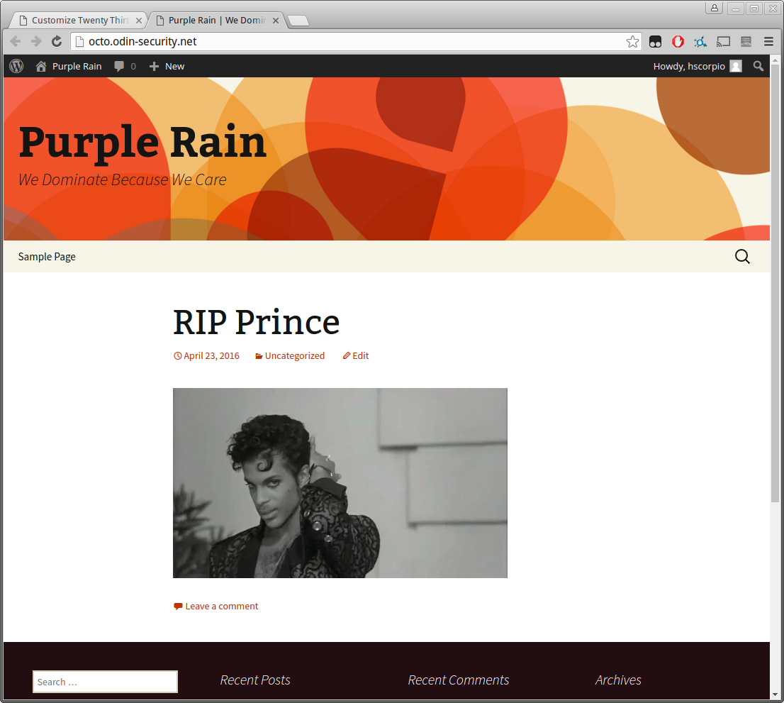
We respect royalty

Slide 20
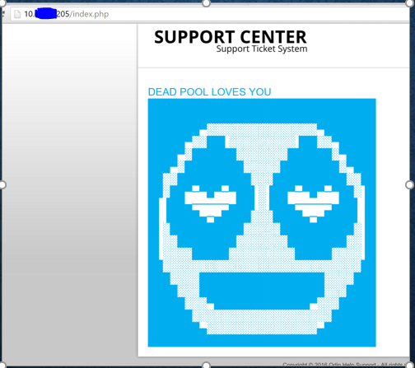
Its too late when you see this

Slide 21
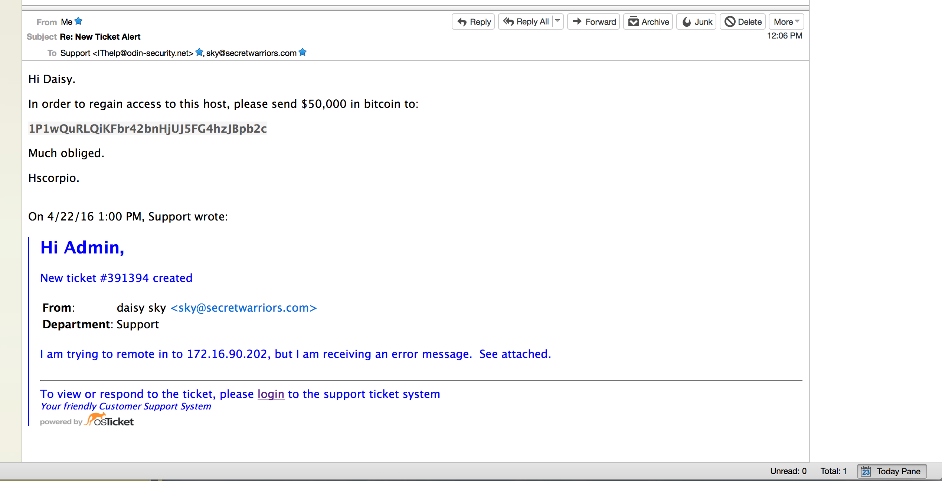
We think we are hilarious

Slide 22
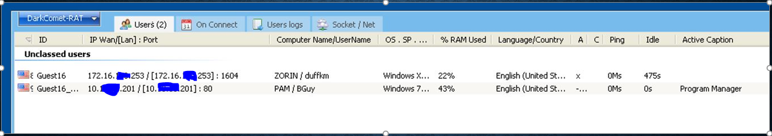
Kicking it old school

Slide 23
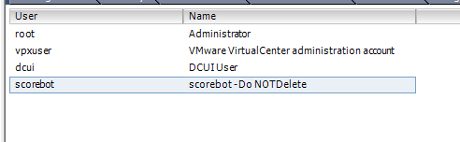
You shouldn’t believe everything you read

Slide 24
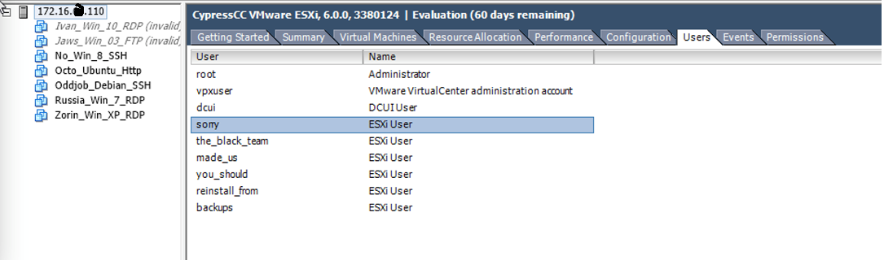
If you’ve resorted to talking us through this, its not good

Slide 25
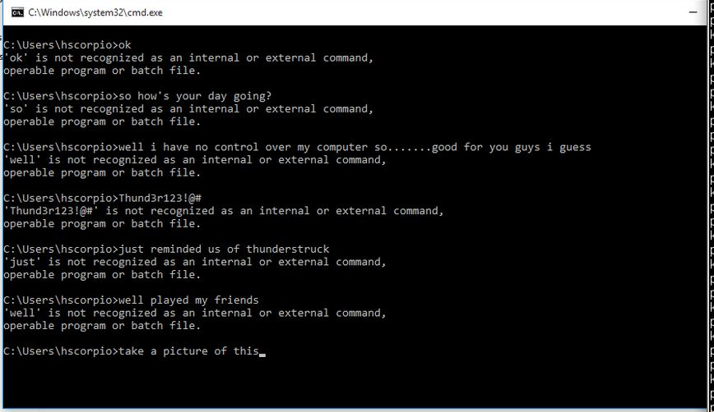
You ask to be in the debrief, you get in the debrief

Slide 26

We are listening

Slide 27
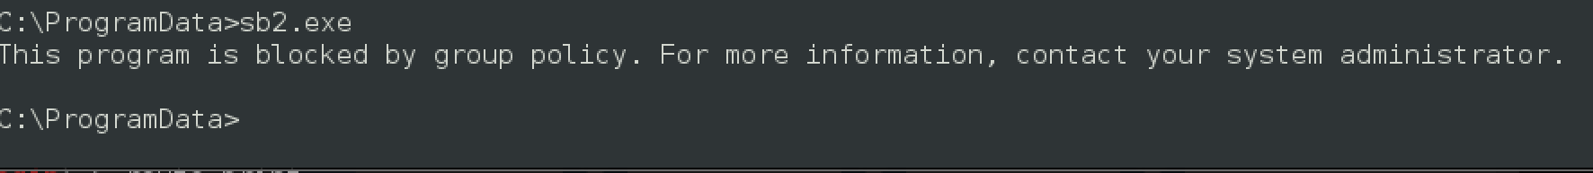
Sometimes you do smart things

Slide 28
Many times we miss things
There was a 3rd network?!

Slide 29
Summer school for blue teams
You need to practice
Change all passwords if you’ve been compromised
If you are playing at nationals, you’ve been compromised
Learn host firewalls in case you can’t get the network firewall working
Practice learning what a normal system looks like
Start watching your own network connections
Practice basic memory forensics

Slide 30
We will get better too
No all red board
More testing for some of our toolkits
More malware
More Persistence
More Agents
More Music
More Fun!

