Slide 1
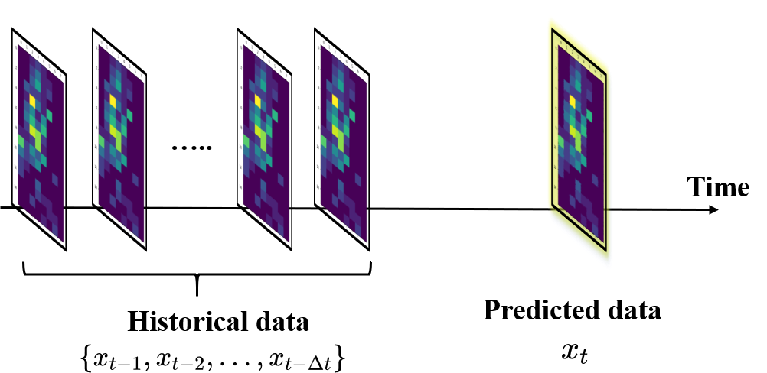
Problem formulation
Spatial-temporal Traffic Flow Data Prediction
Given historical data {Xt | t = 0, · · · , n − 1}, predict target Xt.
Spatial correlations
The traffic flow of a location is affected by nearby locations.
Temporal correlations
The traffic flow at a time interval is correlated to previous time interval. For example, the morning rush hour at 8:00 AM will last to 10:00AM.

Slide 2
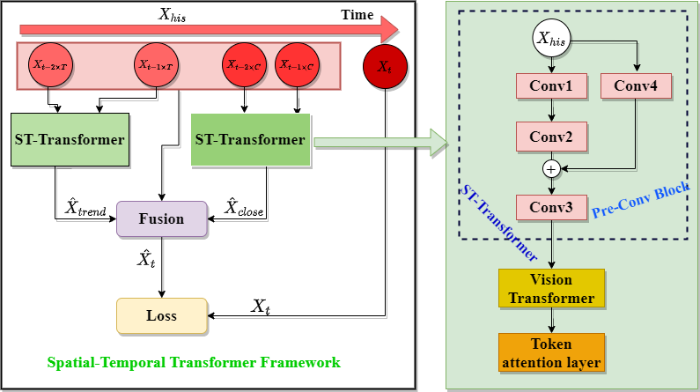
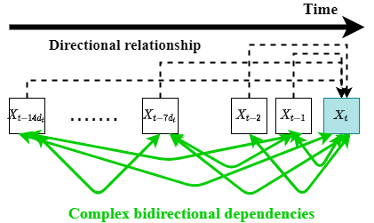
Methods
We propose a transformer-based framework Spatial-temporal Transformer Framework (STTF) to model the spatial-temporal dependencies of traffic flow data. In addition, we introduce a self-supervised learning task named Random Predictive Learning (RPL) to learn a generalized and robust spatial-temporal features.
STTF
RPL

Slide 3
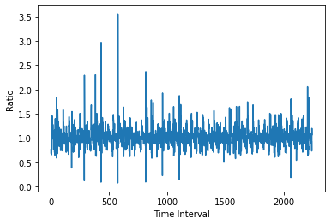
Spatial-temporal Transformer Framework (STTF)
In STTF, we follow previous work classify the historical data into two group (closeness dependent data and trend dependent data). use two ST-Transformer block to separately model them. Inside the ST-Transformer block, we employ a pre-conv block to model local spatial correlations. While a vision transformer encoder block to model global spatial correlation. At the end, we use a token attention layer to refine token features.
In addition, we propose a technique named similar connection to model the similarity between historical data and predictive target.
Similarity in adjacent time

