Slide 1
Pandemic
VS
Health Adjacent Stock Prices
Joseph Trybala,
Manas Bharadwaaj Subramanian,
Miko Wieczorek,
Ritu Kukreja

Slide 2
Introduction and Purpose of Dataset
COVID19 Pandemic and Health Insurance & Pharmaceutical companies
Equities traders and wealth managers who want to take advantage of stock price
Acquire publicly available statistical data
Process it in python to identify trends
Notes:
Ritu
- The goal of our project is to find any potential correlations between the current pandemic and the market value of healthcare companies.
- Our dataset may be helpful to researchers and analysts looking at the connection between a pandemic and the domestic stock market.
- There is currently a lot of interest in vaccine supplies and the COVID dataset due to the heightened global hunt for answers to prevent the pandemic.
- Recognizable trends between higher vaccination rates and higher pharmaceutical company valuations would serve as an illustration of success using Python.

Slide 3
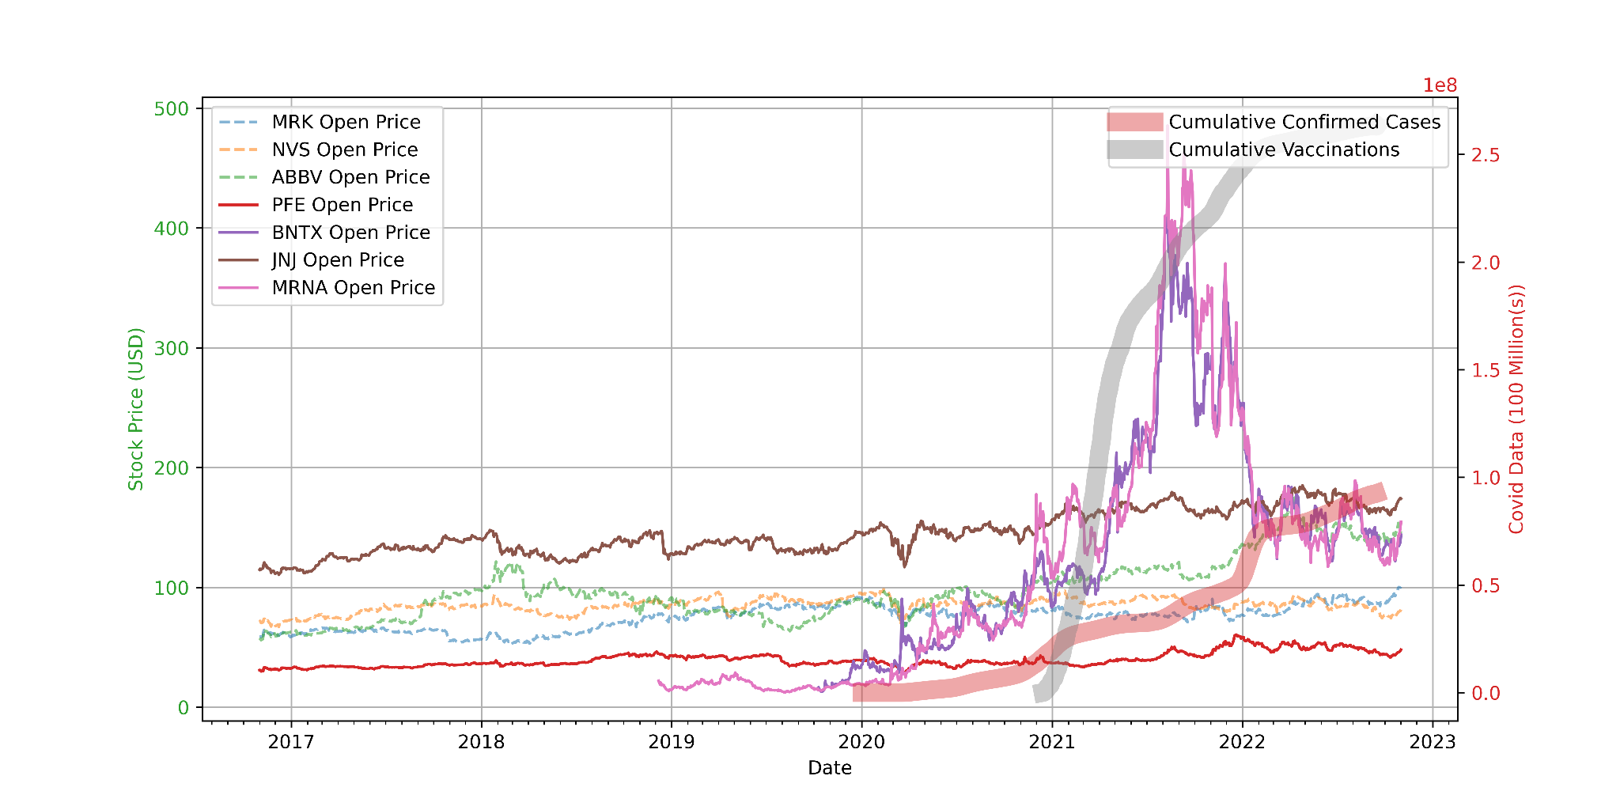
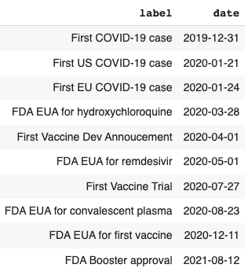
Data Summary: Trend of Big Pharma
Stock Prices and COVID-19 cases
Notes:
Miko

Slide 4
Potential Users and Applications
Pharmaceutical, health care and insurance companies
Potential investors
Correlations between public health and the company valuation
Notes:
Miko

Slide 5
Source of Data
MarketStack.com API
Google Covid-19 Open Data, Various sub-sources
Notes:
Joe - Our source for stock data is MarketStack.com, an online utility with API for daily stock pricing. They have historical data, chronologically organized by minute. Our use case only needed day-to-day free-tier access, however minute-to-minute information that could come from higher tiers could identify panic or greed based buying surrounding public health announcements.

Slide 6
Approach to Data Acquisition
Public Health APIs such as CDC
Google Covid-19 Open Data
Data we used came from CDC and Covid Tracking Project
Various Financial APIs
MarketStack API
Simple JSON output from API request
Date, Symbol were the necessary specified metrics
Using multiple get requests to the market stack that were constrained by day limitations.
JSON to csv > csv saved > csv to dataframe > stitch together dataframes of differing times and stock symbols.
Notes:
Joe - Numerous APIs stemming from numerous sources provide Covid data. After researching the viability of stitching together the data, nothing novel would be exemplified or learned by scrapping APIs with stifling rate limits it was determined that preaggregated produced by Google would suffice.
The stock data is a public resource, in that multiple sources would provide the same data with no differentiation. The API chosen, MarketStack is one of many that would do the job, it also happens to be the first and only one looked over for the purpose.

Slide 7
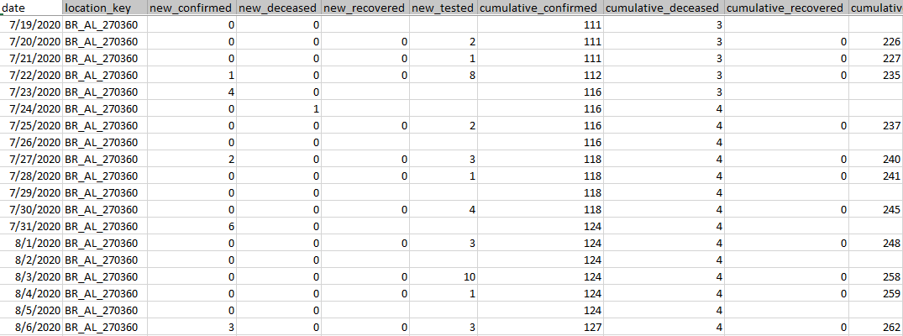
Acquisition - Covid Data - Epidemiology

Slide 8
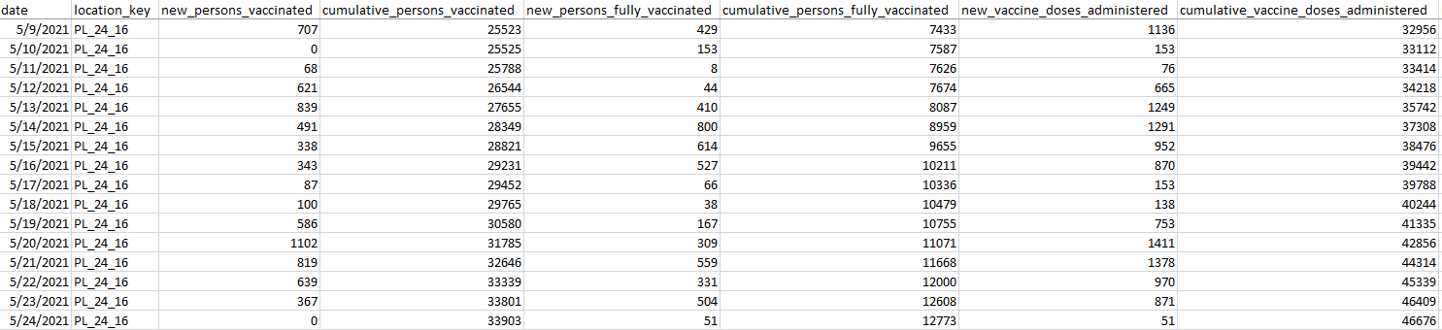
Acquisition - Covid Data - Vaccinations

Slide 9
Approach to Data Acquisition
Public Health APIs such as CDC
Google Covid-19 Open Data
Data we used came from CDC and Covid Tracking Project
Various Financial APIs
MarketStack API
Simple JSON output from API request
Date, Symbol were the necessary specified metrics
Using multiple get requests to the market stack that were constrained by day limitations.
JSON to csv > csv saved > csv to dataframe > stitch together dataframes of differing times and stock symbols
Notes:
Joe - Numerous APIs stemming from numerous sources provide Covid data. After researching the viability of stitching together the data, nothing novel would be exemplified or learned by scrapping APIs with stifling rate limits it was determined that preaggregated produced by Google would suffice.
The stock data is a public resource, in that multiple sources would provide the same data with no differentiation. The API chosen, MarketStack is one of many that would do the job, it also happens to be the first and only one looked over for the purpose.

Slide 10
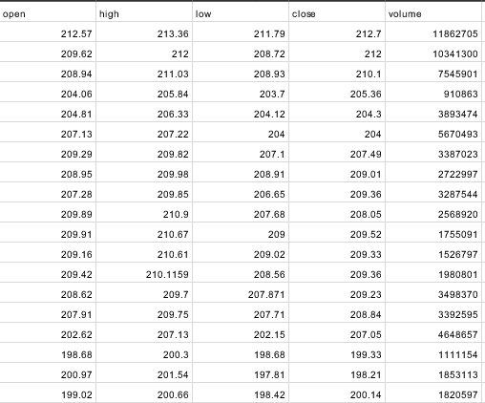
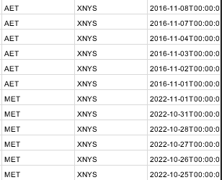
Acquisition - Stock Data

Slide 11
Approach to Preprocessing Data
Cutting down Covid data after identification of interesting metrics. Specifically “cumulative” over “new”
US Data Only
Only data that was well represented without gaps
Selecting, cutting down, and organizing stock data. Selection was an upfront and ongoing process
MarketStack provided their own adjusted metrics which, while valuable, were ultimately not utilized
Notes:
Joe - Selection was an upfront and ongoing process, as certain stocks that may have lended information did not appear interesting at a deeper glance. In addition,

Slide 12
Distribution Approach
Distributed as .csv for ease of use
The dataset will undergo further modifications and updated versions will be released
Code for acquiring, slicing, and organizing may also be released
We released the dataset on GitHub: github.com/bluemaw/covid-stock-data
Notes:
Manas

Slide 13
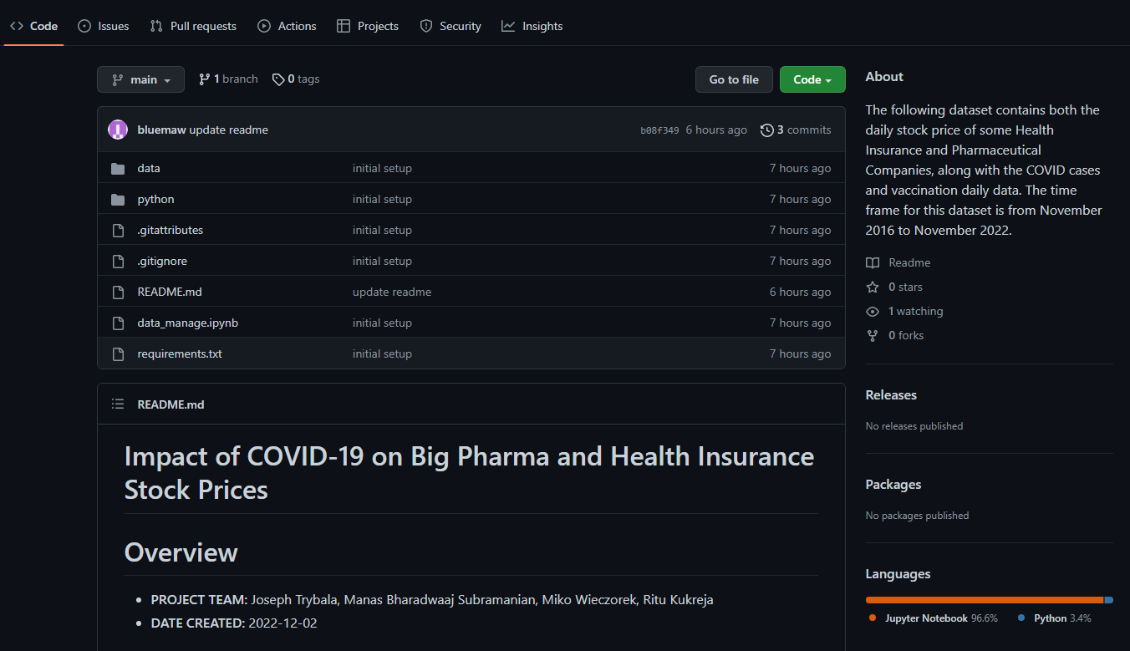
Distribution Approach - Github

Slide 14
Discussion of Access Rights
The dataset can be accessed via the following github.com/bluemaw/covid-stock-data
The Stock data is acquired from an free online service (MarketStack.com) that provides an ability to extract data using an API request
The COVID-19 dataset is acquired from Google Covid-19 Open Data, COVID Tracking Project, and the CDC
The final merged dataset is released publicly under a Creative Commons 4.0 Attribution (CC BY 4.0) license for interested parties
Notes:
Manas
The access rights of both sets of data we are working happens to be the same.
Covid-19 data has been freely available to the public through multiple avenues including through the CDC web portal and Johns Hopkins University's Center for Systems Science and Engineering.
Stock data is freely available from many vendors as it is handed out to many parties and brokerages from the New York Stock Exchange as well as other Exchanges. The web service that we are utilizing provides a free tier which is more than sufficient to acquire the relevant data.
Our combined dataset will likely be released publicly under a Creative Commons 4.0 Attribution (CC BY 4.0) license for use by any interested parties. It will be available in a CSV format for ease of access.

Slide 15
Issues and Limitations
Our stock data is limited to the United States stock exchange data
The issue with Covid Data is that reporting is not uniform across all parties involved
The API we are utilizing for stock data acquisition has a limit for API calls, which limits our data width
Notes:
Ritu
- Further data collection would potentially improve our dataset and provide further insights.
- For instance, we could concentrate and add FDA declarations and crisis use approval for that equivalent time span to research its consequences for stock costs. We could likewise extend the dataset to catch data on doctor prescribed drug costs utilizing the GoodRx Programming interface
- To go even further, the problem is self-correcting in the sense that public perception of the Covid spread would probably have an impact on public view of firm sustainability, which is ultimately what stock pricing represents.
-Unfamiliarity with Python/MatPlotLib for designated coder. For analysis and presentation another utility such as tableau would have been helpful.

Slide 16
Team and Contributions
Joseph Trybala
Topic Identification, Data Acquisition Coding, Data Processing Coding, Editing, Writing
Manas Bharadwaaj Subramanian
Topic identification, Preprocessing Data, Structuring Notebook, Data Visualization, Markdown writing
Miko Wieczorek
Modularizing Code, Structuring Repository, GitHub Setup, Project Reproducibility with virtualenv, and Healthcare Domain Expert
Ritu Kukreja
Topic Identification, Preprocessing Data, Data Visualization, Editing, Writing

