Slide 1
Predicting House Prices using Linear Regression

Slide 2
Problem Statement
Create and select the best regression model for predicting housing sales price.

Slide 3
Approach (Data Cleaning)
Data Imputation
Separating variable types to nominal, ordinal, discrete and continuous
EDA filtered features with scatter plots and histograms
Dropping outliers
Label encoding for ordinal and one hot encoding for nominal variables
Increase features by using polynomial feature for filtered continuous variables

Slide 4
Approach (Training and Evaluation)
Perform train-test split
Standard Scaling
Fit data with Linear regression, LassoCV and RidgeCV
Model Scoring and Selection
Fitting test data to selected model
Visualize top coefficients

Slide 5
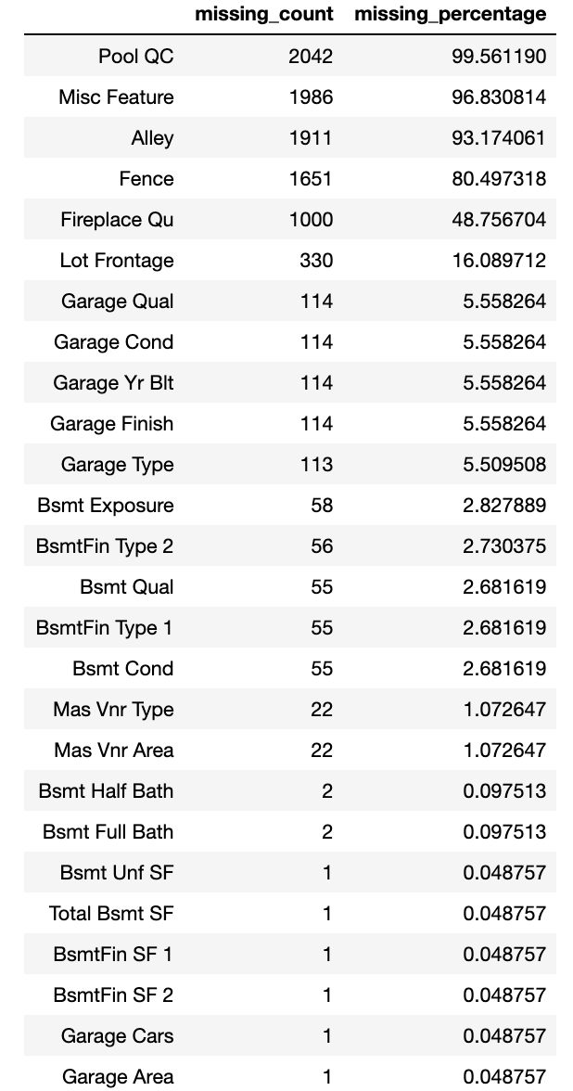
Data Imputation
Features with missing count and their missing percentage
Dropped rows with missing percentage of less than 1
Missing values means that house does not have these features
Filled the rest with 0 if is numeric or ‘none’ if is string as

Slide 6
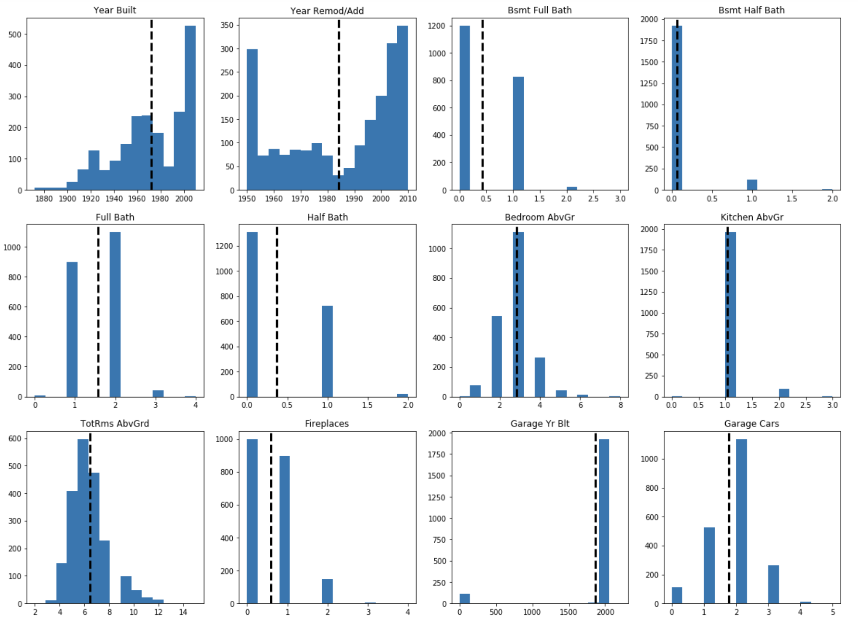
Histograms (Discrete variables)

Slide 7
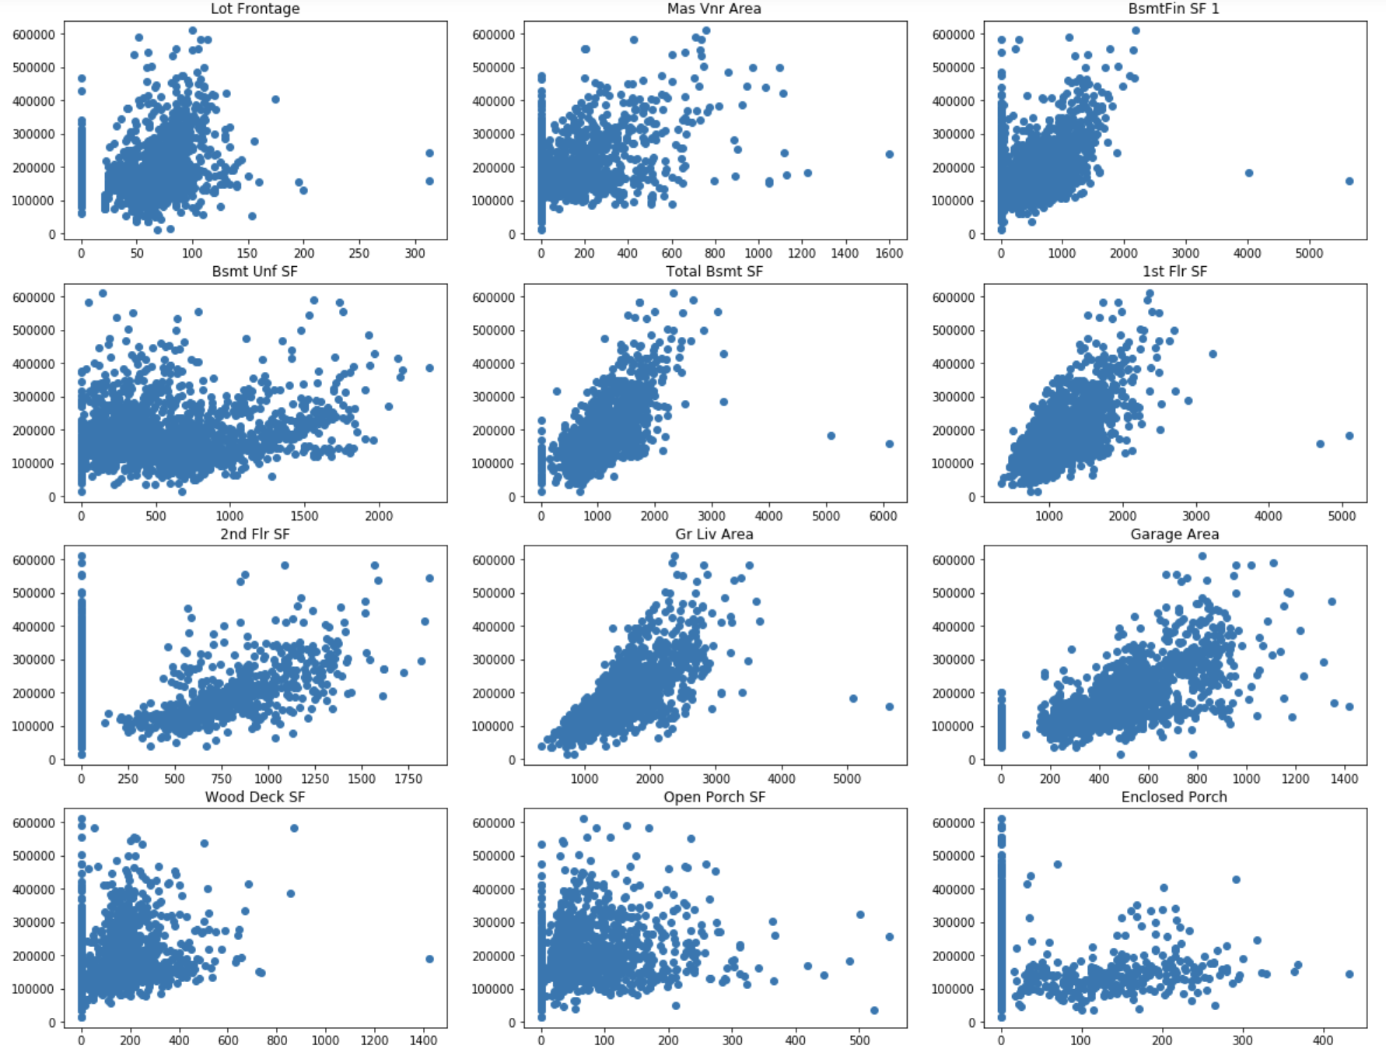
Scatter plots (Continuous variables)
Able to spot outliers from the graph and Correlation with sales price

Slide 8
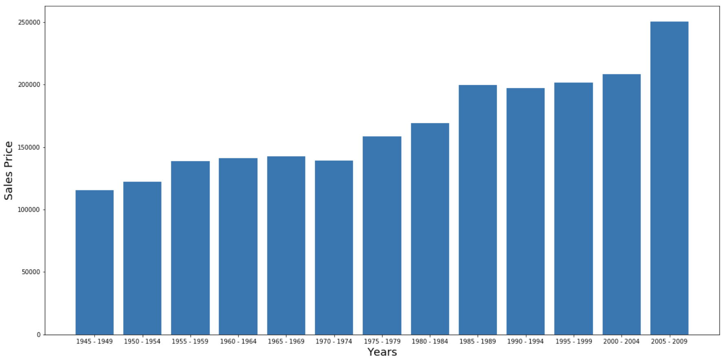
Bar graph of year built and sales price by binning to 5 years

Slide 9
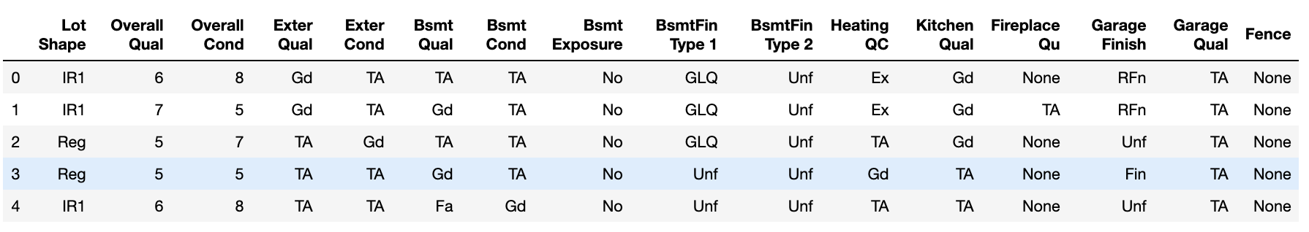
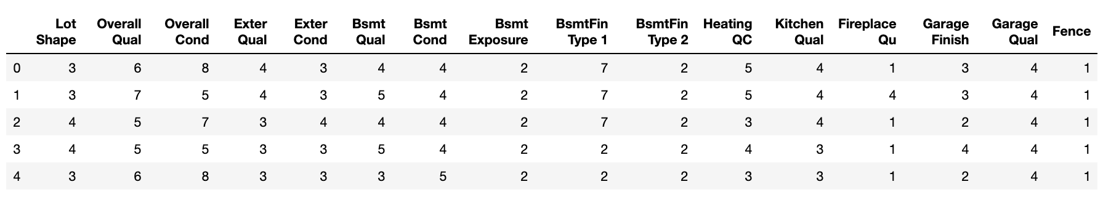
Label Encoding for Ordinal Categories

Slide 10
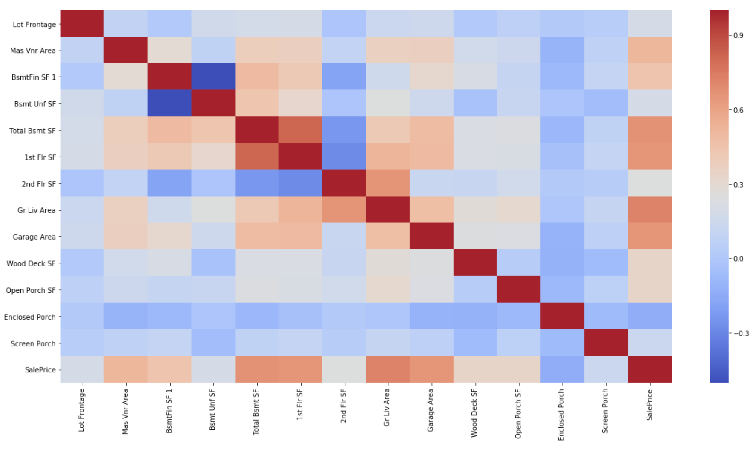
Heatmap of continuous variable coefficients
To visualize and select feature for polynomial fit

Slide 11
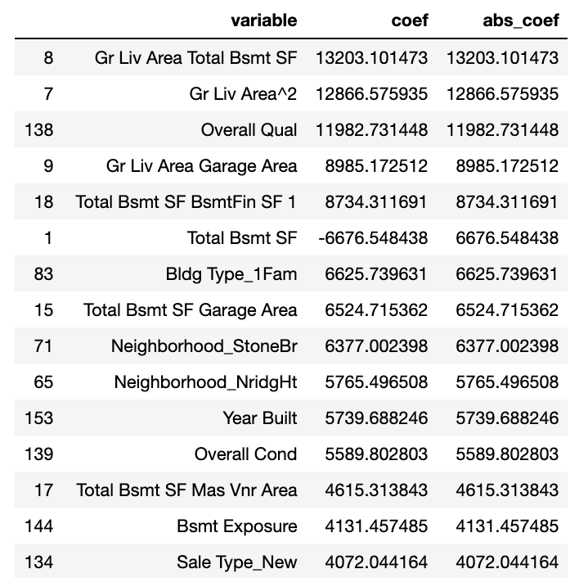
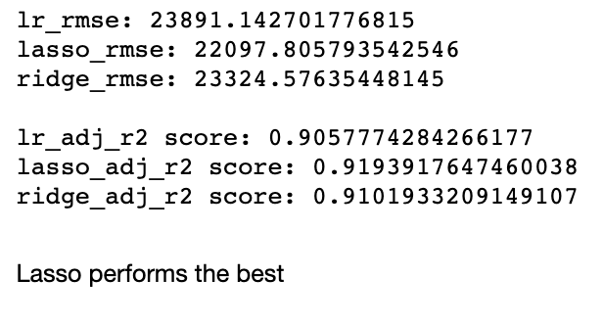
Model Scoring and Lasso Coefficients

Slide 12
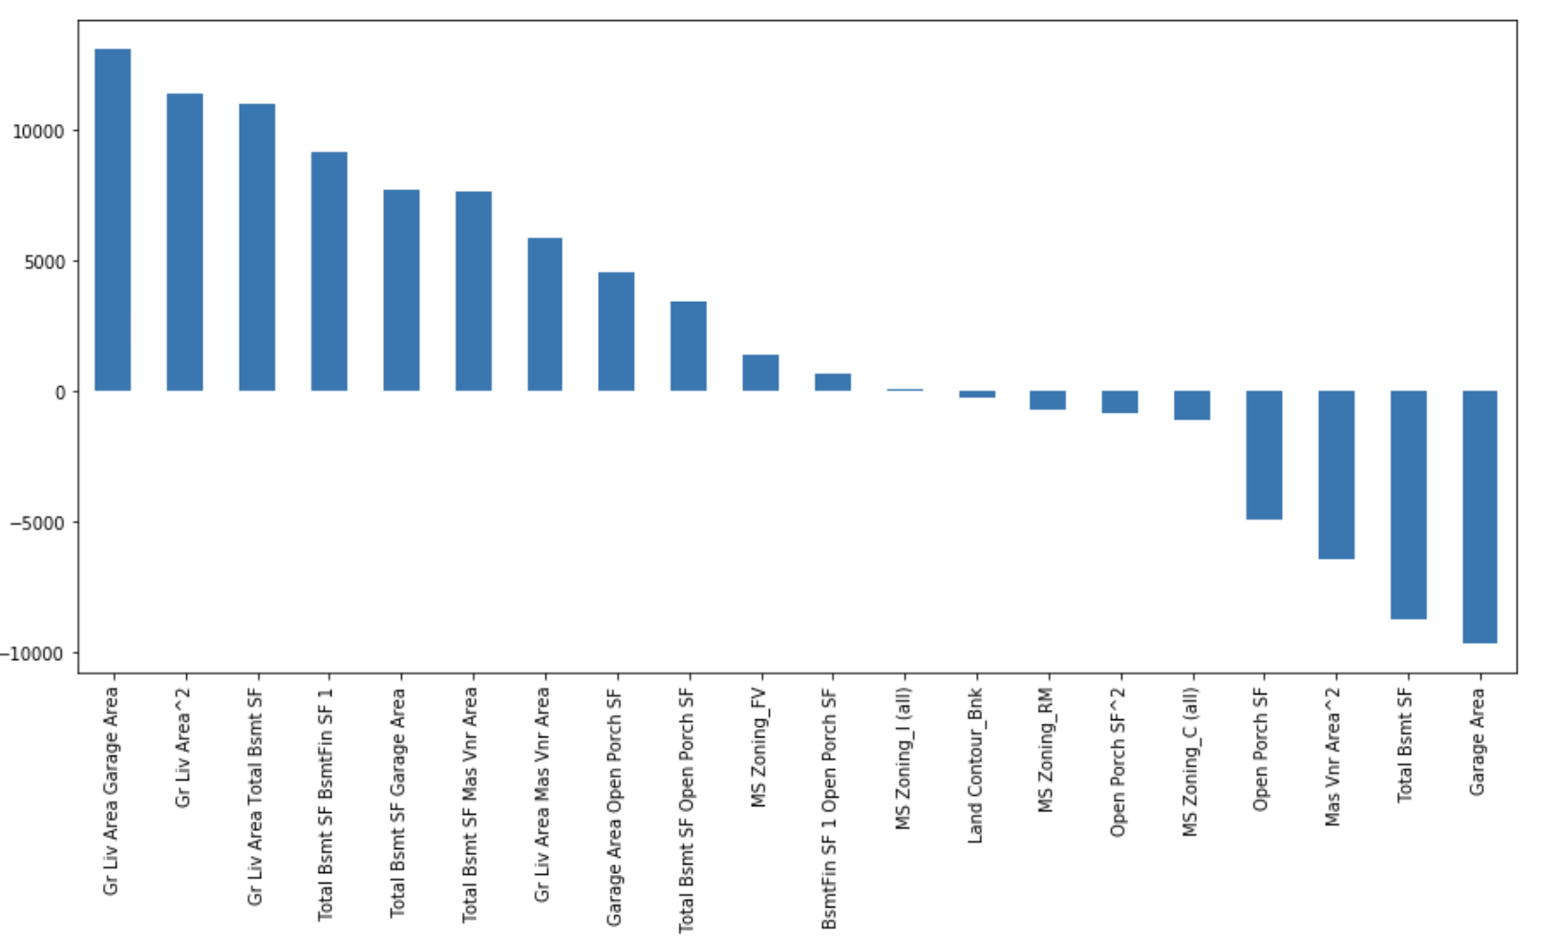
Top 20 lasso coefficients

Slide 13
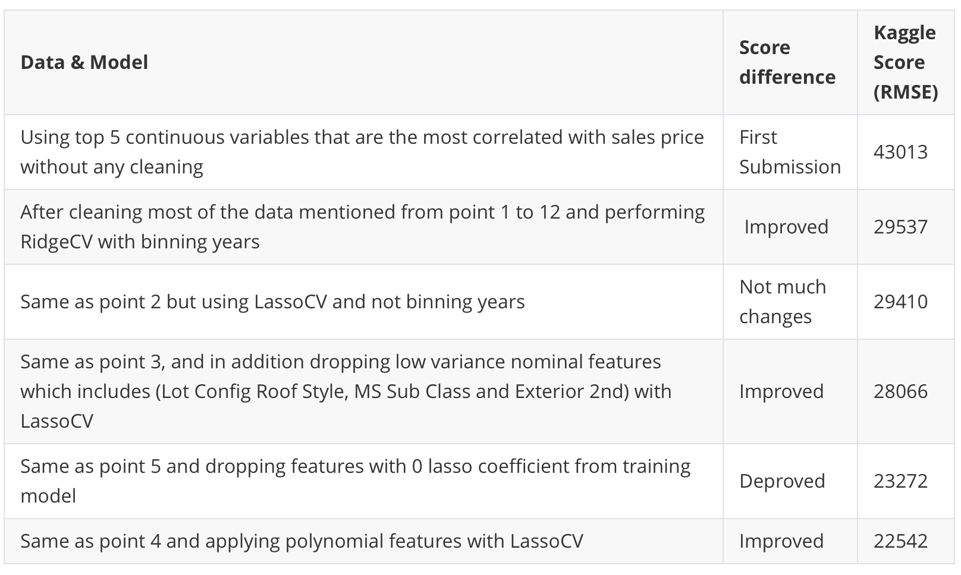
Different iterations with different parameters

Slide 14
Conclusion
Final model selected based on highest adjusted r squared score on test and lowest RMSE score on Kaggle.
The final selected model is to use lasso regression to reduce model complexity and uses about 113 features including dummies variables to achieve 22542 RMSE score.
It might however be overfitted due to the addition of polynomial features as we can see a sharp decrease in bias (low rmse score) and an increase between the difference the public and private score. (~8k difference)
To have a more generalized model, it is better to not use polynomial features for training as it has low difference between public and private score. (less than 1k difference)

Slide 15
Conclusion
To have a more generalized model, it is better to not use polynomial features for training as it has low difference between public and private score. (less than 1k difference)
Using top 30 lasso coefficient features increases the RMSE score as compared to 100 features (Bias and Variance trade-off)

