Slide 1
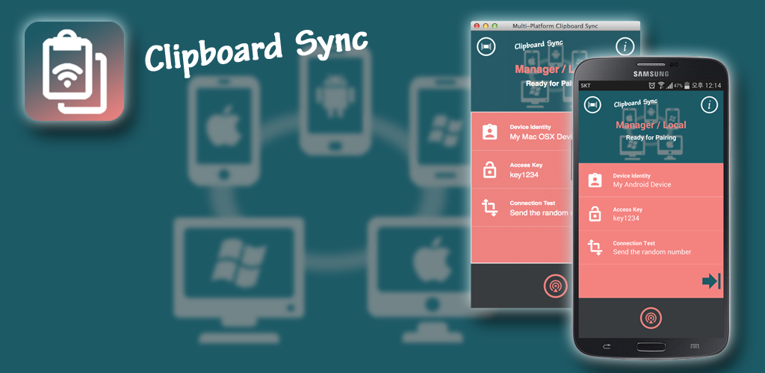
App Tethering 적용 사례 소개
Notes:
30 minutes

Slide 2
Tethering ?
Tethering is connecting one device to another.

Slide 3
Tethering Technology in Rad Studio XE8
Multi-Platform support.
VCL & FMX support simultaneously.
Do not need to know the IP Address of other device.
N:N Connection
Can Transfer String & Stream Data.
Can Execute Remote Action (TActionList)

Slide 4
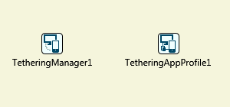
Tethering Object
Connection
Data Transfer

Slide 5
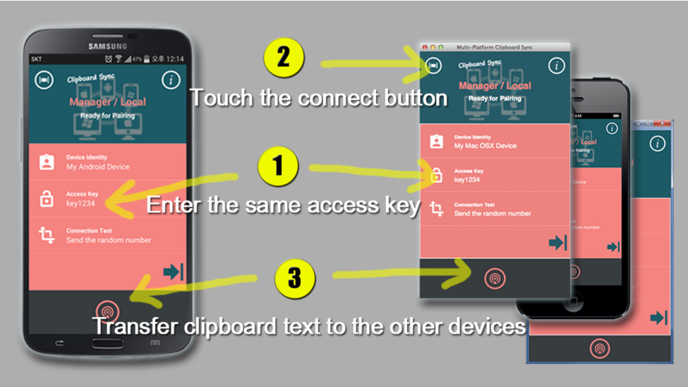
Demo 1
Clipboard Sync
One Source One Project
Download : http://c2design5sh.blogspot.kr/2015/04/clip.html

Slide 6
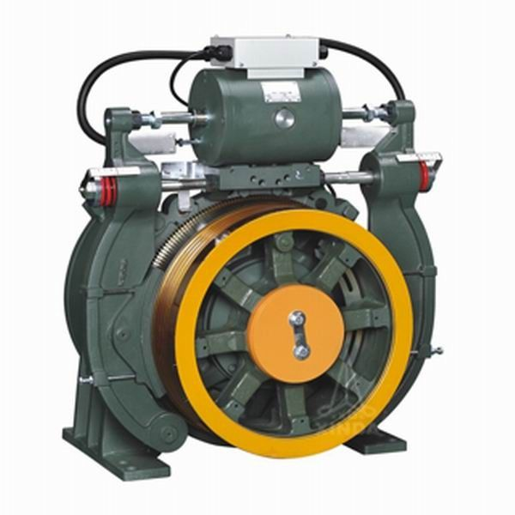
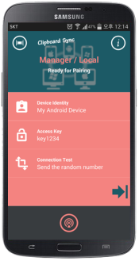
IoT of Tethering.
Desktop PC에 연결된 장비는 쉽게 제어 가능
VCL 또는 FMX로 구성된 MMI는 스마트 단말기로 간단하게 확장
Action
Button1
PLC
Tethering

Slide 7
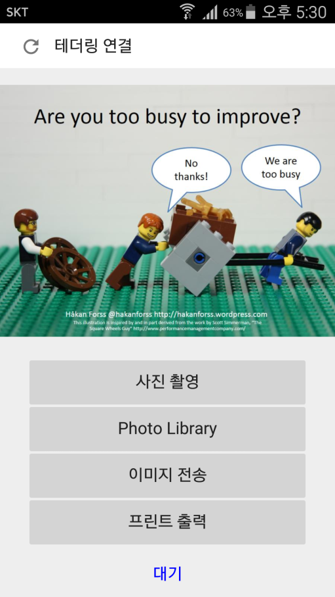
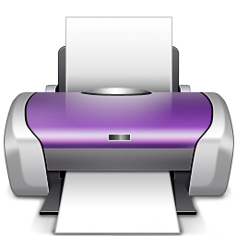
Demo 2
Remote Print
VCL and FMX Mobile

