Slide 1
Detecting Phishing URL’s
Andrew Castaldi
Data Science – Capstone Project 2

Slide 2
Agenda
Business Problem
Harms of phishing URL’s
Preventative Measures
Phishing URL Model
Performance
Business Implementations
Recommendation
Conclusion

Slide 3
Business Problem
Given employees access to personal emails
Higher risk of phishing emails
Higher risk of phishing URL’s
How can we minimize threats to the company?
How do we keep employee satisfaction as high as possible?

Slide 4
Harms of Phishing URL
Business impacts
Breach internal systems, data breaches, intellectual property, disrupt operations
Stolen Personal Information
Passwords, Social Security Numbers, Personal Address & Phone, identity theft
Money Theft
Credit card info, bank accounts
Downloading Malware
Record typing, Lock files for ransom, track user activity
Downloading corrupt data
Harm to personal computer

Slide 5
Preventative Measures
Don’t click
If a URL seems suspicious, don’t click on it – send it for review
Relies on human performance
Systematically
Automatically checks URLs for phishing
URL doesn’t make it to the user
URL is rejected
Continuous improvements

Slide 6
Heuristic Approach
Review URL text for key features
URL text more than 75 characters
Has an IP Address in URL
More than 3 “.” in URL
URL contains an “@”

Slide 7
Model Approach
Multiple datasets used for training
Trained on 10,000 URL’s
5,000 Legitimate
5,000 Phishing
Tested on over 200k URL’s
132,000 Legitimate
98,000 Phishing
Focused on preventing phishing URL’s, not allowing legitimate ones
If its suspicious reject it
Continuous improvement

Slide 8
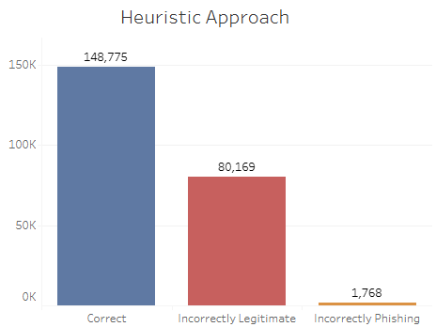
Performance – Heuristic Approach
We used a heuristic approach to benchmark performance of the model.

Slide 9
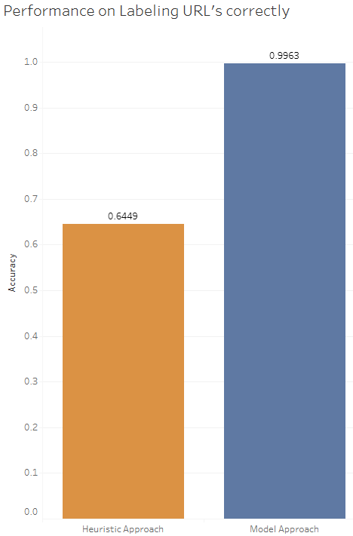
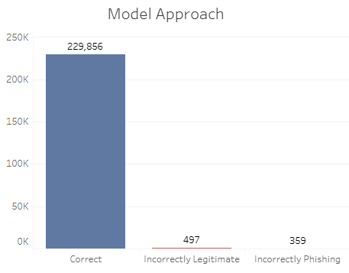
Performance – Model Approach

Slide 10
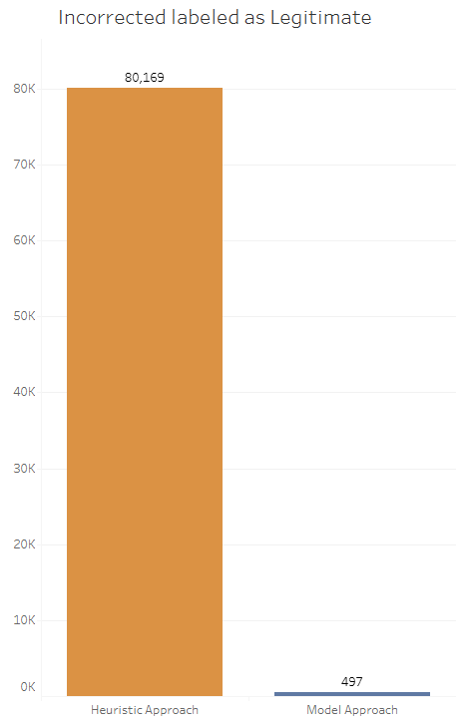
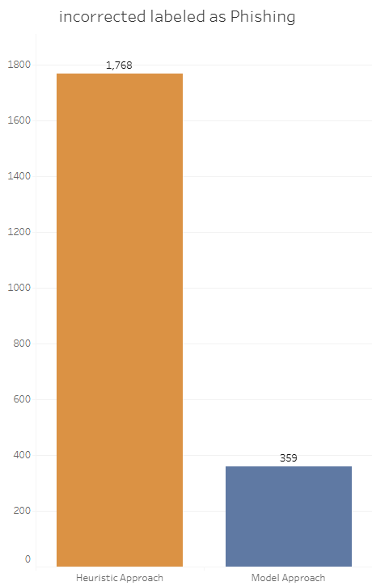
Comparison – Incorrectly Labeled

Slide 11
Business Implementations
Email
Could be a backend service to evaluate links in incoming emails. If a URL is flagged as phishing, you can flag the email or block it entirely
Firewall Integration
Implement the model into a firewall to check outbound web requests. If the URL is seen as phishing, you can redirect to a warning page
Internal API service
Allow users to test their URLs on a webpage that’ll return a result with the predicted outcome and a confidence score

Slide 12
Recommendation
#1 - Firewall implementation
Seamless, unnoticeable way to employees to implement URL safety measures
Employees just received access to personal emails, if we start blocking their emails, employee satisfaction will go down
#2 - Internal API service
This can be beneficial and help employees learn more about phishing URL’s and what looks suspicious
Can be used by employees for personal URL’s they’re unsure of too, increasing employee satisfaction

Slide 13
Conclusion
Model implementation > Heuristic Implementation
The model is our best chance at preventing phishing URL’s
Phishing URLs are likely to still make it through
Phishing attacks will continue to grow and change and make it through, but the model can continue to learn and improve
Employee training on phishing should still be kept in place
Training is still important for employees to know the dangers of phishing
Implement an API for employees and a Firewall integration
Benefits both the company and employees

Slide 14
Tableau Dashboard
Phishing_URL_Dashboard | Tableau Public

