Slide 1

Add a new practitioner or practice listing
START
Create one approved directory listing, keep it as a draft until it is complete, clear the applicable cache, and verify the live result.
Beginner lesson • Live website • Full-screen version
Add practitioner v1.1 • 1/16

Slide 2
Required WordPress access
1
WORDPRESS ROLE REQUIRED
Editor or Administrator
Editor access is enough for this task.
If Medical Practicioners is missing, stop and ask the website administrator for help. User accounts are covered separately.
Add practitioner v1.1 • 2/16

Slide 3
Sign in to the live website
2
LIVE WORDPRESS LOGIN
rebekahspureliving.com/wp-admin
Use your own login. Confirm the live domain. Do not use an old staging address.
Add practitioner v1.1 • 3/16

Slide 4
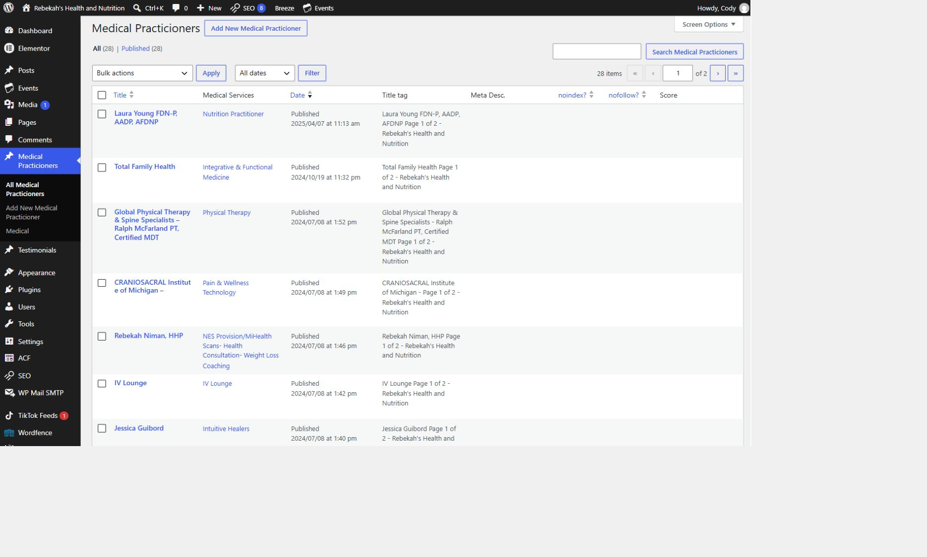
Open All Medical Practicioners
3
LOOK HERE
WRITTEN STEPS
1. Click Medical Practicioners.
2. Click All Medical Practicioners.
3. Find Add New at the top.
Add practitioner v1.1 • 4/16

Slide 5
Choose Add New Medical Practitioner
4
LOOK HERE
1. Find Add New Medical Practitioner.
2. Create only one approved record.
3. Click Add New once.
Add practitioner v1.1 • 5/16
Notes:
[Sources]
- Live WordPress practitioner-list interface captured August 31, 2026.

Slide 6
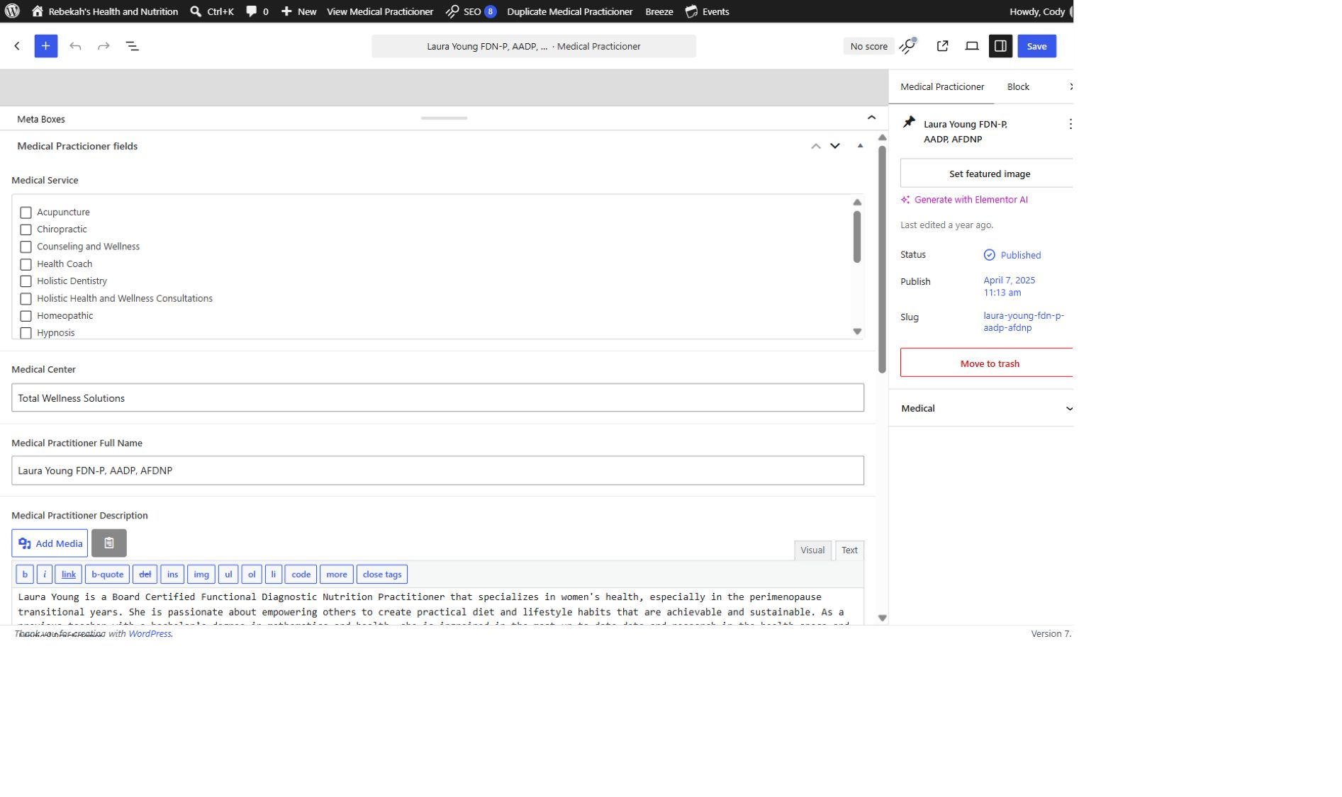
Keep the new record as a draft
5
WRITTEN STEPS
1. Keep the record as Draft.
2. Open Medical Practicioner fields.
3. Stop if the fields are missing.
LOOK HERE
Add practitioner v1.1 • 6/16

Slide 7
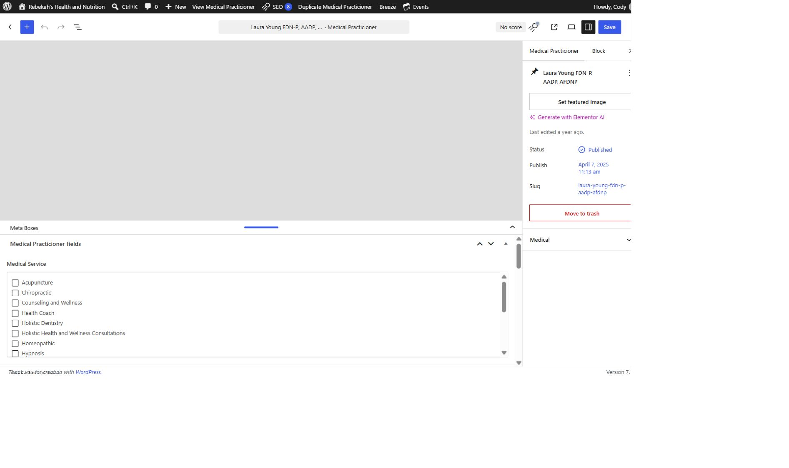
Choose only approved service categories
6
WRITTEN STEPS
1. Find Medical Service.
2. Check only approved categories.
3. Do not create or guess a category.
LOOK HERE
Add practitioner v1.1 • 7/16

Slide 8
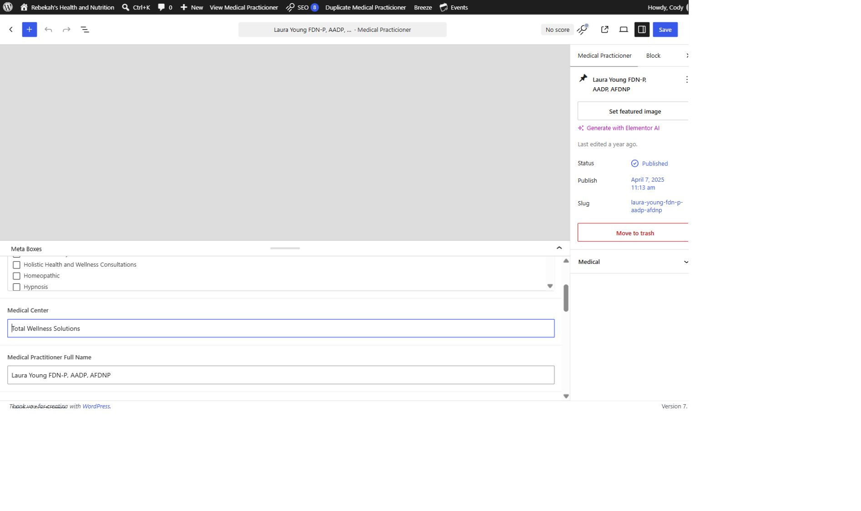
Enter the practice and public name
7
WRITTEN STEPS
1. Enter the approved Medical Center.
2. Enter the exact public name.
3. Match spelling and credentials.
LOOK HERE
Add practitioner v1.1 • 8/16

Slide 9
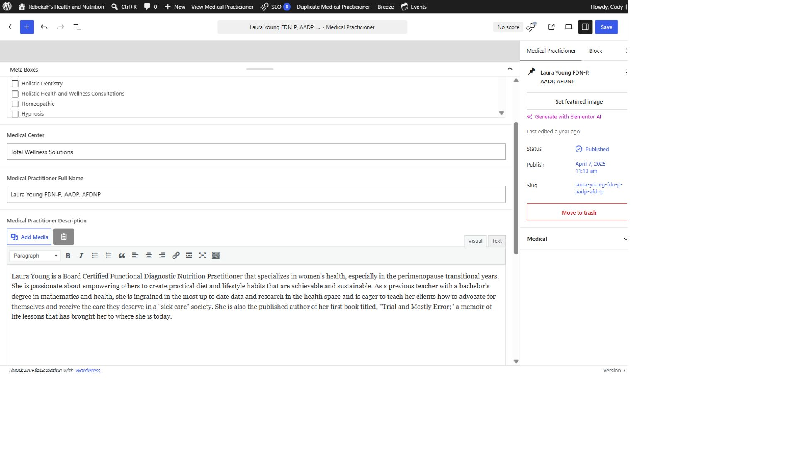
Add the approved description in Visual mode
8
WRITTEN STEPS
1. Select Visual.
2. Add only approved public copy.
3. Preserve the paragraph breaks.
LOOK HERE
Add practitioner v1.1 • 9/16

Slide 10
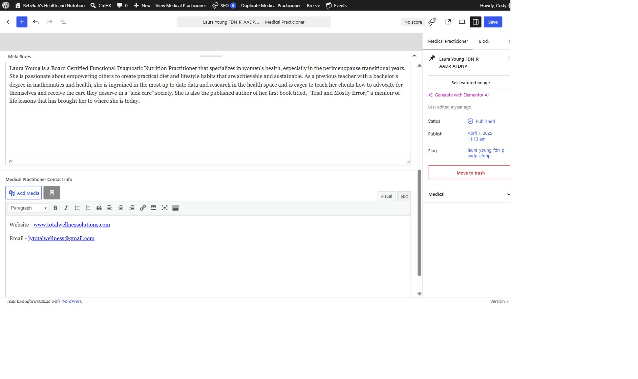
Add only approved public contact details
9
WRITTEN STEPS
1. Add approved public details.
2. Test every phone and web link.
3. Remove placeholders or private data.
LOOK HERE
Add practitioner v1.1 • 10/16

Slide 11
Review every field before publishing
10
WRITTEN STEPS
1. Re-read every field.
2. Compare with the approved information.
3. Leave as Draft if anything is uncertain.
LOOK HERE
Add practitioner v1.1 • 11/16

Slide 12
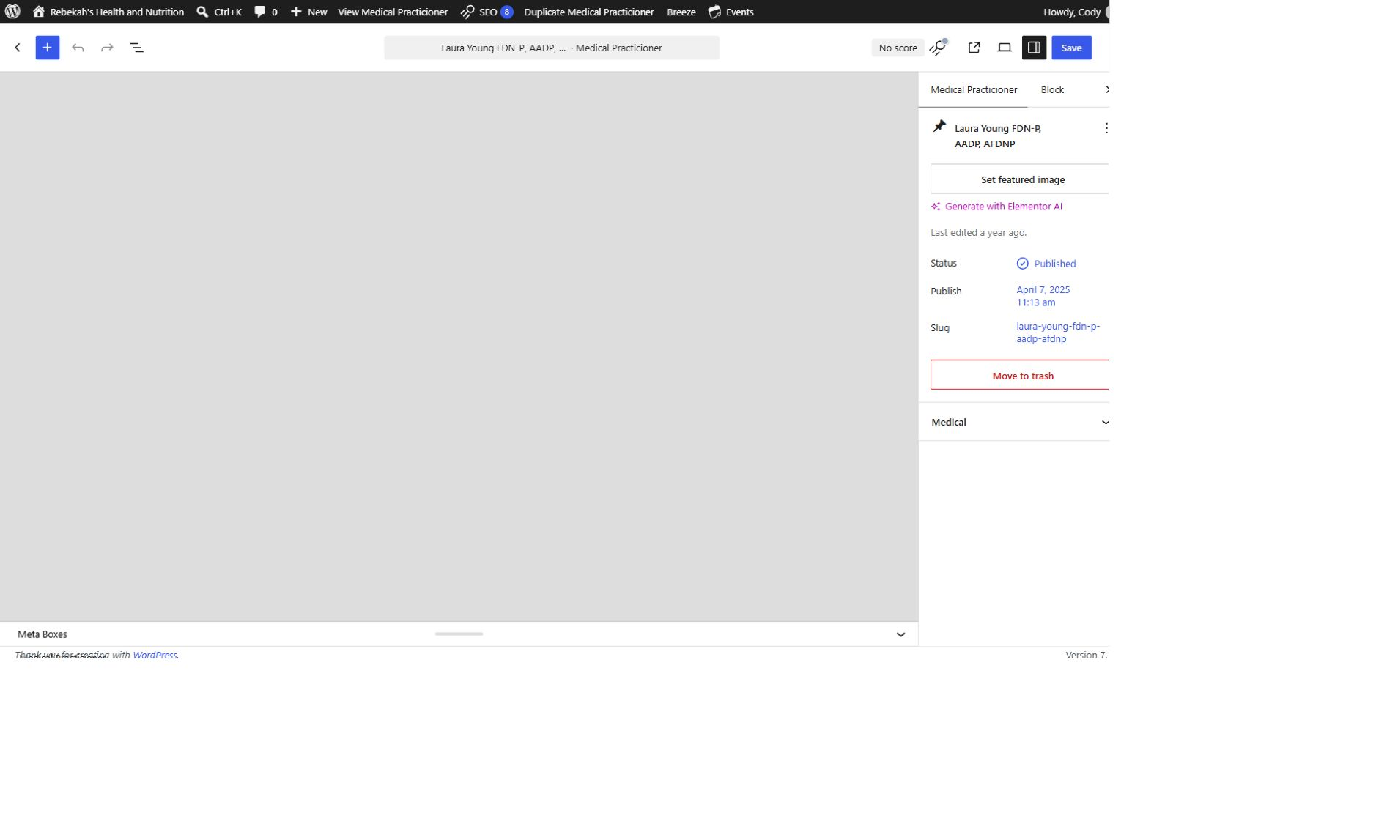
Publish or Save once—and wait
11
LOOK HERE
WRITTEN STEPS
1. Click Publish or Save once.
2. Wait for confirmation.
3. Do not click repeatedly.
Add practitioner v1.1 • 12/16

Slide 13
Clear only the applicable cache
12
LOOK HERE
1. Return to the practitioner list.
2. Find the new record.
3. Click Clear Cache once.
Add practitioner v1.1 • 13/16
Notes:
[Sources]
- Live WordPress practitioner-list interface captured August 31, 2026.

Slide 14
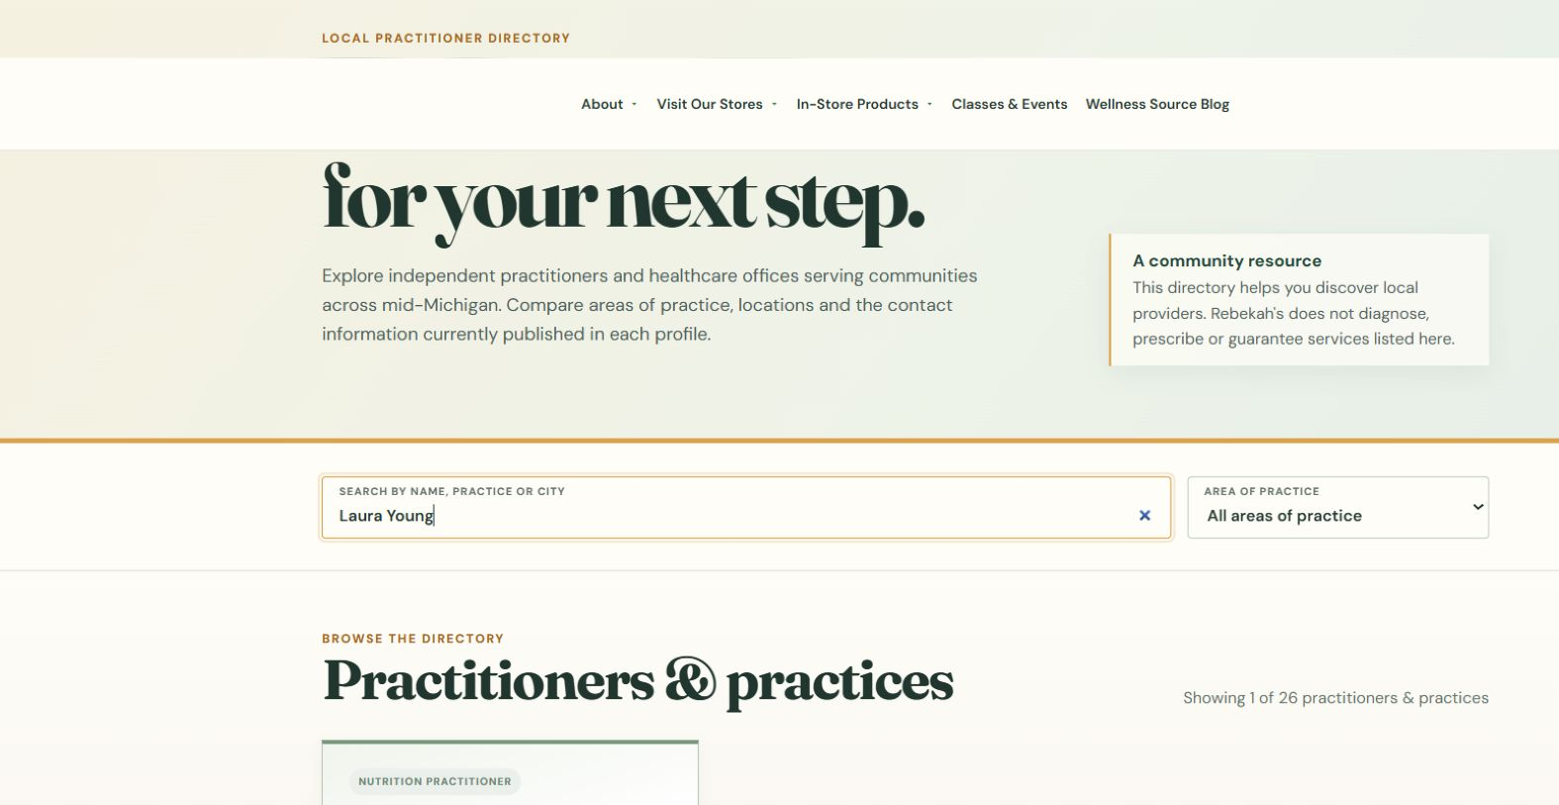
Verify the exact public directory
13
LOOK HERE
WRITTEN CHECK
1. Search the name, practice, or city.
2. Confirm the category and details.
3. Test the public links.
Add practitioner v1.1 • 14/16
Notes:
[Sources]
- https://rebekahspureliving.com/practitioners/ (captured September 1, 2026).

Slide 15

Open the full listing and check a phone
14
LOOK HERE
WRITTEN STEPS
1. Click View full listing.
2. Check every detail and link.
3. Repeat the check on a phone.
Add practitioner v1.1 • 15/16

Slide 16
Always finish with the same three checks
DONE
SAVE → CLEAR APPLICABLE CACHE → VERIFY LIVE
Check the exact /practitioners/ directory on desktop and phone. There is no separate public practitioner page to manage.
If the live result is wrong or missing, stop and ask for help.
Add practitioner v1.1 • 16/16

