Slide 1

REBEKAH'S WEBSITE EDITING LIBRARY
START
Update an existing practitioner listing
WHAT YOU WILL BE ABLE TO DO
Find the correct record, edit only approved information, save once, clear the applicable cache, and verify the live page.
Beginner lesson • Live website • About 7 minutes
Practitioner pilot v1.1 • 1 of 16

Slide 2
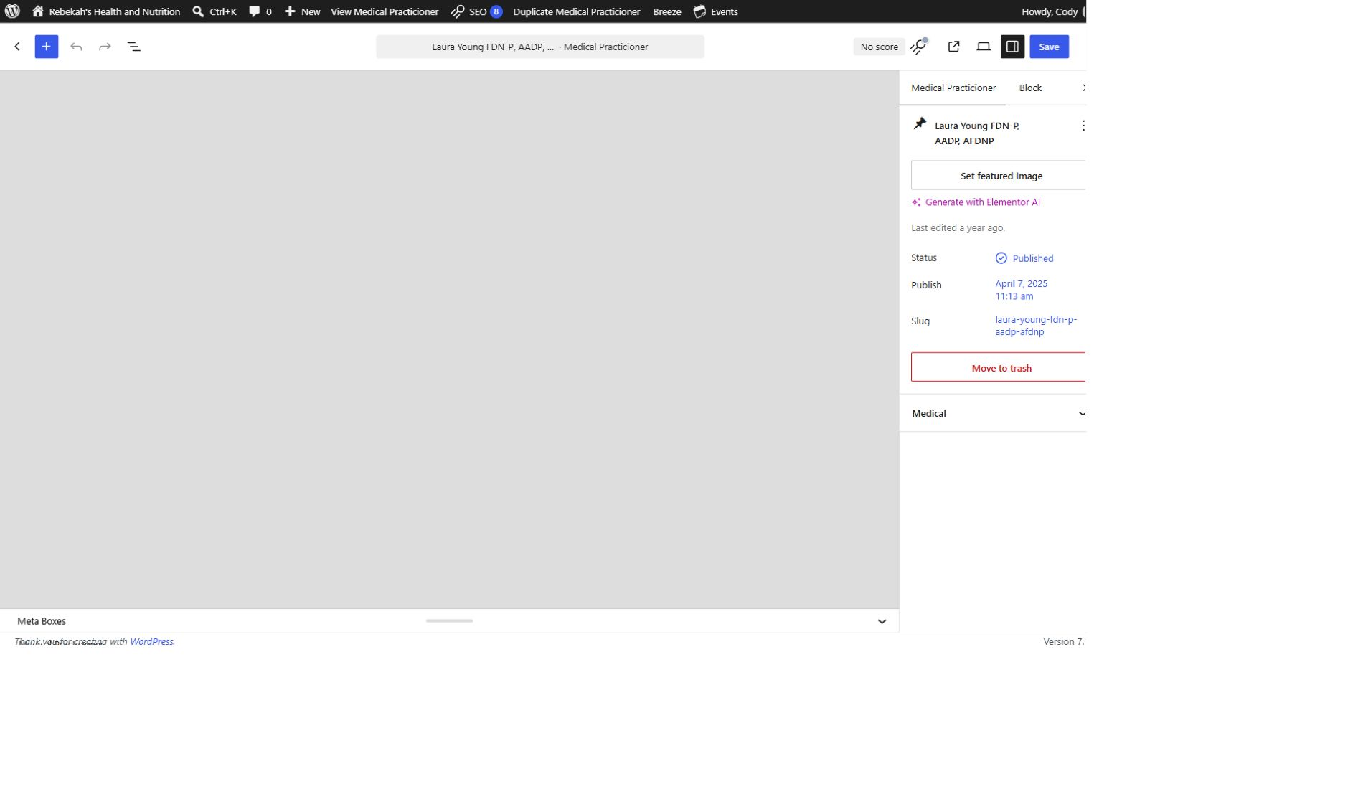
REBEKAH'S WEBSITE EDITING LIBRARY
1
Use an Editor account
DO THIS
Recommended staff role: Editor. Administrator access is not required for routine practitioner updates. Each staff member should use a separate login.
If unsure: stop before saving.
Practitioner pilot v1.1 • 2 of 16

Slide 3
REBEKAH'S WEBSITE EDITING LIBRARY
2
Confirm the live login address
LIVE WORDPRESS LOGIN
rebekahspureliving.com/wp-admin
Confirm this address before changing the live site.
Practitioner pilot v1.1 • 3 of 16

Slide 4
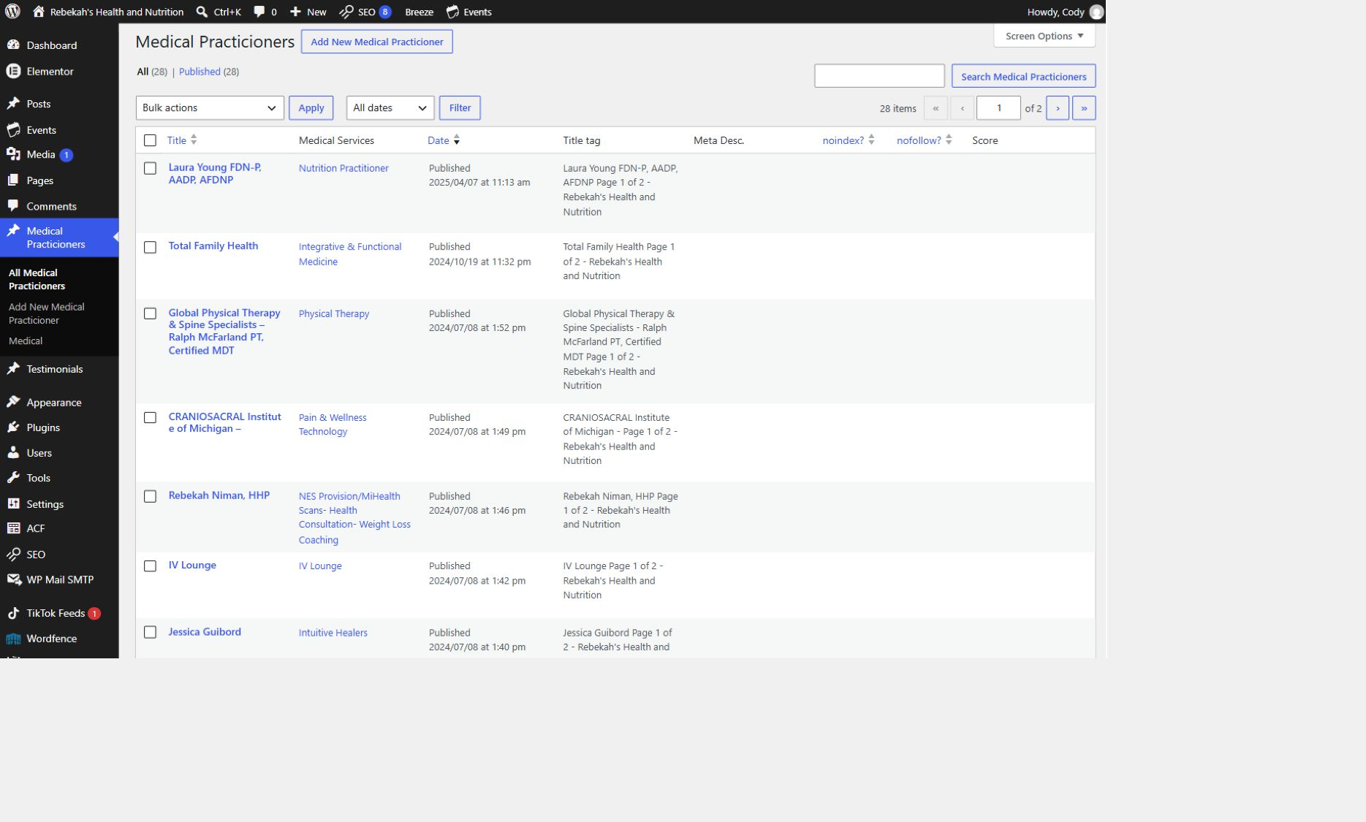
REBEKAH'S WEBSITE EDITING LIBRARY
3
Open All Medical Practicioners
DO THIS
In the left menu, select Medical Practicioners, then All Medical Practicioners. The current WordPress label is spelled “Practicioners.”
LOOK HERE
If unsure: stop before saving.
Practitioner pilot v1.1 • 4 of 16

Slide 5
REBEKAH'S WEBSITE EDITING LIBRARY
4
Find the correct record and choose Edit
DO THIS
LOOK HERE
Search by name when needed. Hover over the correct row and select Edit. Do not choose Quick Edit, Trash, or Clear Cache yet.
If unsure: stop before saving.
Practitioner pilot v1.1 • 5 of 16

Slide 6
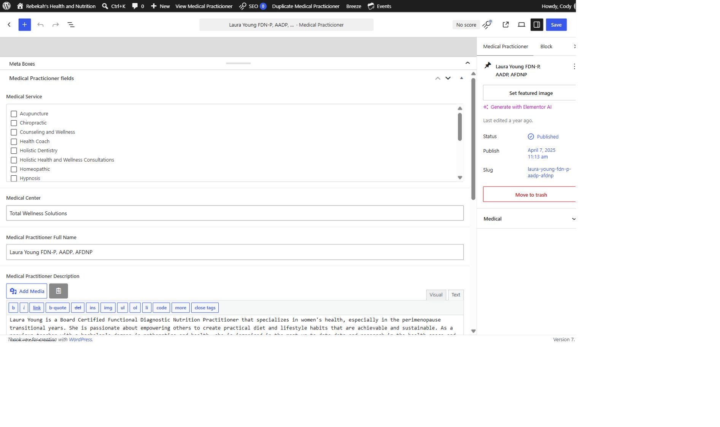
REBEKAH'S WEBSITE EDITING LIBRARY
5
Open Medical Practicioner Fields
DO THIS
Wait for the editor to load, then scroll down. If the fields are hidden, select Meta Boxes and enlarge the panel with Drag to resize.
LOOK HERE
If unsure: stop before saving.
Practitioner pilot v1.1 • 6 of 16

Slide 7
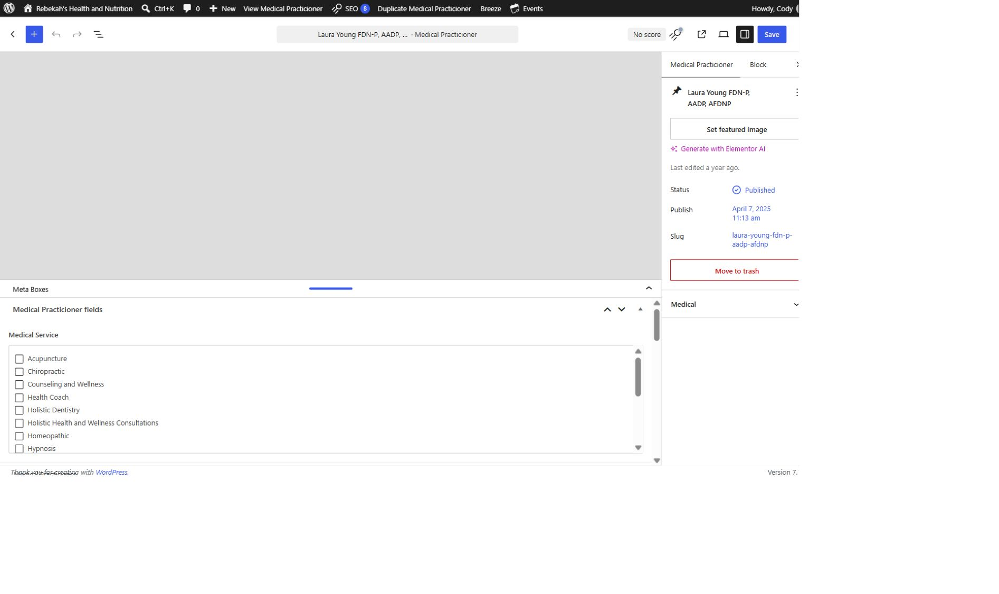
REBEKAH'S WEBSITE EDITING LIBRARY
6
Choose only approved service categories
DO THIS
Check the approved Medical Service category or categories. Leave unrelated boxes alone. Stop and ask if the needed category does not exist.
LOOK HERE
If unsure: stop before saving.
Practitioner pilot v1.1 • 7 of 16

Slide 8
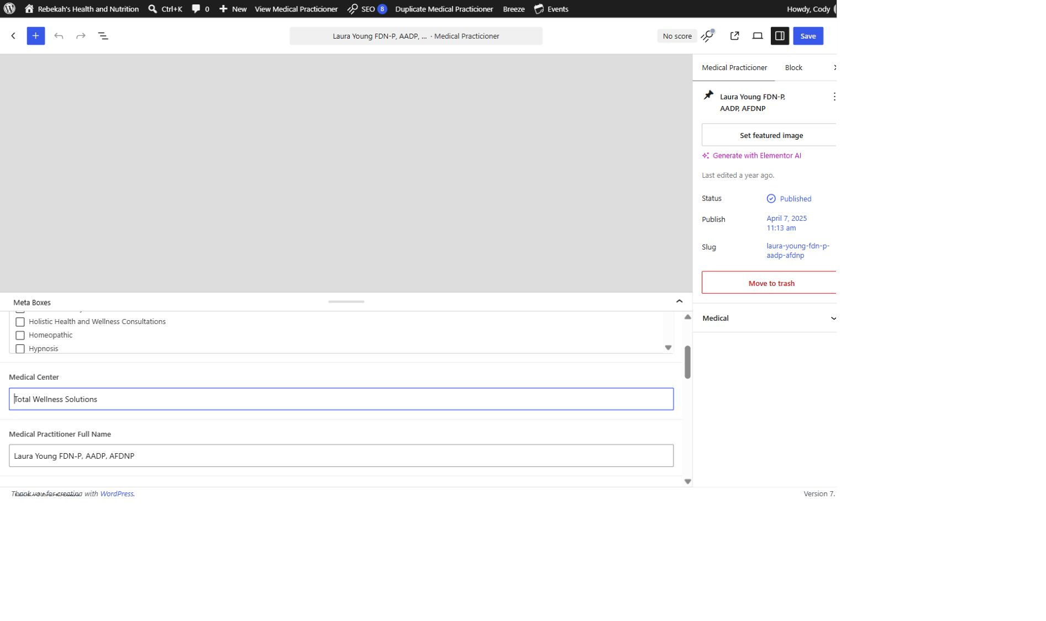
REBEKAH'S WEBSITE EDITING LIBRARY
7
Update the practice and public name
DO THIS
Medical Center is the public practice name. Medical Practitioner Full Name is the public name and credentials. Verify every character.
LOOK HERE
If unsure: stop before saving.
Practitioner pilot v1.1 • 8 of 16

Slide 9
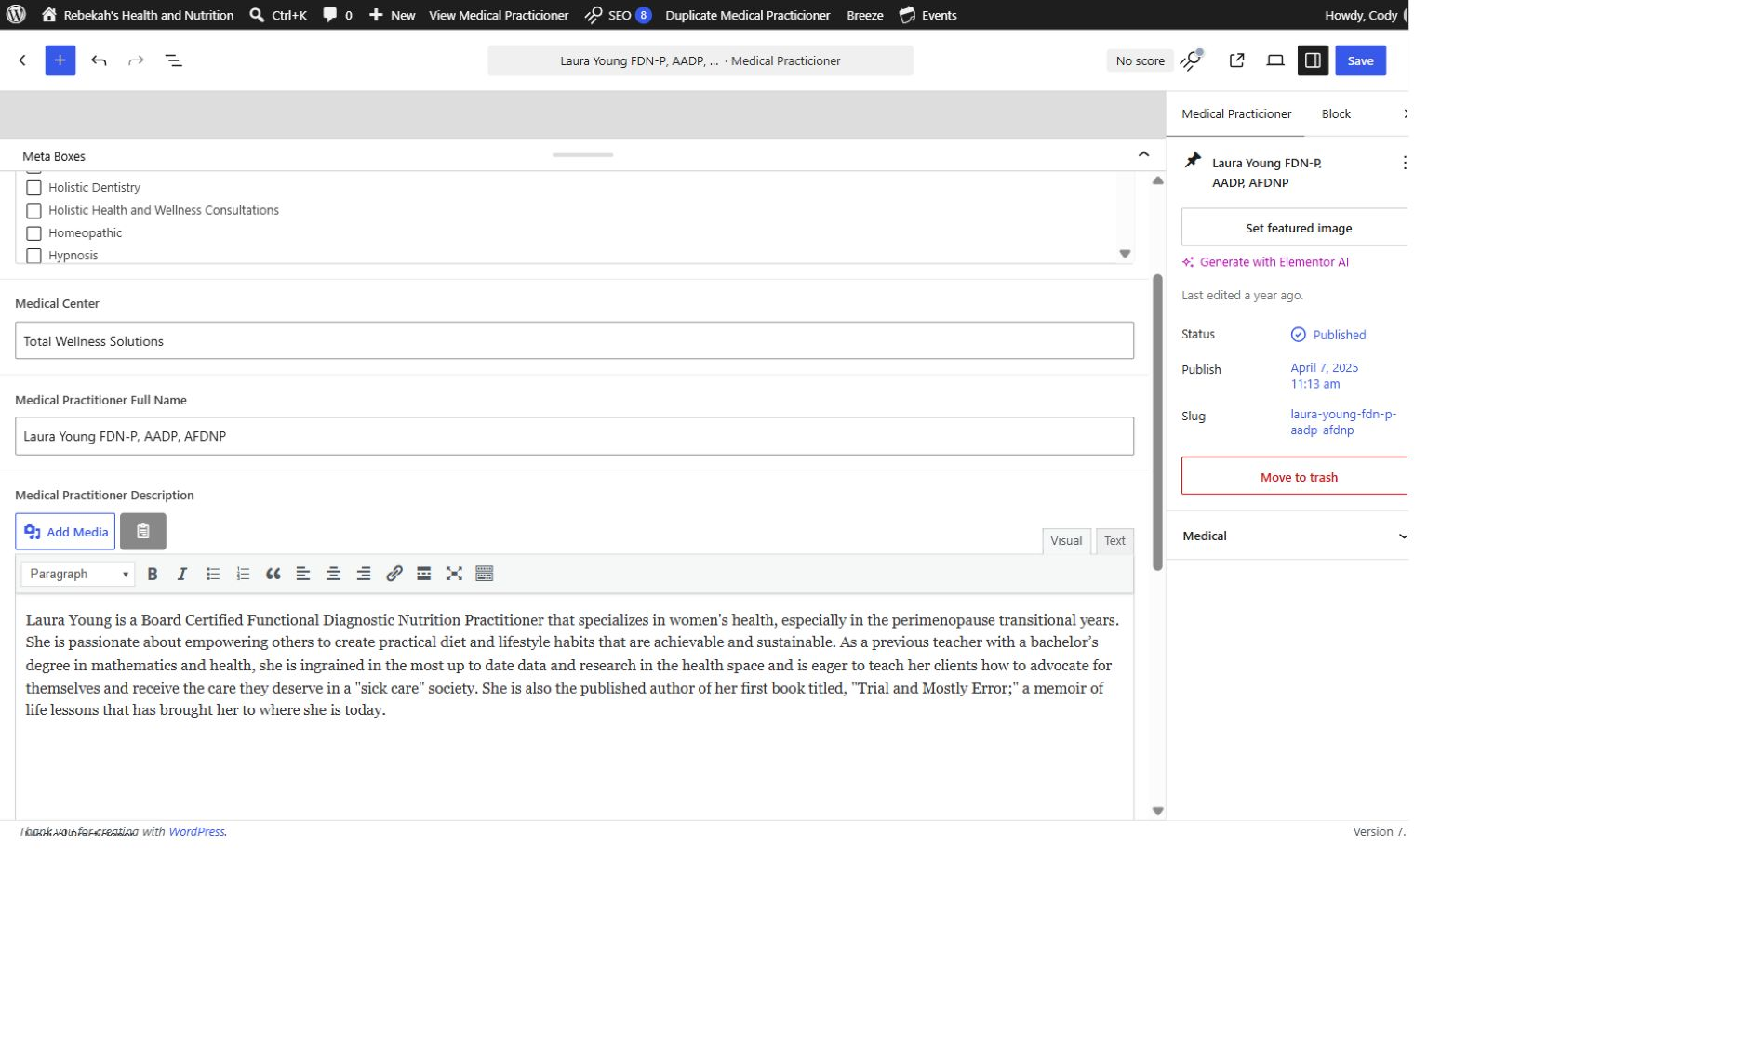
REBEKAH'S WEBSITE EDITING LIBRARY
8
Edit the description in Visual mode
DO THIS
Select Visual before editing. Replace only the approved text. Re-read the first and last sentence after pasting. Do not use the Text or HTML tab.
LOOK HERE
If unsure: stop before saving.
Practitioner pilot v1.1 • 9 of 16

Slide 10
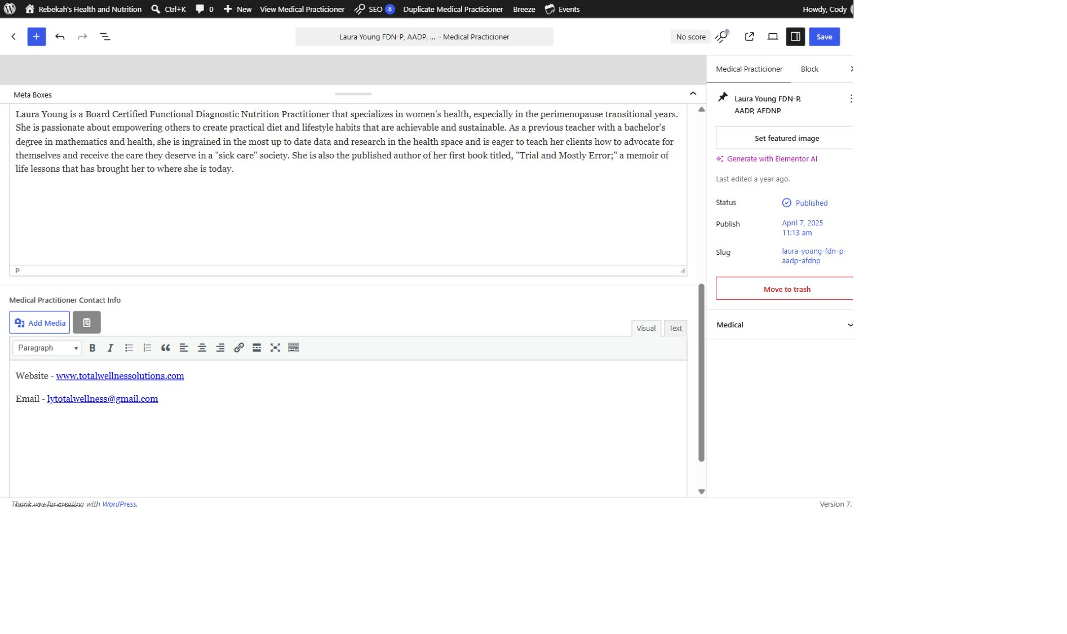
REBEKAH'S WEBSITE EDITING LIBRARY
9
Add only approved public contact details
DO THIS
Use Visual mode. Add approved website, email, phone, or location details. Test every link and never publish private information.
LOOK HERE
If unsure: stop before saving.
Practitioner pilot v1.1 • 10 of 16

Slide 11
REBEKAH'S WEBSITE EDITING LIBRARY
10
Review only the fields you touched
DO THIS
Check category, practice, name, credentials, description, and contact links. Do not change the page address, SEO settings, code, or unrelated controls.
LOOK HERE
If unsure: stop before saving.
Practitioner pilot v1.1 • 11 of 16

Slide 12
REBEKAH'S WEBSITE EDITING LIBRARY
11
Select Save once—and wait
LOOK HERE
DO THIS
Use the blue Save button in the upper-right corner. Wait for the saved confirmation. If WordPress displays an error, stop and take a screenshot.
If unsure: stop before saving.
Practitioner pilot v1.1 • 12 of 16

Slide 13
REBEKAH'S WEBSITE EDITING LIBRARY
12
Clear only the record’s applicable cache
DO THIS
LOOK HERE
Return to the practitioner list. Hover over the updated row and select its Clear Cache action. Server-wide purges are covered in the separate cache lesson.
If unsure: stop before saving.
Practitioner pilot v1.1 • 13 of 16

Slide 14
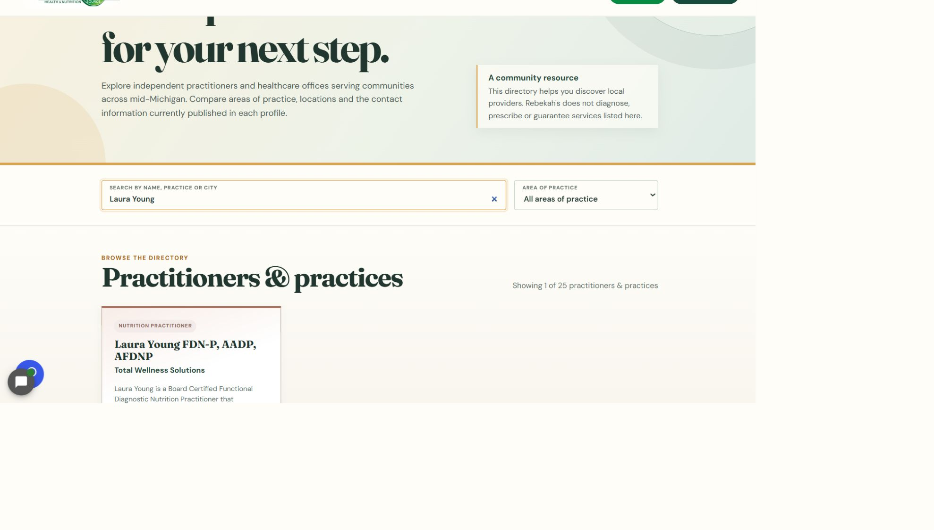
REBEKAH'S WEBSITE EDITING LIBRARY
13
Verify the exact public directory
DO THIS
Open rebekahspureliving.com/practitioners/. Search for the person and confirm the name, practice, category, and description preview.
LOOK HERE
If unsure: stop before saving.
Practitioner pilot v1.1 • 14 of 16

Slide 15
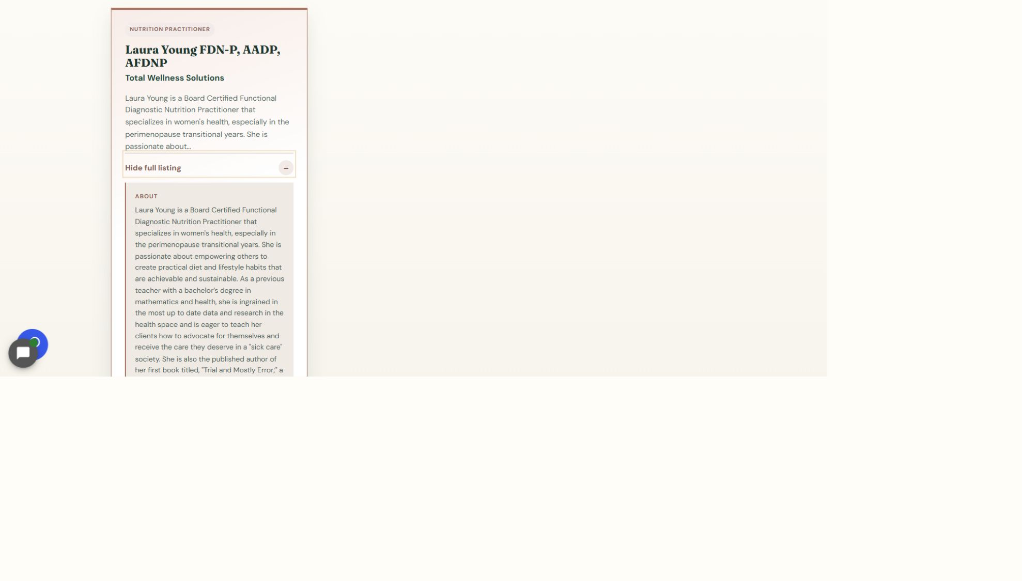
REBEKAH'S WEBSITE EDITING LIBRARY
14
Open the full listing and check a phone
LOOK HERE
DO THIS
Select View full listing. Confirm the complete description and contact information. Repeat the check on a phone and test every link.
If unsure: stop before saving.
Practitioner pilot v1.1 • 15 of 16

Slide 16
REBEKAH'S WEBSITE EDITING LIBRARY
DONE
Finish every website edit the same way
SAVE → CLEAR THE APPLICABLE CACHE → VERIFY THE EXACT PUBLIC PAGE ON DESKTOP AND PHONE
If any check fails, take a screenshot and contact Blue Nova before changing anything again.
Practitioner pilot v1.1 • 16 of 16

