Slide 1

Update an existing practitioner listing
START
Update approved practitioner information, save it safely, clear the applicable cache, and verify the live result.
Beginner lesson • Live website • Full-screen version
Practitioner editing v1.3 • 1/16

Slide 2
Required role: Editor or Administrator
1
WORDPRESS ROLE REQUIRED
EDITOR OR ADMINISTRATOR
Editor is enough for this task.
If you do not know your role, stop and ask Blue Nova before editing.
Practitioner editing v1.3 • 2/16

Slide 3
Confirm the live login address
2
LIVE WORDPRESS LOGIN
rebekahspureliving.com/wp-admin
Confirm this live address before making a change.
Practitioner editing v1.3 • 3/16

Slide 4
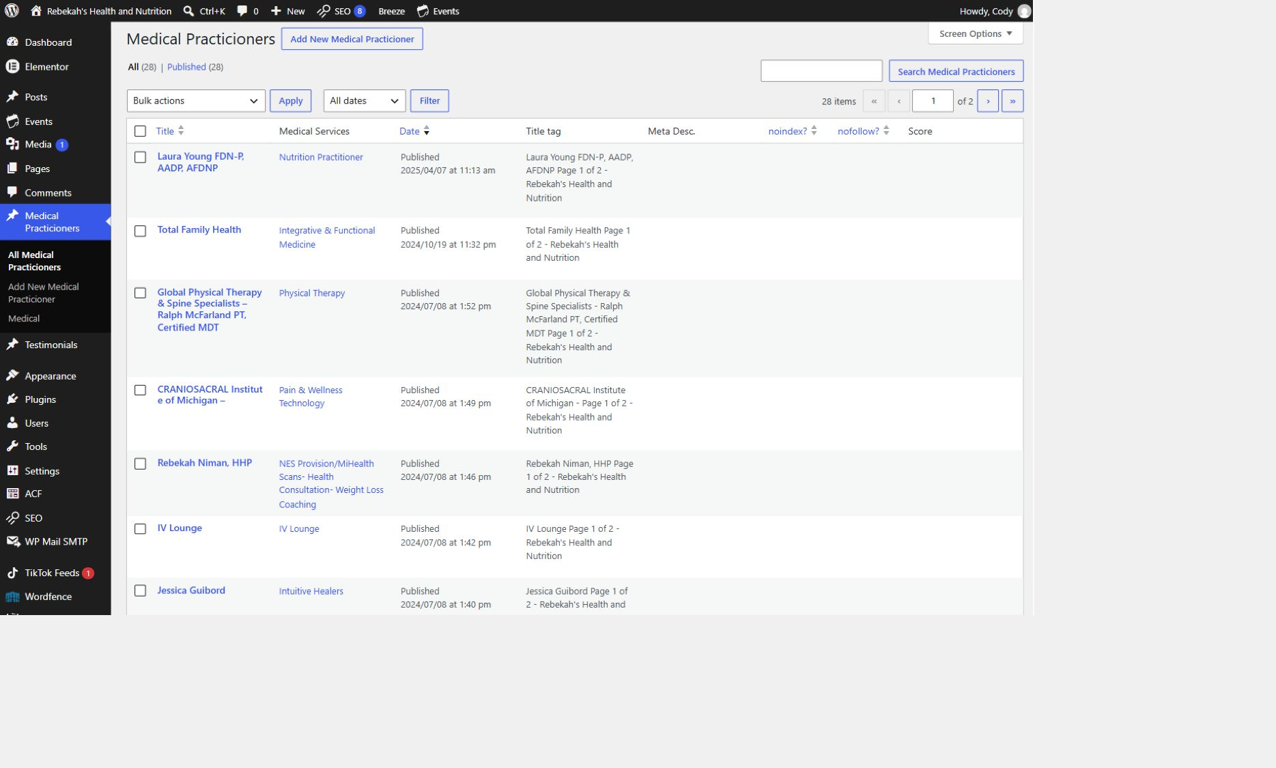
Open All Medical Practicioners
3
LOOK HERE
Practitioner editing v1.3 • 4/16

Slide 5
Find the correct record and choose Edit
4
LOOK HERE
HOVER OVER THE CORRECT ROW
Then click Edit
Practitioner editing v1.3 • 5/16
Notes:
[Sources]
- Live WordPress practitioner-list interface captured August 31, 2026.

Slide 6
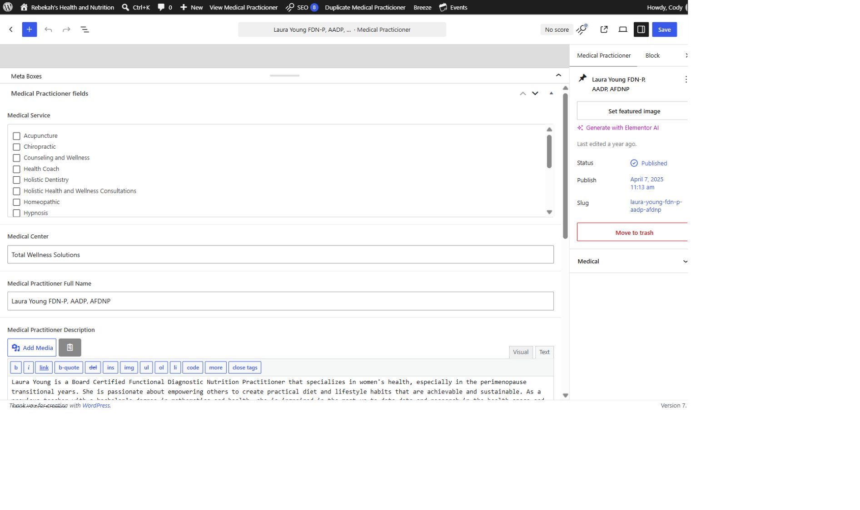
Open Medical Practicioner Fields
5
LOOK HERE
Practitioner editing v1.3 • 6/16

Slide 7
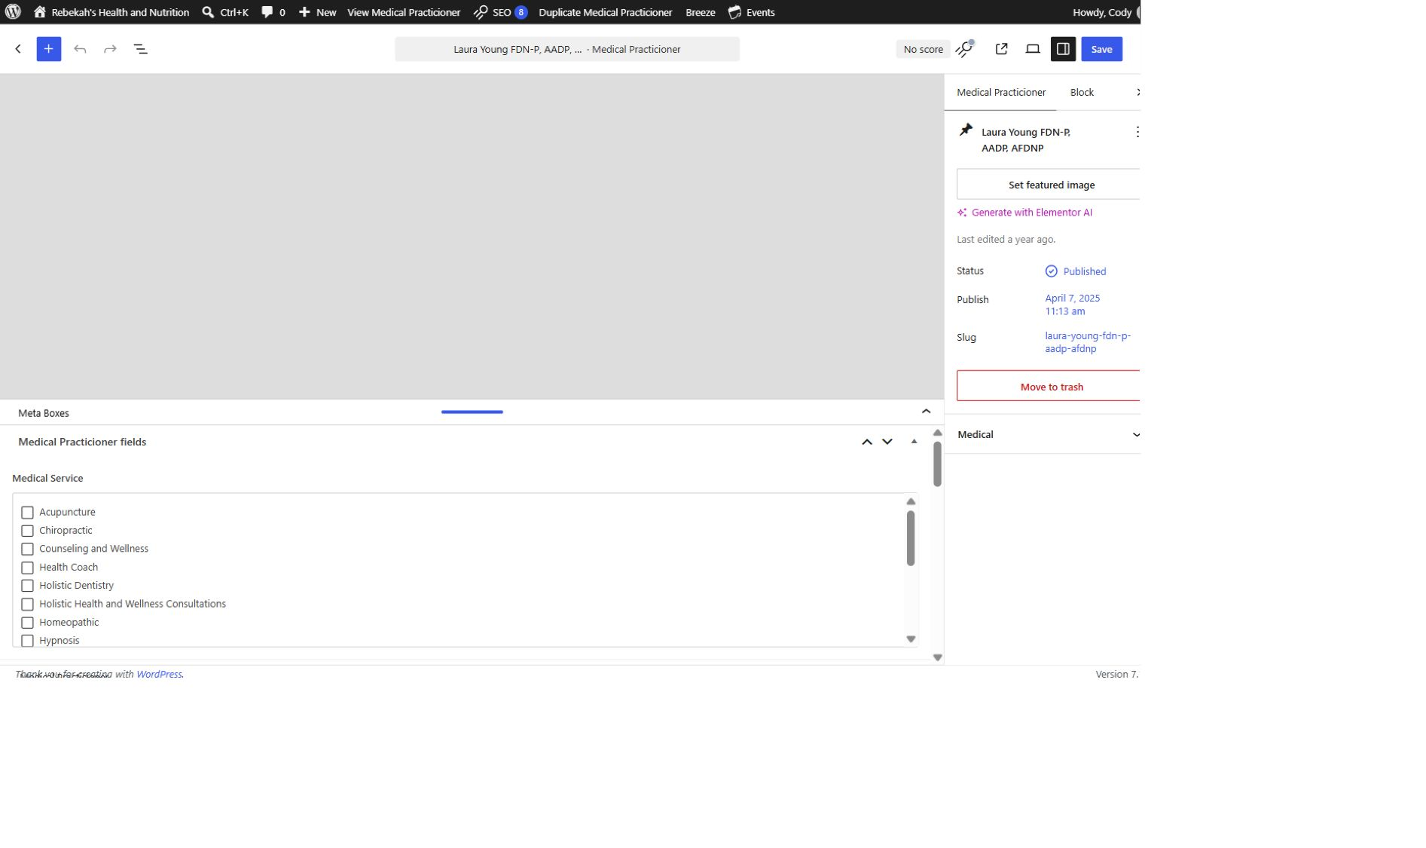
Choose only approved service categories
6
LOOK HERE
Practitioner editing v1.3 • 7/16

Slide 8
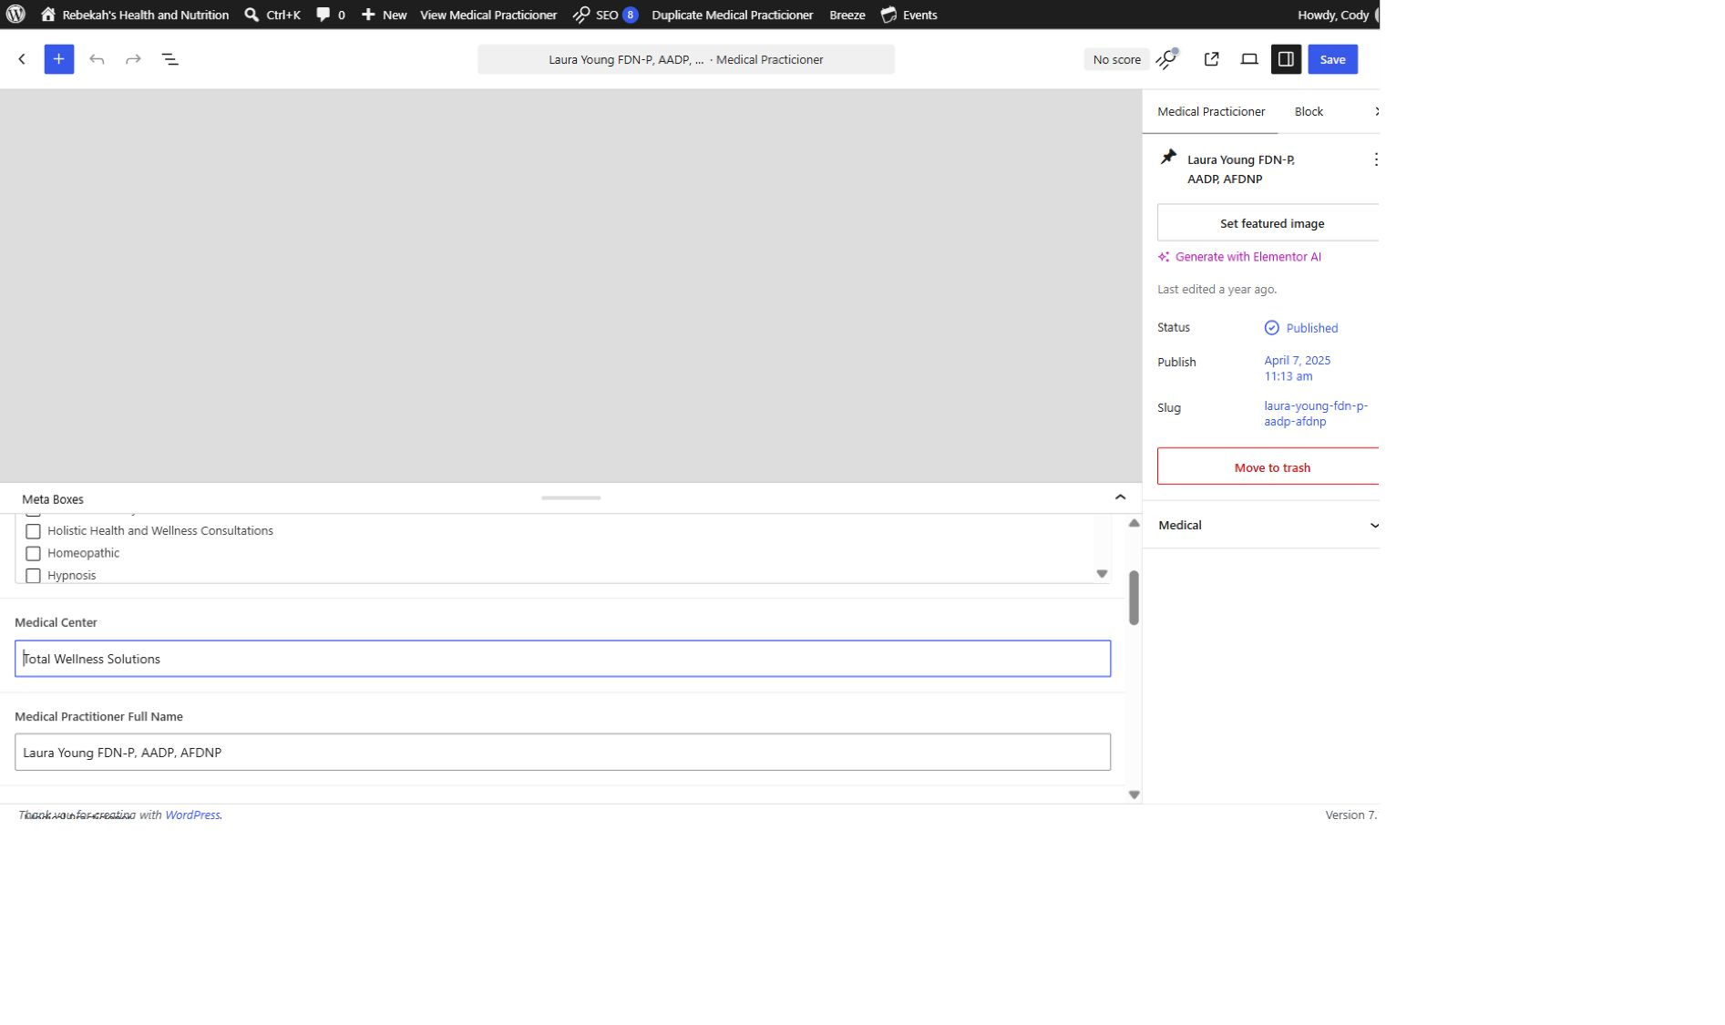
Update the practice and public name
7
LOOK HERE
Practitioner editing v1.3 • 8/16

Slide 9
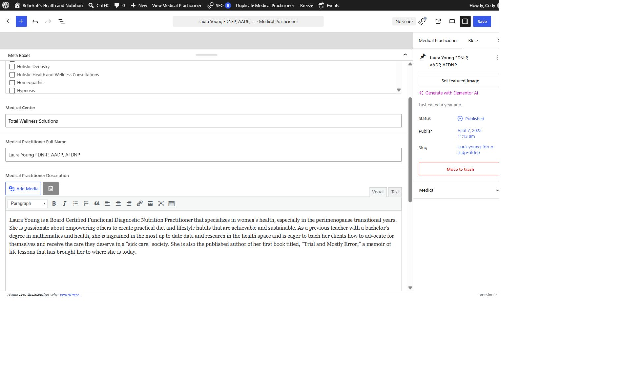
Edit the description in Visual mode
8
LOOK HERE
Practitioner editing v1.3 • 9/16

Slide 10
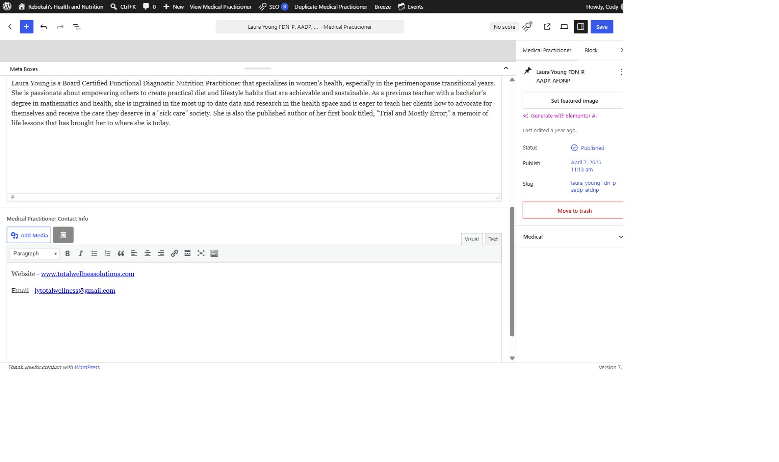
Add only approved public contact details
9
LOOK HERE
Practitioner editing v1.3 • 10/16

Slide 11
Review every field you changed
10
LOOK HERE
Practitioner editing v1.3 • 11/16

Slide 12
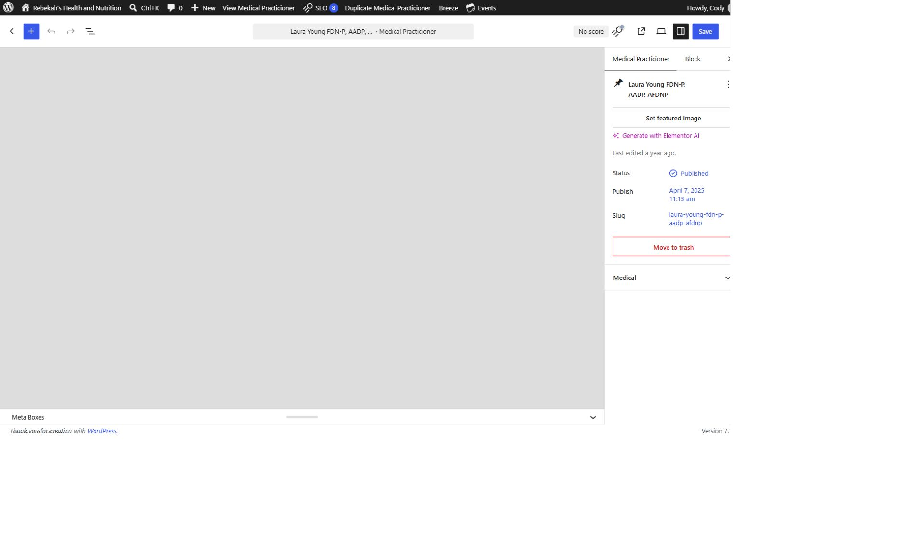
Select Save once—and wait
11
LOOK HERE
Practitioner editing v1.3 • 12/16

Slide 13
Clear only the record’s applicable cache
12
LOOK HERE
HOVER OVER THE CORRECT ROW
Then click Clear Cache
Practitioner editing v1.3 • 13/16
Notes:
[Sources]
- Live WordPress practitioner-list interface captured August 31, 2026.

Slide 14
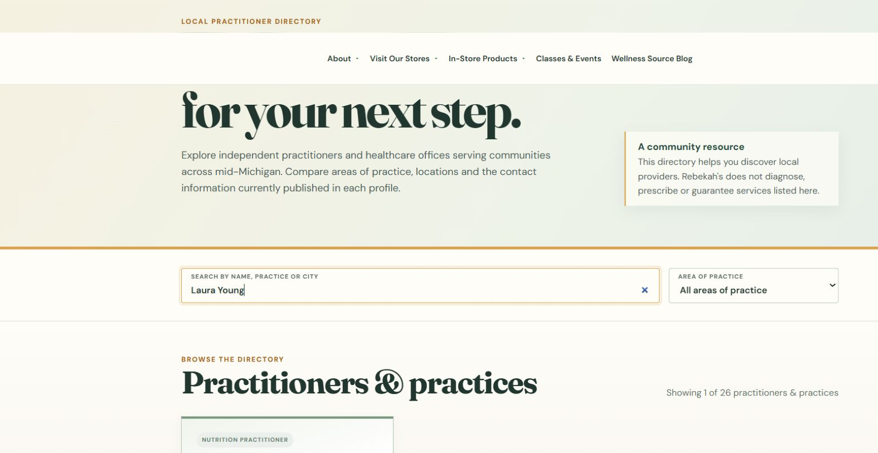
Verify the exact public directory
13
LOOK HERE
Practitioner editing v1.3 • 14/16
Notes:
[Sources]
- https://rebekahspureliving.com/practitioners/ (captured September 1, 2026).

Slide 15
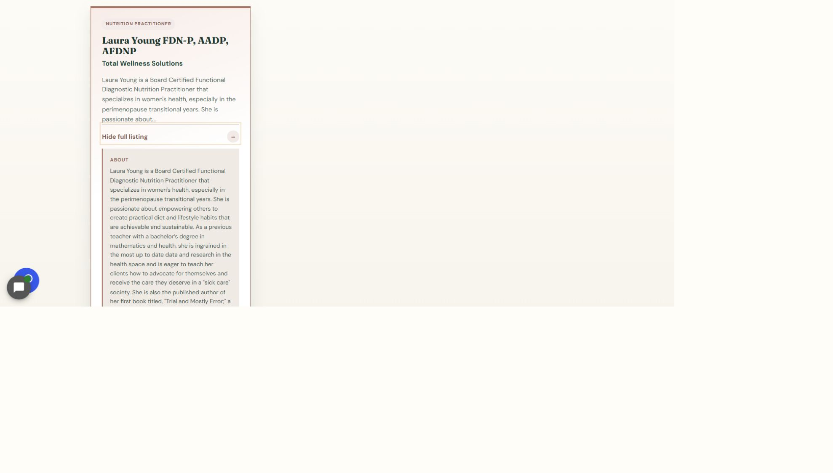
Open the full listing and check a phone
14
LOOK HERE
Practitioner editing v1.3 • 15/16

Slide 16
Finish every edit with the same three checks
DONE
SAVE → CLEAR THE APPLICABLE CACHE → VERIFY THE EXACT PUBLIC PAGE
Check the result on desktop and phone.
If any check fails, take a screenshot and contact Blue Nova before changing anything again.
Practitioner editing v1.3 • 16/16

