Slide 1

Update an existing practitioner listing
START
Update approved practitioner information, save it safely, clear the applicable cache, and verify the live result.
Beginner lesson • Live website • Full-screen version
Practitioner editing v1.4 • 1/16

Slide 2
Required role: Editor or Administrator
1
WORDPRESS ROLE REQUIRED
EDITOR OR ADMINISTRATOR
Editor is enough for this task.
If you do not know your role, stop and ask Blue Nova before editing.
Practitioner editing v1.4 • 2/16

Slide 3
Confirm the live login address
2
LIVE WORDPRESS LOGIN
rebekahspureliving.com/wp-admin
Confirm this live address before making a change.
Practitioner editing v1.4 • 3/16

Slide 4
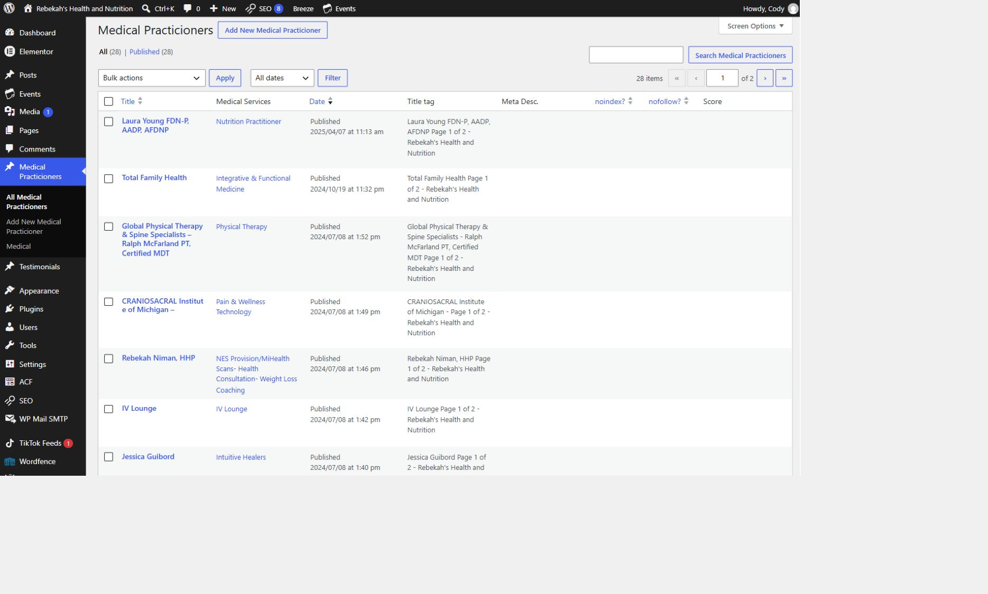
Open All Medical Practicioners
3
LOOK HERE
WRITTEN STEPS
1. Click Medical Practicioners.
2. Click All Medical Practicioners.
3. Search by name if needed.
Practitioner editing v1.4 • 4/16

Slide 5
Find the correct record and choose Edit
4
LOOK HERE
1. Find the correct row.
2. Hover over it.
3. Click Edit.
Practitioner editing v1.4 • 5/16
Notes:
[Sources]
- Live WordPress practitioner-list interface captured August 31, 2026.

Slide 6
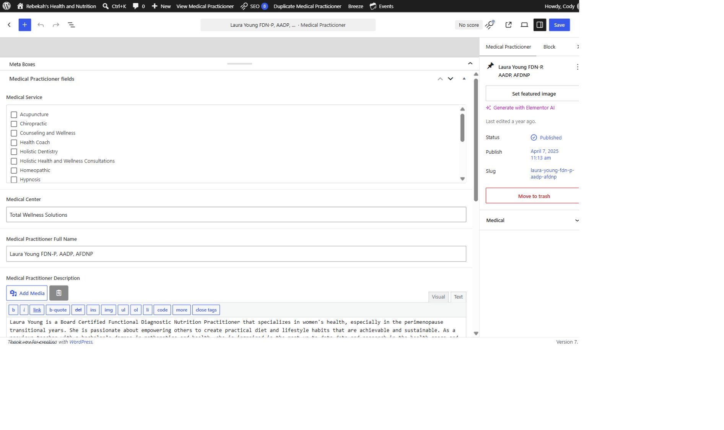
Open Medical Practicioner Fields
5
WRITTEN STEPS
1. Scroll to Meta Boxes.
2. Open Medical Practicioner fields.
3. Stop if you do not see them.
LOOK HERE
Practitioner editing v1.4 • 6/16

Slide 7
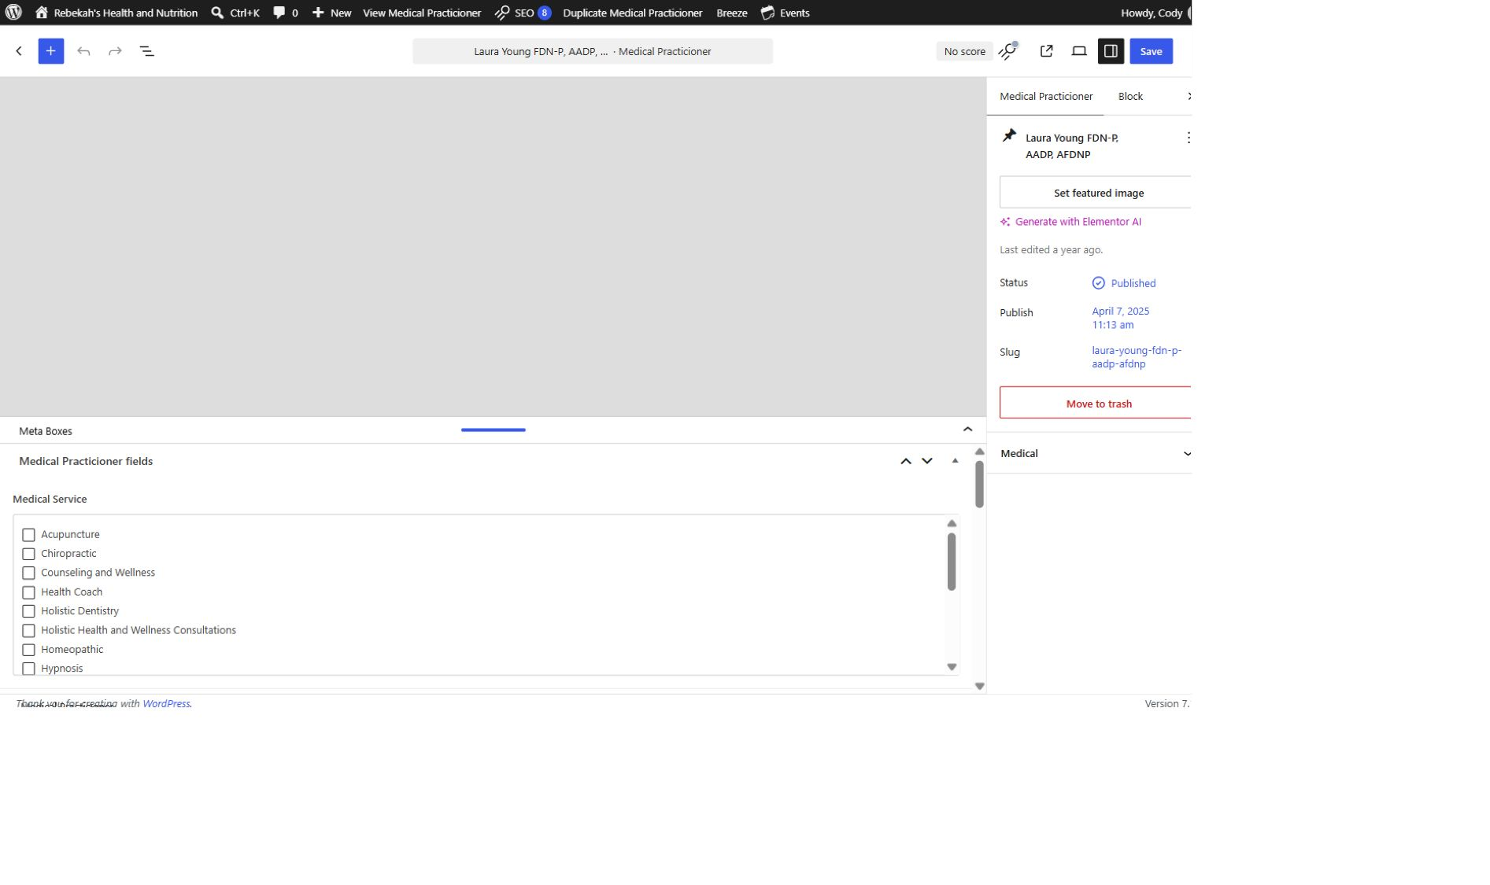
Choose only approved service categories
6
WRITTEN STEPS
1. Find Medical Service.
2. Check the approved category.
3. Uncheck incorrect categories.
LOOK HERE
Practitioner editing v1.4 • 7/16

Slide 8
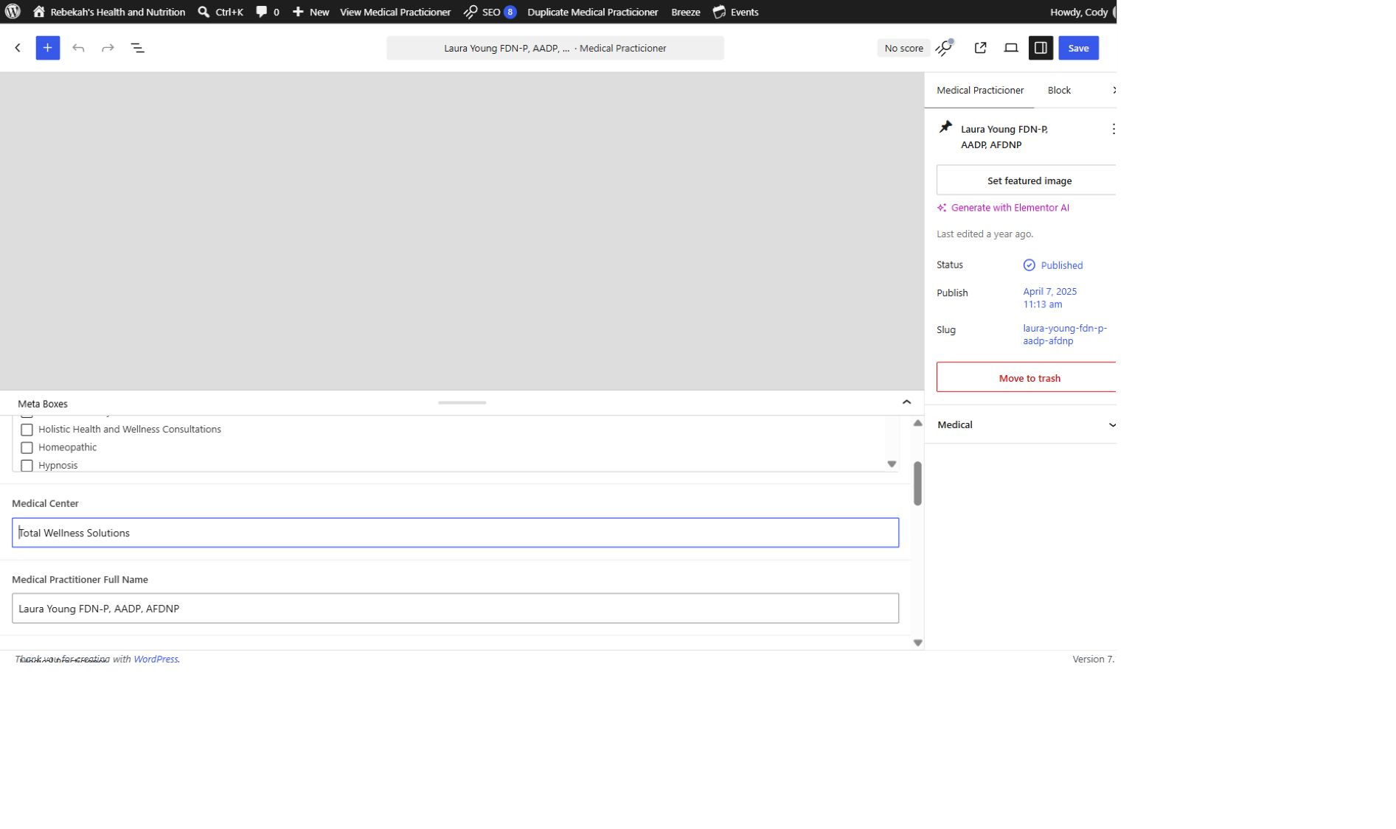
Update the practice and public name
7
WRITTEN STEPS
1. Update Medical Center.
2. Update Full Name.
3. Match the approved spelling.
LOOK HERE
Practitioner editing v1.4 • 8/16

Slide 9
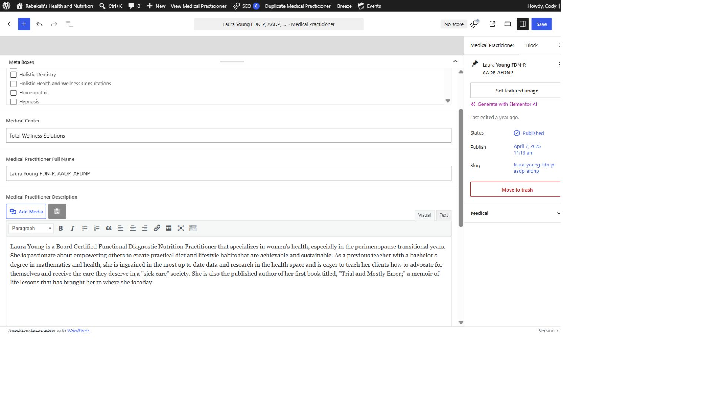
Edit the description in Visual mode
8
WRITTEN STEPS
1. Select Visual.
2. Replace the approved description.
3. Keep the paragraph breaks.
LOOK HERE
Practitioner editing v1.4 • 9/16

Slide 10
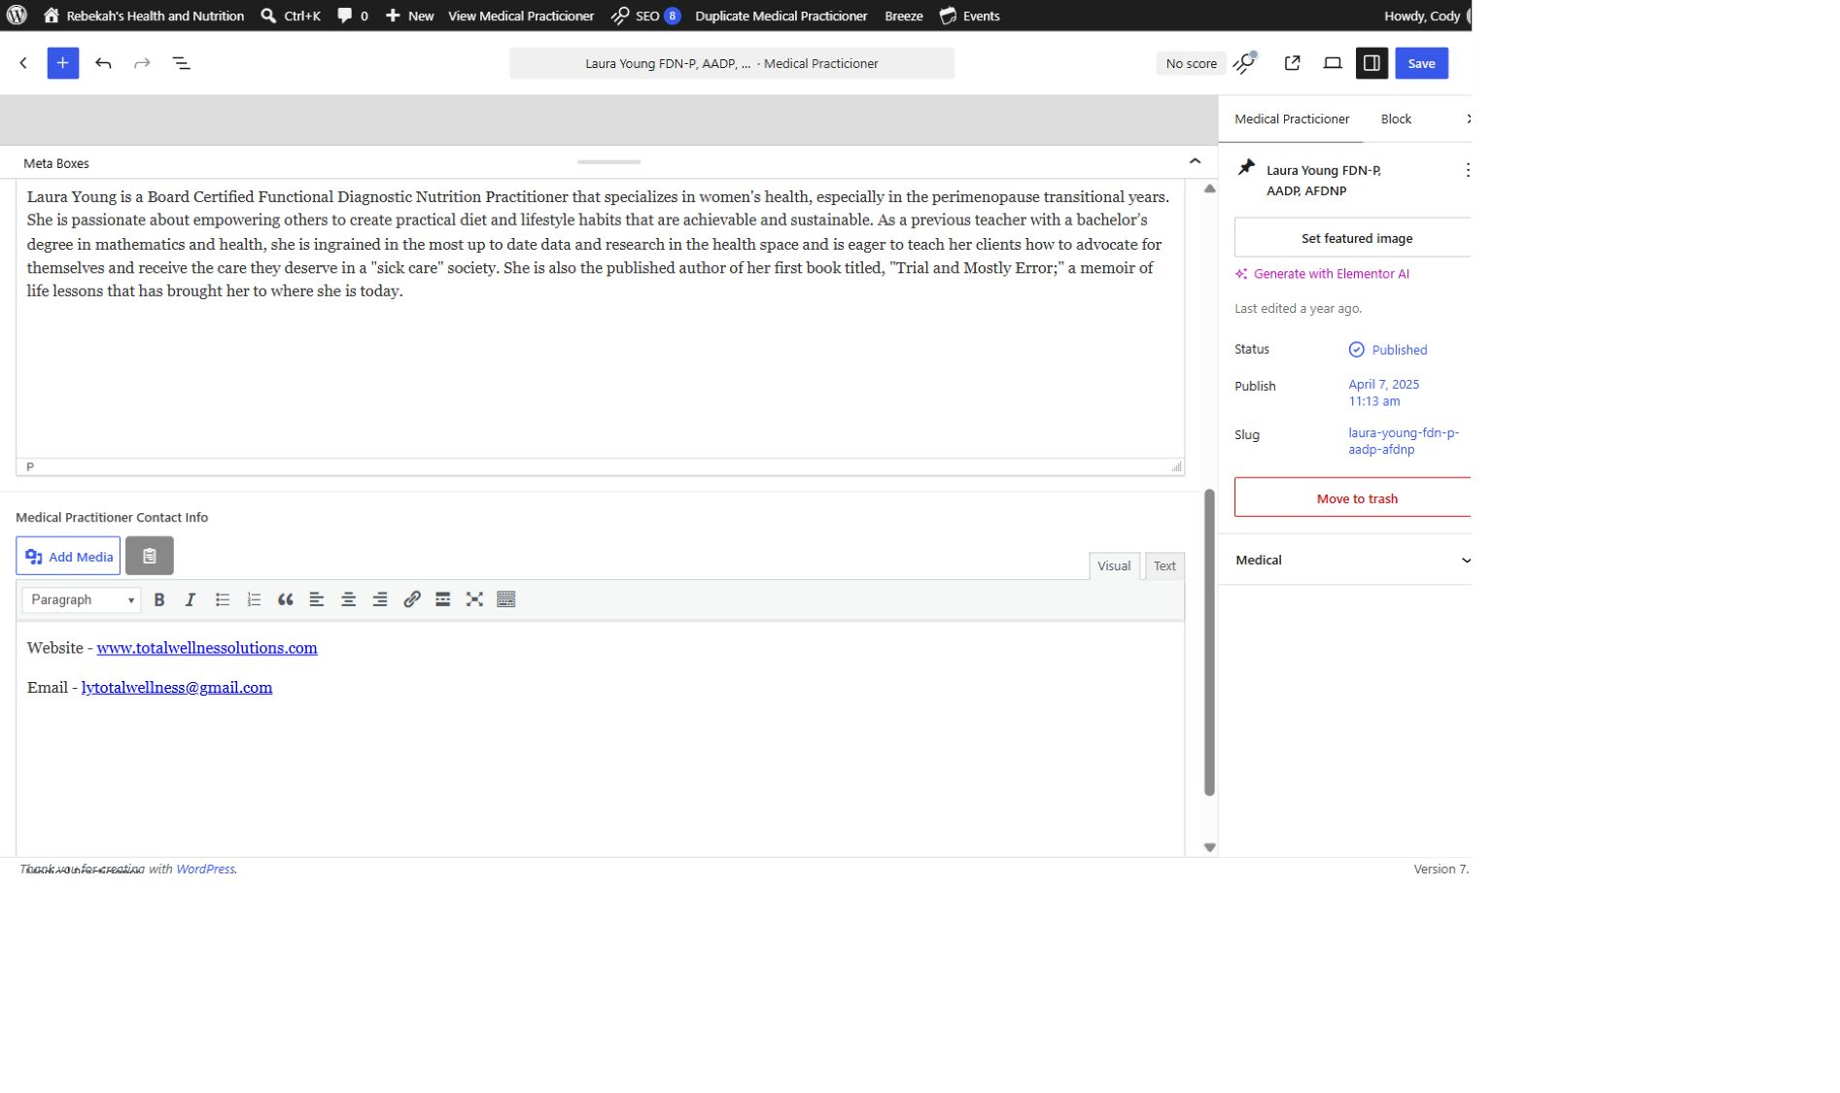
Add only approved public contact details
9
WRITTEN STEPS
1. Add only approved public details.
2. Test every link.
3. Remove outdated contact information.
LOOK HERE
Practitioner editing v1.4 • 10/16

Slide 11
Review every field you changed
10
WRITTEN STEPS
1. Re-read every changed field.
2. Compare with the approved information.
3. Fix errors before saving.
LOOK HERE
Practitioner editing v1.4 • 11/16

Slide 12
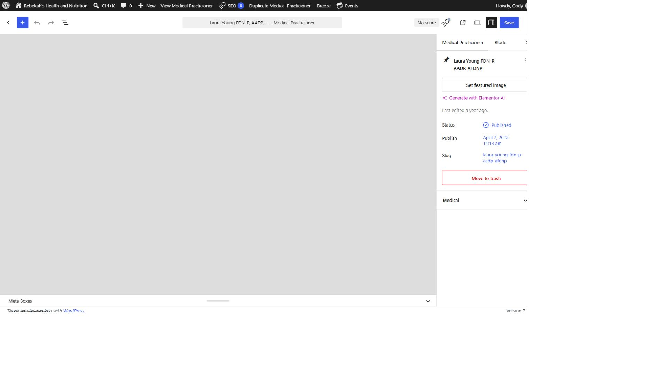
Select Save once—and wait
11
LOOK HERE
WRITTEN STEPS
1. Click Save once.
2. Wait for confirmation.
3. Do not click repeatedly.
Practitioner editing v1.4 • 12/16

Slide 13
Clear only the record’s applicable cache
12
LOOK HERE
1. Return to the practitioner list.
2. Hover over the same row.
3. Click Clear Cache.
Practitioner editing v1.4 • 13/16
Notes:
[Sources]
- Live WordPress practitioner-list interface captured August 31, 2026.

Slide 14
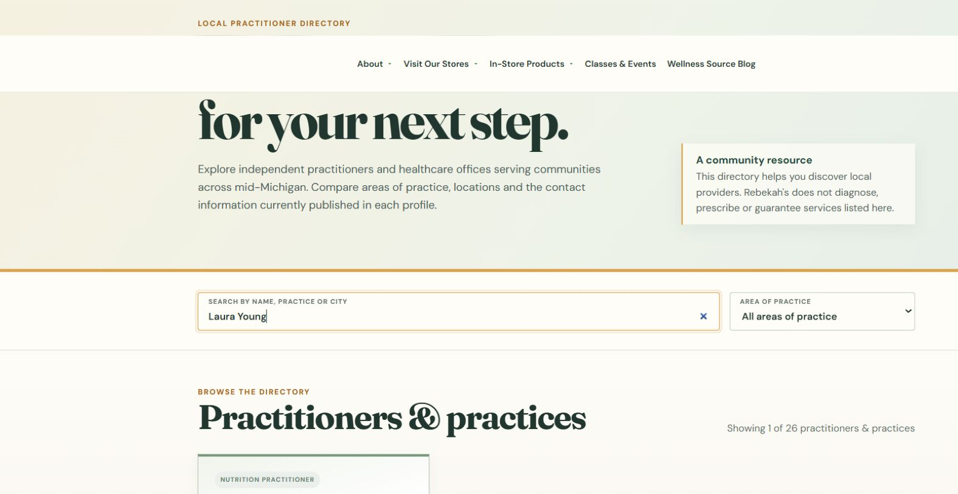
Verify the exact public directory
13
LOOK HERE
WRITTEN CHECK
1. Search the name.
2. Confirm the public details.
3. Check the links.
Practitioner editing v1.4 • 14/16
Notes:
[Sources]
- https://rebekahspureliving.com/practitioners/ (captured September 1, 2026).

Slide 15
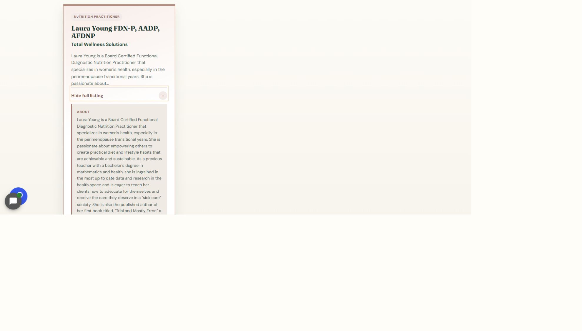
Open the full listing and check a phone
14
LOOK HERE
WRITTEN STEPS
1. Click View full listing.
2. Check the full details and links.
3. Repeat the check on a phone.
Practitioner editing v1.4 • 15/16

Slide 16
Finish every edit with the same three checks
DONE
SAVE → CLEAR THE APPLICABLE CACHE → VERIFY THE EXACT PUBLIC PAGE
Check the result on desktop and phone.
If any check fails, take a screenshot and contact Blue Nova before changing anything again.
Practitioner editing v1.4 • 16/16

