Slide 1

Create or update an event
START
Create or update an approved event, preview it carefully, clear the applicable cache, and verify the live Events page.
Beginner lesson • Live website • Full-screen version
Event editing v1.1 • 1/13

Slide 2
Required WordPress access
1
WORDPRESS ROLE REQUIRED
Editor or Administrator
Editor access is enough for this task.
If Events is missing, stop and ask the website administrator for help. User accounts are covered separately.
Event editing v1.1 • 2/13

Slide 3
Sign in to the live website
2
LIVE WORDPRESS LOGIN
rebekahspureliving.com/wp-admin
Use your own login. Confirm the live domain. Do not use an old staging address.
Event editing v1.1 • 3/13

Slide 4
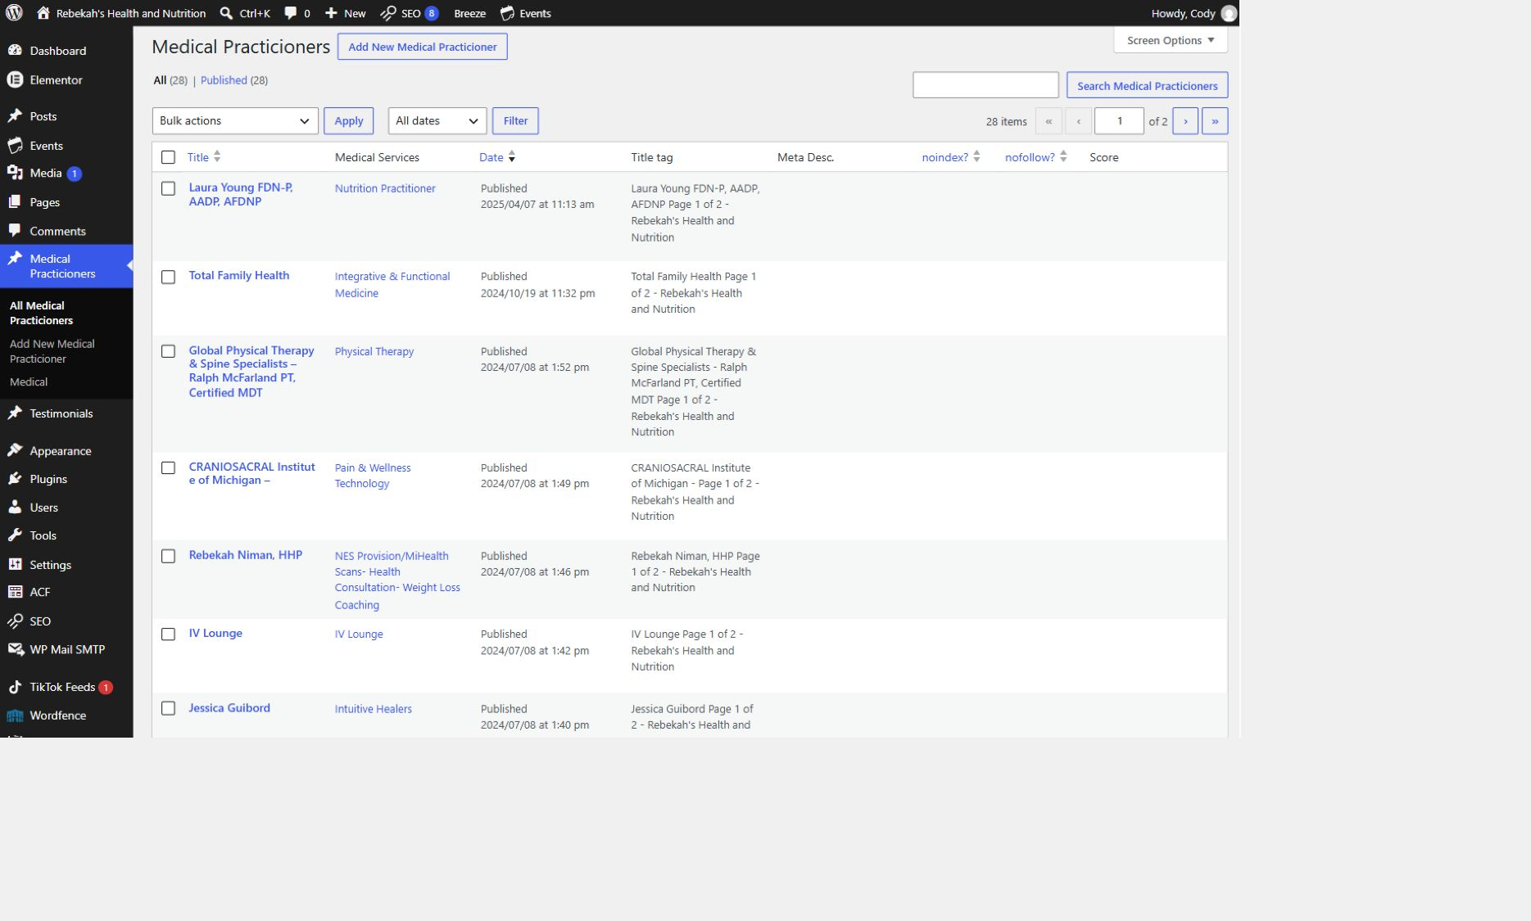
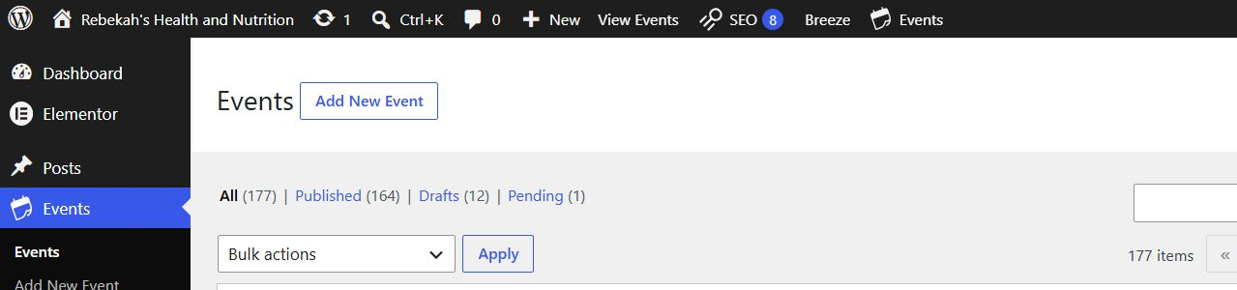
Open Events and choose the correct action
3
WRITTEN STEPS
LOOK HERE
WRITTEN STEPS
1. Click Events in the left menu.
2. For a new event, click Add New Event.
3. For an update, find the correct title and click Edit.
1. Click Medical Practicioners.
2. Click All Medical Practicioners.
3. Search by name if needed.
Event editing v1.1 • 4/13

Slide 5
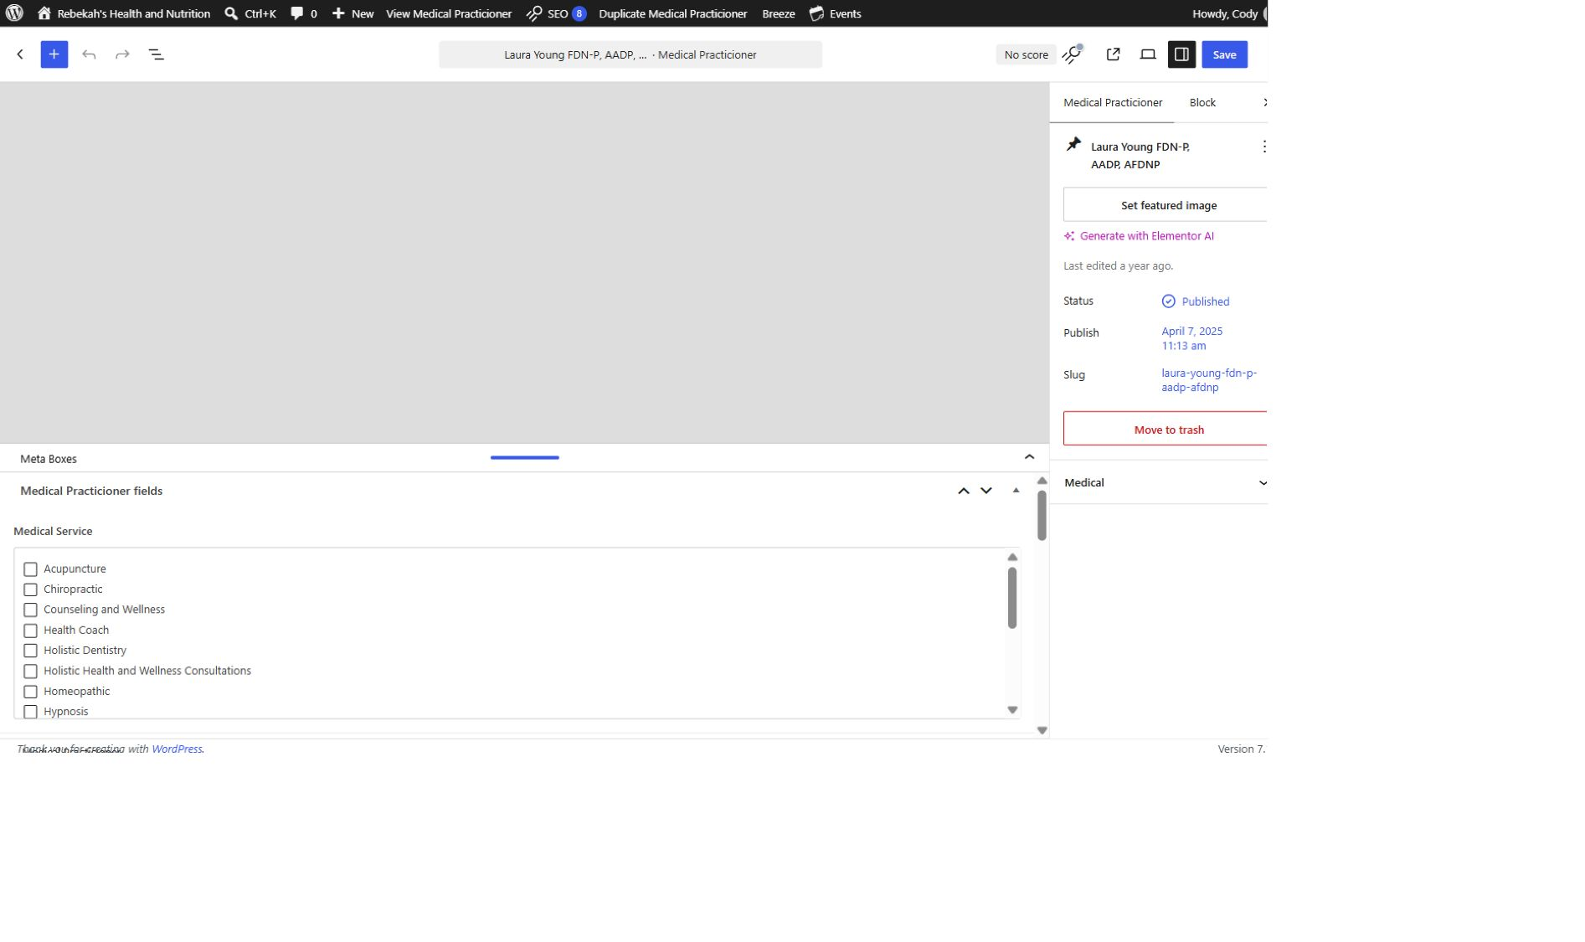
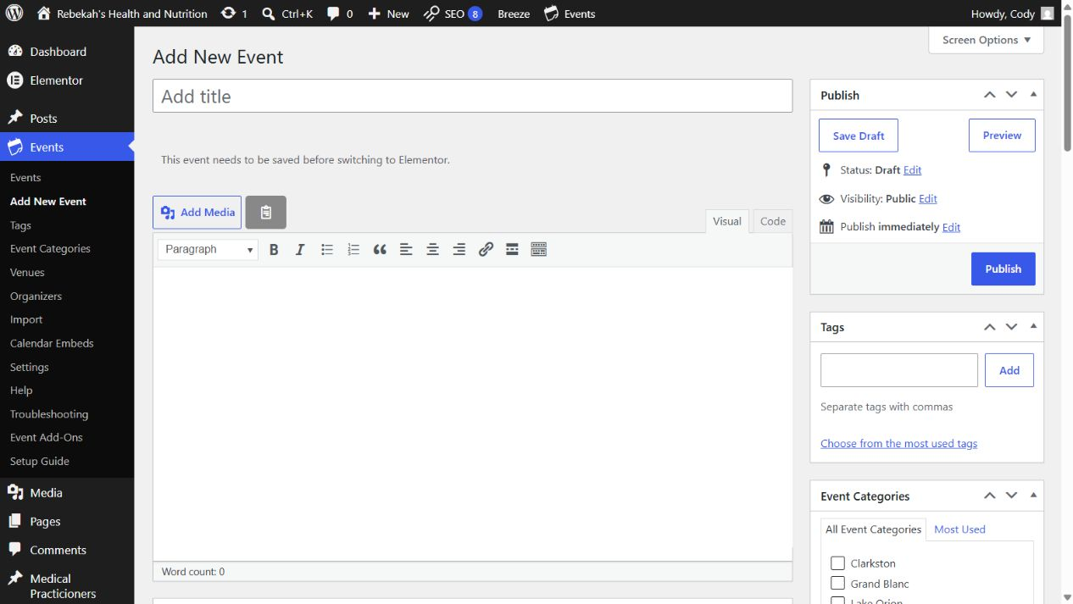
Add the title and description as a draft
4
WRITTEN STEPS
WRITTEN STEPS
1. Find Medical Service.
2. Check the approved category.
3. Uncheck incorrect categories.
1. Enter the approved event title.
2. Add the complete description in Visual mode.
3. Click Save Draft while you work.
LOOK HERE
Event editing v1.1 • 5/13

Slide 6
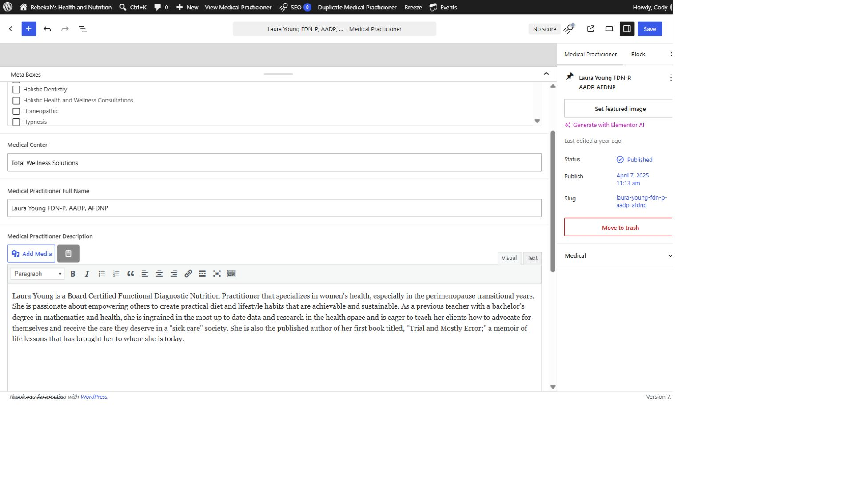
Choose the correct store category
5
WRITTEN STEPS
WRITTEN STEPS
1. Select Visual.
2. Replace the approved description.
3. Keep the paragraph breaks.
1. Open Event Categories.
2. Choose Clarkston, Grand Blanc, Lake Orion, or Lapeer.
3. Do not create or guess a category.
LOOK HERE
Event editing v1.1 • 6/13

Slide 7
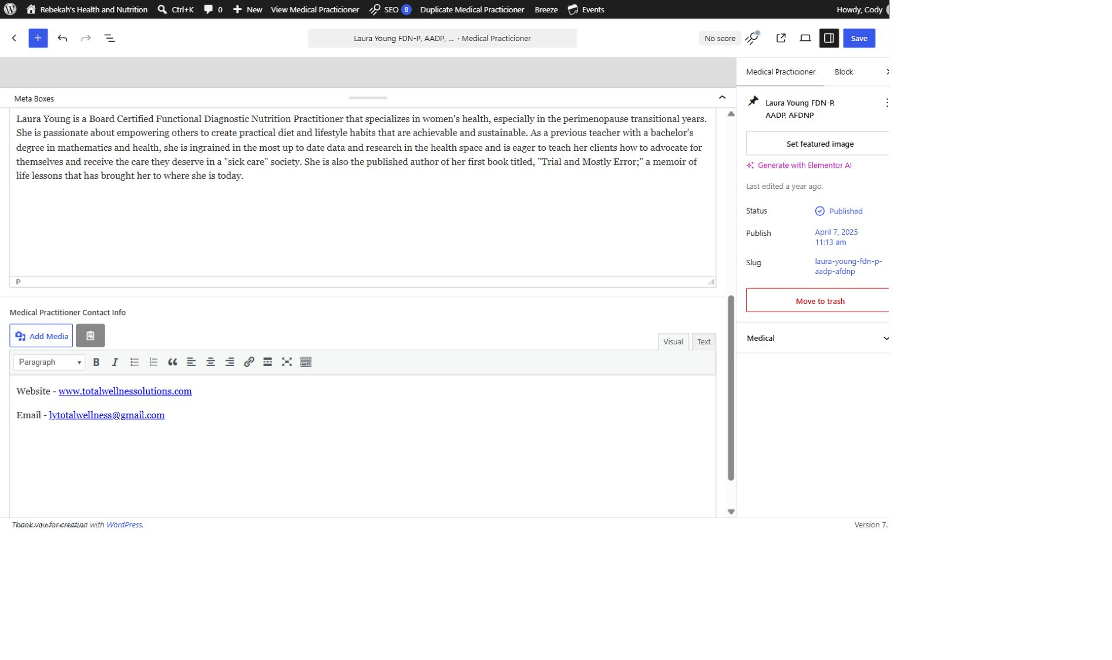
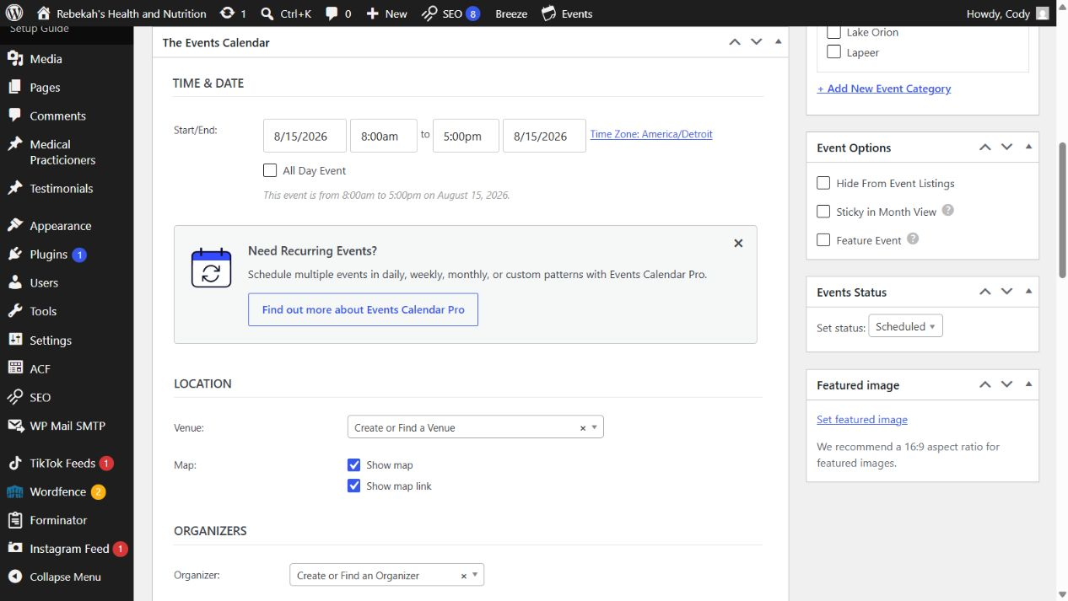
Complete every event detail
6
WRITTEN STEPS
WRITTEN STEPS
1. Add only approved public details.
2. Test every link.
3. Remove outdated contact information.
1. Enter date, time, and time zone.
2. Choose venue and organizer; add cost or link if needed.
3. Add a 16:9 featured image and alt text.
LOOK HERE
Event editing v1.1 • 7/13

Slide 8
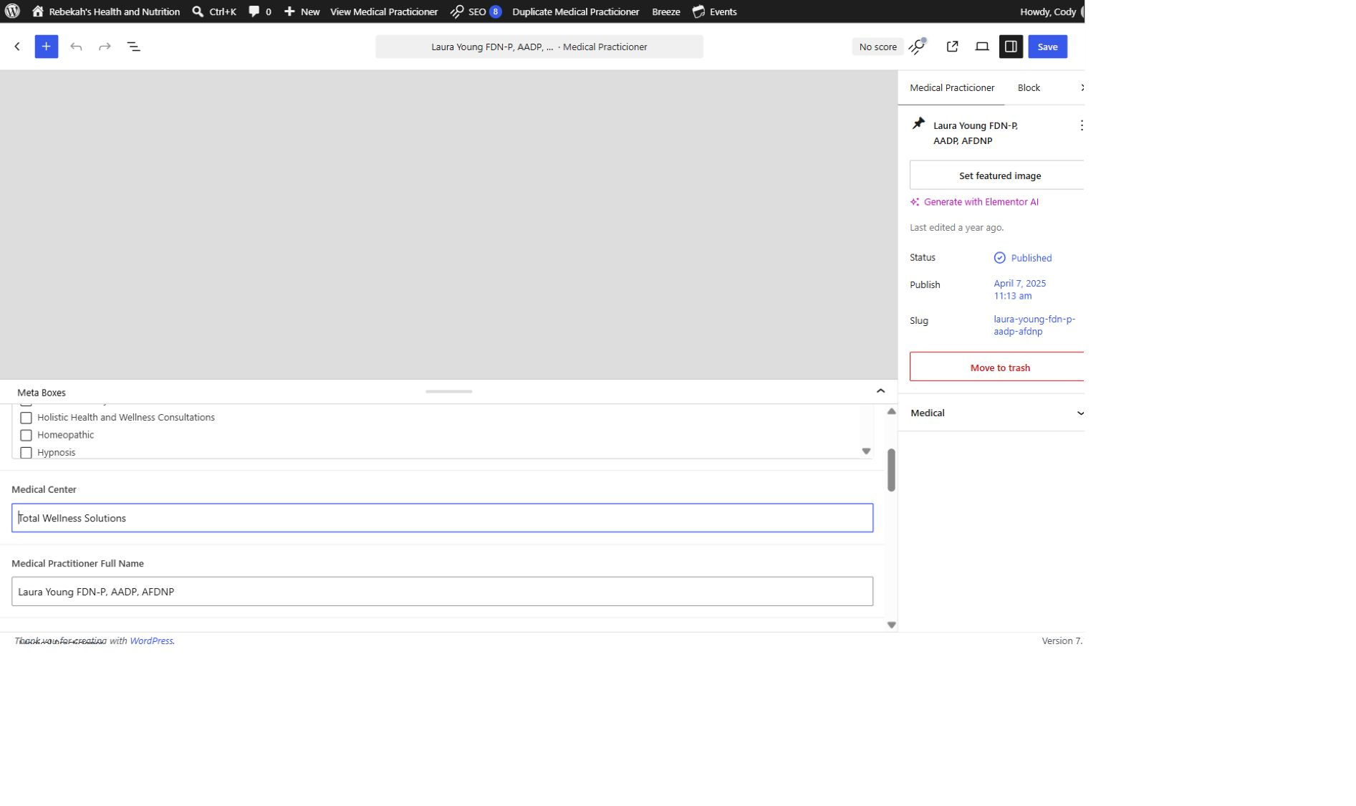
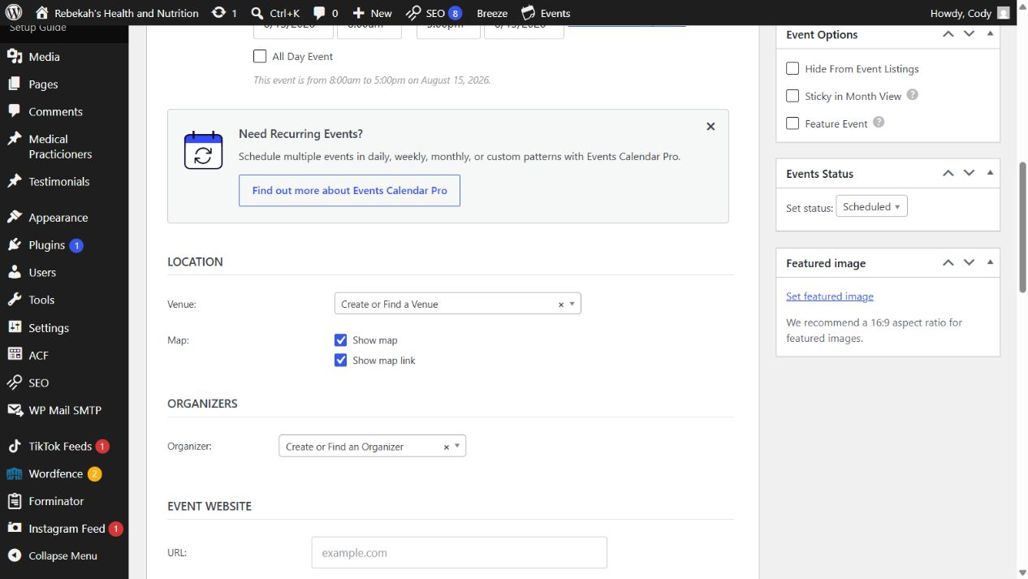
Preview before publishing
7
WRITTEN STEPS
WRITTEN STEPS
1. Re-read every changed field.
2. Compare with the approved information.
3. Fix errors before saving.
1. Click Preview.
2. Check every detail at desktop size.
3. Repeat the preview at phone size.
LOOK HERE
Event editing v1.1 • 8/13

Slide 9
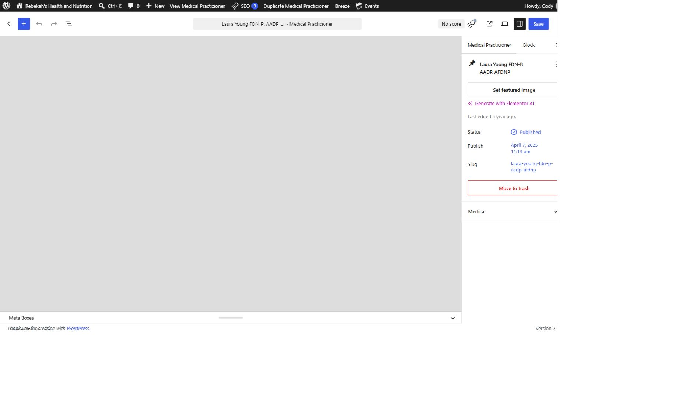
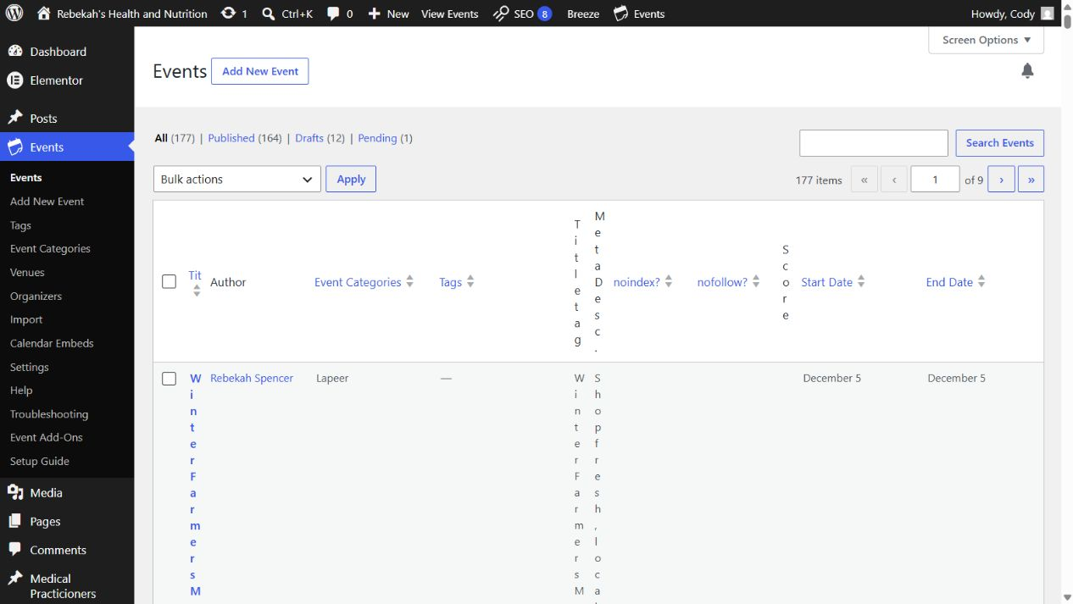
Publish, update, or cancel safely
8
LOOK HERE
WRITTEN STEPS
WRITTEN STEPS
1. Click Save once.
2. Wait for confirmation.
3. Do not click repeatedly.
1. Publish or Update once, then wait.
2. For a cancellation, set status to Canceled.
3. Add a clear cancellation note; do not immediately delete.
Event editing v1.1 • 9/13

Slide 10
Clear only the applicable cache
9
LOOK HERE
1. Return to the practitioner list.
2. Hover over the same row.
WRITTEN STEPS
3. Click Clear Cache.
1. Return to the Events list.
2. Find the event you changed.
3. Clear only the applicable page, record, Breeze, or Varnish cache.
Event editing v1.1 • 10/13
Notes:
[Sources]
- Live WordPress practitioner-list interface captured August 31, 2026.

Slide 11
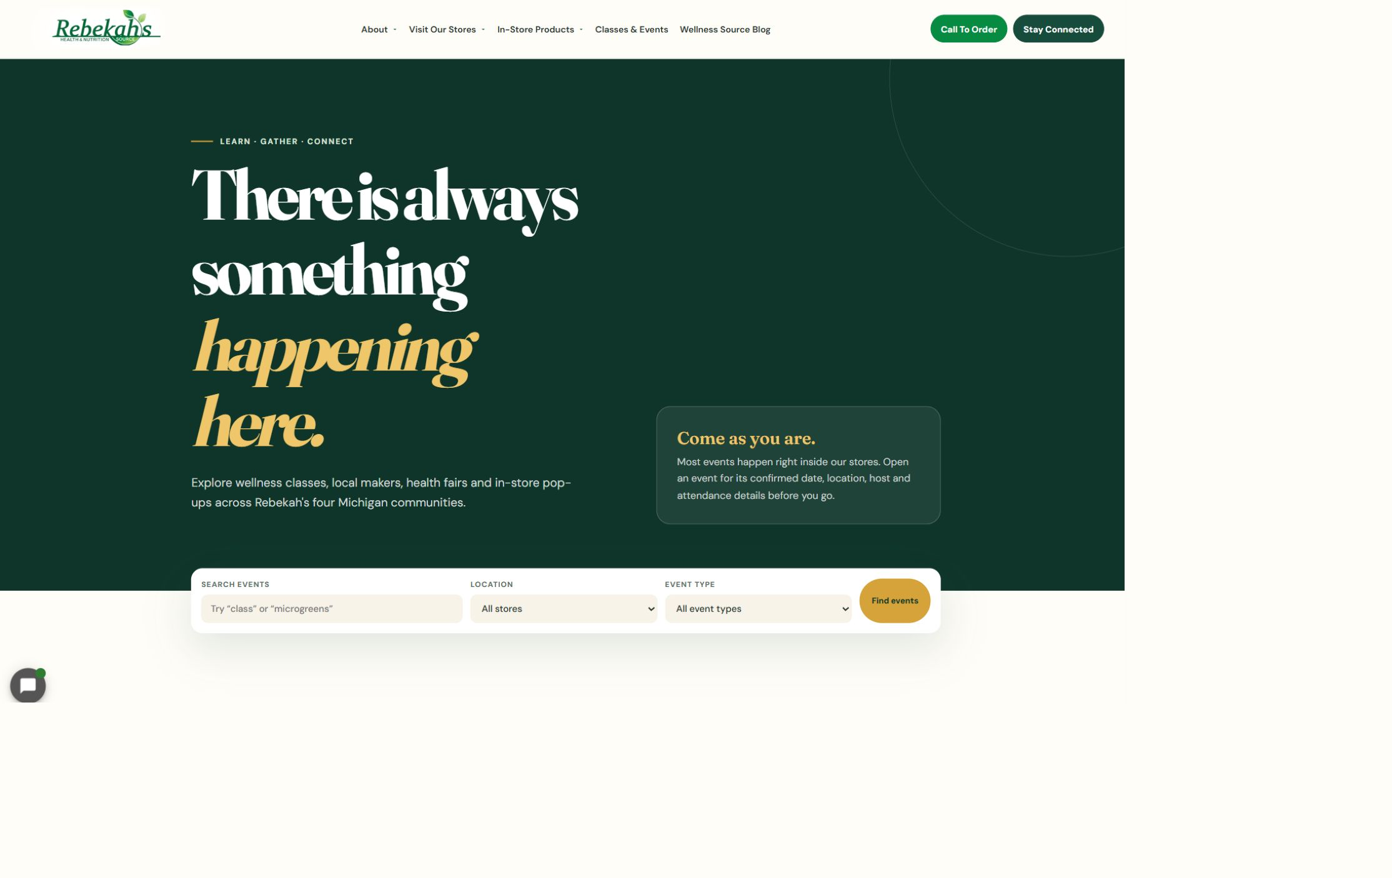
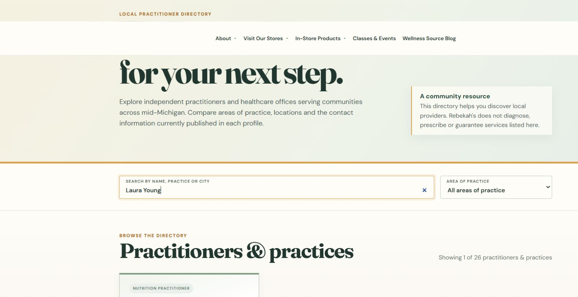
Verify the exact public Events page
10
WRITTEN STEPS
LOOK HERE
1. Open /events/ with no extra address text.
2. Find the event and open it.
3. Confirm details, image, and every public link.
WRITTEN CHECK
1. Search the name.
2. Confirm the public details.
3. Check the links.
Event editing v1.1 • 11/13
Notes:
[Sources]
- https://rebekahspureliving.com/practitioners/ (captured September 1, 2026).

Slide 12
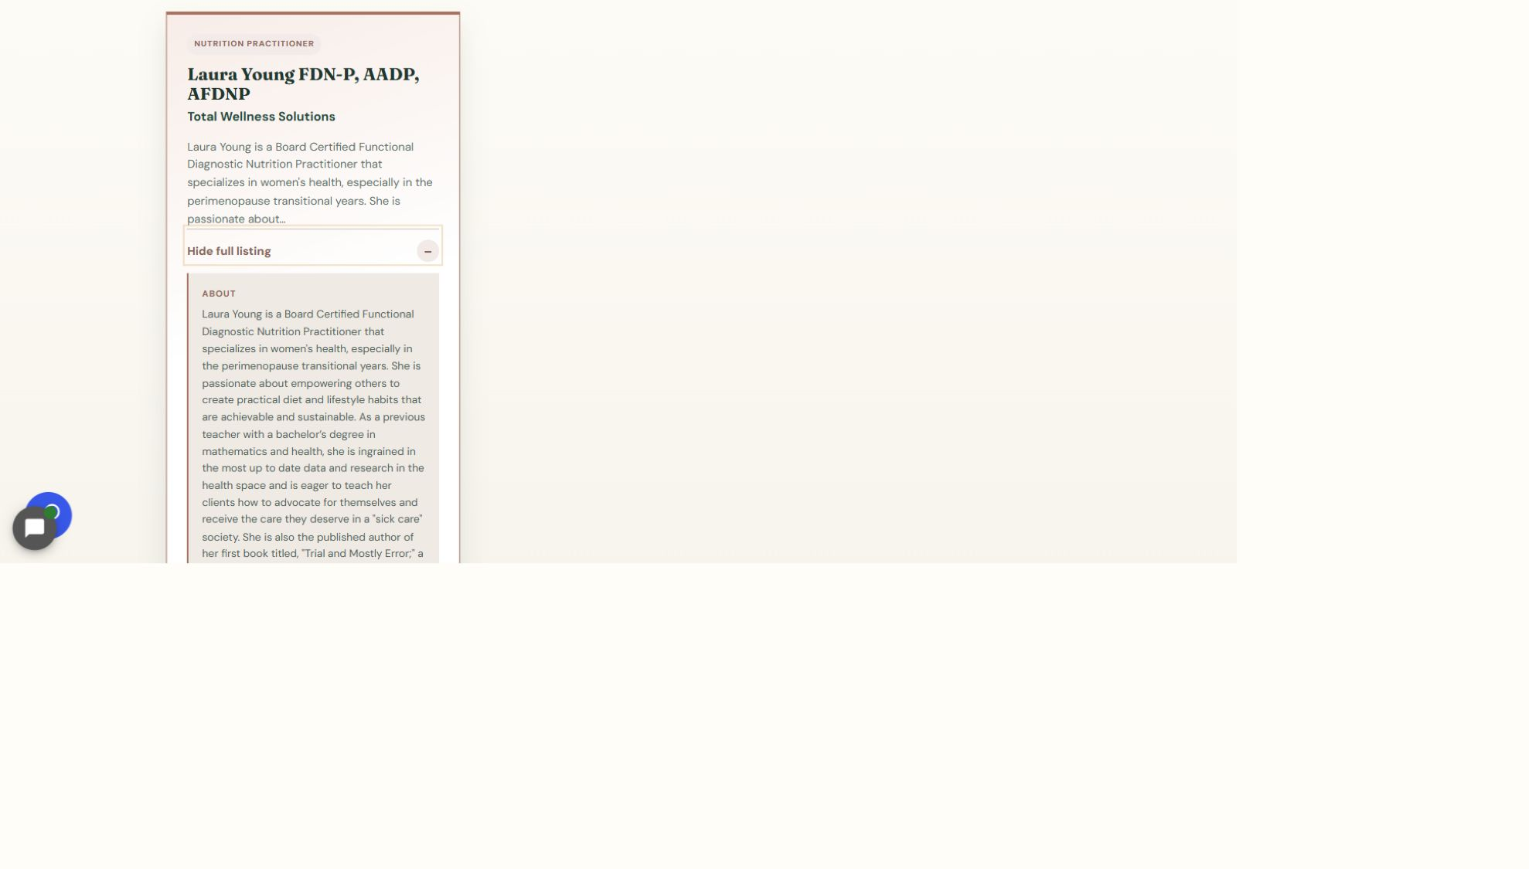
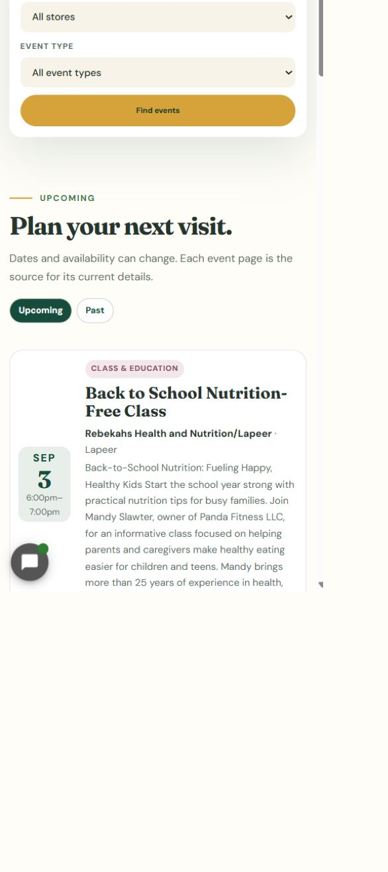
Repeat the public check on a phone
11
LOOK HERE
WRITTEN STEPS
WRITTEN STEPS
1. Click View full listing.
2. Check the full details and links.
3. Repeat the check on a phone.
1. Check the location filter.
2. Confirm the event card fits and is readable.
3. Make sure nothing runs off the side.
Event editing v1.1 • 12/13

Slide 13
Always finish with the same three checks
DONE
SAVE → CLEAR APPLICABLE CACHE → VERIFY LIVE
Check the exact public event and /events/ page on desktop and phone.
If the live result is wrong or missing, stop and ask for help.
Event editing v1.1 • 13/13

